Slide 1
KCTCS
Asset Preservation Projects
Presenter:
Andy Casebier, Assistant Vice President – Facilities and Support Services
Sandy Adkins, Director of Capital Projects & Budgets – Facilities and Support Services

Slide 2
Impact of Asset Preservation funding
KCTCS is a group of 16 Community and Technical Colleges dispersed over 70 campuses across the Commonwealth. There are more than 330 buildings in our system.
KCTCS is committed to providing an accessible, sustainable and healthy environment, which provides efficient, functional, and pleasant surroundings for fulfilling KCTCS' mission and objectives.
Throughout our 20 years of existence, the maintenance of KCTCS facilities has not been significantly state funded, but rather funding has come mostly from KCTCS restricted funds.
Even with a focused effort to maintain the sustainability of our operational facilities and develop and implement our asset preservation plan to invest in the physical and operational infrastructure of our colleges, we continue to have an ever-increasing backlog of deferred maintenance.
KCTCS is much appreciative of the influx of funding through this initiative

Slide 3
KCTCS is much appreciative of the influx of funding through this initiative
The Asset Preservation Pool that KCTCS received is assisting us in accomplishing over $200M in deferred maintenance projects.
A number of the projects that we are undertaking are replacement and upgrades of Mechanical and Electrical systems (many from the 1960s). This is providing energy savings that will continue for decades.
This funding is having a tremendous (and much needed) impact on the condition, functionality, code compliance and comfort of our facilities that students use everyday.
Since the recent economic downturns from COVID19 have negatively impacted our revenues, the lower amount of matching funds contribution is allowing us to move forward with projects that would have been impossible otherwise.
Roof Replacement and Repair projects top the list of projects we are accomplishing. A roof can have a significant impact on the life of the building and on the health of building occupants.

Slide 4
Impact on Capital Budget and 6-year planning
Asset Preservation funding
Capital Budget
6-Year Planning
KCTCS is attempting to accomplish a majority of the asset preservation projects that were requested in our 2022-2024 budget request.
  18 Building Renovation projects.
  5 College Site improvement projects.
  21 Roof Replacement projects.
  2 Campus Life Safety/ ADA projects.
  Fire Alarm updates at all 16 campuses.
  Significant mechanical system upgrades at 6 campuses.
Should funds allow, we will be attempting to accomplish additional asset preservation projects, that were included in the 2024-2026 Capital Plan and projects that have a scope of less than $1M.
Deferred maintenance projects that are currently being accomplished will not be carried forward in 6-year plan.
Other deferred maintenance projects that are often delayed due to funding can be in included in our planning which will enhance our ability to maintain assets.
Accomplishing deferred maintenance projects in a timely manner is expected to reduce costs of these projects.
Energy savings projects that are accomplished will improve overall operating budgets in the coming years.
KCTCS has a total of approximately $310M in asset preservation projects that will remain. These were included in the 2nd and 3rd biennium (2024-2028).

Slide 5
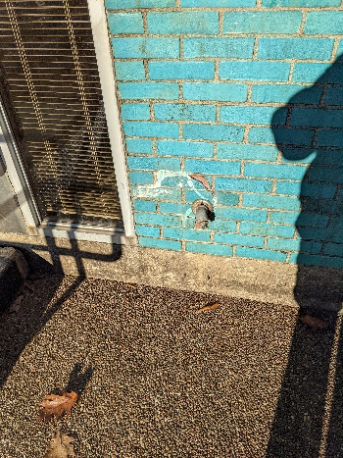
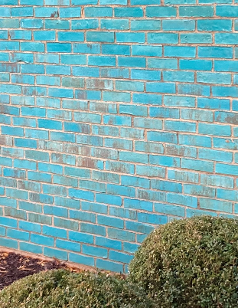
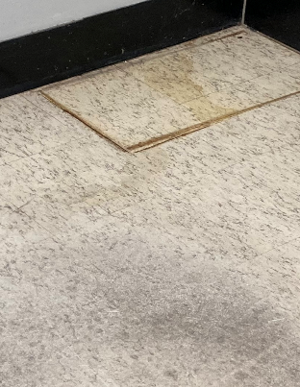
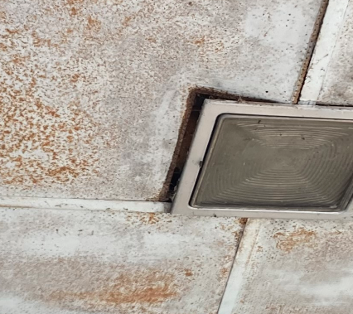
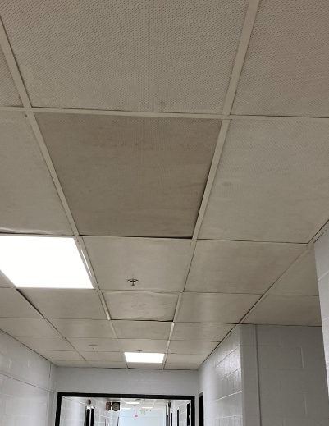
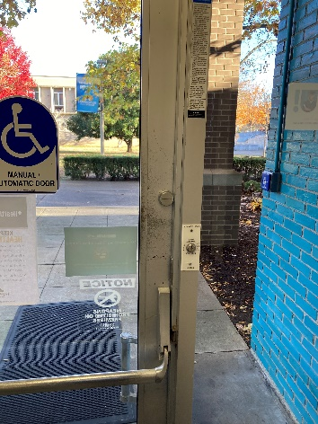
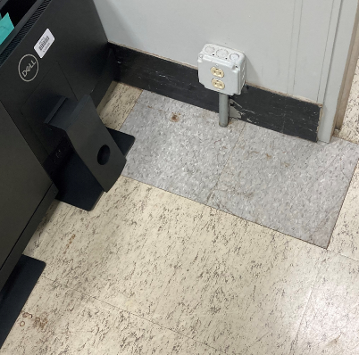
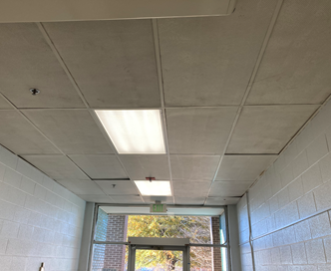
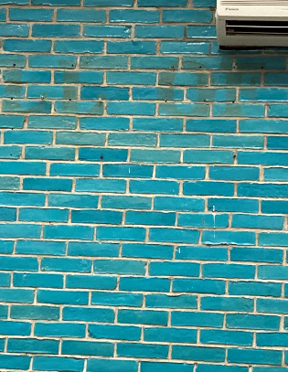
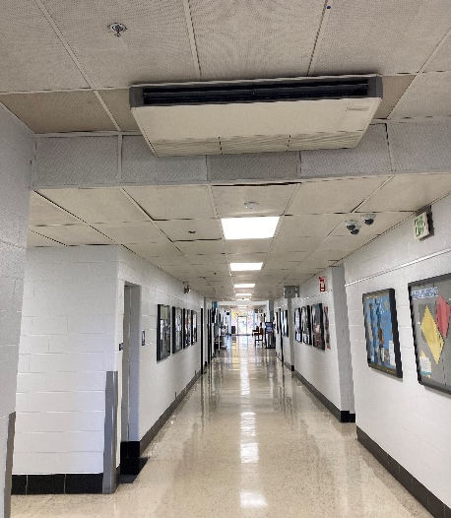
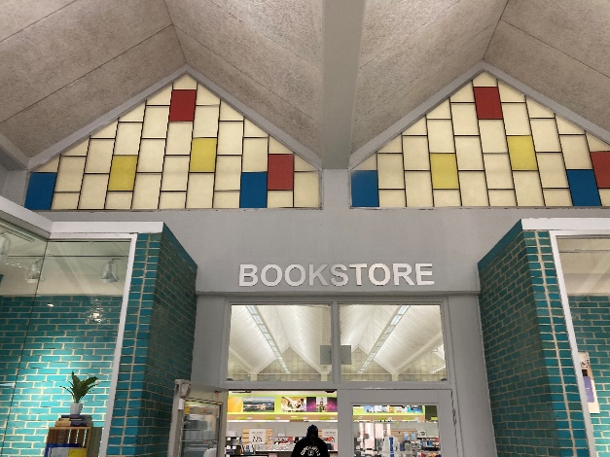
Renovate Hopkinsville Academic Building
$13.9 million
Repair water infiltration in exterior masonry walls.
Replace restroom ceilings and lighting. Add exhaust fans to meet current code.
Replace ceilings and lighting that has exceeded useful life. Bring fire suppression system up to current life safety codes.
Replace damage at wall penetrations.
Replace finishes throughout the building.
Replace storefronts and doors. Replace door hardware.
Replace ceilings and lighting that has exceeded useful life.
Replace ceilings and lighting that has exceeded useful life. Replace finishes. Replace HVAC equipment.
Repair existing stained glass window units which are leaking.
Upgrade electrical system to meet current building codes.
Repair water infiltration in interior masonry walls.

Slide 6
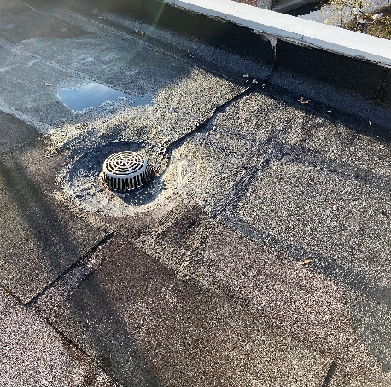
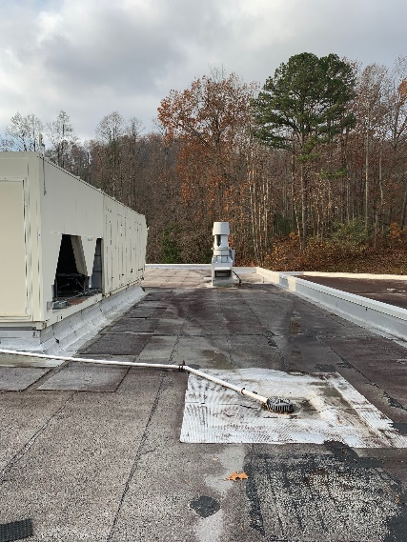
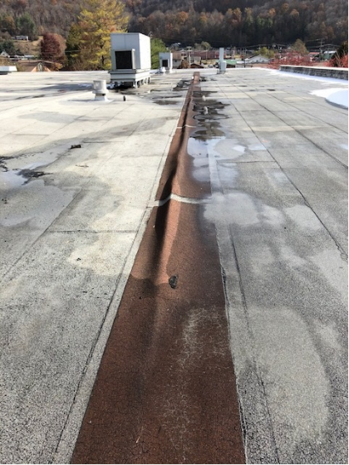
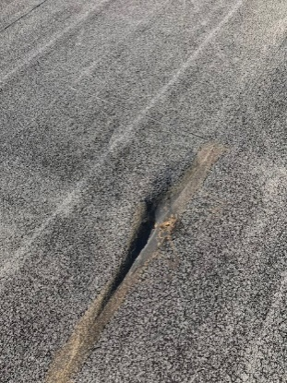
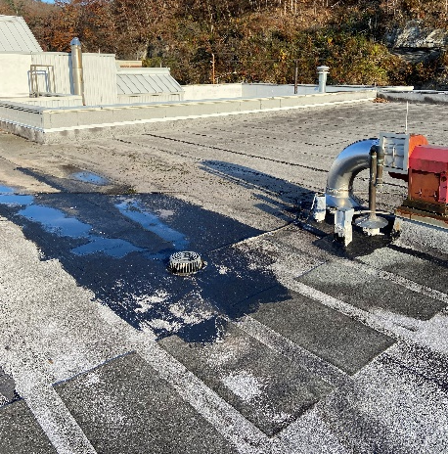
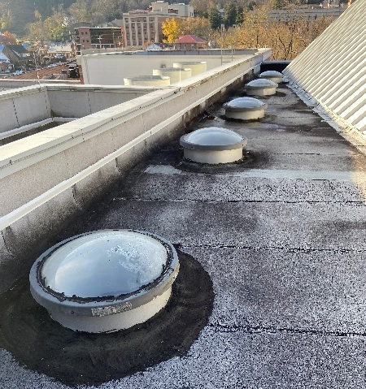
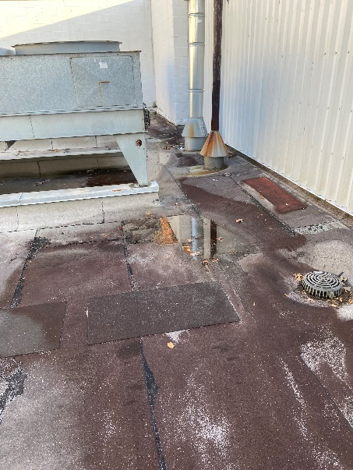
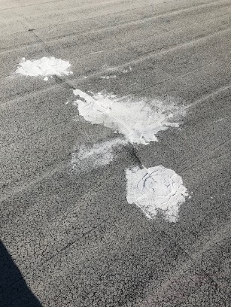
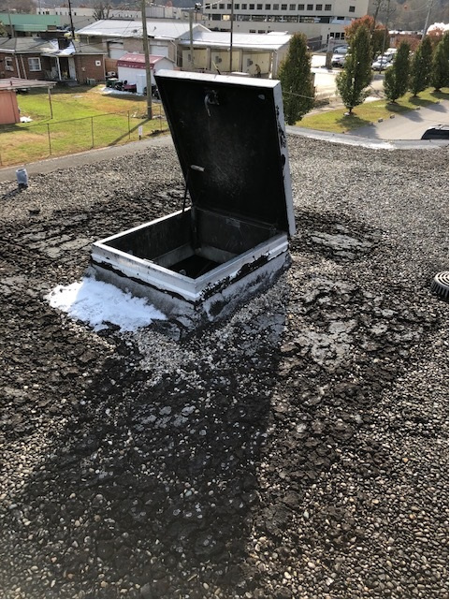
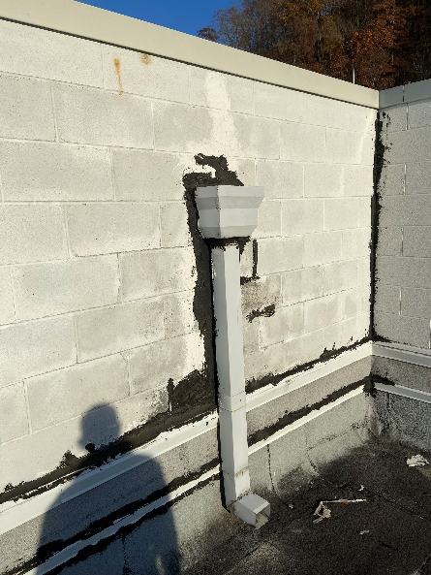
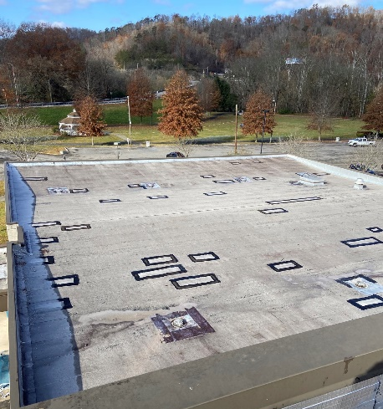
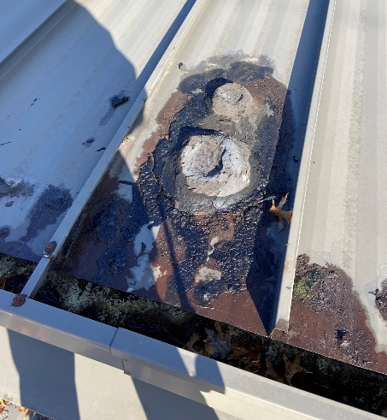
Replace roof membrane and flashings that have exceeded their life expectancy.
Roof Replacements and Repairs – Various Colleges and Campuses
Normal building settlement and membrane rigidity (due to age) has created significant issues with the roof membrane. Correct this with membrane replacement and expansion joint installation.
Repair roof drains, replace roof membrane and equipment curbs and flashing.
Repair skylights that are severely leaking.
Repair roof drains, replace membrane roofing and parapet flashings.
Replace roof membrane which has significant damage.
Repair roof overflow scuppers and replace flashing on parapet walls.
Replace roof membrane and parapet flashings which have deteriorated.
Repair metal roofing panels which are damaged. Recoat existing metal roofing panels.
Replace roof membrane which has exceeded its life expectancy.
Repair roof drains, replace roof membrane and equipment curbs and flashing.
Reconfigure roof access which does not meet current safety codes. Replace roof membrane is alligatoring throughout.

Slide 7
Replace Hartford Building Phase I - Jefferson CTC
$22.5 million
Address various structural issues with building envelope.
Address various window issues with building envelope.
Address various structural issues with building envelope.
Renovate existing science labs to address current/ future programs and building code issues.
Address various window issues with building envelope.
Roof System replacement to address membrane and flashing issues.
Address existing ADA accessibility Issues throughout the complex (interior/ exterior)

Slide 8
Current construction market conditions affected by supply chain issues and skilled labor availability is causing wide fluctuations in the cost of projects that cannot be predicted until time of bidding.
Projects can bid at prices in a range of 15% below estimates to 30% above estimates, and sometimes even higher.
We are attempting to schedule asset preservation projects, in coordination with Finance Cabinet - DECA to determine appropriate timing of project bids to hopefully maximize the funding.
However, this economic situation has the potential to cause the current funding to be
expended before all projects are fully accomplished.
Impact of Current Market Conditions on use of funding for Asset Preservation Projects

Slide 9
Questions?

