Slide 1
Capital Planning Advisory Board Meeting September 14, 2022

Slide 2
Asset Preservation Funding
HB 1 (Asset Preservation) Funding for 2022-24: $47,176,000
Murray State (Agency Bonds) Match: $7,078,000 Total Funding: $54,254,000
Thank you General Assembly!

Slide 3
Asset Preservation Funding
Top Priorities for MSU:
Capital Renewal and Building Modernization
Renovate Oakley Applied Science Building classrooms and office space for the Hutson School of Agriculture
Renovate Mason Hall Labs/Classrooms/Systems for the School of Nursing and Health Professions

Slide 4
Deferred Maintenance/Campus Improvements

Slide 5
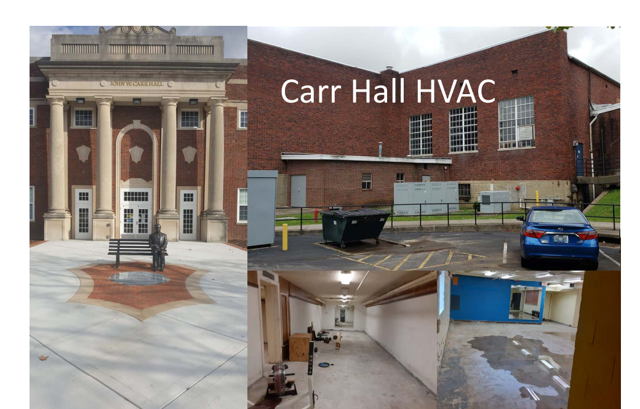
Deferred Maintenance/Campus Improvements

Slide 6
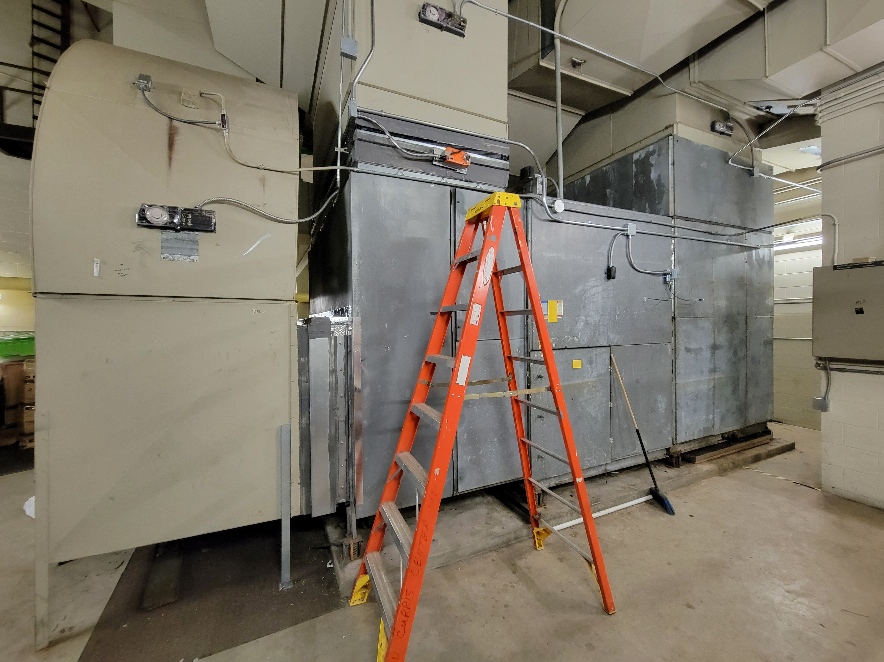
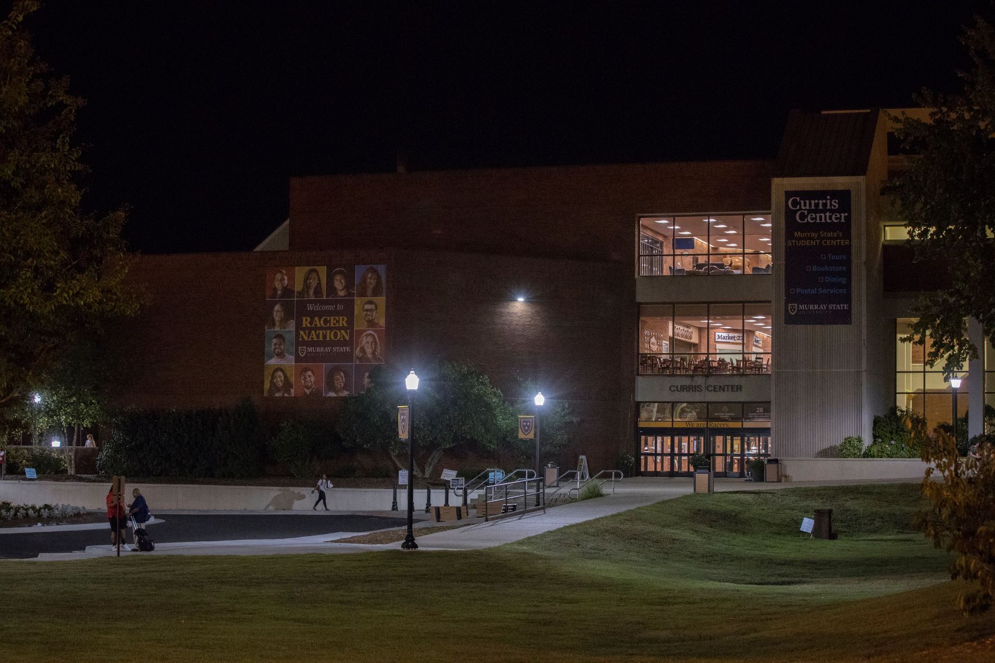
Deferred Maintenance/Campus Improvements
Curris Center
Air Handler Seals

Slide 7
Deferred Maintenance/Campus Improvements
CFSB Center Cooling Tower Replacements

Slide 8
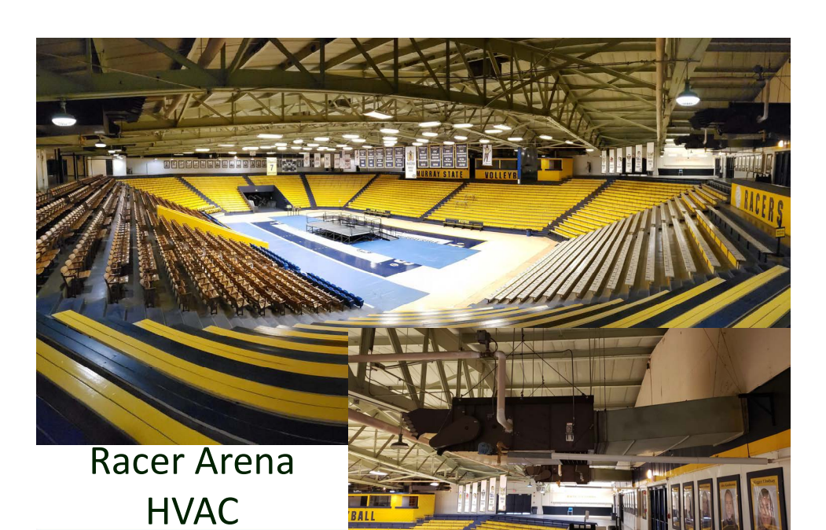
Deferred Maintenance/Campus Improvements

Slide 9
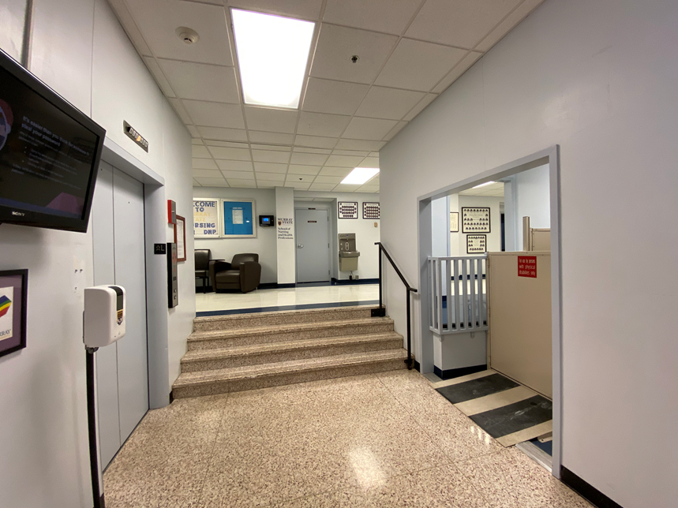
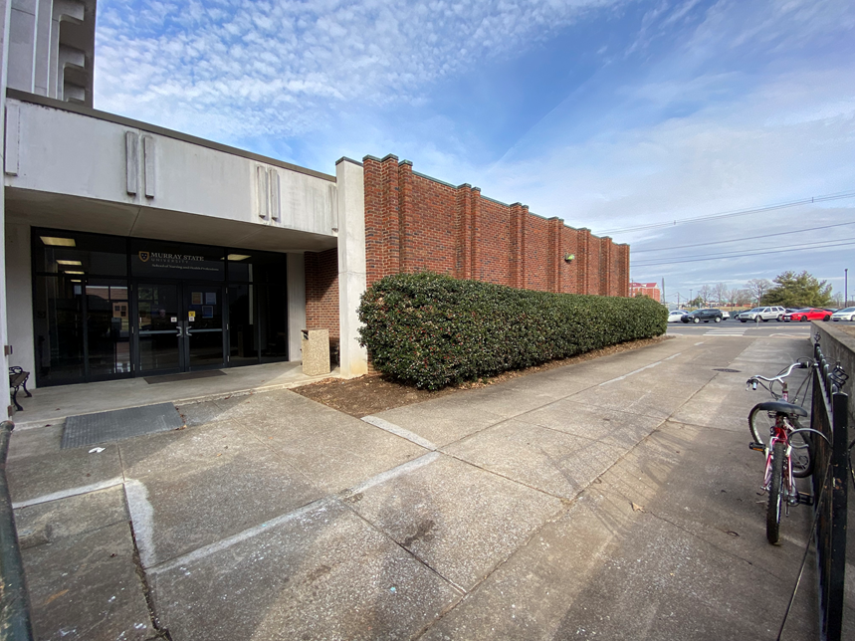
Deferred Maintenance/Campus Improvements
Mason Hall ADA Access
Mason Hall ADA Access

Slide 10
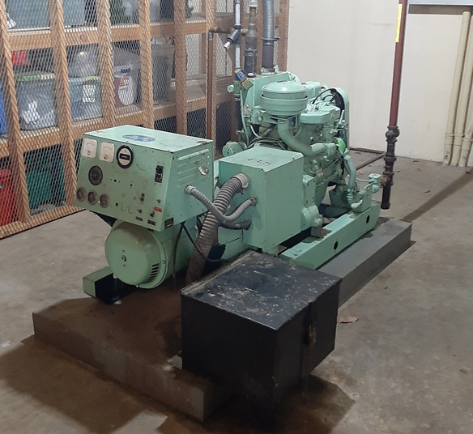
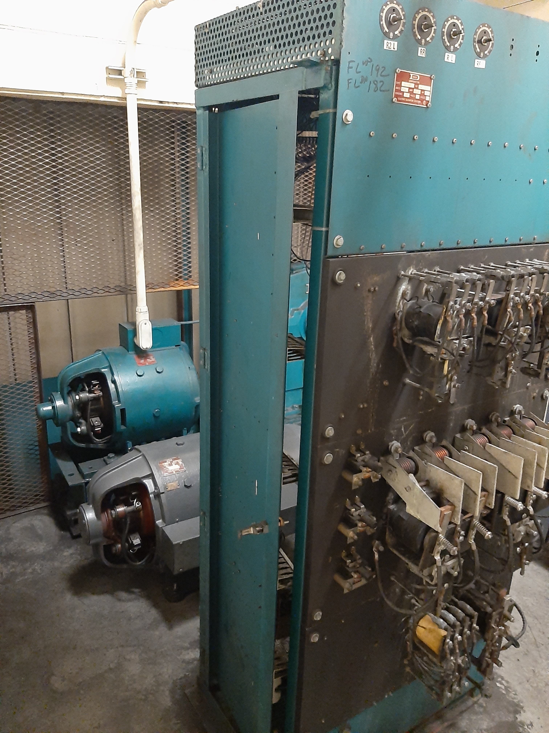
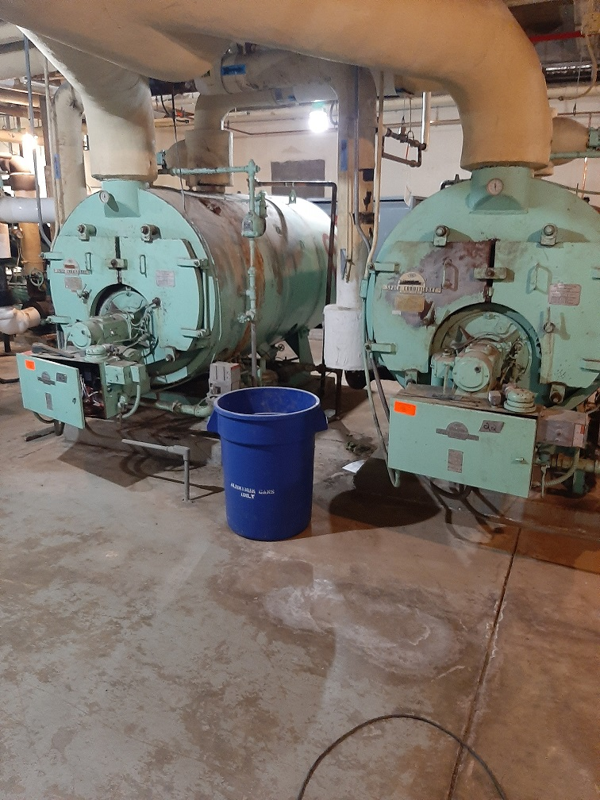
Mason Hall Chiller/Boiler/HVAC
Mason Hall Generator
Mason Hall Elevator

Slide 11
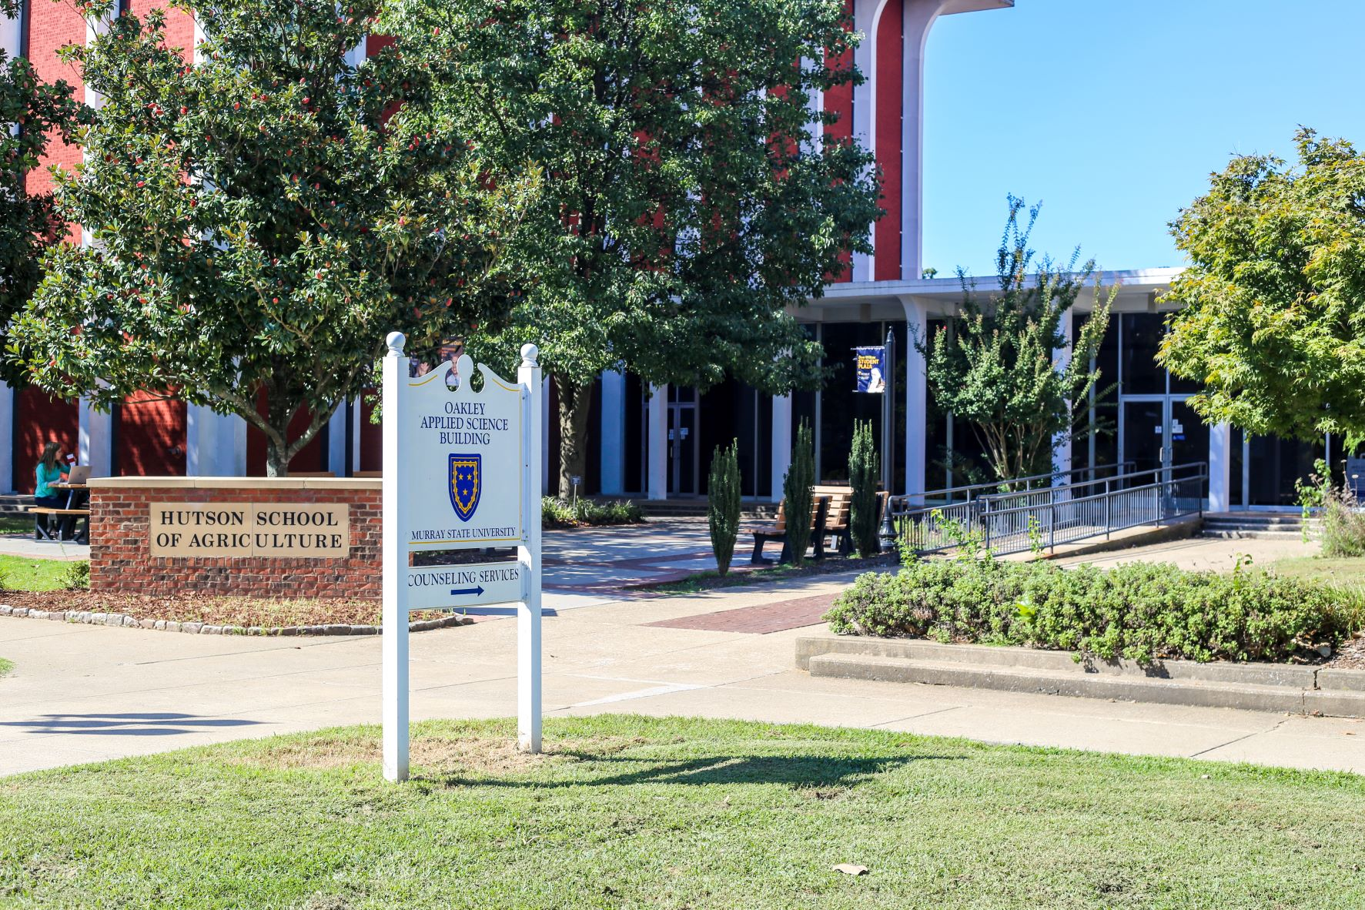
Deferred Maintenance/Campus Improvements

Slide 12
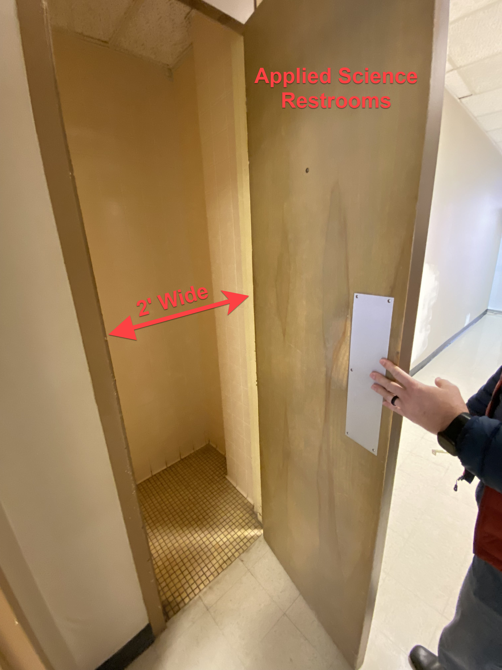
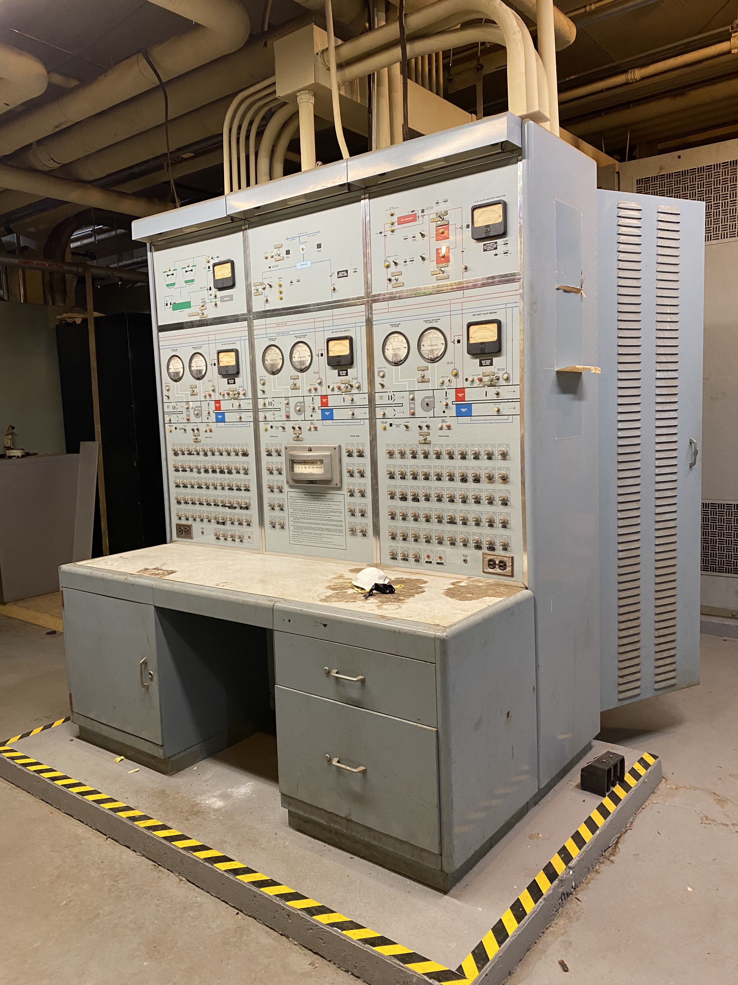
Deferred Maintenance/Campus Improvements
Applied Science ADA Access
Applied Science HVAC & Electrical Systems

Slide 13
Questions?

