Slide 2
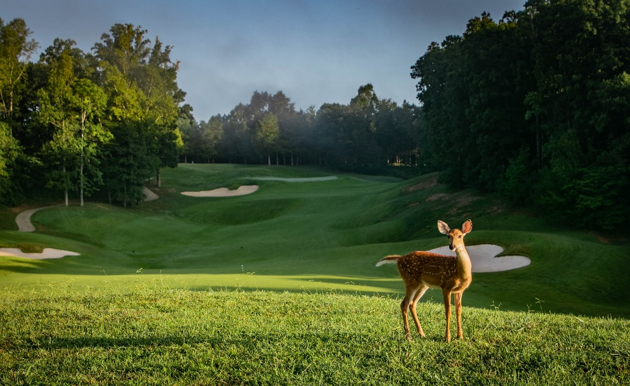
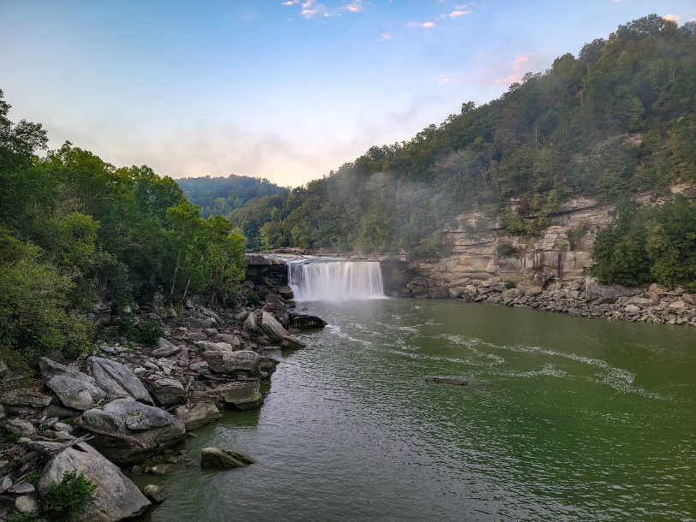
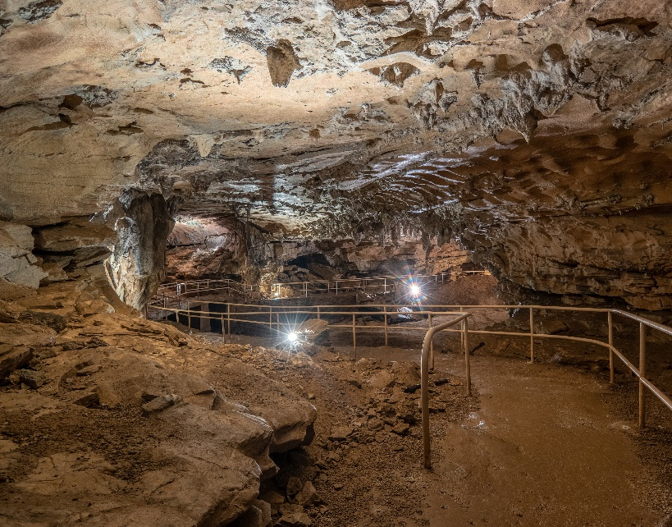
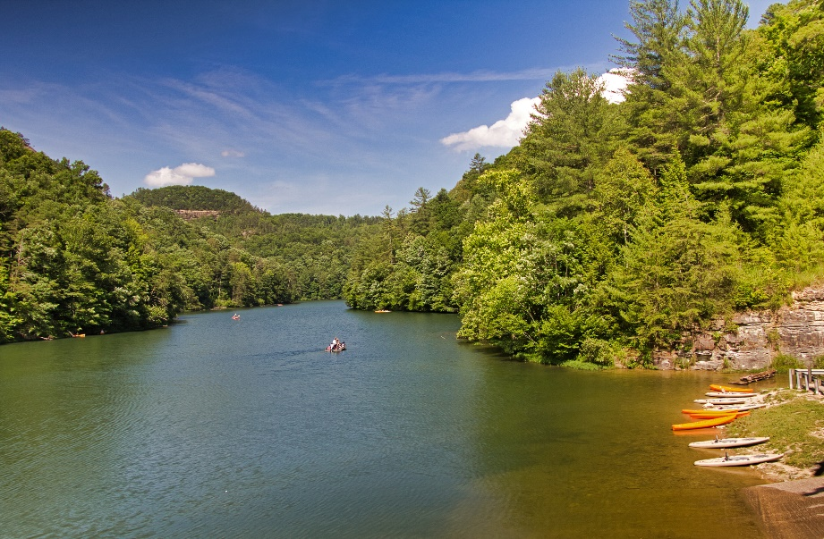
Our Mission
Provide a sustainable system of parks that delivers quality programs, amenities, and services.
Create memorable experiences and preserve historic and natural integrity.
Promote Kentucky as an inclusive travel experience that welcomes visitors of diverse backgrounds and interests.
Serve as a lifeline for communities impacted by disasters by utilizing state parks as an integral part of the state’s emergency response plan.

Slide 3
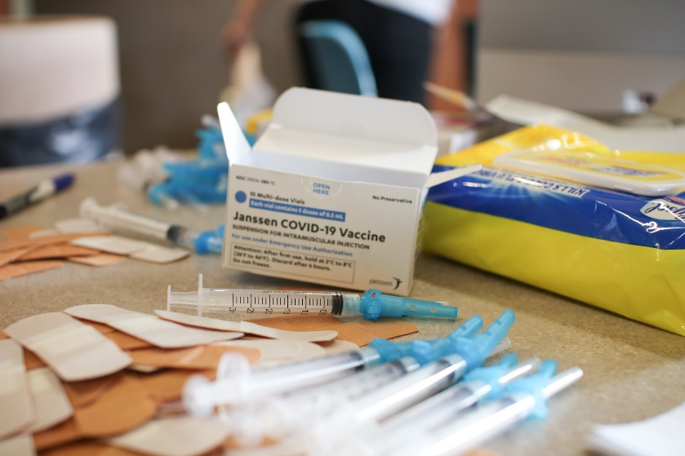
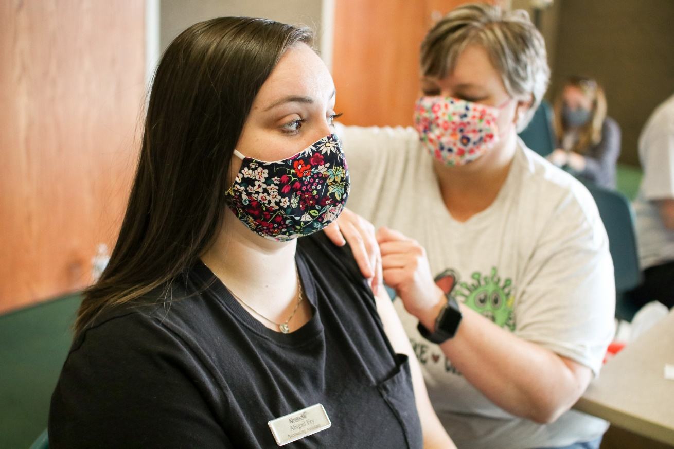
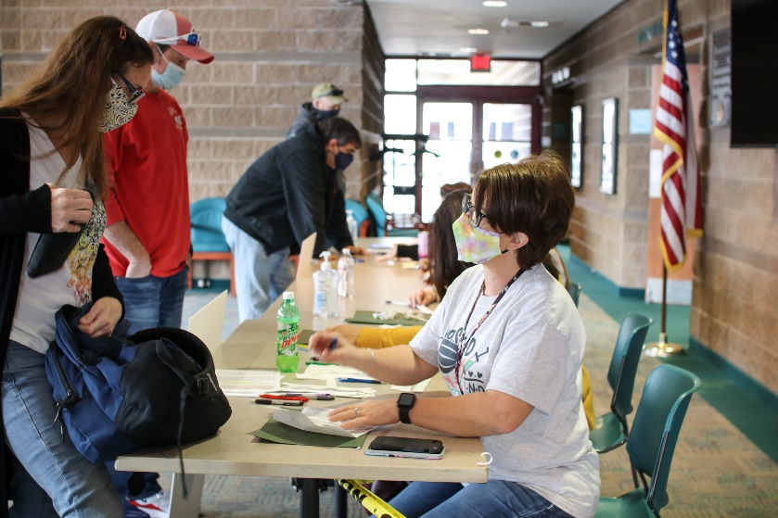
Covid-19 Response Efforts
Throughout the pandemic, Kentucky State Parks provided temporary housing for first responders and front-line healthcare workers.
A few parks also served as vaccination sites.

Slide 4
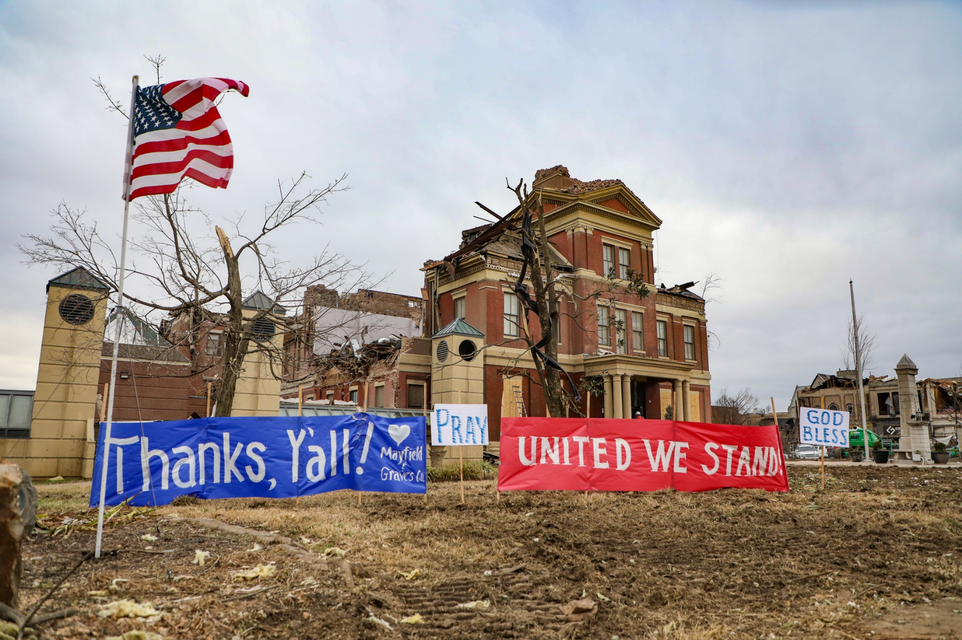
Western Kentucky Tornado Response Efforts

Slide 5
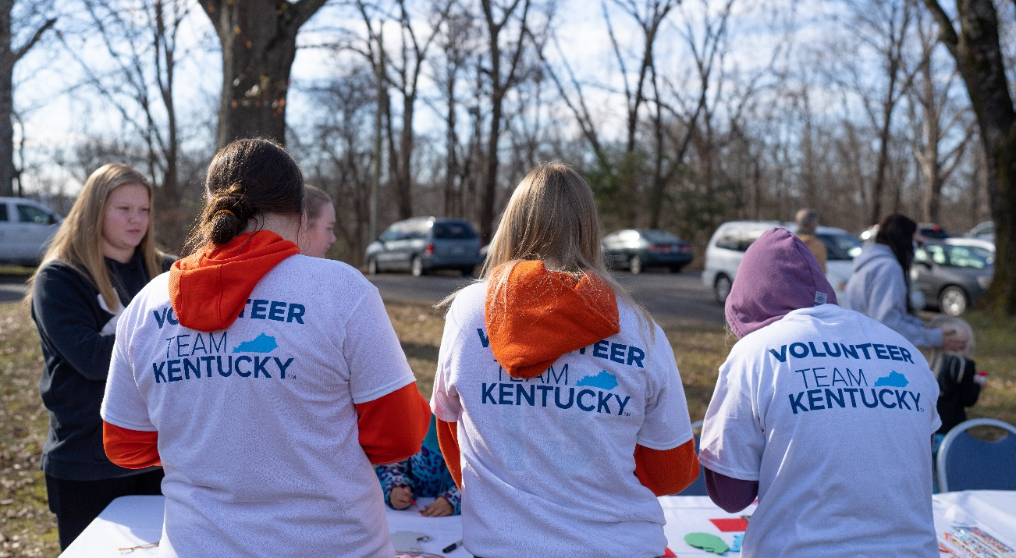
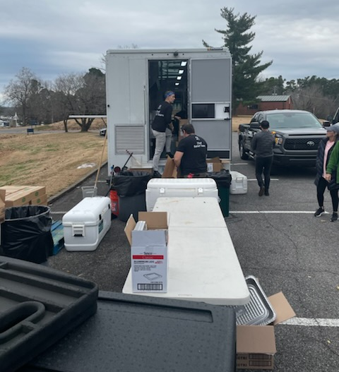
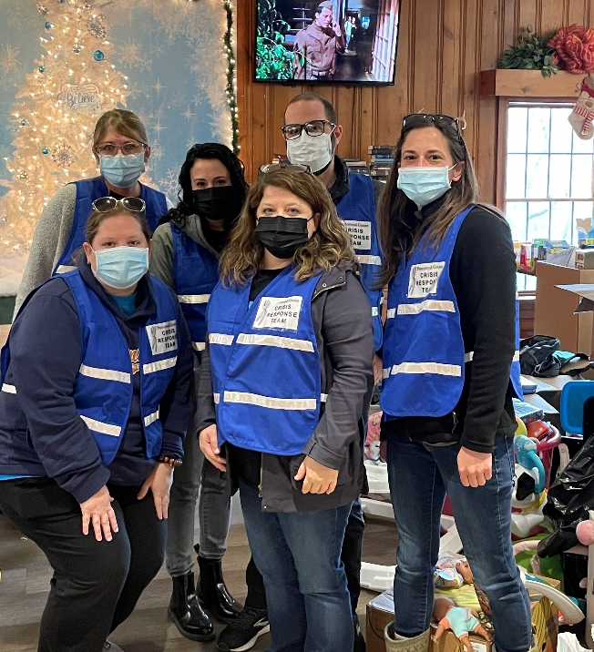
Western Kentucky Tornado Response Efforts (Continued)
Kentucky State Parks’ ranger division dedicated 33 rangers and 6,868 park ranger hours to support efforts to rebuild our Western Kentucky communities.
Kentucky State Parks provided temporary housing to more than 800 individuals and 250 first responders.

Slide 6
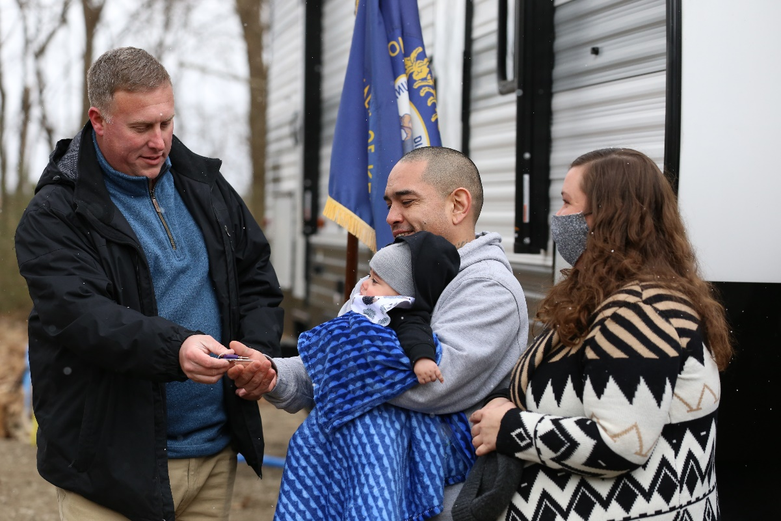
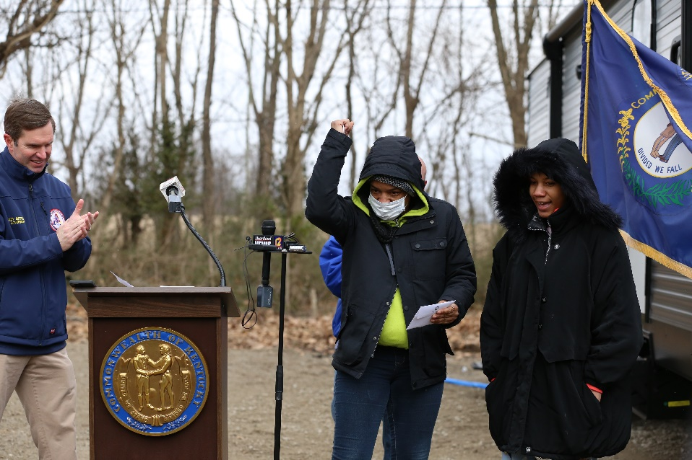
Western Kentucky Tornado Response Efforts (Continued)
The Commonwealth Sheltering Program sheltered more than 580 people in over 100 travel trailers and hotels and have continued to actively transition survivors to long-term housing solutions.

Slide 7
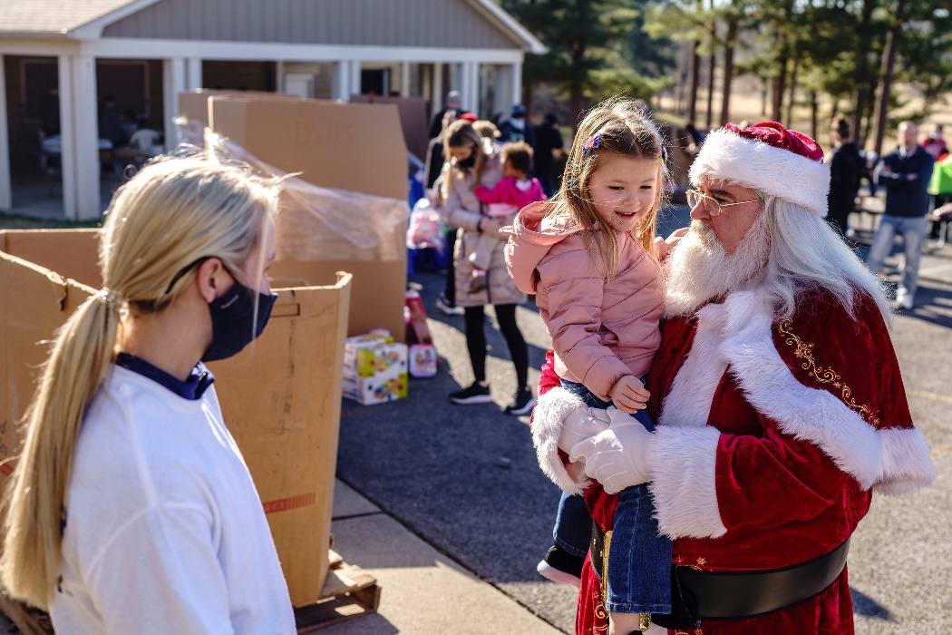
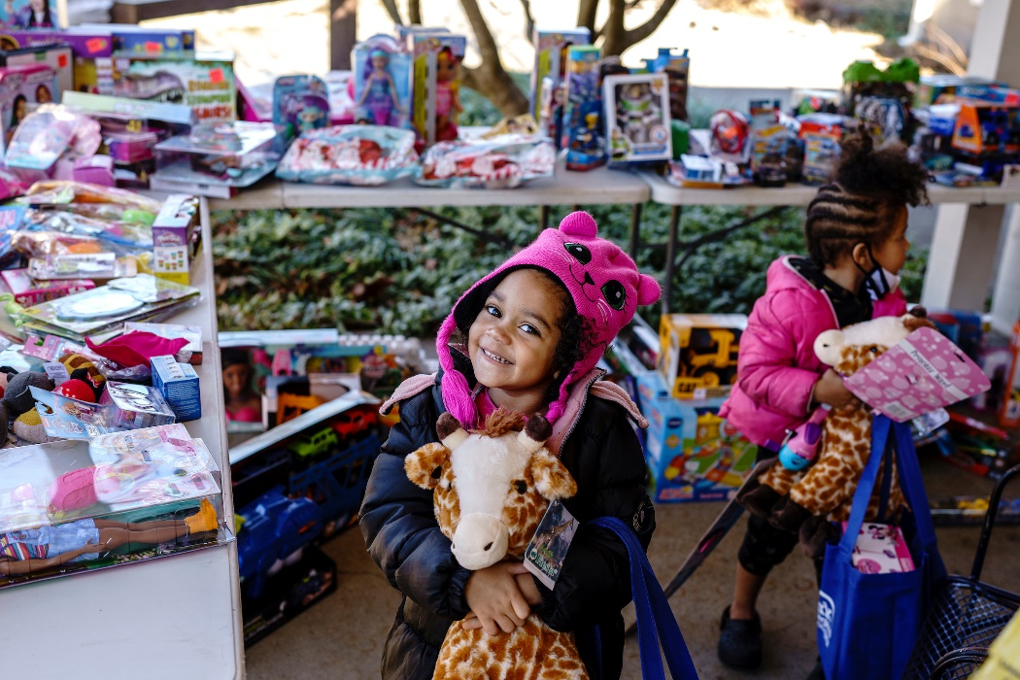
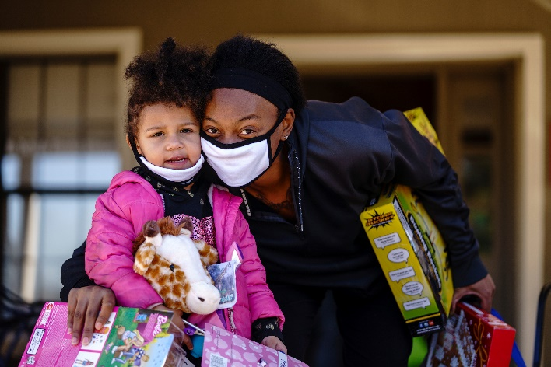
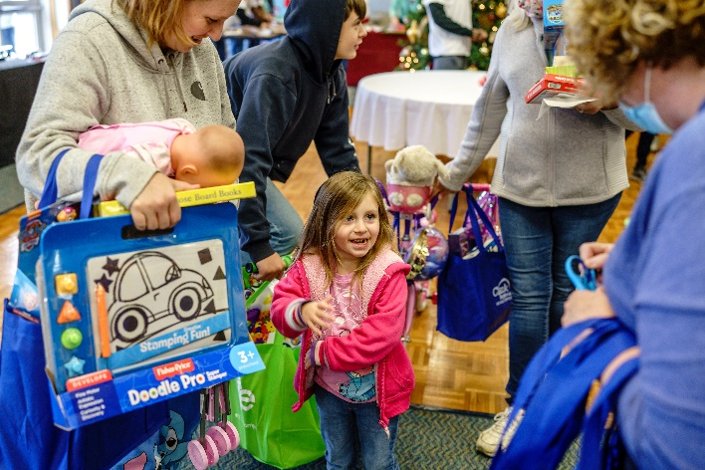
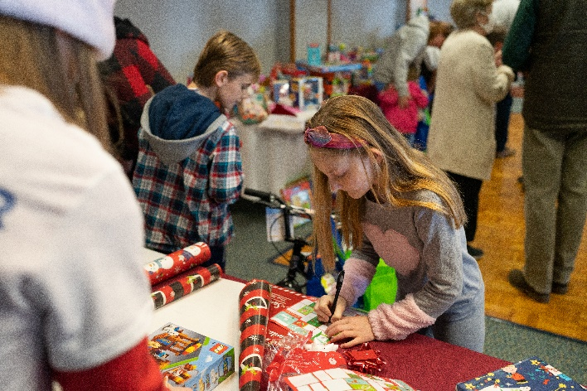
Western Kentucky Tornado Response Efforts (Continued)

Slide 8
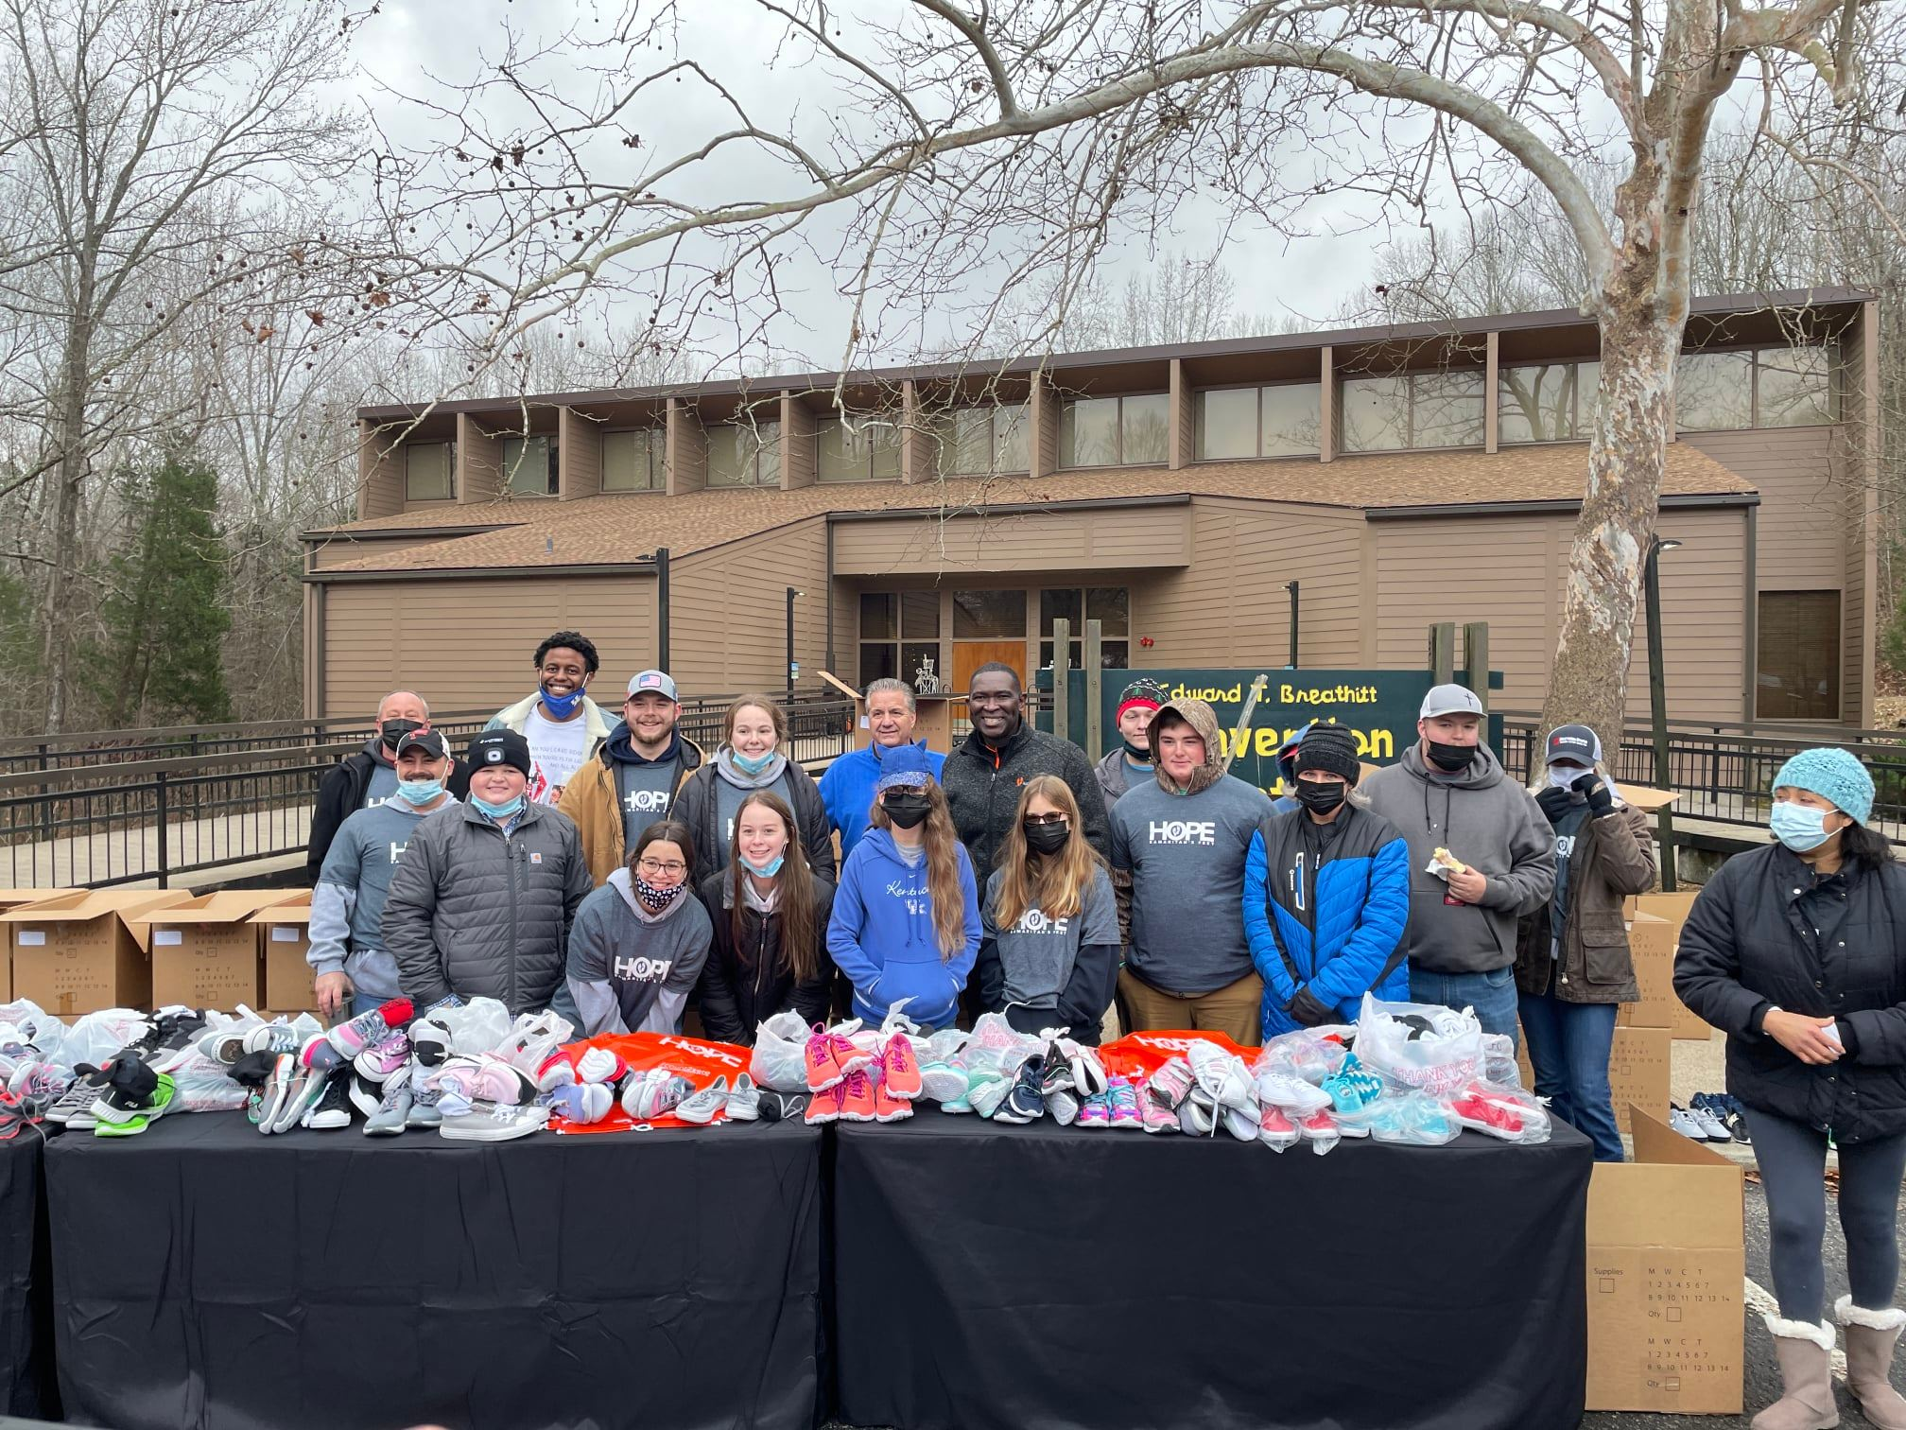
Western Kentucky Tornado Response Efforts (Continued)

Slide 9
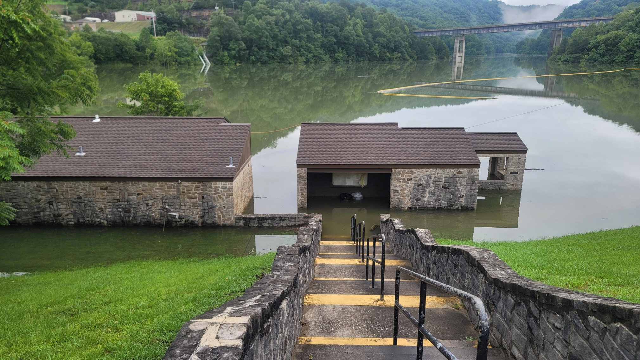
Eastern Kentucky Flooding Response Efforts

Slide 10
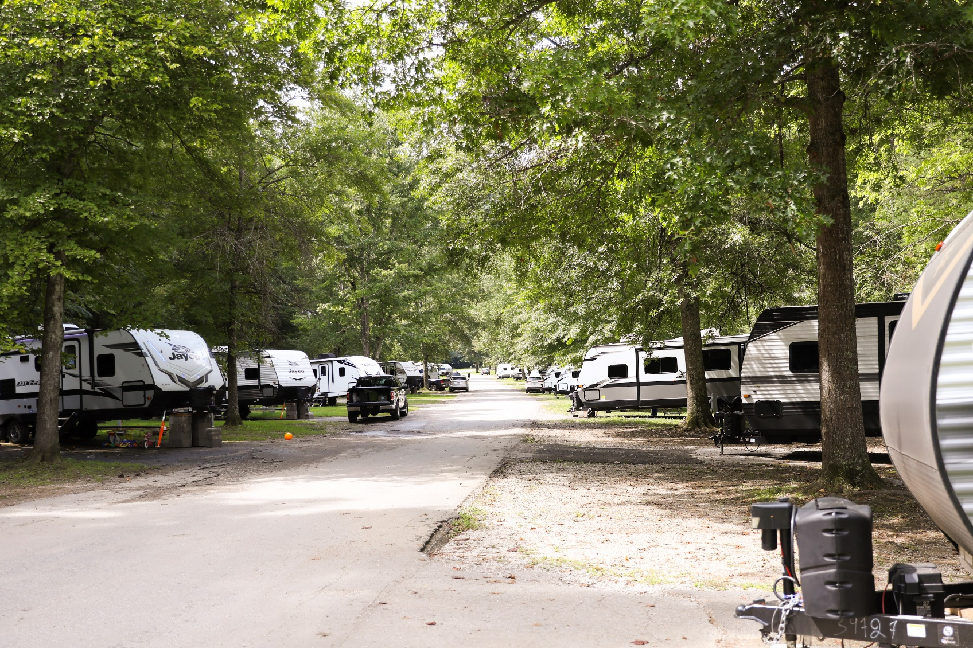
Eastern Kentucky Flooding Response Efforts (Continued)
Over 360 people impacted by the flooding have been temporary housed at our parks in Eastern Kentucky.
Currently, 464 individuals are being housed in 168 travel trailers including travel trailers located at Jenny Wiley and Carr Creek State Park.

Slide 11
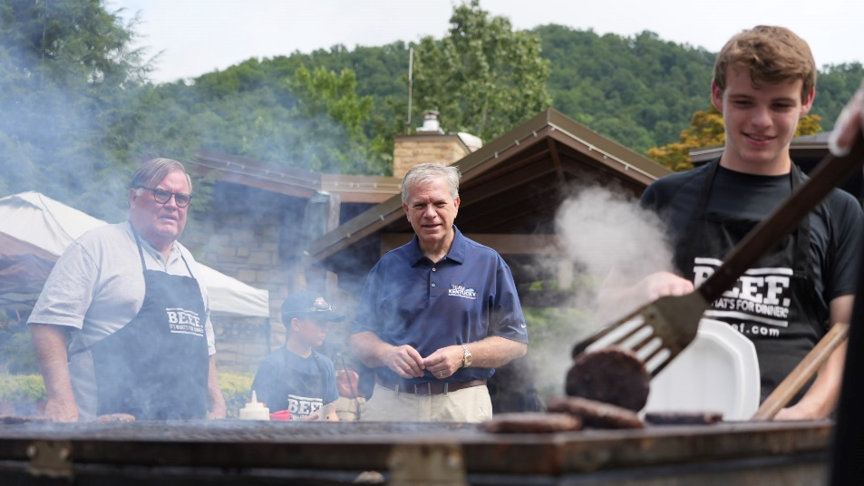
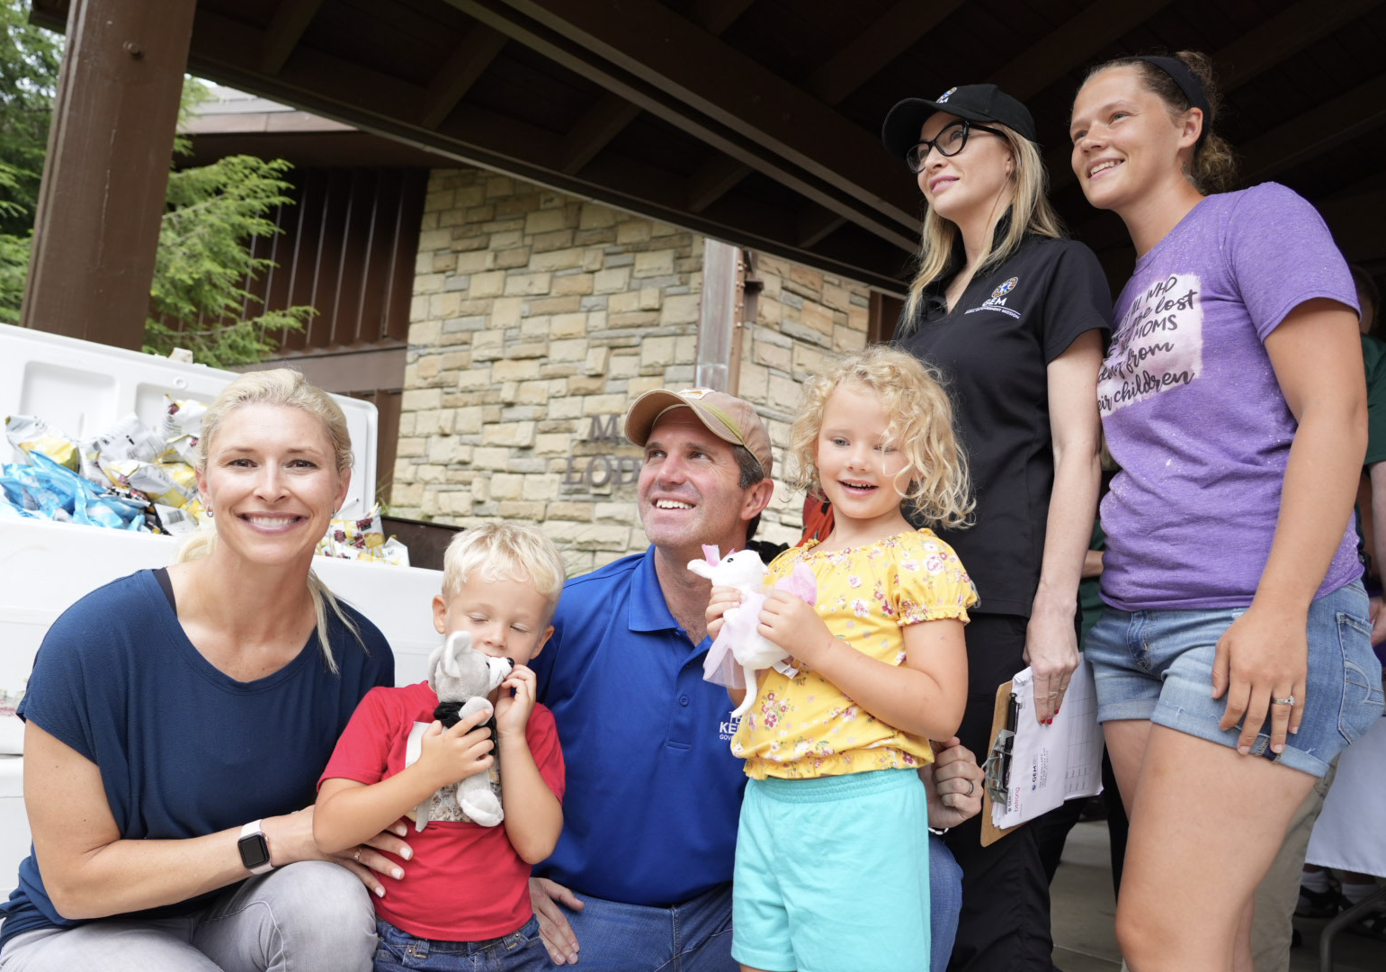
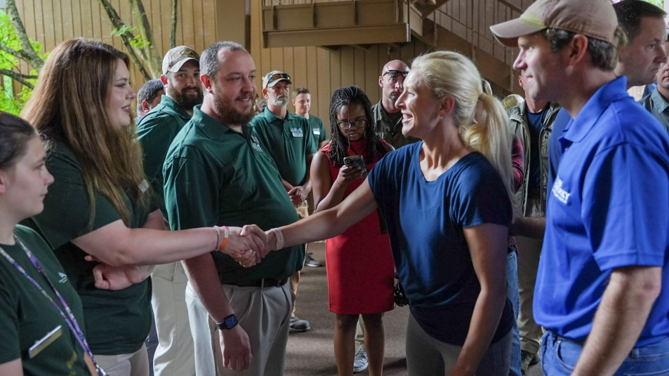
Eastern Kentucky Flooding Response Efforts (continued)

Slide 12
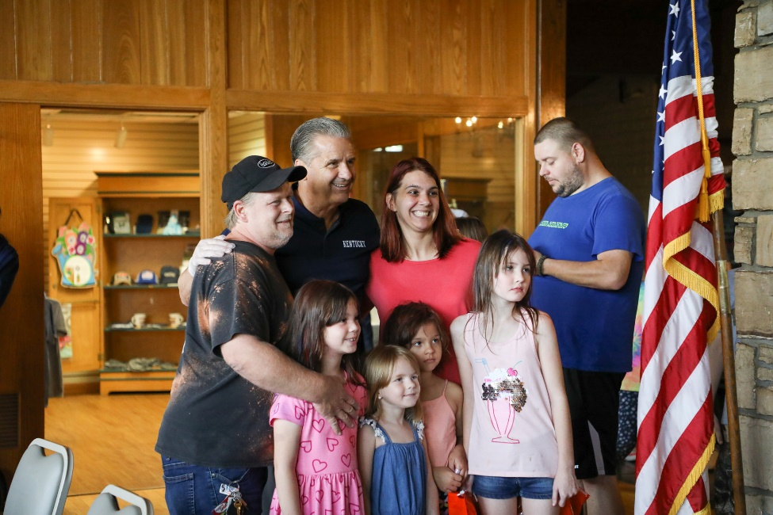
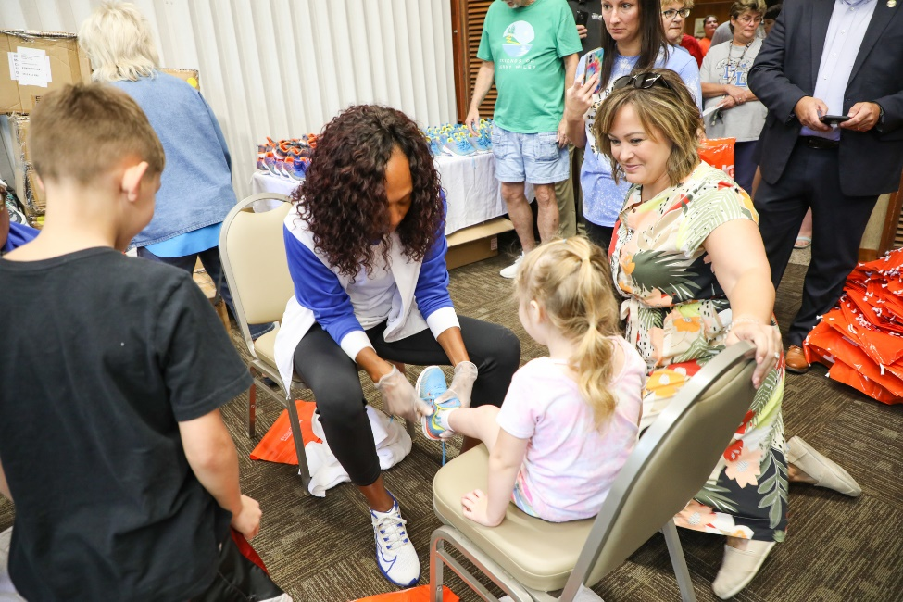
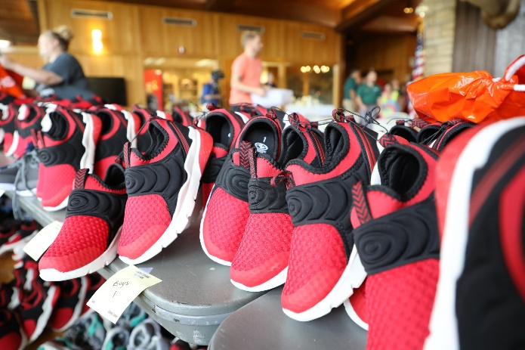
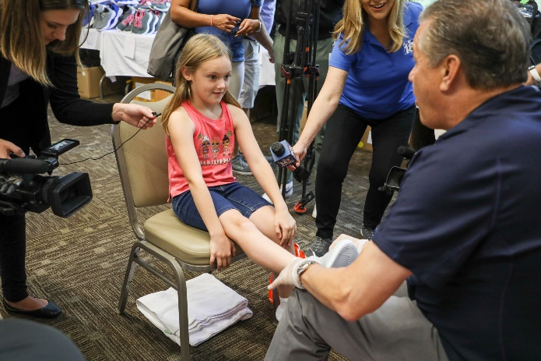
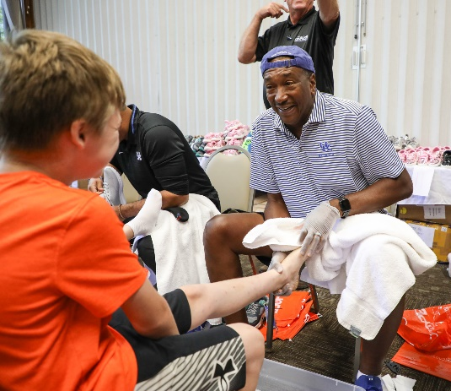
Eastern Kentucky Flooding Response Efforts (continued)

Slide 13
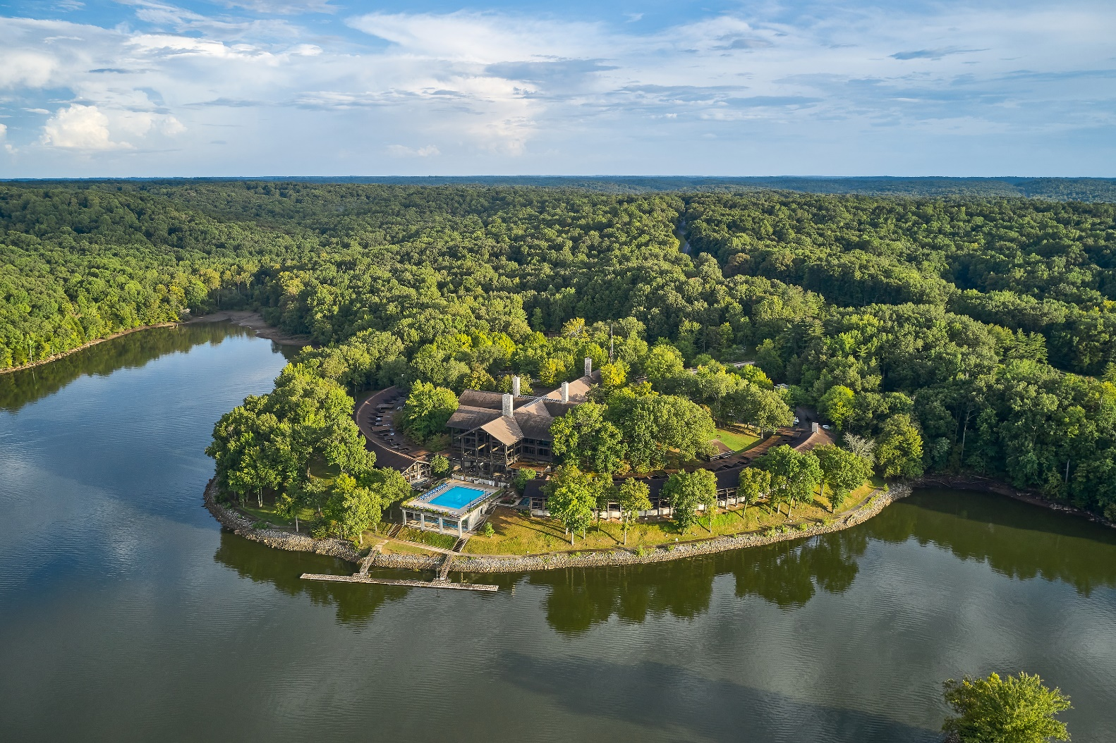
Support Your State Park
Join a park friends' group and volunteer
Contribute to the Kentucky State Parks Foundation (kentuckystateparksfoundation.org)
Buy state park gift cards
Hold a business meeting or conference at a park
Visit state parks with your family
www.parks.ky.gov

