Slide 1
CAPITAL IT PROJECT REVIEW 2024-2030
Ruth Day, Chief Information Officer
Commonwealth Office of Technology
June 14, 2023

Slide 2
Capital IT Planning – COT’s Role Per Capital Planning Advisory Board Instructions
KRS Chapter 7A does not outline a specific role for the Commonwealth Office of Technology (COT) in the capital planning process.
However, it has been the Capital Planning Advisory Board’s stated policy and practice in prior years to utilize COT’s specialized expertise relative to the information technology projects submitted by the executive branch agencies, excluding postsecondary education institutions.

Slide 3
Capital IT Planning – COT’s Role Per Capital Planning Advisory Board Instructions
An independent review panel, comprised of state government information technology professionals, will evaluate the projects.
COT will invite agency representatives to present an overview of their information technology needs and address any questions the review panel may have.
The panel will then develop an objective score for each project based on a set of well-defined criteria developed by COT.

Slide 4
Capital IT Planning – COT’s Role Per Capital Planning Advisory Board Instructions
Capital Project Scoring Committee includes Nine (9) Scorers from:
Office of State Budget Director
Finance and Administration Cabinet
Justice Cabinet
Education and Labor Cabinet
Kentucky Transportation Cabinet
Cabinet for Health and Family Services
Twelve (12) Capital IT Project Requests totaling approximately $87 million

Slide 5
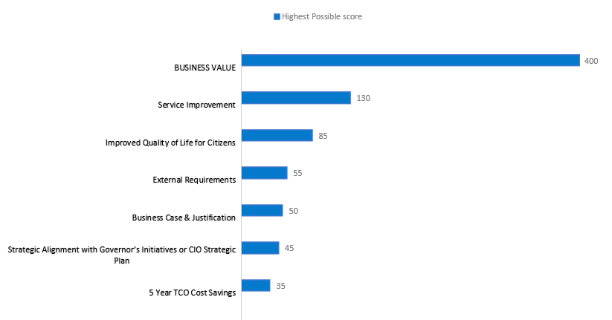
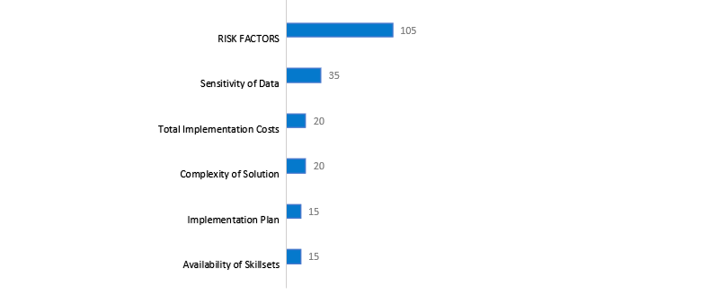
Capital IT Project Review 2024-2030
Scoring Criteria

Slide 6
Capital IT Project Review 2024-2030
Scoring Process
Requesters submitted detailed information supportive of the criteria
Committee scored during oral presentations
Automated prioritization of projects based upon scores and weights favoring projects with high business values and low risk
Real-time review of variances in scores to ensure reviewers shared common:
Understanding of the scoring criteria
Details of the project

Slide 7
Capital IT Project Review 2024-2030
Funds Requested by Ranking
Ranking | Cabinet | Project | General Funds | Other Funds | Total Project Budget ($)
1 | FIN | Legacy Modernization | GF |  | 20,000,000
2 | KYTC | AASHTOWare Upgrades |  | Road | 1,600,000
3 | CHFS | SAMS Replacement | GF |  | 13,000,000
4 | GEN | Kentucky Wired Critical Infrastructure Upgrades | GF |  | 12,927,000
5 | ELC | KET Capitol Production Center Maintenance Pool 2023-2030 | GF |  | 1,000,000
6 | FIN | eMARS Upgrade & Enhancement | GF |  | 3,500,000
7 | ELC | Case Management System for Vocational Rehabilitation |  | Federal | 3,180,000
8 | JUS | KSP Telecommunicator Technology Enhancement Project | GF |  | 2,200,000
9 | PPC | HBC Application Modernization (HAM) |  | Restricted | 3,588,000
10 | ELC | KET Rural Service Access and Reception | GF |  | 20,000,000
11 | ELC | Adult Education Modernization System | GF |  | 2,800,000
12 | ELC | Case Management System for Workforce Innovation Opportunity Act |  | Federal | 3,250,000

Slide 8
Thank you!

