Slide 1
Department of Military Affairs
BG (Ret) Charles T. Jones, Executive Director
MG (Ret) Stephen D. Collins, Director, Bluegrass Station
Joe Sanderson, Director, Facilities Division
BG (Ret) Steven T. King, Construction and Facilities Management Officer, KYARNG
Capital Planning Advisory Board
June 14, 2023

Slide 2
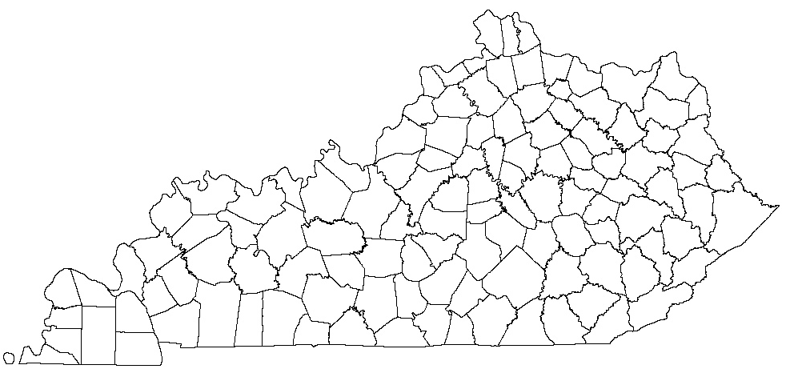
Louisville - Bowman Field (307)
75th Troop Cmd
101st MCPOD
USA Cyber Tm 175 Det 1
20th MI Co
HHD 198th MP BN
R&R Co A (-)
38th DIVARTY (FY24)
Air Guard Base (22)
41st CST
Standiford Field
123d TAW
Louisville – Buechel Armory (241)
223rd MP Co
2138th FWD SPT Co
Frankfort BNGC (773)
JFHQ-KY
JFHQ-Det 1 Select Srvc
ARMY Elmt JFHQ
1988 Contract Team
DCARNG MAC Det 2
KYARNG MED DET
1809 JAG Team
CSMS Det 1 / FMS 5
751st Troop CMD
63rd Theatre AVN BDE
Co C 1-376th AV
Co B (-) 351st ASB
Co B 2-147th AV
Det 1 HHC 2-147th AV
Det 1 Co D 2-147th AV
Det 1 Co E 2-147th AV
Det 3 HHC 2-238th AV
Det 1 Co C 2-238th AV
Det 4 Co D 2-238th AV
Det 4 Co E 2-238th AV
202nd Band
133rd MPAD
Frankfort Airport (7)
ARNG Flt Det KY OSA
Co C Det 4 2-245th AV Regt
NGAKY Bldg (98)
R&R Cmd
Burlington (432)
HHC 103rd CM BN
299th CM Co
2061st MRBC (-)
2112 Trans Co
R&R Co B Det 1
FMS 7
Lexington (291)
HHB 138th Field Artillery BDE
HHB 2-138th FA BN
138th Signal Co
FMS 3
Bluegrass Station AVON
VACANT
Richmond - Depot (385)
617th MP Co
149th Signal Co
2123rd Trans Co
1734th FFP
R&R Co B (-)
CSMS (-) / FMS 4
Richmond - Armory (243)
149th HHC MEB
Ft. Knox (0)
MATES
FMS
Walton (55)
940th MP Co (FY24)
Carlisle (89)
BTRY B 2-138th FA BN
Cynthiana (72)
149th EN Co(-)
Olive Hill (83)
Det 1 149th EN Co
Elizabethtown (81)
Det 1 2061st MRBC
38th DIVARTY (Temporary)
Carrollton (89)
BTRY A 2-138th FA BN
Shelbyville (78) 1163rd Med Co
Ashland (157)
HHC 201st EN
201st FSC
FMS 1
Leitchfield (93)
1123rd Sapper Co
Owensboro (157)
HHC 206th EN
FSC 206th EN
Bardstown (89)
BTRY C 2-138th FA BN
Brandenburg (39)
Det 1 Co B 1-149 IN BN
Morehead (96)
301st CM Co
Henderson
Maintenance Status
Prestonsburg (93)
577th Sapper Co
Madisonville (110)
130th EN Co (-)
Marion (0)
Maintenance Status
Paducah (101)
2113rd Trans
FMS 12
Benton (68)
Det 1 438th MP Co
R&R Co A, Det 1
Jackson (72)
DET 1 207 EN Co
FMS 6
Hazard (81)
207th EN Co (-)
Ravenna (131)
Co C 1-149th IN BN
Harrodsburg (77)
103rd BSB
Harlan (39)
Det 1 A Co 1-149th IN BN
Central City (152)
307th SMC
Glasgow (148)
HHB 1-623rd FA BN
R&R Co A Det 2
FMS 9
Murray (108)
438th MP Co
Greenville (255)
KY ARNG TNG Site
238TH Regt
1st BN 238th Regt
2nd BN 238th Regt
JFHQ Marksmanship Tm
UTES
761 FFT HQ
176th FTTG
177th FTTG
178th FTTG
Det 1 130th EN Co
Monticello (75)
BTRY B 1-623rd FA BN
Barbourville (113)
HHC(-) 1-149th IN BN
Disney TNG Site
Artemus (1)
R&R Co B Det 2
Hopkinsville (39)
Co B 1-149th IN BN
Russellville (0)
Maintenance Status
149 MEB
75 TRP CMD
138 FAB
63 TAB
JFHQ-KY
38th DIVARTY
Bowling Green (71)
HHC 1792D CSSB
1820th FFP
FMS 10
Tompkinsville (75)
BTRY A 1-623rd FA BN
Danville (51)
Det 1, 617th MP
Williamsburg (56)
RSP Site
Middlesboro (92)
A Co 1-149th IN BN
Springfield (94)
613th En (FAC)
D Co 1-149th IN BN
Kentucky National Guard
Unit Armory Locations
As of 01SEP2022
Somerset (56)
Det 1 HHC 1-149th IN BN
London (74)
429th FSC Co I
JFHQ JSO
FMS 2
Campbellsville (74)
203rd SPT Co FSC

Slide 3
2024-2026 Capital Projects Requiring General Fund Support
Priority | Project Title | Total Budget | General Funds | Other Funds (FF=Federal Funds)
1 | Armory Installation Maintenance Pool | $10,000,000 | $10,000,000
2 | Modernization Pool KY National Guard | $8,000,000 | $2,000,000 | $6,000,000 (FF)
3 | KY Youth ChalleNGe Academies Maintenance Pool | $2,000,000 | $2,000,000
4 | Ashland Armory Restoration Phase I | $4,000,000 | $1,000,000 | $3,000,000 (FF)
5 | Construct Armory Addition – Shelbyville | $4,000,000 | $1,000,000 | $3,000,000 (FF)
(cont. on next pg.)

Slide 4
2024-2026 Capital Projects Requiring General Fund Support (cont.)
Priority | Project Title | Total Budget | General Funds | Other Funds (FF=Federal Funds)
6 (see last slide)
7 | Construct BNGC Athletic Field | $3,000,000 | $750,000 | $2,250,000 (FF)
8 | Construct BNGC Installation Micro-Grid Project | $3,000,000 | $1,750,000 | $5250,000 (FF)
9 | Construction Readiness Center Somerset – Additional | $9,470,000 | $4,032,000 | $5,438,000 (FF)
10 | Construct Armory 4 Frankfort | $4,000,000 | $1,000,000 | $3,000,000 (FF)
11 | Construct Energy Resiliency – Armories – Statewide | $4,000,000 | $1,000,000 | $3,000,000 (FF)

Slide 5
2024-2026 Capital Projects NOT Requiring General or Road Fund Support
Project Title with County | Total Budget | Fund Source (RF=Restricted Funds FF=Federal Funds)
Bluegrass Station Northern Area Infrastructure (Fayette) | $6,000,000 | RF
Bluegrass Station Facility Maintenance Pool (Fayette) | $2,000,000 | RF
Construct and Extend Electric BGS (Fayette) | $3,500,000 | RF
Construct Bowman OMS Restoration (Jefferson) | $3,000,000 | FF
Construct Civil Support Team Facility – Additional (Franklin) | $7,200,000 | FF
Construct Electric Vehicle Charging Stations (statewide) | $5,000,000 | FF
Construct Fitness Center at WHFRTC (Muhlenberg) | $5,000,000 | FF
(cont. on next pg.)

Slide 6
2024-2026 Capital Projects NOT Requiring General or Road Fund Support (cont.)
Project Title with County | Total Budget | Fund Source (RF=Restricted Funds FF=Federal Funds)
Construct FMS Burlington – Additional (Boone) | $2,700,000 | FF
Construct Improve Sewer System Bluegrass Station (Fayette) | $5,000,000 | RF
Construct New Barracks at WHFRTC-Additional (Muhlenberg) | $1,000,000 | FF
Construct Support Building WHFRTC-Additional (Muhlenberg) | $1,000,000 | FF
Install Energy Resiliency at Training Ctr’s Stwd (Muhlenberg) | $6,000,000 | FF
JSO HVAC Upgrade (Franklin) | $2,000,000 | FF
WHFRTC Facilities Operations Maintenance Complex (Muhlenberg) | $3,000,000 | FF
WHFRTC Installation Micro-grid (Muhlenberg) | $3,000,000 | FF
(cont. on next pg.)

Slide 7
2024-2026 Capital Projects NOT Requiring General or Road Fund Support (cont.)
Project Title with County | Total Budget | Fund Source (RF=Restricted Funds FF=Federal Funds)
Construct HLDTS Athletic Field – Additional (Knox) | $1,000,000 | FF
Construct HLDTS Drainage Improvement (Knox) | $2,000,000 | FF
Construct New Barracks HLDTS (Knox) | $3,000,000 | FF
Construct Jackson FMS (Breathitt) | $15,000,000 | FF
Extension of Utilities W.H. Ford Training Site (Muhlenberg) | $2,000,000 | FF

Slide 8
2024-2026 Capital Projects
Bluegrass Station
Airport/Airpark Project
 | General Funds | Other-Long-Term Financing
P3 Land Acquisition | $55,000,000
P3 Airport/Airpark |  | 196,500,000

Slide 9
2024-2026 Capital Projects
Bluegrass Station
Other-Long-Term Financing Projects
 | Other-Long-Term Financing
Construct Multi-Purpose Building | $15,000,000
Construct Road Improvements | $1,500,000
Construct Two MC 130 Hangars | $36,000,000
Construct Warehouse for MC 130 Hangars | $12,000,000

