Slide 1

Capital Planning Advisory Board
June 14, 2023
Kentucky Tourism, Arts and Heritage Cabinet
Secretary Lindy Casebier
Chief of Staff
Mona Juett
Director of Finance
Melissa Brewer
Executive Branch Efficiency Task Force

Slide 2

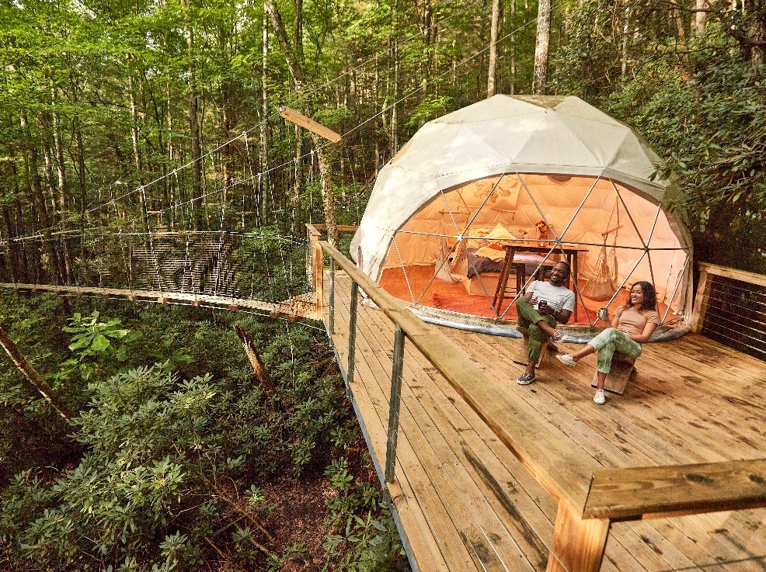
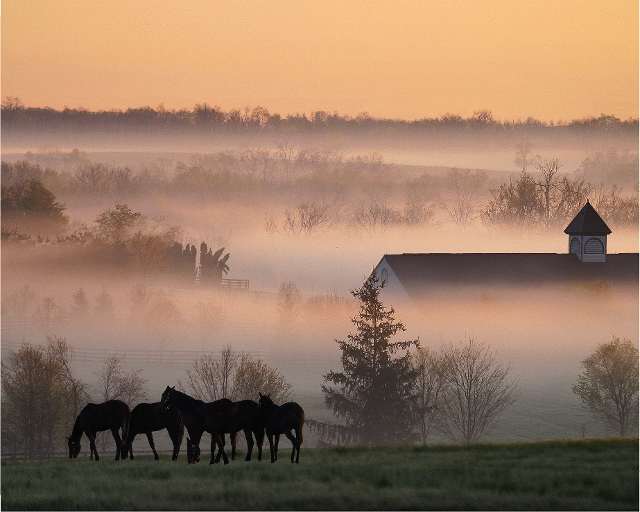
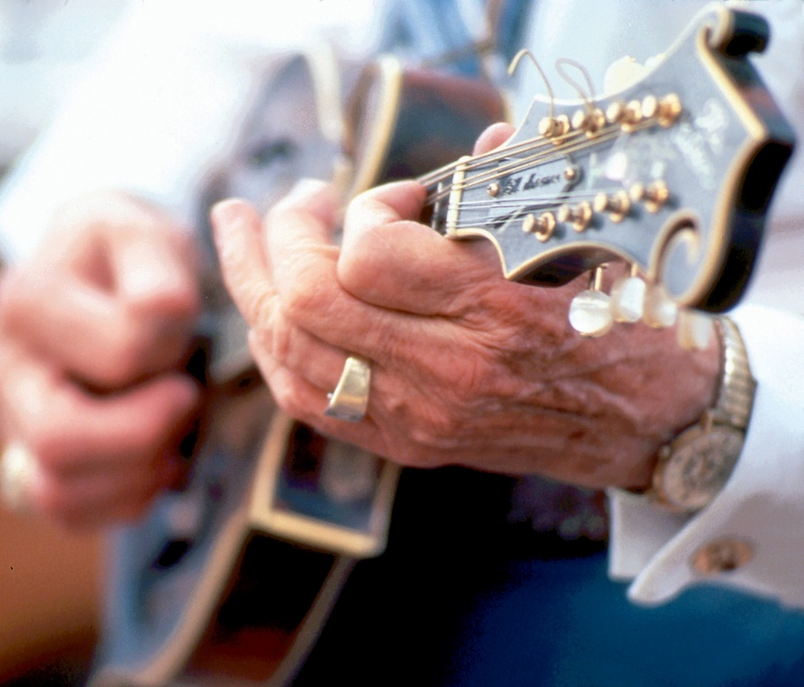
Our Mission
Support the promotion and development of Kentucky tourism, arts and heritage as a mechanism to foster economic growth, education and employment for communities throughout the commonwealth while appealing as a destination to a diverse audience at home, nationally and internationally.

Slide 3
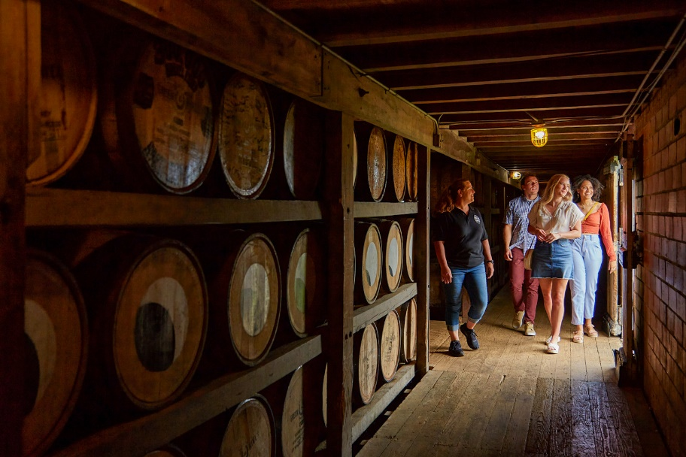
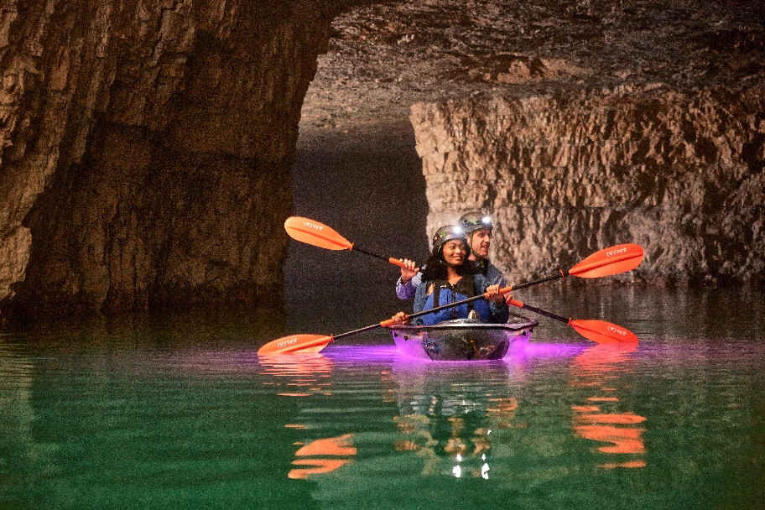
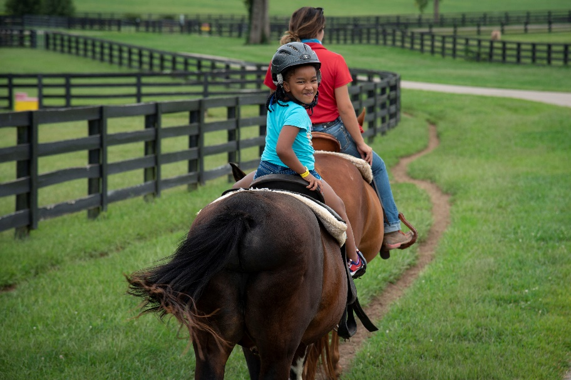
Cabinet Overview
The Kentucky Tourism, Arts and Heritage Cabinet is dedicated to fostering and promoting the state’s rich heritage as well as continuing Kentucky’s long history of being a premier travel destination for all travelers to enjoy.
The Cabinet serves as Kentucky’s top tourism agency and collaborates with local tourism partners to coordinate tourism, arts and heritage efforts through legislation, tourism development, and marketing/outreach.

Slide 4
2024 - 2026 capital plans
Maintenance Pool
$24 million – Kentucky State Parks
$1 million – Kentucky Artisan Center
$1.1 million – Kentucky Performing Arts
$3 million – Kentucky Horse Park
$6 million – Kentucky Venues

Slide 5
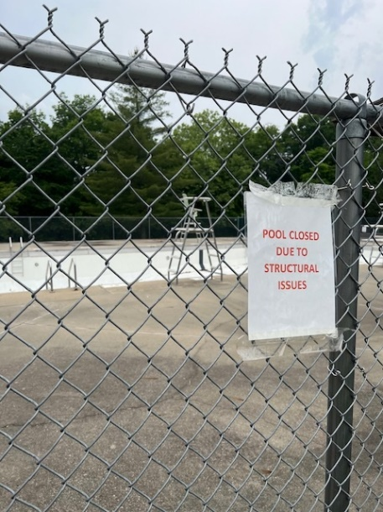
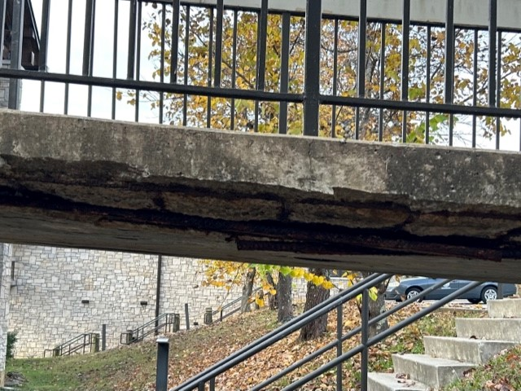
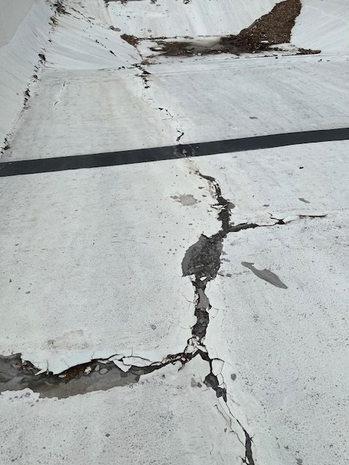
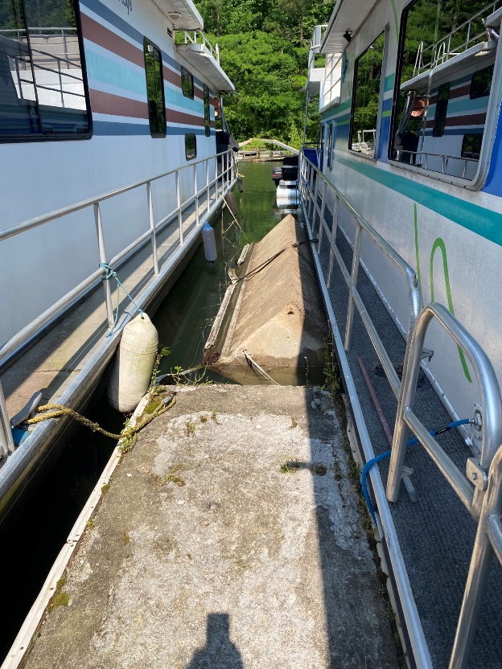
2024 - 2026 capital plans
Kentucky State Parks
$8,000,000 - Structural and Safety Repairs
$3,000,000 - Life Safety Systems Upgrade and Replace
$1,200,000 - Statewide Replacement of Door Locking System
$22,000,000 - Hospitality Upgrades (Phase 1)
$6,000,000 - Lake Barkley Lodge Wing Exterior Repair
$12,200,000 - Jenny Wiley Marina Reconstruction
$12,000,000 - Pool Improvements and Repairs
$5,000,000 - Dam Safety Reconstruction and Repairs
$1,545,000 - Perryville ADA Accessible Restroom Facility
$10,000,000 - Cumberland Falls Lodge Room Upgrade/Reconfiguration
$5,000,000 - Building Systems Repair & Replace (Phase 1)
$18,000,000 - Multi Park WWTP System Upgrades

Slide 6
2024 - 2026 capital plans
Kentucky State Parks Continued
$2,500,000 - Lake Barkley Lodge Wing Interior Upgrades
$3,125,000 - Big Bone Lick State Park Nature Center
$2,000,000 - Repair/Replace Signage at Park Facilities
$3,065,000 - Conference Center Upgrades (Phase 1)
$1,085,000 - Convert Golf Courses to Bermuda (BR,KD,PF)
$5,000,000 - Cumberland Falls-New Conference Center
$1,100,000 - Dale Hollow Golf Course Slide and Bunker Repair
$2,217,000 - Dredge Lakes and Ponds
$1,200,000 - General Burnside Community Pool Demo and Reuse
$3,000,000 - Golf Car and Equipment Replacement
$7,750,000 - Golf Course Irrigation Replacement (Multi Parks)
$3,900,000 - Grounds Equipment Replace and Upgrades
$1,210,000 - Historic Home Restoration (Phase 1)
$1,045,000 - JJ Audubon Beach House Conversion
$3,448,000 - JJ Audubon Museum Restoration
$1,500,000 - Kenlake Structure Refurbishment (Cherokee)
$3,000,000 - Lake Barkley Fitness Center Upgrades
$1,250,000 - Lake Barkley Lodge Window and Door Replacement
$1,200,000 - Pennyrile Beach Complex Repair/Upgrade
$4,900,000 - Perryville Battlefield - New Museum Building
$2,250,000 - Replica Fort Restoration and Repair (Phase 1)
$3,490,000 - Restore CCC Structures (Statewide)
$1,000,000 - Beach Refurbishment (Statewide)
$1,000,000 - Develop/Enhance Golf Driving Ranges (Statewide)
$3,200,000 - Park Residence Repair/Refurbishment (Statewide)

Slide 7
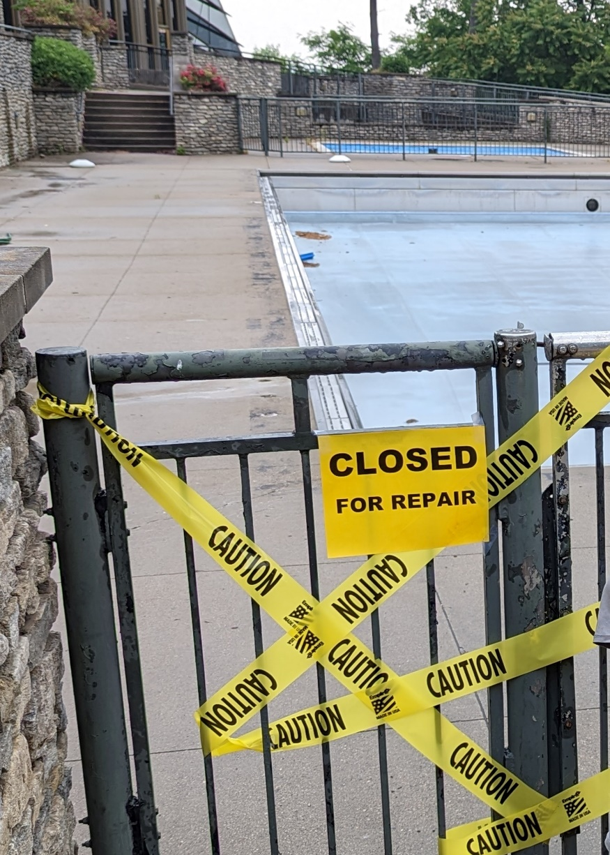
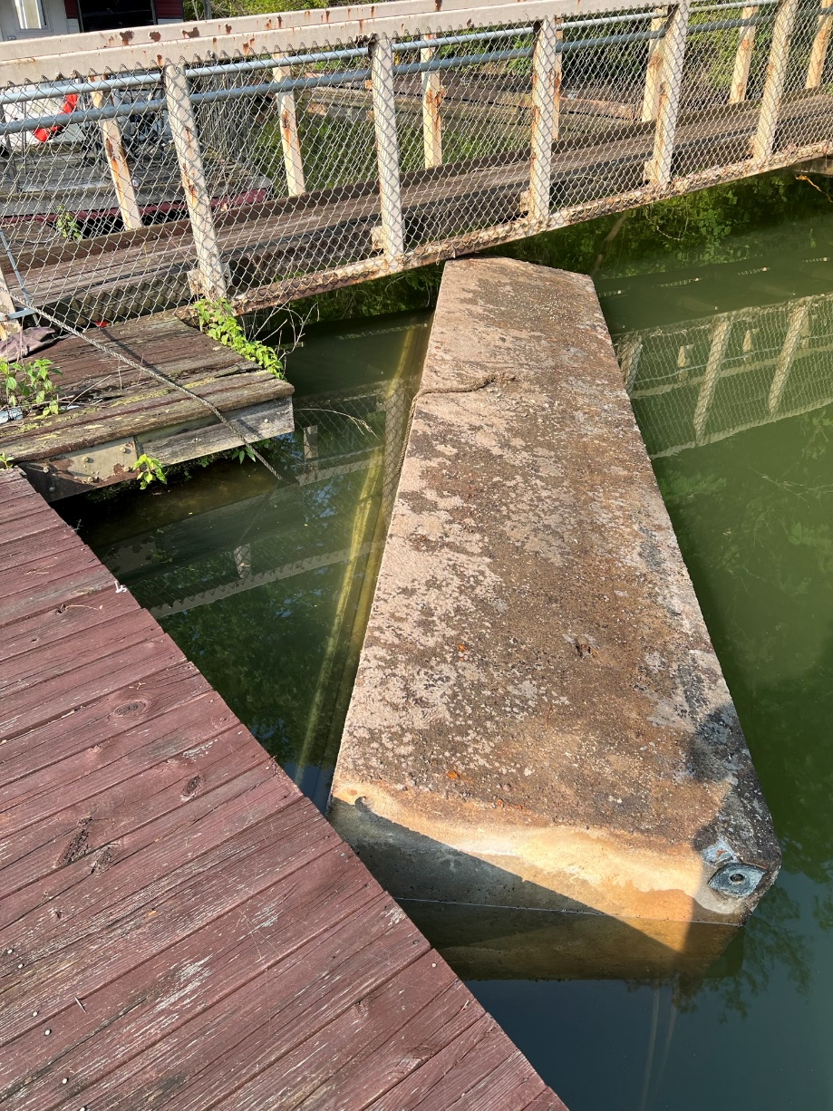
2024 - 2026 capital plans
Kentucky State Parks Continued
$3,267,000 - Statewide ADA Improvements (Phase 1)
$1,280,000 - Upgrade Recreational Building - Pool EP Tom Sawyer
$55,000,000 - Utility Infrastructure Replacement (Phase 2)
$10,000,000 - Yatesville Marina Replacement

Slide 8
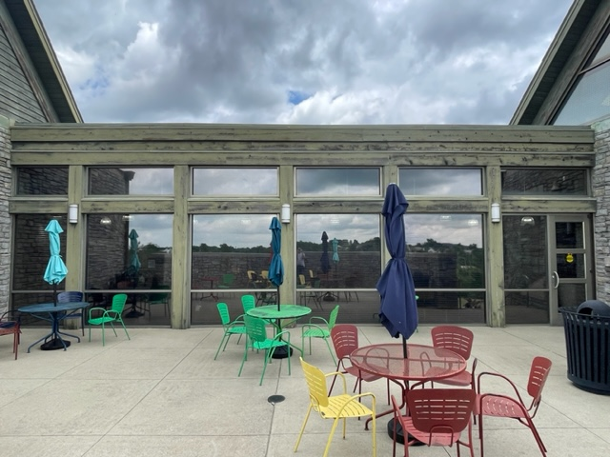
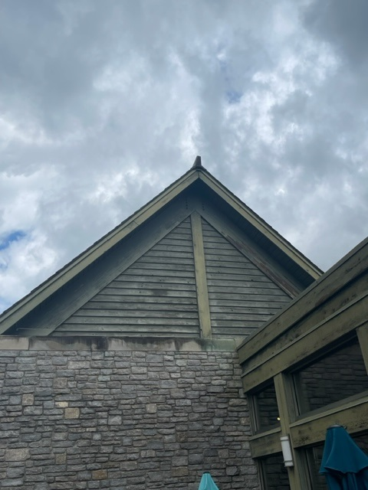
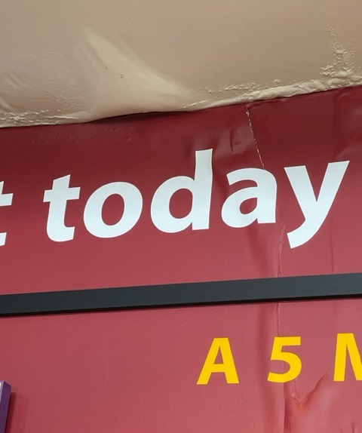
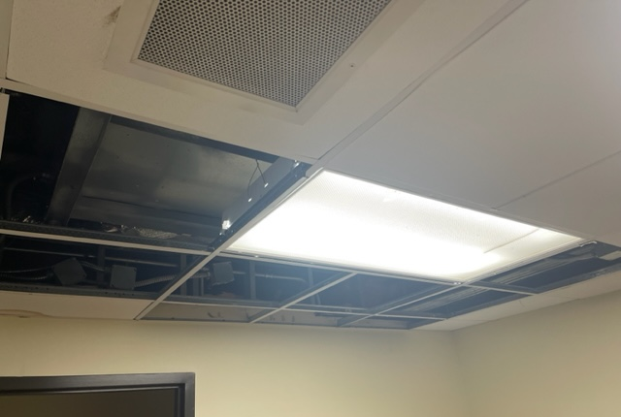
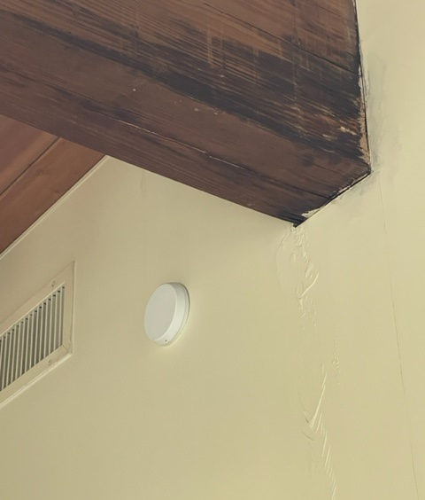
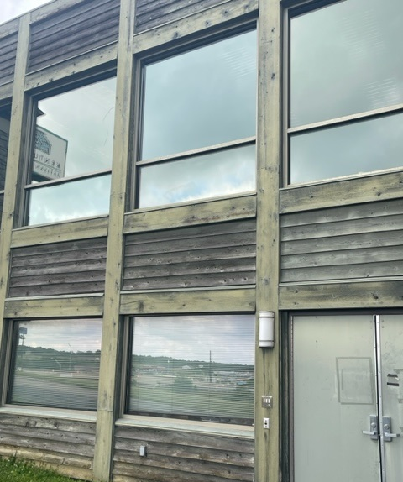
2024 - 2026 capital plans
Kentucky Artisan Center
$1,000,000 - Outdoor Needs Project 2
Outdoor stage concert venue
$1,000,000 - Equipment Project 3
Including displays, shelving, kitchen components, and outdoor equipment.

Slide 9
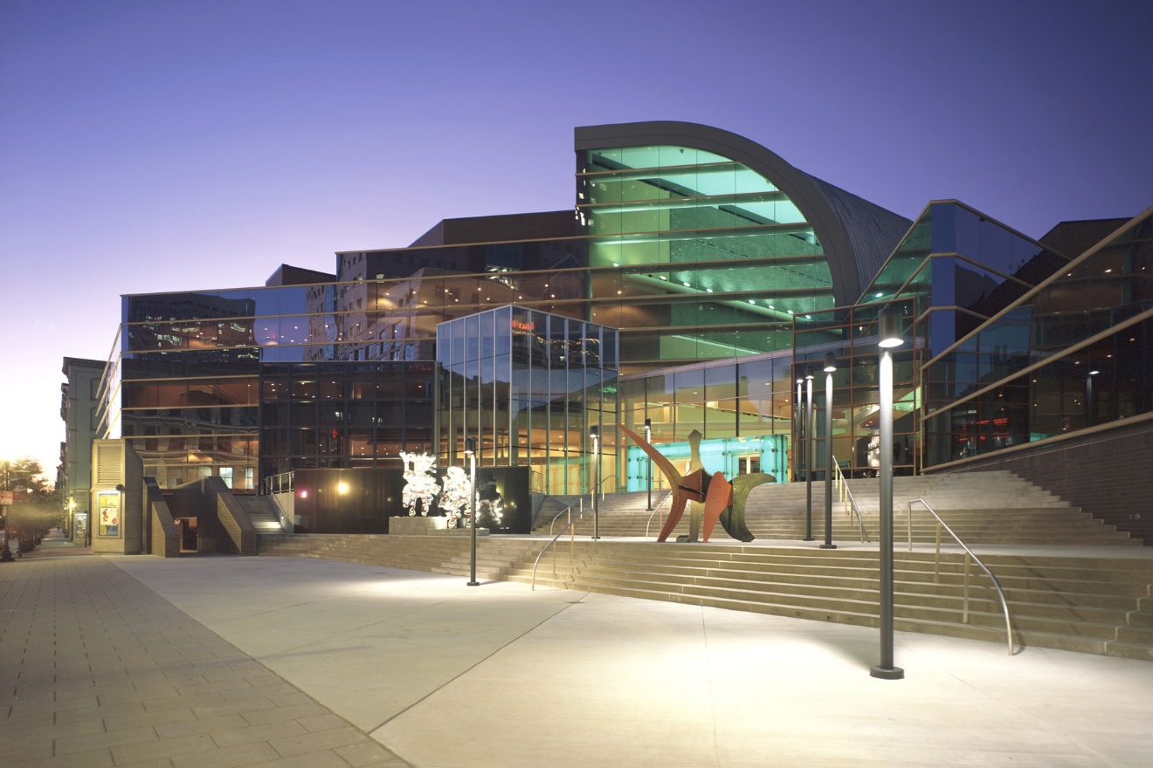
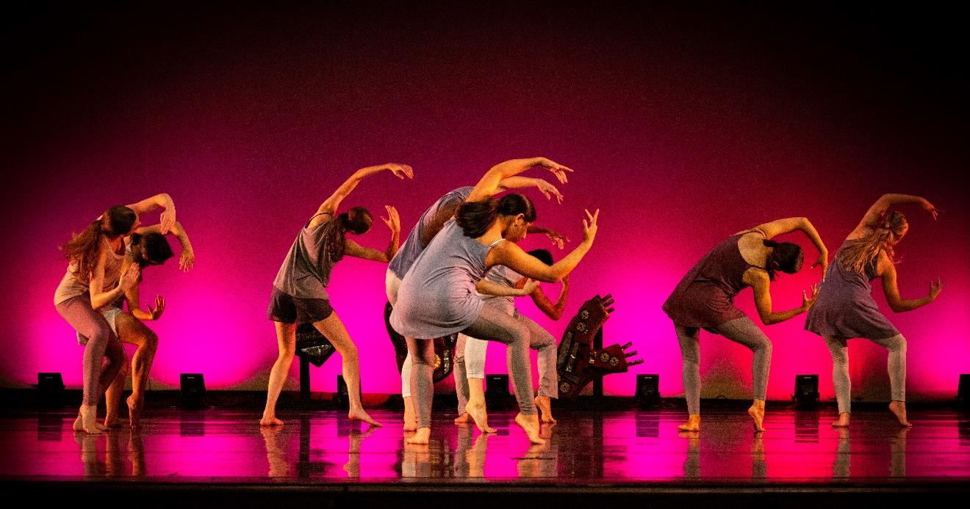
2024 - 2026 capital plans
Kentucky Performing Arts
$6,000,000 - Replace Technical Equipment Theaters/All Spaces
$1,525,000 - Building Renovation to Improve Security
$2,400,000- Renovate Client & Patron Spaces

Slide 10
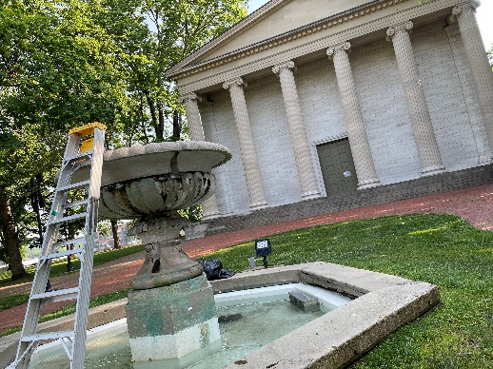
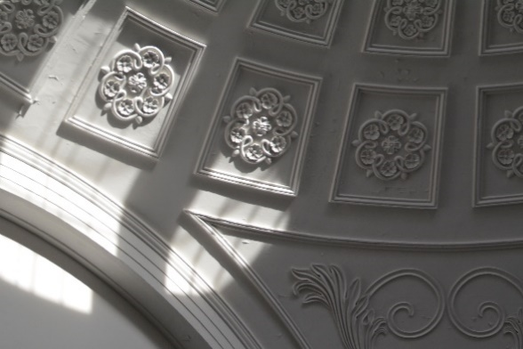
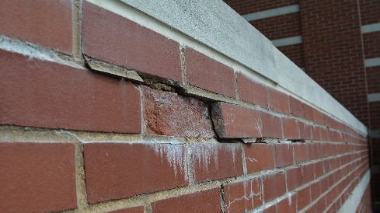
2024 - 2026 capital plans
Kentucky Historical Society
$2,354,000 - Kentucky Old State Capitol Preservation
$4,656,000 - Thomas D Clark Center for KY History Museum Renovation ($2,362,00 GF and $2,294,000 other funds)
$3,496,000 – Ctr for Ky History Visitor Center Renovation ($2,378,000 GF and $1,118,00 private funding)

Slide 11
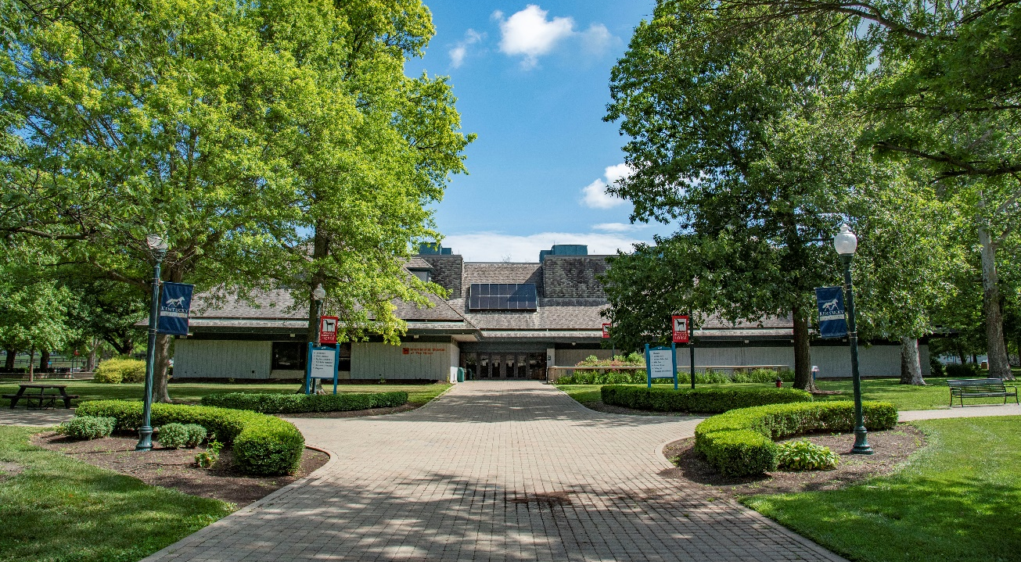
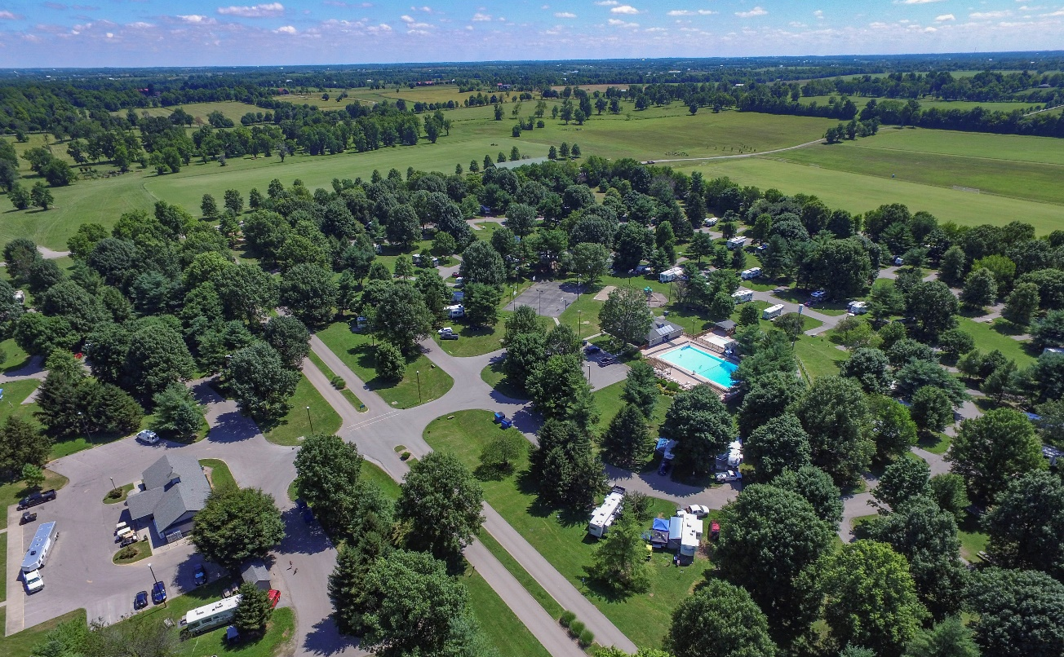
2024 - 2026 capital plans
Kentucky Horse Park
$5,000,000 - Renovate Campground Sites and Bathhouses
$1,500,000 - Covered Muck Storage
$7,000,000 - Entertainment Pavilion
$4,000,000 - Paving Roads and Parking Lots
$2,500,000 - Purchase Maintenance Equipment
$3,500,000 - Relocate Maintenance Area
$5,000,000 - Relocation of Hall of Champions
$1,500,000 - Renovate Equine Education Complex
$46,917,000 - Renovate the International Museum of the Horse
$2,500,000 - Renovate Restaurant Facility
$15,000,000 - Replace Competition Barns and Stalls
$1,500,000 - Alltech Arena Renovation

Slide 12
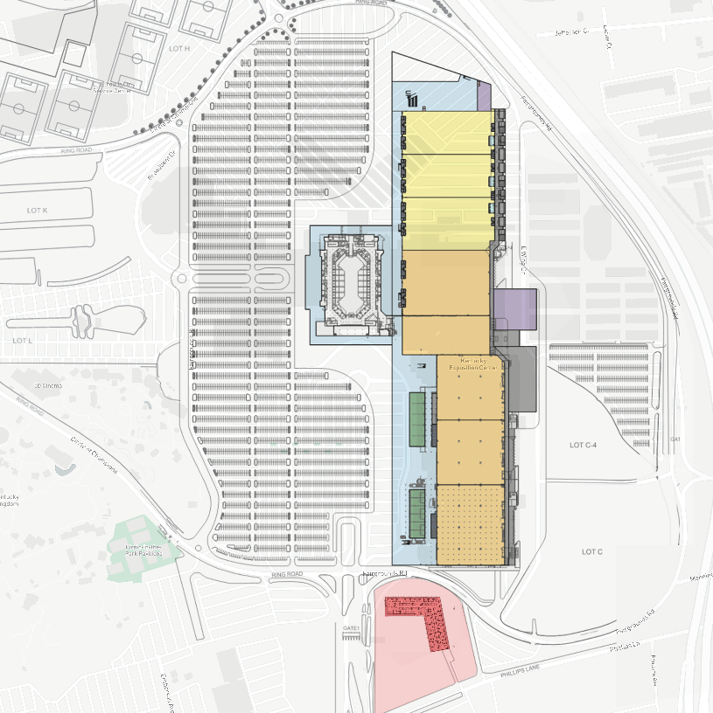
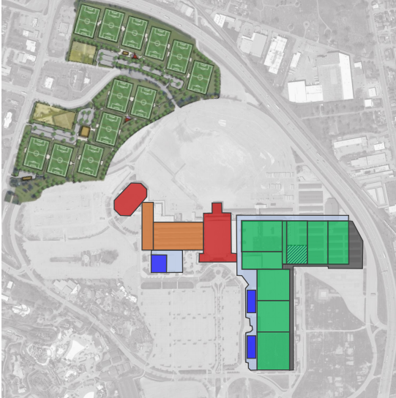
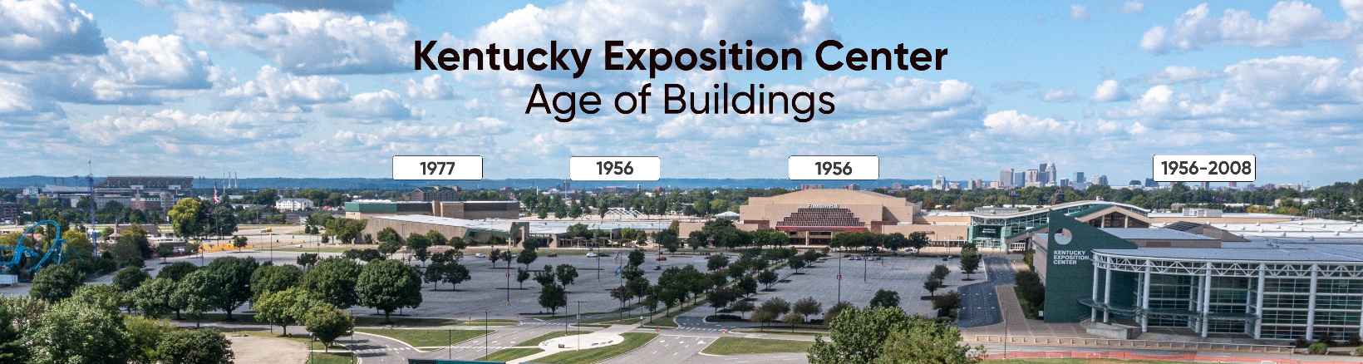
2024 - 2026 capital plans
Kentucky Venues
$212,709,000 – Kentucky Expo Center Redevelopment Plan Phase II
$30,000,000 - Backup Power Supply
$4,000,000 - Air Handling and Filtration Upgrades
$2,100,000 - IT Infrastructure Replacement
$1,000,000 - KEC Equipment, Dirt/Salt Storage Facility
$10,000,000 - KEC Paving Pool
$2,000,000 - KEC Wayfinding Digital Signage
$3,200,000 – Kentucky International Convention Center Pedway System Maintenance
$1,090,000 - Land Acquisition

Slide 13
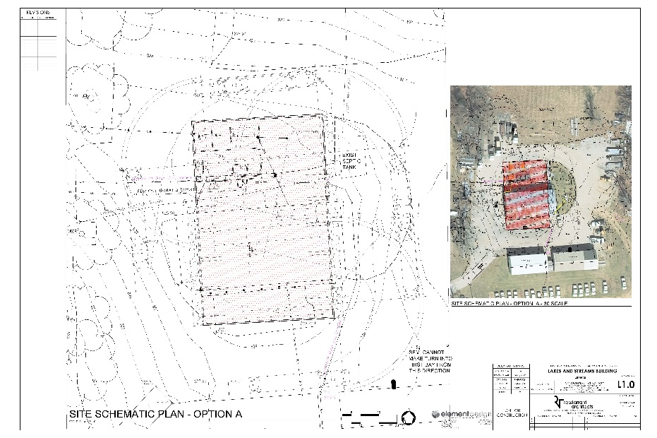
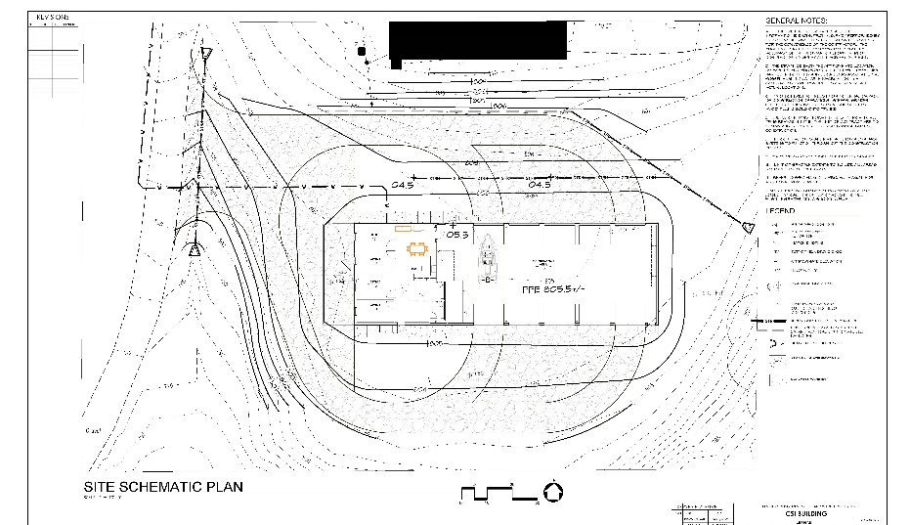
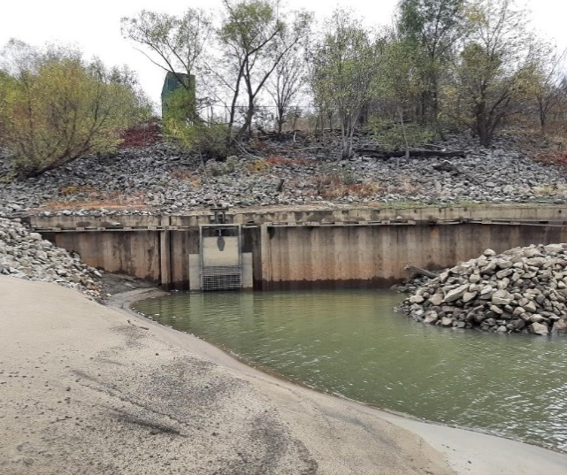
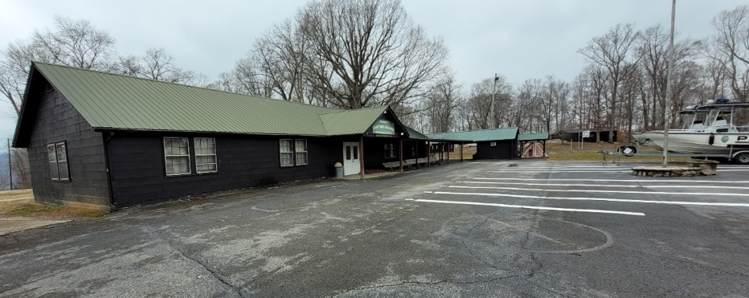
2024 - 2026 capital plans
Kentucky Fish and Wildlife
$10,000,000 - Ballard Wildlife Management Area (WMA) Big Pump
$4,500,000 - Camp Earl Wallace Dining Hall Construction
$1,602,000 - Critical Species Investigation Building
$113,100,000 - Fees-in-Lieu-of Stream Mitigation Projects Pool (2024-2026)
$6,650,000 - Ky Cumberland Forest Conservation Program/Ataya
$1,603,000 - Lakes and Streams Building
$12,000,000 - Land Acquisition Pool
$4,000,000 - Veteran’s Memorial Shooting Range

Slide 14

Questions?

