Slide 1
EASTERN KENTUCKY UNIVERSITY

Slide 2
WE ARE FOCUSED
Embrace Student Success as Our Purpose
Encourage Focused Academic Investment
Emphasize Being an Employer of Choice
Ensure Financial Strength
Enhance the Campus Beautiful
Elevate the University Brand
Energize Collaboration Across the Service Region
Enrich Strategic Partnerships

Slide 3
NEW MODEL LAB SCHOOL PHASE II - $59.1M
Current Donovan Complex
Has served K-12 programs since 1961
Determined to be functionally obsolete in 2007
New school
*Provides 1000+ PreK-12th Grade students, building on the laboratory model established in 1906
*Provides applied, real-world experiences for student teachers and aspiring educators
*Recognizes EKU's historic leadership in P12 teacher preparation
*Solidifies Model Lab's statutory role for the Commonwealth

Slide 4
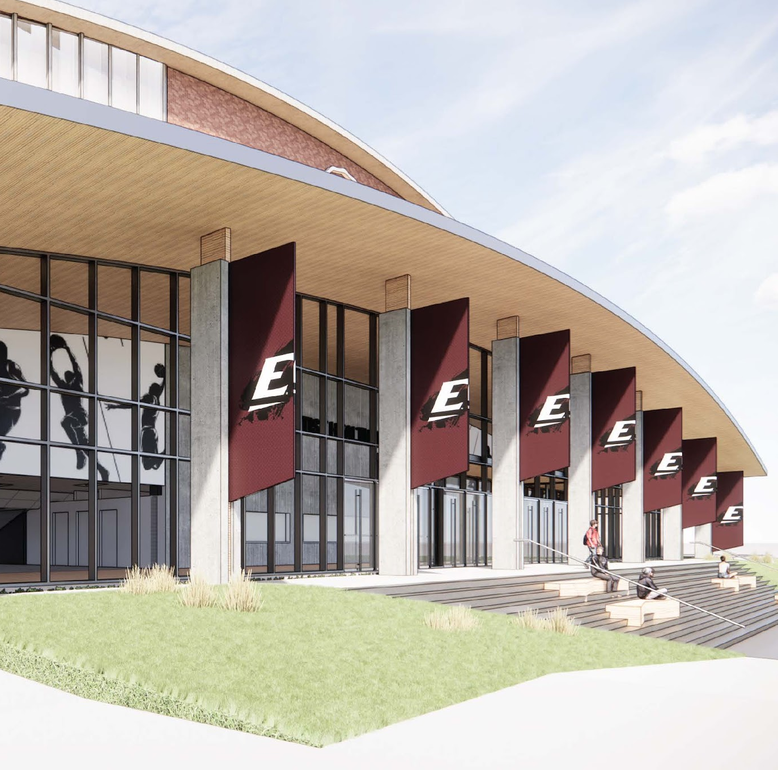
ALUMNI COLISEUM RENOVATION PHASE II - $32M
The front door to EKU
Hosts thousands of Kentuckians and EKU students a year
Athletic competitions
Graduation ceremonies
Big E Welcome
Entertainment events
Community events

Slide 5
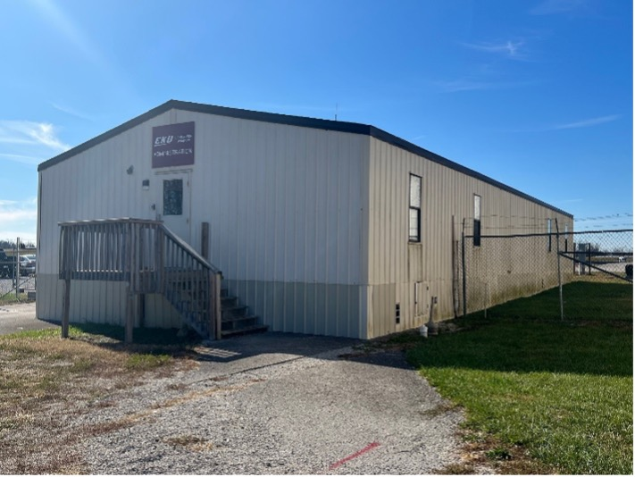
AVIATION CLASSROOM BUILDING - $25M
EKU Aviation
Kentucky’s only four-year, university-based flight program
Located at the third busiest airport in Kentucky
Enrollment has more than doubled since 2017 - expect 425 students in Fall 2023
Student flight hours have quadrupled in 10 years
High market demand for graduates
Most affordable program among competitor universities
Students come from more than 25 states
At capacity

Slide 6
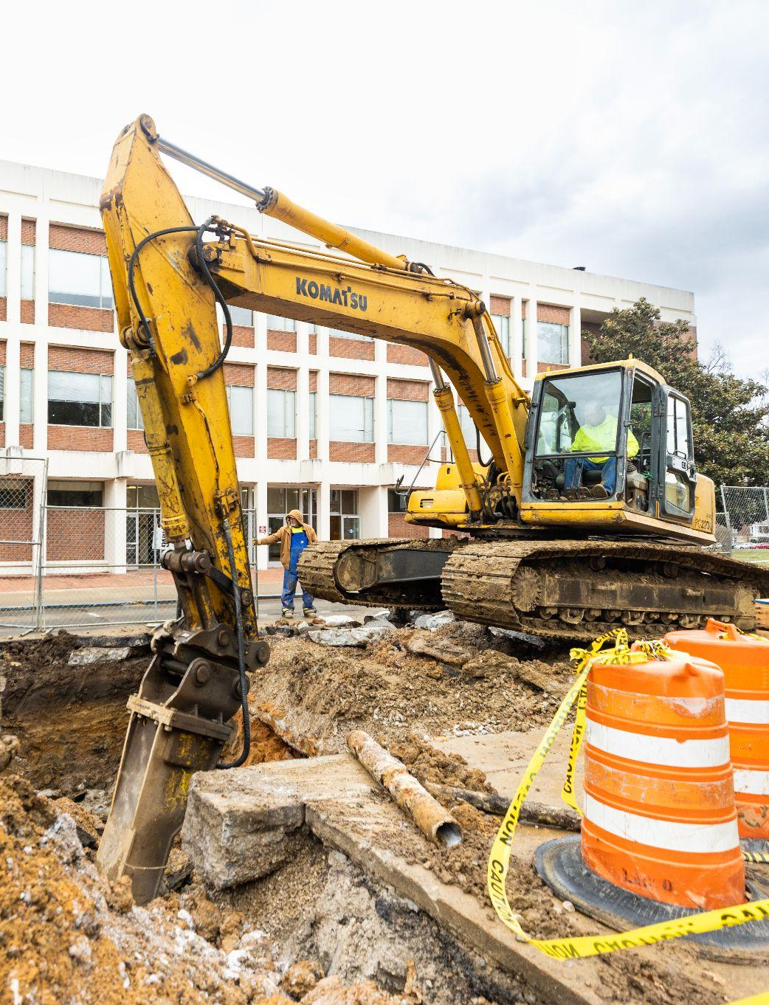
asset preservation
Total 2022 HB 1 Asset Preservation Pool for EKU: $63,028,000
$59,200,000 approved by the Board of Regents, CPE and Office of the State Budget Director
Projects underway with the remainder in reserve for potential cost fluctuations
$75M requested to assist with campus critical maintenance needs during 2024-26

Slide 7
Questions?

