Slide 1
KCTCS SIX YEAR CAPITAL PLAN
2024-2030
Presentation to the Capital Planning Advisory Board
July 20, 2023
Presenters:
Andy Casebier, Assistant Vice President, Facilities Support Services
Lincoln Farmer, Director of Major Projects
Sandy Adkins, Director of Capital Projects Budgeting
Notes:
Introductions

Slide 2
KENTUCKY’S LARGEST PROVIDER OF WORKFORCE TRAINING
State of the Art
Technical Programs
Workforce & Economic development
Companies Served (FY 23) | 1,162
Workforce Customized Training Enrollments (FY 23) | 43,505
Technical Program Credentials Awarded (2021-22 Academic Year) | 32,984
Maintaining Strong Private Sector Partnerships.
Impacting Trades-Talent Pipelines to enable quick response to growth and re-tooling.
Preparing the “ready workforce” of tomorrow making Kentucky a strong competitor.
Affecting the Quality of Life for Kentuckians, by changing lives one student... one family at a time.
KCTCS supports companies who are investing in their workforce by offsetting the cost of training for up to 75% through our state-funded TRAINS grant.
Dollars Invested (FY 23) | $6,035,970
Total Number of Projects (Growth FY 2021-23) | +121%
Repeat Companies (Growth FY 2021-23) | +179%
New Companies (Total FY 21-23) | 290 Companies
Notes:
ANDY
KCTCS is Kentucky’s primary provider of workforce education, delivering programs and services that address the full spectrum of business and industry needs and therefore providing Kentuckians the fast track to high paying, in-demand careers with state-of-the art skills.
Our state-wide system of colleges provide rapid response customized training and support for business and industry, which:
Allows KCTCS to maintain strong private sector partnerships that thrive on innovation and technology skills, we provide through our graduates.
Provide Kentucky workers with world-class portable skills that increase employability and lead to rewarding careers.
Provide the trades-talent pipeline that enables quick response to growth and retooling. We keep the Kentucky workforce job-ready.
KCTCS also offers challenging, more traditional, educational opportunities in a supportive environment practically in the student’s backyard that enables them to start their 4-year college degree that would not be possible if they couldn’t get this near home leg up.
The most important thing we do, that we believe we do very well, is affect the quality of life for Kentuckians, by changing lives one student.... One family at a time.

Slide 3
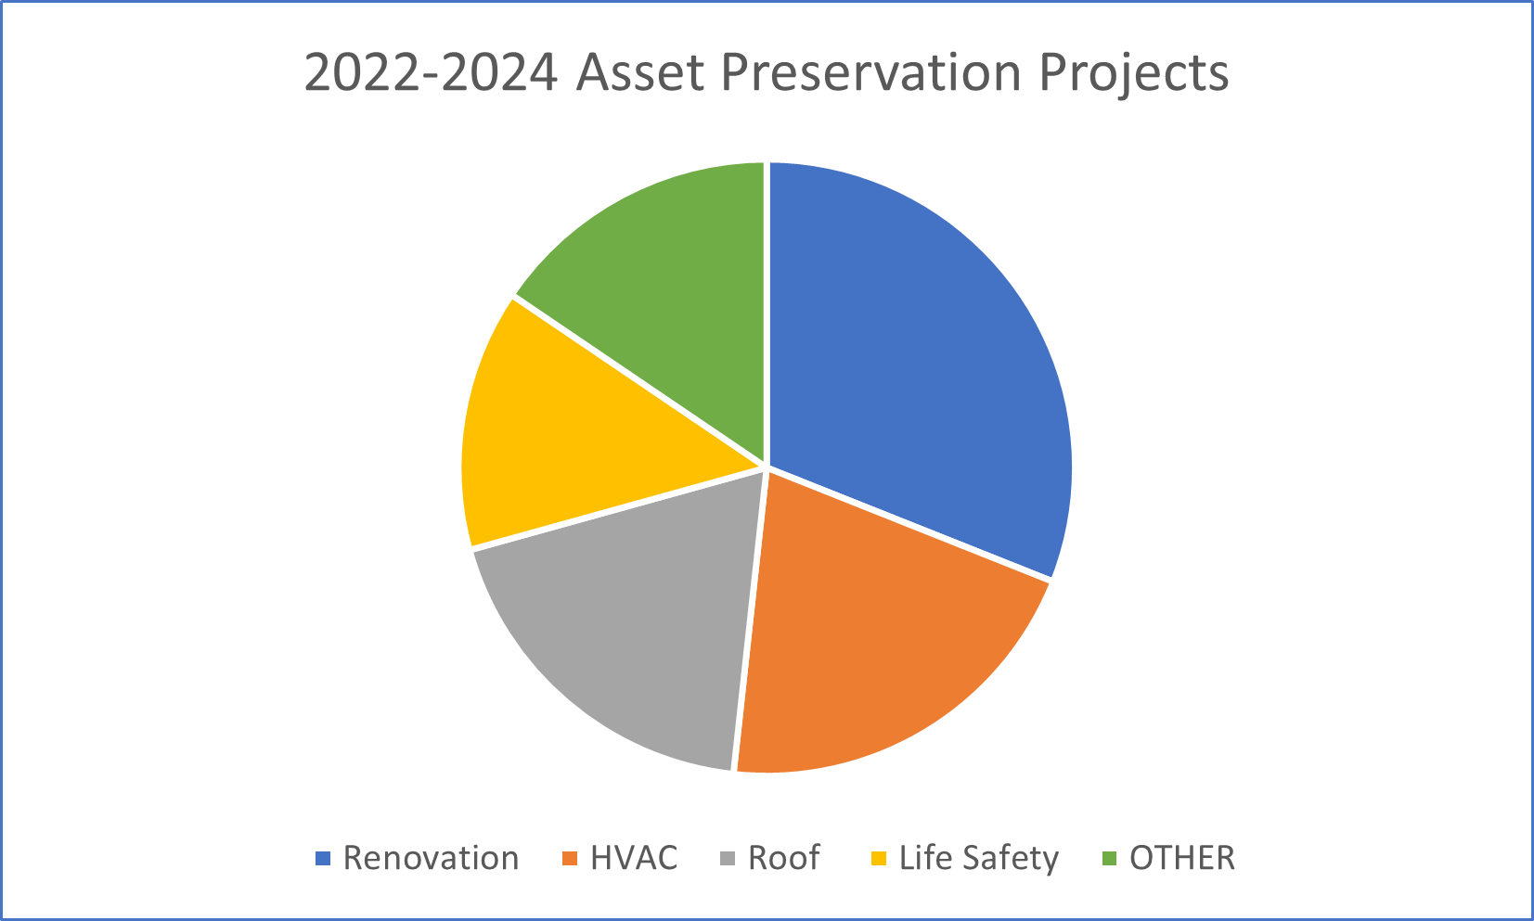
Asset preservation
With the 2022-2024 funds KCTCS will be completing 58 projects impacting all 16 of our colleges on 70 campuses throughout Kentucky.
All projects in the KCTCS 2022-2024 budget request will be completed using the AP funds received from the General Assembly.
Investment in Plant needed:
2024-2026: $359,900,000
2026-2028: $289,000,000
2028-2030: $134,800,000
16%
31%
14%
19%
21%
Notes:
ANDY
KCTCS truly appreciates the General Assembly’s generosity in providing Asset Preservation funding in the last biennium. With this much need influx of flexible funding we were able to complete 58 capital construction project impacting all our system of colleges and their community campuses.
We worked diligently to be good stewards of this funding opportunity and used the money wisely and effectively. We were able to complete all projects in the 2022-24 budget request and even took care of several other important asset preservation projects.
While this funding made historic improvements to facilities in our System, there continues to be a need for additional investments in our Plant. Currently, we have identified $784 M, that could prudently be used over the next 6-years.
Our current 6-year plan has been carefully planned and detailed to ensure that our Capital efforts result in continuing our primary responsibility of supporting the economic trajectory of our State and its citizens.

Slide 4
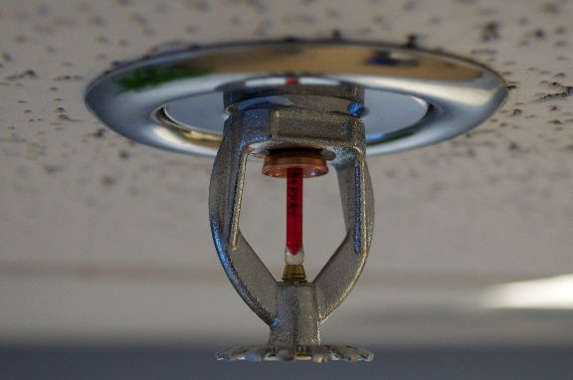
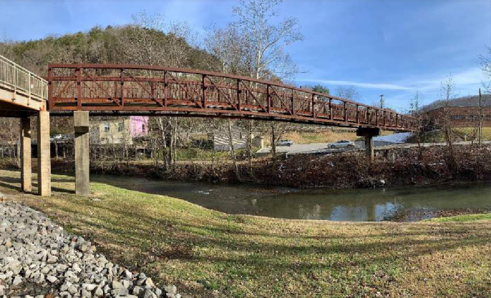
2022-2024 Life safety, Security, Maintenance & Accessibility (ADA) projects
“Safety is no accident,
the key to security is in your hands,
make education accessible to all,
and create a bridge to the future”.
KCTCS-College Deferred Maintenance Pool—$30,000,000
West KY CTC-Upgrade ADA and Life Safety—$1,500,000
Jefferson CTC-upgrade Safety and Security—$3,000,000
Big Sandy CTC-Upgrade Safety and Security—$4,500,000
Gateway CTC-Upgrade Security Technology—$2,000,000
Southeast KY CTC-Replace Whitesburg Bridge—$1,800,000
Owensboro CTC-Upgrade Infrastructure—$16,700,000
Notes:
LINCOLN
In the coming Biennium, we have identified some significant Life Safety, Security, and Accessibility projects needed at six (6) of our campuses to address critical building issues that directly affect the well-being of our students, faculty and staff.
We also have identified a number of smaller Capital projects through-out our system needed to mitigate many similar issues in other locations that will complete the work we accomplished with the Asset Preservation funding of the previous biennium. We have compiled these into a $30 M maintenance pool to provide the most flexibility to accomplish these projects in the current volatile construction markets.

Slide 5
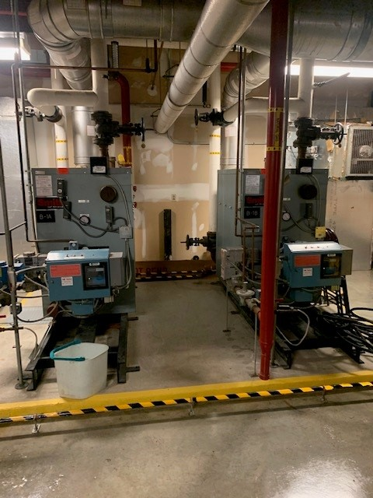
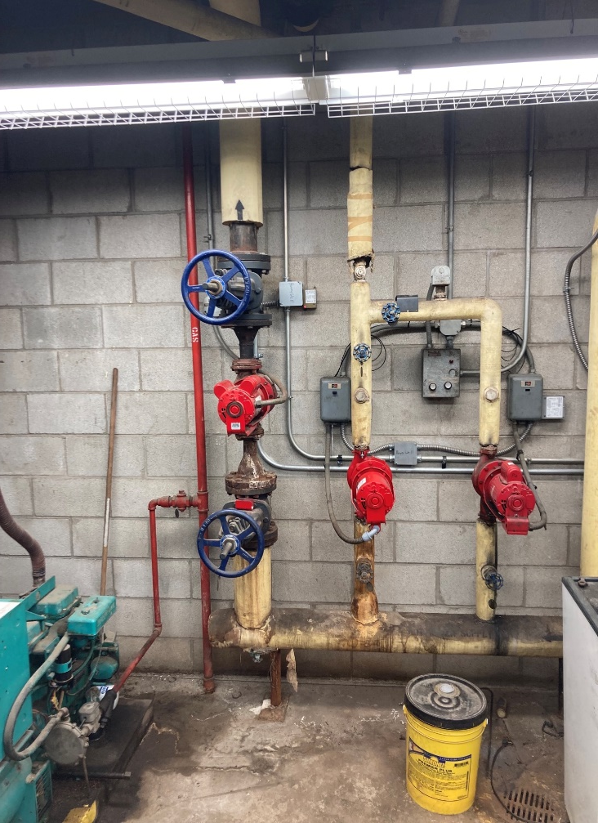
2024-2026 Mechanical SYStems upgrades
Hopkinsville CC-Replace HVAC System-Technology Center—$5,700,000
Owensboro CTC-Replace HVAC Ph. II—$5,800,000
Gateway CTC-Upgrade Mechanical Equipment Ph. II—$4,500,000
Southeast Upgrade Mech Equipment—$7,500,000
Somerset CC-Replace Somerset South Campus HVAC Ph. II—$2,700,000
Elizabethtown CTC- Upgrade/Replace Switchgear—$3,500,000
“Invest in today, save money,
Invest in conservation, save energy,
invest in education, save lifetimes”.
Notes:
ANDY
KCTCS has recently received a first-place international award from the American Society of Heating, Refrigeration and Air Conditioning Engineers (ASHRAE) for our extra-ordinary efforts in energy conservation. Rising above other public and private sector facilities managers (such as Apple Computers, Microsoft, Disney, and large Post-Secondary Universities).
These efforts have resulted in over $90 million savings in utilities cost over the past 15 years.
In an on-going effort to continue the Capital investment necessary to experience even more energy conservation and cost reductions, the first Biennium of our plan includes Six (6) projects to upgrade mechanical and electrical systems, affecting more than 24 buildings.
Not only is energy conservation good for our planet, the cost reductions contribute to KCTCS being able to make better investments in educational opportunities while also keeping tuition affordable to our students.

Slide 6
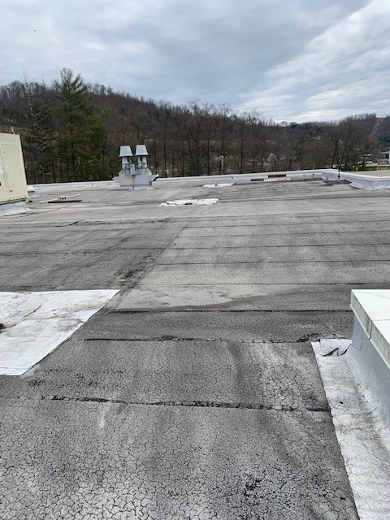
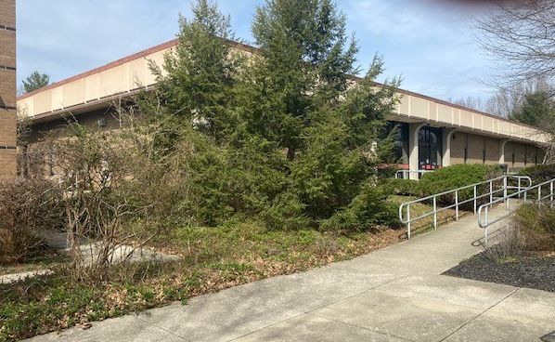
2024-2026 Roof replacements & site Improvements
Madisonville CC-Replace Roofs (3)—$2,200,000
Hazard CTC-Replace and Repair Roofs(5)—$5,700,000
Big Sandy CTC-Replace Roofs (3)—$2,500,000
3 additional roofing systems being addressed in renovation projects
Ashland CTC-Upgrade Entrance Ways—$4,000,000
Somerset CC-Upgrade Somerset North Campus—$3,000,000
Somerset CC-Exterior Upgrades Somerset South Campus—$3,000,000
Ashland CTC-Upgrade Technology Drive Parking Lot and Security—$1,500,00
Maysville CTC-Campus Enhancements and Road Completion—$3,500,000
Elizabethtown CTC-Campus Site Enhancements—$3,400,000
“The “sky is the limit”,
when there is a healthy roof over your classroom”.
Notes:
LINCOLN
The KCTCS 6-year plan includes in the first biennium, roof system replacements for fourteen (14) buildings on 6 campuses.
Having a healthy roof system on a building is a keystone to preserving the physical asset, maintaining an environment conducive to learning for our students, and ensuring the building indoor air quality is not affected by unwanted mold and moisture.
The first biennium also includes significant site improvements at 6 campuses. These improvements are related to security, accessibility, convenient parking, traffic flow and other conditions that have been identified in master planning that will enhance the student experience on these campuses.

Slide 7
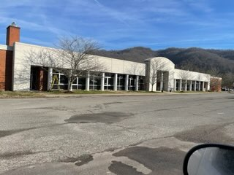
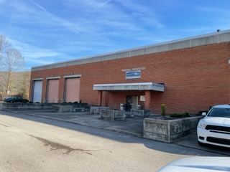
2022-2024 Renovation projects
Big Sandy CTC-Renovate Mayo Campus—$4,100,000
Maysville CTC-Renovate or Replace Administration Building—$28,200,000
Henderson CC-Renovate Harford Library—$10,500,000
Southeast KY CTC-Renovate Harlan Campus—$7,800,000
Bluegrass CTC-Renovate Building A—$18,900,000
Bluegrass CTC-Renovate Building N—$5,700,000
Big Sandy CTC-Renovate Johnson Bldg—$10,800,000
Bluegrass CTC-Renovate Lawrenceburg Campus—$9,800,000
West KY CTC-Renovate Haws Gym—$2,000,000
Henderson CC-Renovate Classrooms-Campuswide—$3,500,000
Hazard CTC-Renovate First Federal Center—$5,700,000
Somerset CC-Renovate Stoner Hall Theatre—$2,300,000
Ashland CTC-Relocate and Expand Cosmetology Program—$5,900,000
“A building is more than the sum of its parts. It’s the environment in which we live, work, learn, connect and dream. How we maintain the building speaks loudly about how we value the future”.
Notes:
ANDY
With over 300 buildings in the KCTCS System, protecting the capital investment and ensuring the facility provides the infrastructure necessary for the wide variety of educational opportunities we provide, each Biennium plan needs to include a number of renovations and upgrades to buildings.
This KCTCS first biennium of the current plant includes thirteen (13) significant renovations.
The KCTCS philosophy for building renovations is that we are very much reactive to changes in local economic opportunities, business and industry projected needs and the student experience that promotes learning and well-being. We also address building code compliance, energy conservation, accessibility, and other key factors in every renovation.
Every renovation project in our 6-year plan are selected because we anticipate they will have a significant impact on the economic development opportunities in the area of the state where the renovation is located.

Slide 8
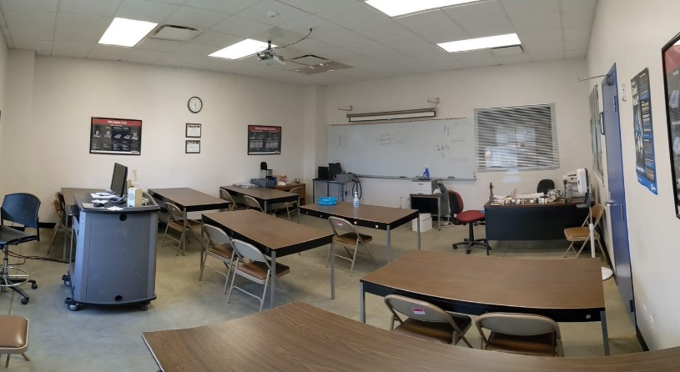
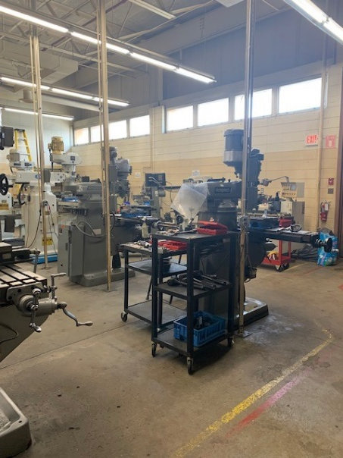
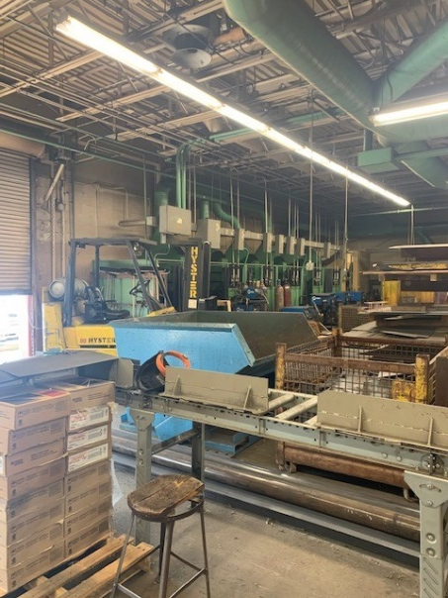
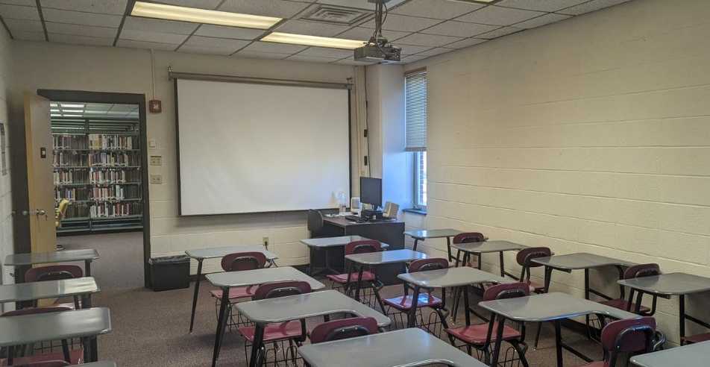
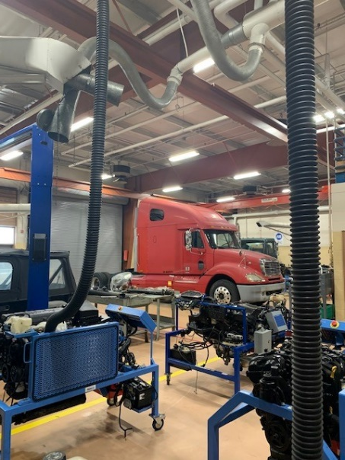
2022-2024 CONTINUATION PROJECTS
Elizabethtown CTC-Renovate Occupational Tech Bldg. Ph. II—$44,000,000
Jefferson CTC-Replace Hartford Hall Ph. II-$35,700,000
Hazard CTC-Renovate Jolly Classroom Center Ph. II-$8,200,000
Somerset CC-Renovate or Replace Laurel South Campus Ph. II-$30,000,000
Gateway CTC-Renovate Edgewood Campus Ph. II—$8,100,000
“Once started strong, it is important to invest to the end, so that the original ‘good Idea’ becomes the dream fields of tomorrow”.
Notes:
LINCOLN
We have five (5) projects in the first biennium of this plan that are continuations of projects started in the previous budget cycle.
Each of these projects were found necessary by the General Assembly previously, but were too large for KCTCS to be able to complete the entire scope of work in one project while also continuing to use the buildings for their current educational purposes.
The costs necessary to complete the projects in the second phases are higher than originally expected due to the current inflationary impacts of the construction markets. It is anticipated that these market trends will continue for some time to come. While some supply sectors have eased, others continue at escalated levels with long lead times, maintaining the volatility we have experienced over the past two-three years.
However, the continuation of the projects are vital to the perpetuation of the KCTCS mission to educate Kentucky’s workforce of tomorrow. An example of this is the OTB Building renovation at the Elizabethtown CTC. The economic climate along the I-65 corridor of the state (along which this college is situated) is accelerating at tremendous rates due to the BOSK Battery Park in Glendale. ECTC is working to respond to growing technological needs of business, industry, and populations moving into the area.

Slide 9
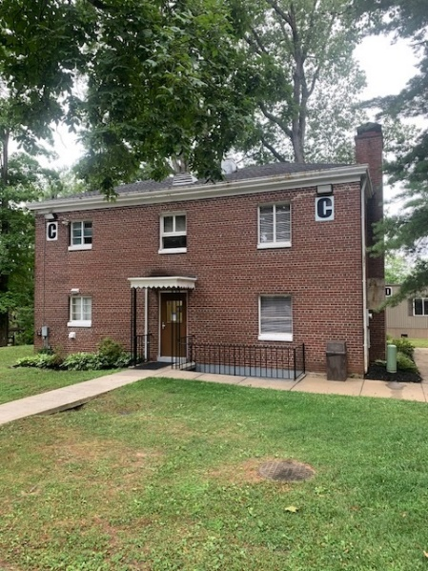
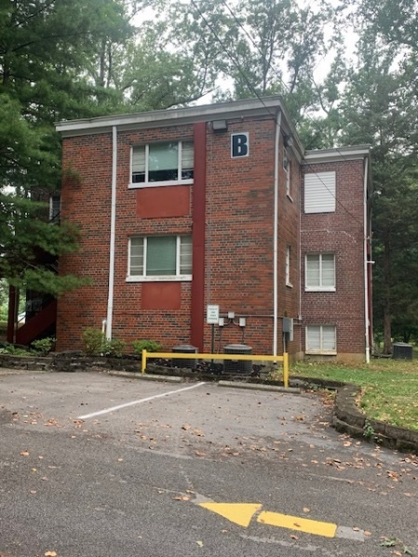
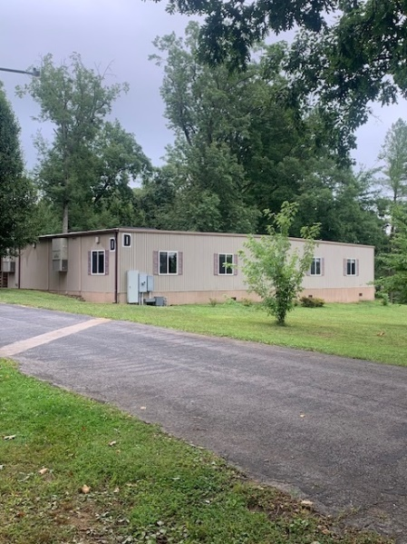
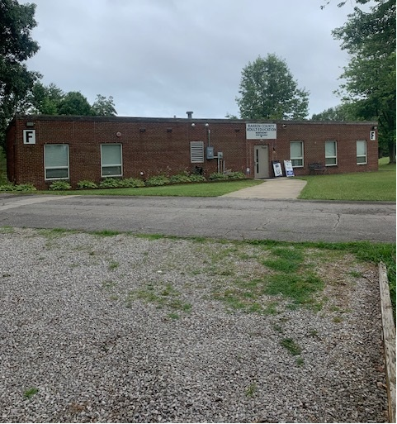
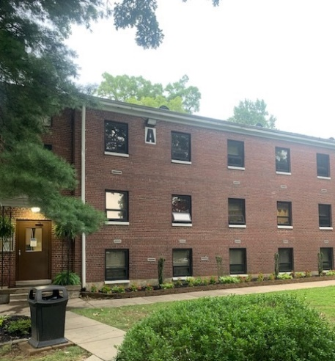
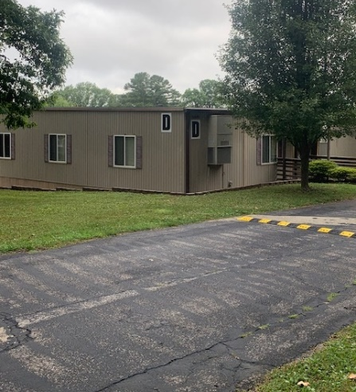
2022-2024 Projects Specifically reacting to economic development initiatives
“We do not seek fulfilment for ourselves but are focused on the progress and prosperity of our community. Our ambitions must be broad enough to include the aspirations and needs of others, for their sakes and for our own”.
Southcentral KY CTC-Replace Glasgow Campus Ph. I—$27,800,000
Southcentral KY CTC-Expand Transpark Campus—$25,000,000
Madisonville CC-Construct Muhlenberg Campus Ph. II—$26,600,000
Madisonville CC-Purchase Aviation Equipment—$3,600,000
Elizabethtown CTC-Construct Engineering Building—$55,000,000
Gateway CTC-Expand CDL Program—$5,600,000
Bluegrass CTC-Construct Equine Training Program Facility—$11,100,000
Hopkinsville CC-Construct Diesel Technology/CDL Training Building—$3,800,000
Notes:
ANDY
Our plan also include eight (8) significant projects which each are responding to a critical and immediate need to provide the workforce necessary to meet the needs of the tremendous economic development initiatives that Kentucky has been fortunate in earning.
Many parts of our state are on the move economically. New business, industry and population pressures have created significant opportunities for KCTCS to rise to meet the challenges that Kentucky’s Primary Workforce Education Provider needs to greet head-on.
A prime example is in Glasgow: Our South Central Kentucky College has provided nursing education on a Glasgow campus for decades. While the current campus, with it’s portable building and several old TB Hospital Buildings worked fine to educate the nursing students necessary to meet the needs of the past, now with EV Battery Plants in Glendale and Bowling Green, the population is anticipated to expand to new levels and KCTCS needs to expand our nursing programs exponentially to meet the needs.
This requires an expanded modernized facility on a new campus. This facility needs to quickly ready the healthcare workforce of the near future. The other projects on this list have similar stories.

Slide 10
Questions?
Notes:
ANDY
We appreciate your considering our plan.
We anticipate that you can see that we have looked toward the bright future of Kentucky and have planned well to be positioned to meet the challenges that our students and private sector partners need us to overcome for them.
We need your help and support to make lifetimes Kentuckians deserve.
We will be happy to address any questions you might have.

