Slide 1
2024-2030
Six Year Capital Plan

Slide 2
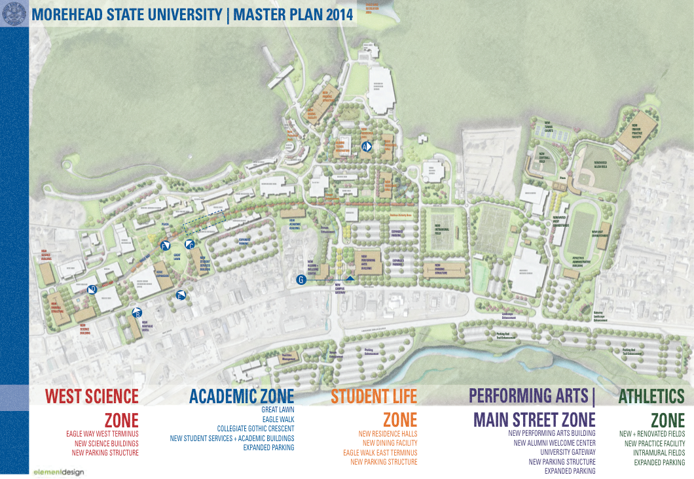
Overview Campus Master Plan – Updated 2019
Goal –
Reduce building footprint & operational costs
Enhance existing campus facilities
Better utilize existing facilities
Replace outdated classroom facilities

Slide 3
Overview Campus Master Plan – Updated 2019
Since 2017 -
Razed/Disposed 13 buildings = 140,000 sq. ft.+
Reduced Operational Cost
Disposed of 150 acres
Sales Used to Reduce Debt

Slide 4
Overview Campus Master Plan – Updated 2019
Future -
30 General Fund Project Requests are for
the preservation of existing facilities
2 General Fund Project Requests are new construction to replace older facilities

Slide 5
#1 Project Request Construct New Multi-disciplinary Classroom Building
Construct new 120,000 sq. ft energy efficient classroom facility
Will include state of the art instructional technologies
Will serve all academic areas on campus except science & engineering
To be constructed on property currently owned by MoSU
To be served by existing utility infrastructure
Multiple existing buildings will be taken off-line once completed
General Fund Request- $90,000,000

Slide 6
#1 Project Request Construct New Multi-disciplinary Classroom Building
MoSU Classroom Facilities – Old & Outdated
1920-1930 2 buildings 87,130 sq. ft.
1930-1940 1 building 101,343 sq. ft.
1950-1960 1 building 63,375 sq. ft.
1960-1970 4 buildings 288,844 sq. ft.
1970-1980 1 building 97,981 sq. ft.
2000-2010 1 building 48,452 sq. ft.
Note: does not include Lappin Science Building (1937) or Camden – Carroll Library (1930)

Slide 7
#1 Project Request Construct New Multi-disciplinary Classroom Building
MoSU Classroom Facilities – Old & Outdated
Average age of classroom facilities 65 years old
Oldest classroom facility (Rader Hall) 98 years old
Newest classroom facility (Space Science) 15 years old
Accessibility challenges
Technology challenges
Mechanical/Electrical/Plumbing system challenges
Note: does not include Lappin Science Building (1937) or Camden – Carroll Library (1930)

Slide 8
Existing MoSU Classroom Facilities

Slide 9
Existing MoSU Classroom Facilities

Slide 10
Existing MoSU Classroom Facilities

Slide 11
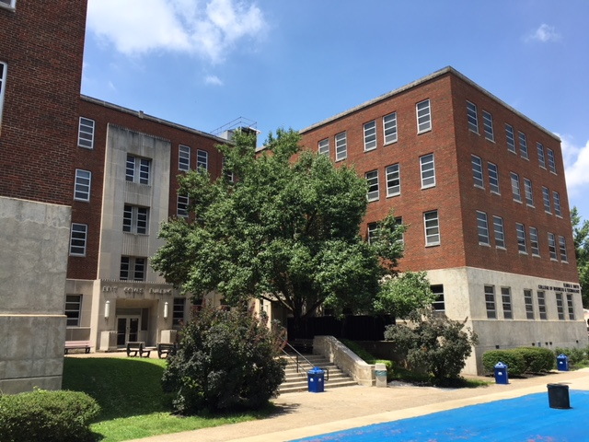
#2 Project Request
Renovate - Bert T. Combs Building
87,480 sq. ft.
Upgrades Needed:
Interiors
Classrooms
Technology
HVAC System
Piping/Plumbing
Electrical System
Elevator Replacement
Roof Replacement
Security
Interior Signage
General Fund Request- $40,867,000

Slide 12
#3 Project Request Construct New Business Classroom Building
If this project is funded, the #2 request – Renovate Bert T. Combs will be eliminated
Construct new 65,000 sq. ft energy efficient classroom facility
Will include state of the art business instructional technologies
Will serve the academic business program
To be constructed on property currently owned by MoSU
To be served by existing utility infrastructure
Combs Building will be taken off-line once completed
General Fund Request- $49,500,000

Slide 13
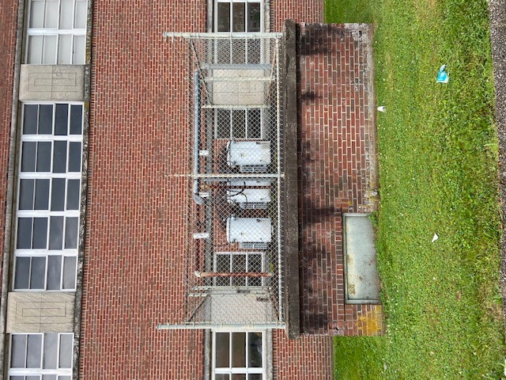
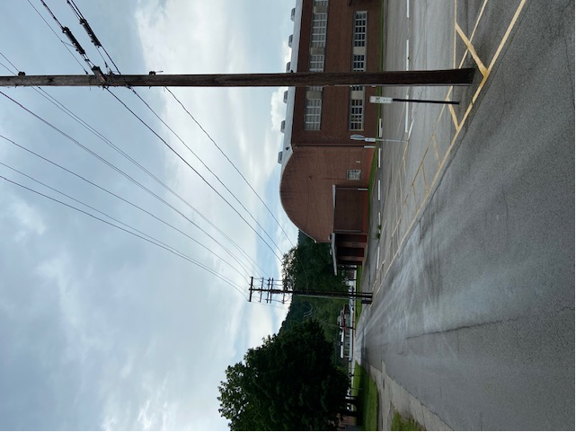
#4 Project Request
Replace Electrical Switchgear B
The B circuit & switchgear feeds the residence halls. There have been multiple power outages related to this electrical system
General Fund - $6,000,000

Slide 14
Questions?

