Slide 1
Capital Planning Advisory Board
July 20, 2023

Slide 2
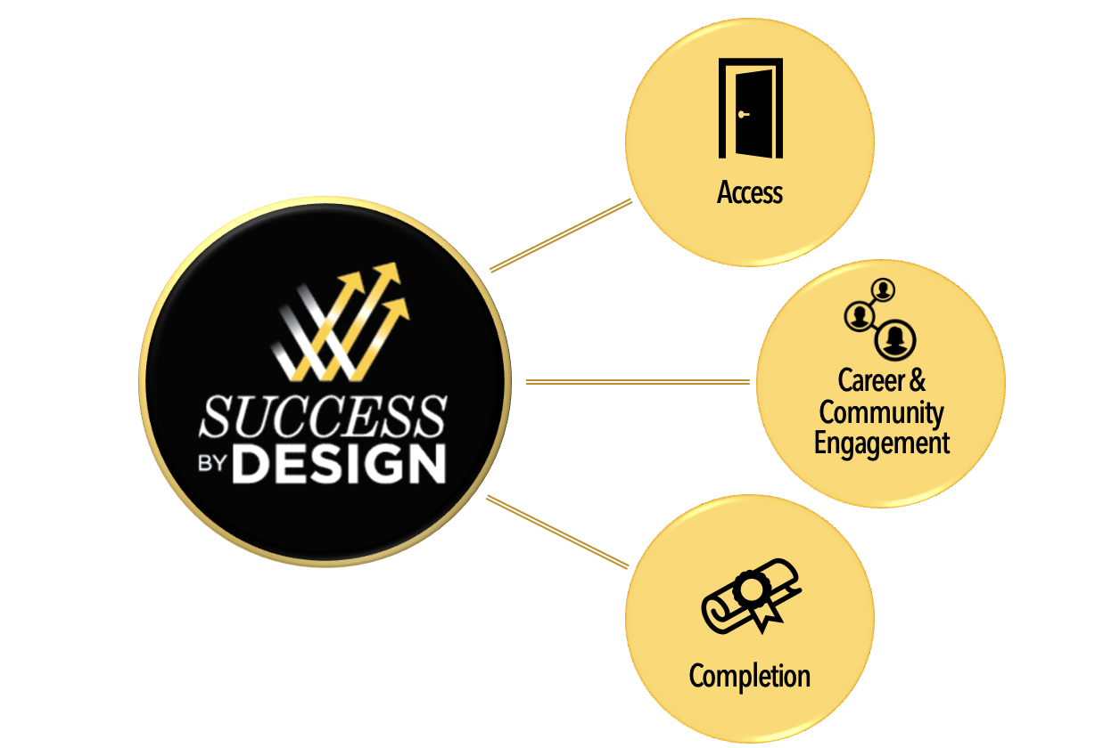
SUCCESS
BY
DESIGN

Slide 3
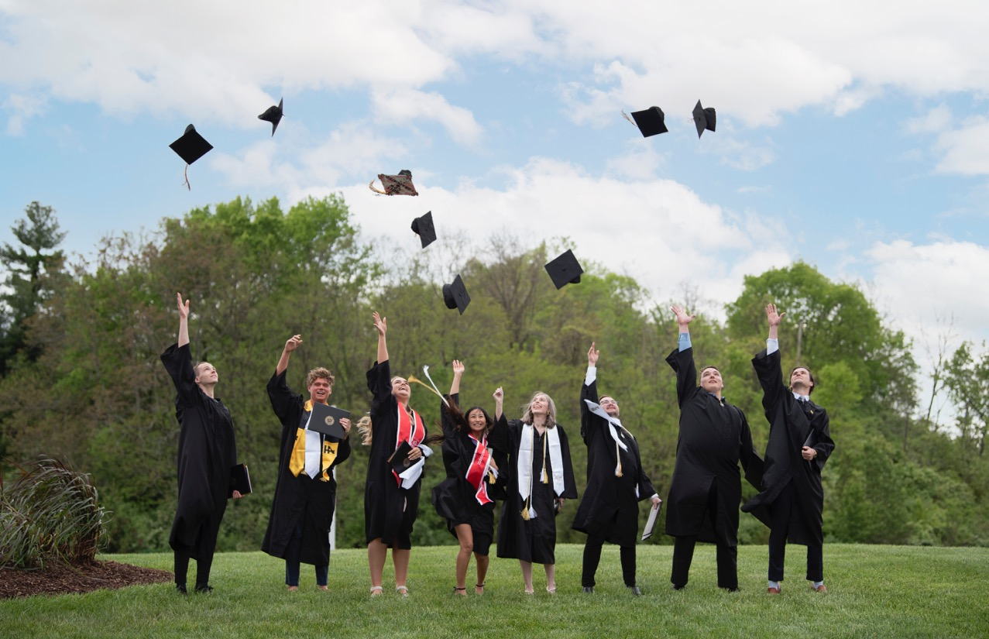
REGIONAL LEADERS
77,000 Alumni
82 Percent Stay in our Region
1,900 Graduates May 2023
15,827 Students
46% of Students Arrive at NKU with some College Credit

Slide 4
World’s Universities with Real Impact – Top 100 Most Innovative Universities in the World (No. 78)
  NKU also ranked No. 17 globally in category of Entrepreneurial Spirit
  Only Greater Cincinnati or Commonwealth of Kentucky university included in rankings
NKU Retention Rate:
  77.5% (an increase of 9 percentage points since 2018)
NKU Graduation Rate:
  51.7% (an increase of 8 percentage points since 2018)
HIGH RANKINGS
Impact
Economic Mobility
ROI

Slide 5
Master Plan Update
Increase Science Labs and Opportunities for STEM Careers
Repurpose Legacy Buildings for New Ways of Learning
Create an Academic Commons in Steely Library
Increase Opportunities for Student Engagement
Eliminate Capital Renewal Issues

Slide 6
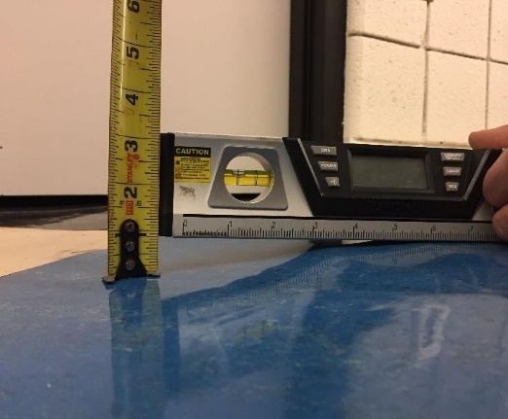
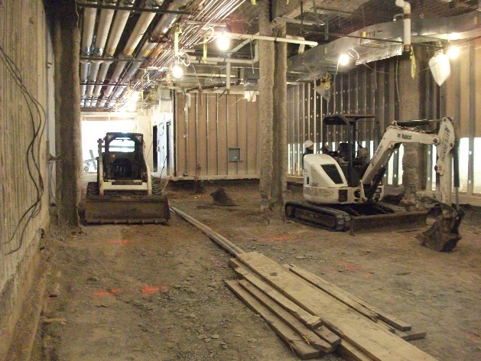
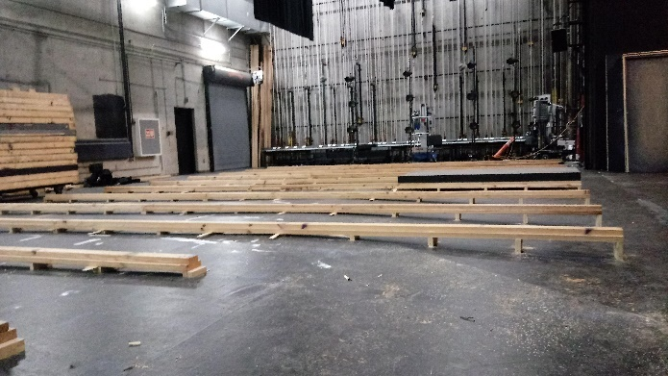
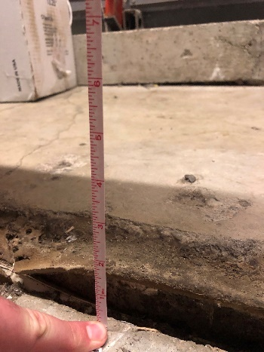
2022-2024 Asset Preservation Funds Overview
$46.8M in State Bonds Matched with $7M NKU Funds = $53.8M AP Funds
$23.6M dedicated to floor heaving repairs, HVAC and other upgrades in Nunn Hall & Fine Arts
  Nunn and Fine Arts are 50+ years old and in need of significant renewal
  Replacement of floors heaved 2-7 inches due to underground expansive shale
Other funds are dedicated to Campus-Wide Maintenance Needs

Slide 7
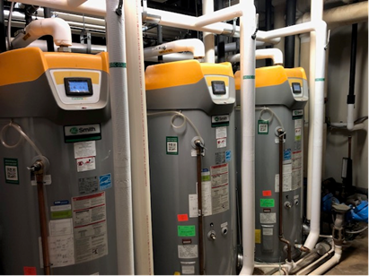
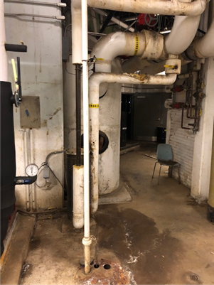
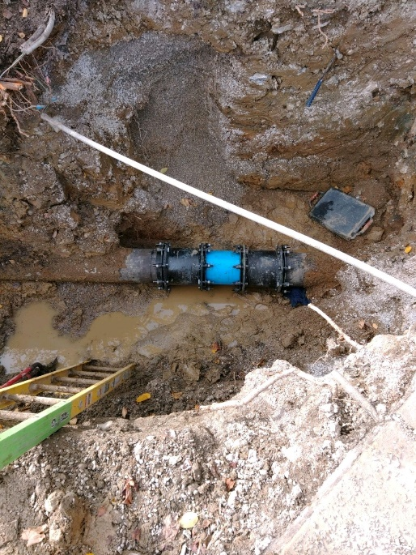
INFRASTRUCTURE
Replacement of steel gas lines with non-corrosive plastic, installation of new underground water valves, various sewer line repairs, replacement of aging switchgear and generators, and various critical upgrades to the steam and chilled water systems
Gas, Sewer and Water Line Repairs
New Switchgear and Generators
Work in the Steam and Chilled Water Plant

Slide 8
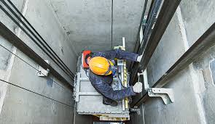
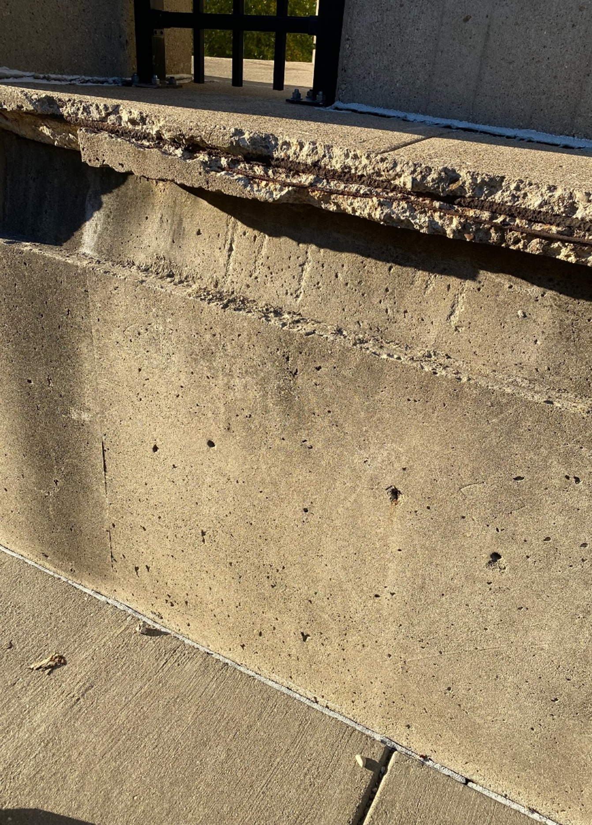
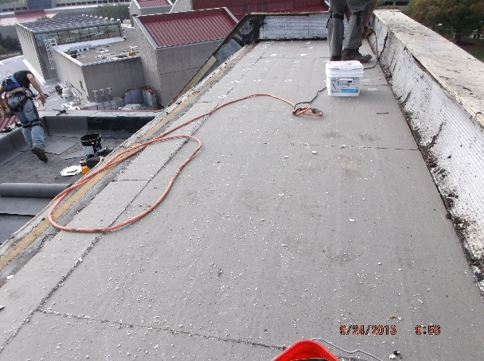
Building Systems
Several roofs are being restored, a more economical alternative compared to replacement.
Elevators are being modernized in Fine Arts and Steely Library, and three buildings are receiving new fire alarm systems
Roofs
Elevators
Fire Alarms Systems
Façade Repairs

Slide 9
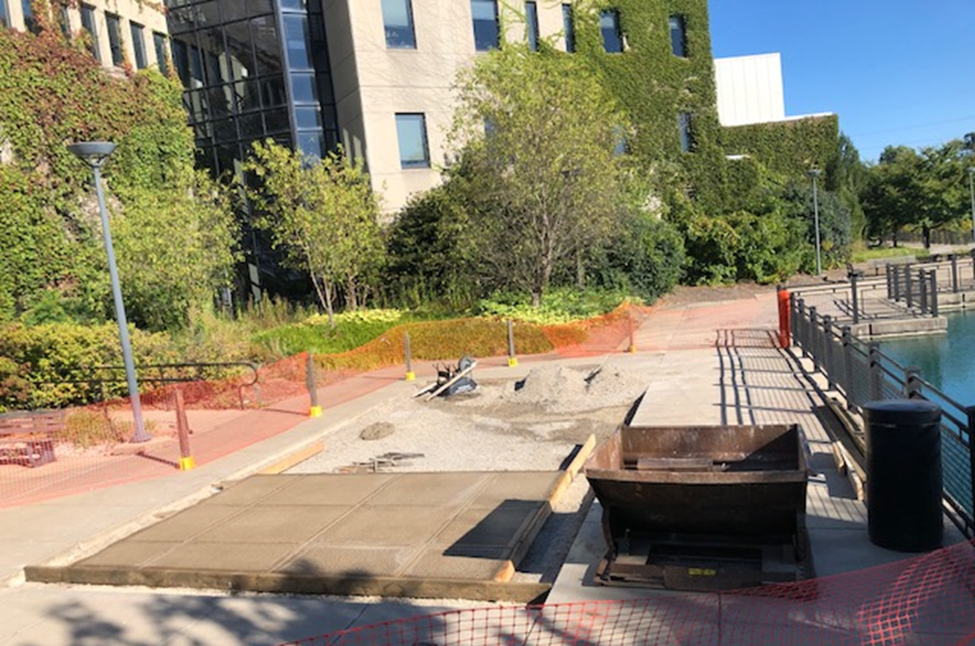
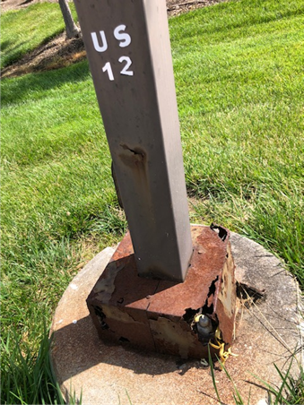
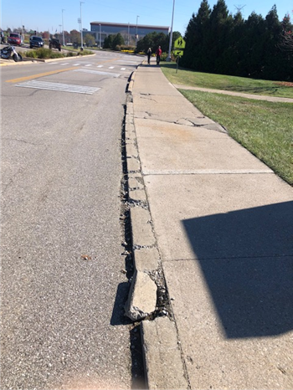
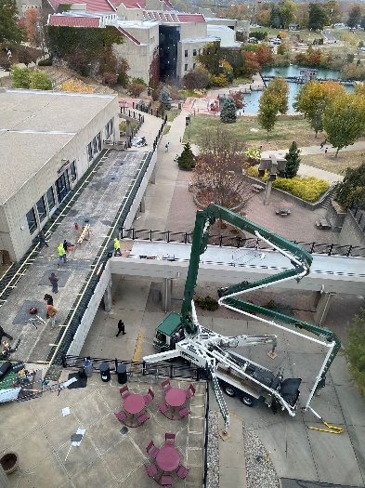
CAMPUS GROUNDS
Nearly $2M will be spent replacing deteriorated concrete, replacing light poles and bollards and repaving campus roads.
These improvements ensure a safe campus.
Concrete Repairs
Lighting Replacement
Road Paving

Slide 10
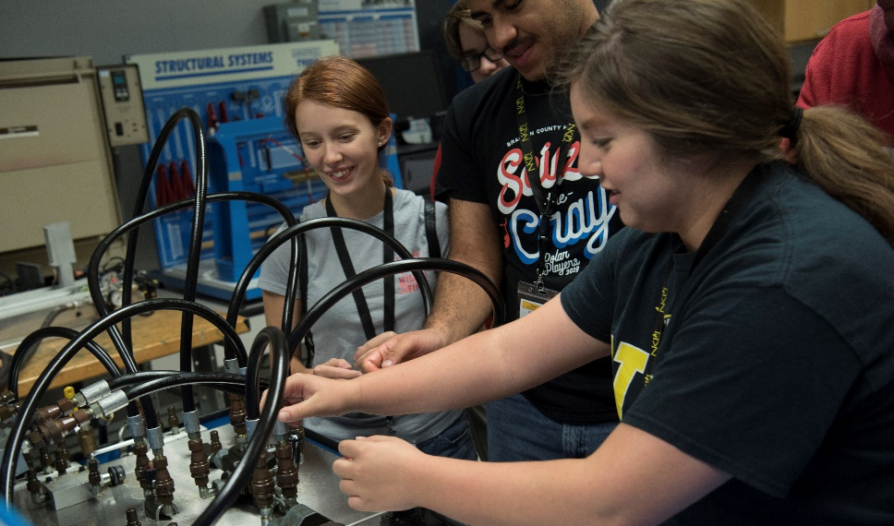
CAPITAL PROJECT
HERRMANN SCIENCE CENTER EXPANSION
87,000 square-foot addition
Addresses urgent need for STEM + H
Currently in architectural design phase
$79.9M project funding in place

Slide 11
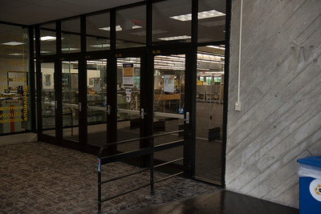
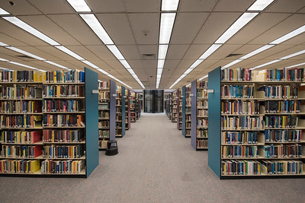
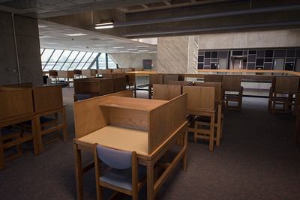
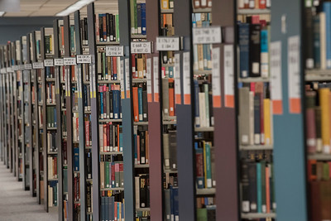
Priorities for 2024-2026
Many critical asset preservation needs remain, including the capital renewal and modernization of Steely Library to create an Academic Commons
Capital Renewal and Modernization of Steely Library
NKU’s Asset Preservation Needs Exceed $300M

