Slide 1
UNIVERSITY OF KENTUCKY FY 2024-30 Capital Plan and request
Angie Martin, VICE PRESIDENT FOR FINANCIAL PLANNING AND CHIEF BUDGET OFFICER Mary Vosevich, Vice President for Facilities Management and Chief Facilities Officer
Capital planning advisory board | July 20, 2023

Slide 2
university of Kentucky 2024-26 top priorities
I
Construct/Improve Medical/Administrative Facility 3
2
Asset Preservation
3
Construct Agricultural Research Facility 1
4
Construct Research Facility
2

Slide 3
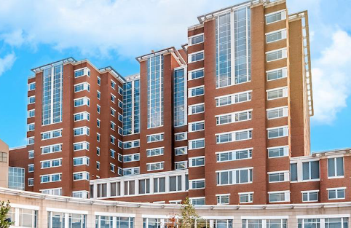
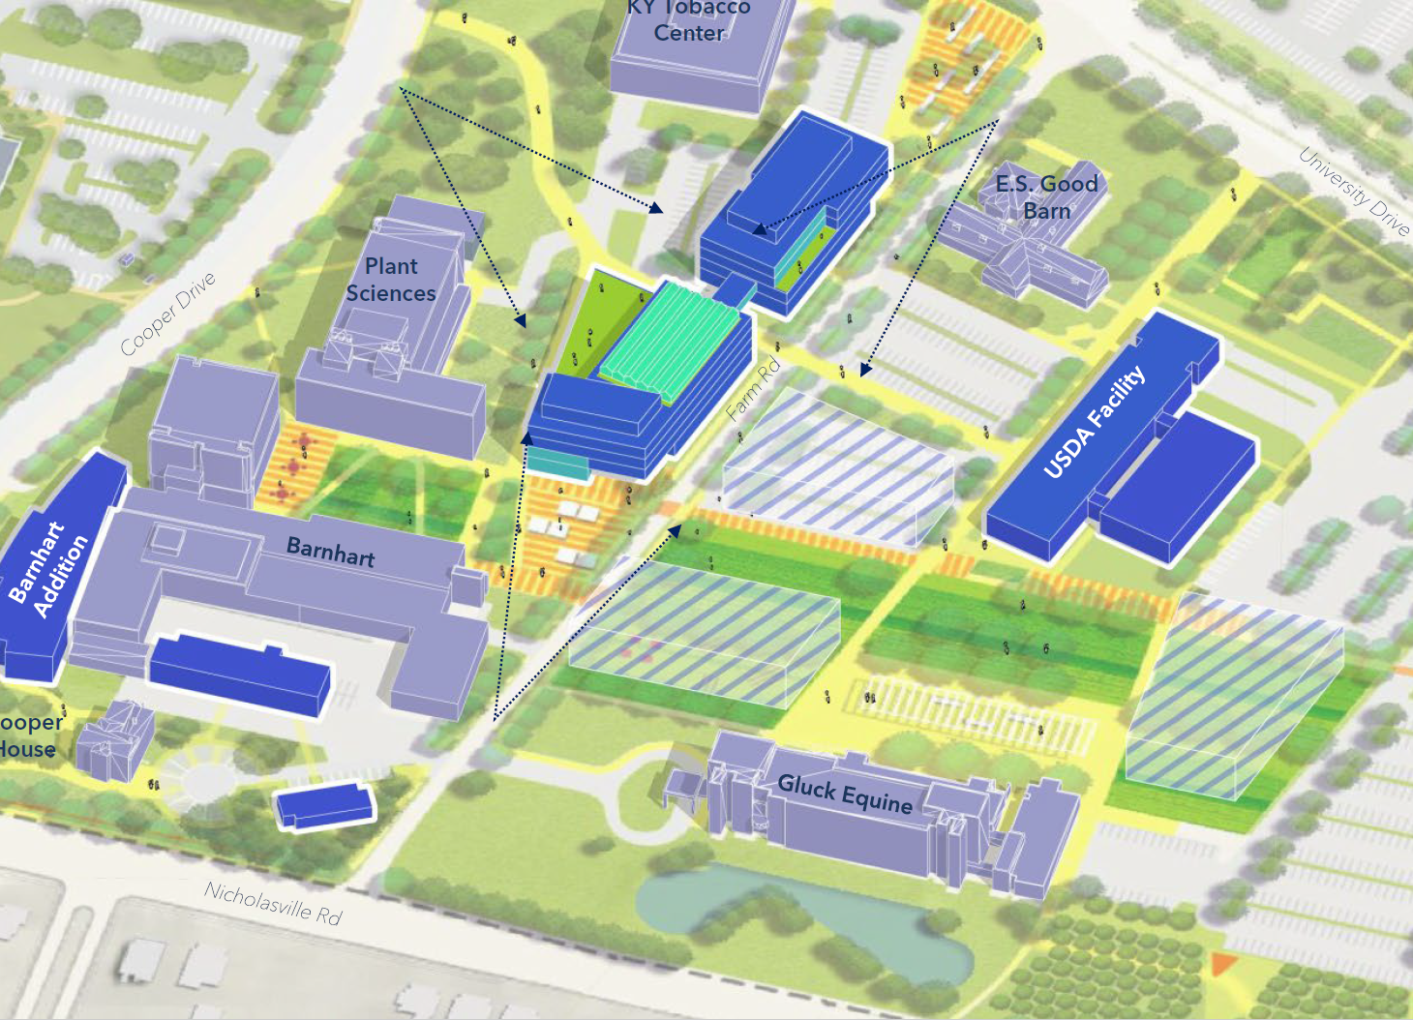
Reauthorization requests
1
Construct/Improve Medical/Administrative Facility 3
PRIORITY
Expansion of Albert B. Chandler Hospital to eventually provide 700 +/- beds as well as needed clinical support spaces
Scope: $2 billion ($800 million Agency Bonds and $1.2 billion Restricted Funds)
Design team selections are currently underway
Completion scheduled for Q3 of 2029
3
Construct Agricultural Research Facility 1
PRIORITY
New facility to replace aging lab research and classroom facilities for the Martin-Gatton College of Agriculture, Food and Environment
Scope: $250 million ($200 million State Bonds and $50 million Restricted Funds)
Design team selections are currently underway
Completion scheduled for Q2 of 2026
3

Slide 4
2
Asset Preservation
PRIORITY
PRINCIPLES FOR THE ASSET PRESERVATION POOL
Preserve and extend the useful life of existing facilities
Improve the utilization of space by providing a more flexible array of classrooms to serve our growing student population, creating spaces that are responding to Kentucky’s workforce needs, especially in the STEM+H disciplines (science, technology, engineering, math and health)
Create better space to increase research collaboration among faculty, staff and students across and among disciplines where ingenuity can unfold
Efficiently manage repair and maintenance costs
Upgrade existing infrastructure to improve energy efficient systems that reduce operating costs and lower future maintenance expenses
4

Slide 5
2
Asset Preservation 2022-24 Projects: an Update
PRIORITY
Improve Multi-Disciplinary Science Building: $15 million. Completion scheduled June 2024
Improve White Hall Classroom Building: $83 million. Completion scheduled April 2026
Improve Pence Hall: $32 million. Completion scheduled May 2025
Improve Patterson Office Tower: $3.5 million. Completion scheduled January 2025
Improve Miller Hall: $4.5 million. Completion scheduled November 2024
Various Infrastructure/Building System Improvements: $25 million. Various completion dates
A total of $98,775,000 in Asset Preservation Funds is currently committed for 21 projects.
5

Slide 6
2
Asset Preservation 2024-26
PRIORITY
UK’s State Bond request for FY 2024-26
$200 million
Potential projects currently identified
$50 million
Building Systems improvements ― mechanical, electrical, plumbing, building envelope, life safety
$50 million
Utility Infrastructure Systems improvements ― steam, chilled water, electrical
$187 million
Major renovations to multiple buildings being considered
Kastle Hall: $54 million
Willard Medical Education/Science Building: $40 million
Erickson Hall: $36 million
Patterson Office Tower (2 additional floors): $10 million
McVey Hall: $47 million
Total: $287 million
6

Slide 7
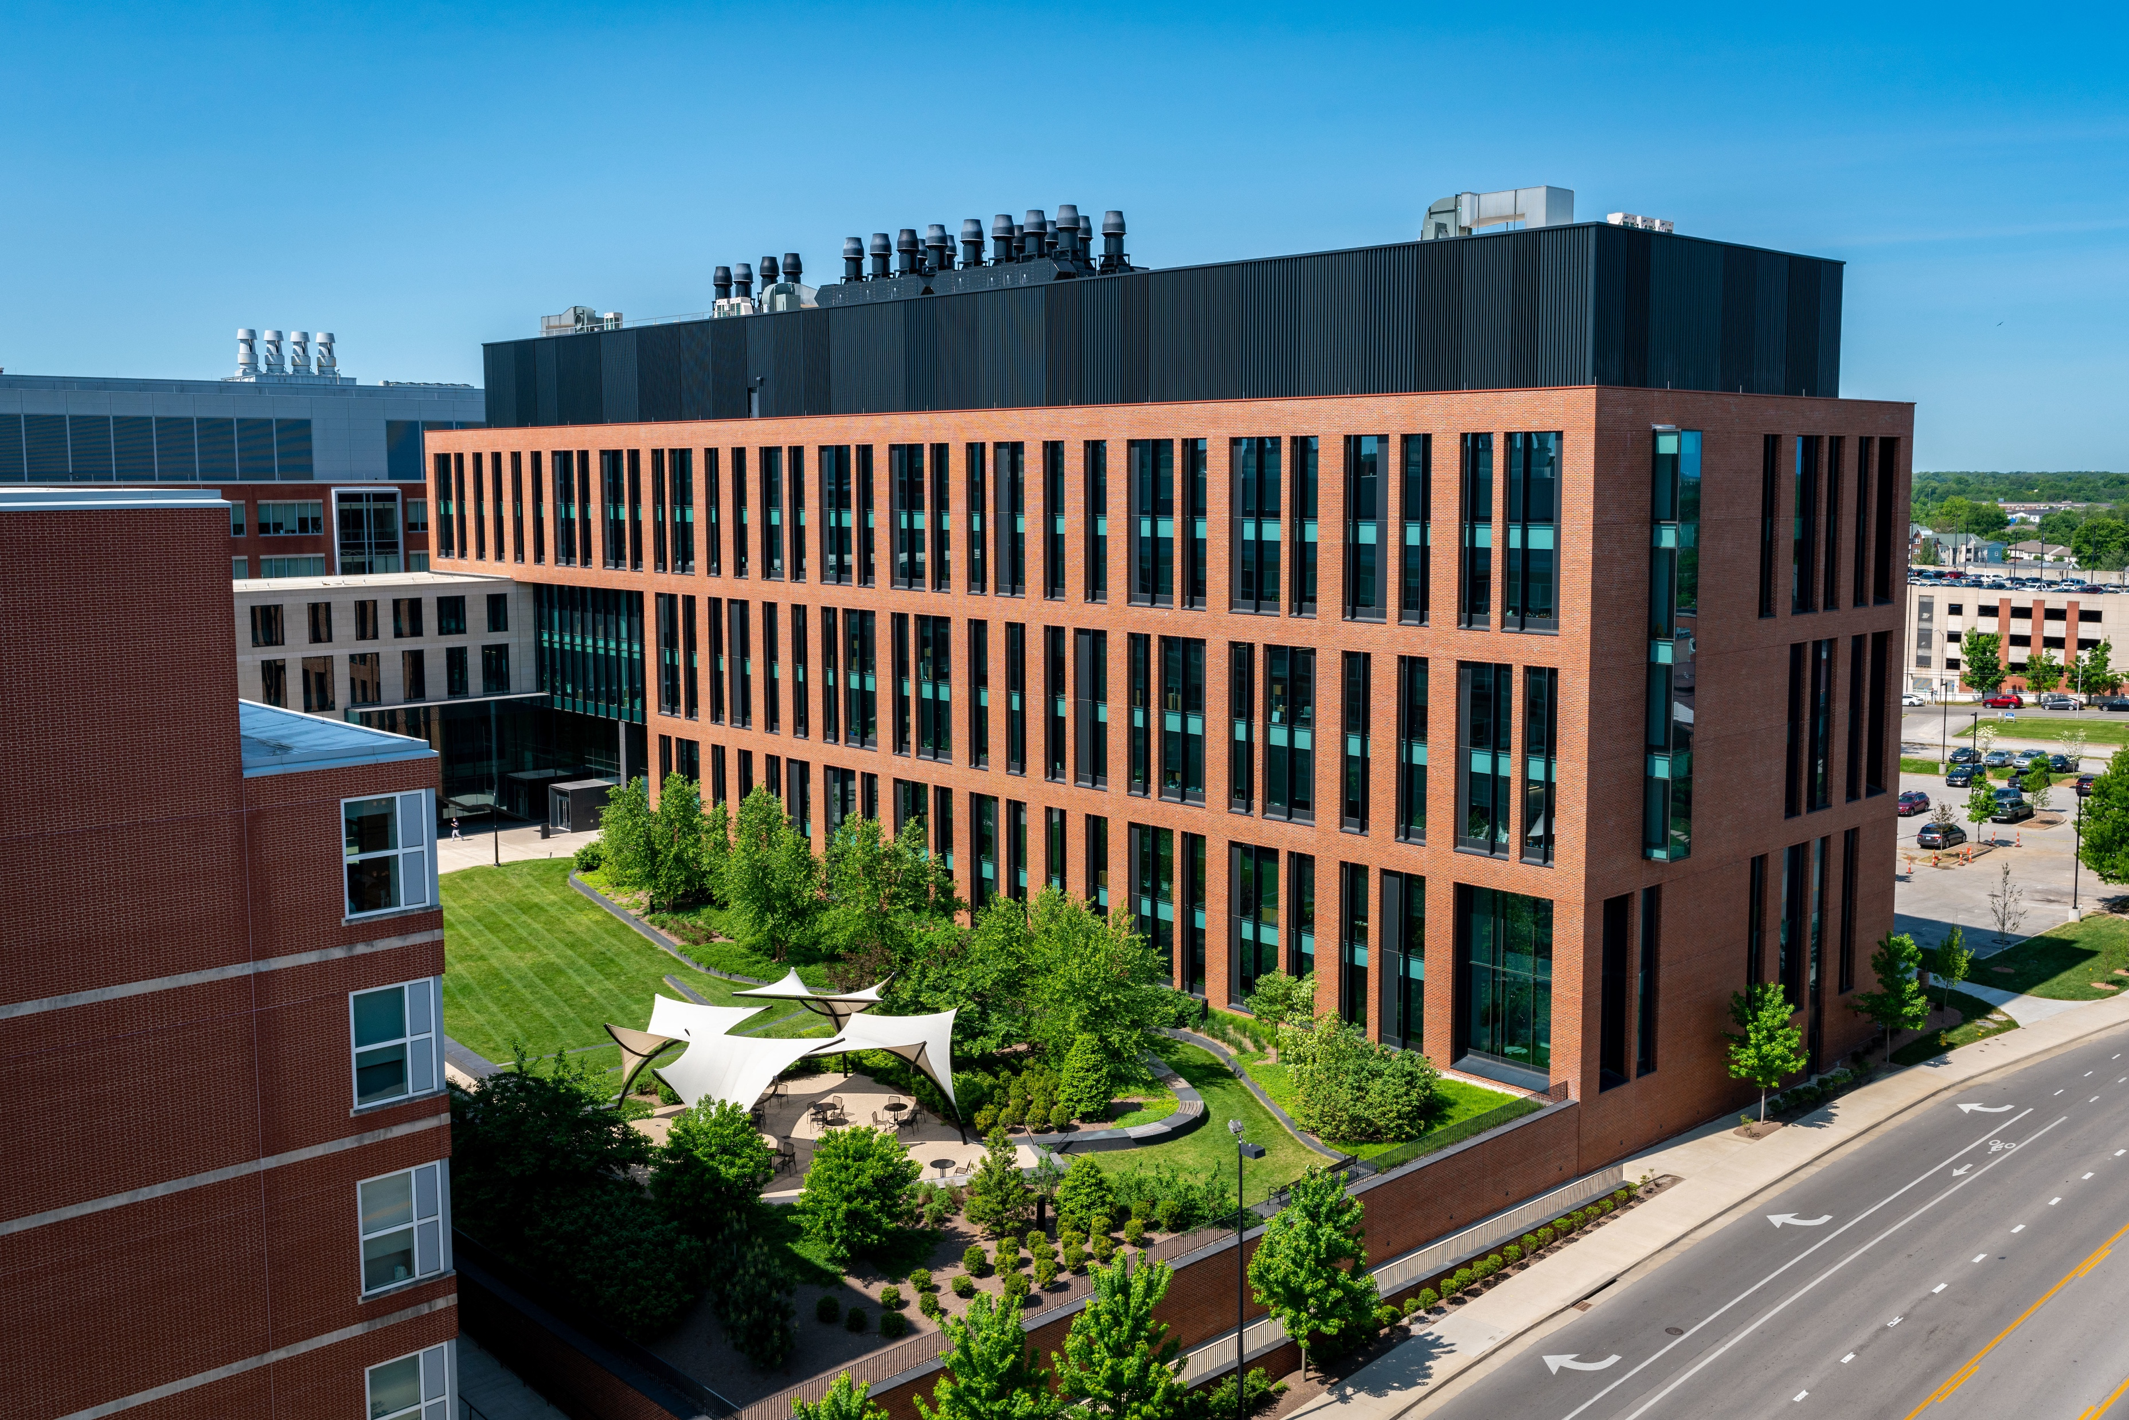
4
Construct research facility
PRIORITY
Research Facility Request
300,000 +/- square feet building to expand research capabilities that advance the priorities and needs of the Commonwealth.
Scope: $450 million ($350 million State Bonds, $100 million in Agency Bonds)
Research Priorities:
Cancer
Cardiovascular
Diabetes & Obesity
Diversity and Inclusion
Energy
Materials Science
Neuroscience
Substance Use Disorders
7

Slide 8
Questions?

