Slide 1
University of Louisville Capital Plan and Priorities 2024-26 Capital Planning Advisory Board July 20, 2023

Slide 2
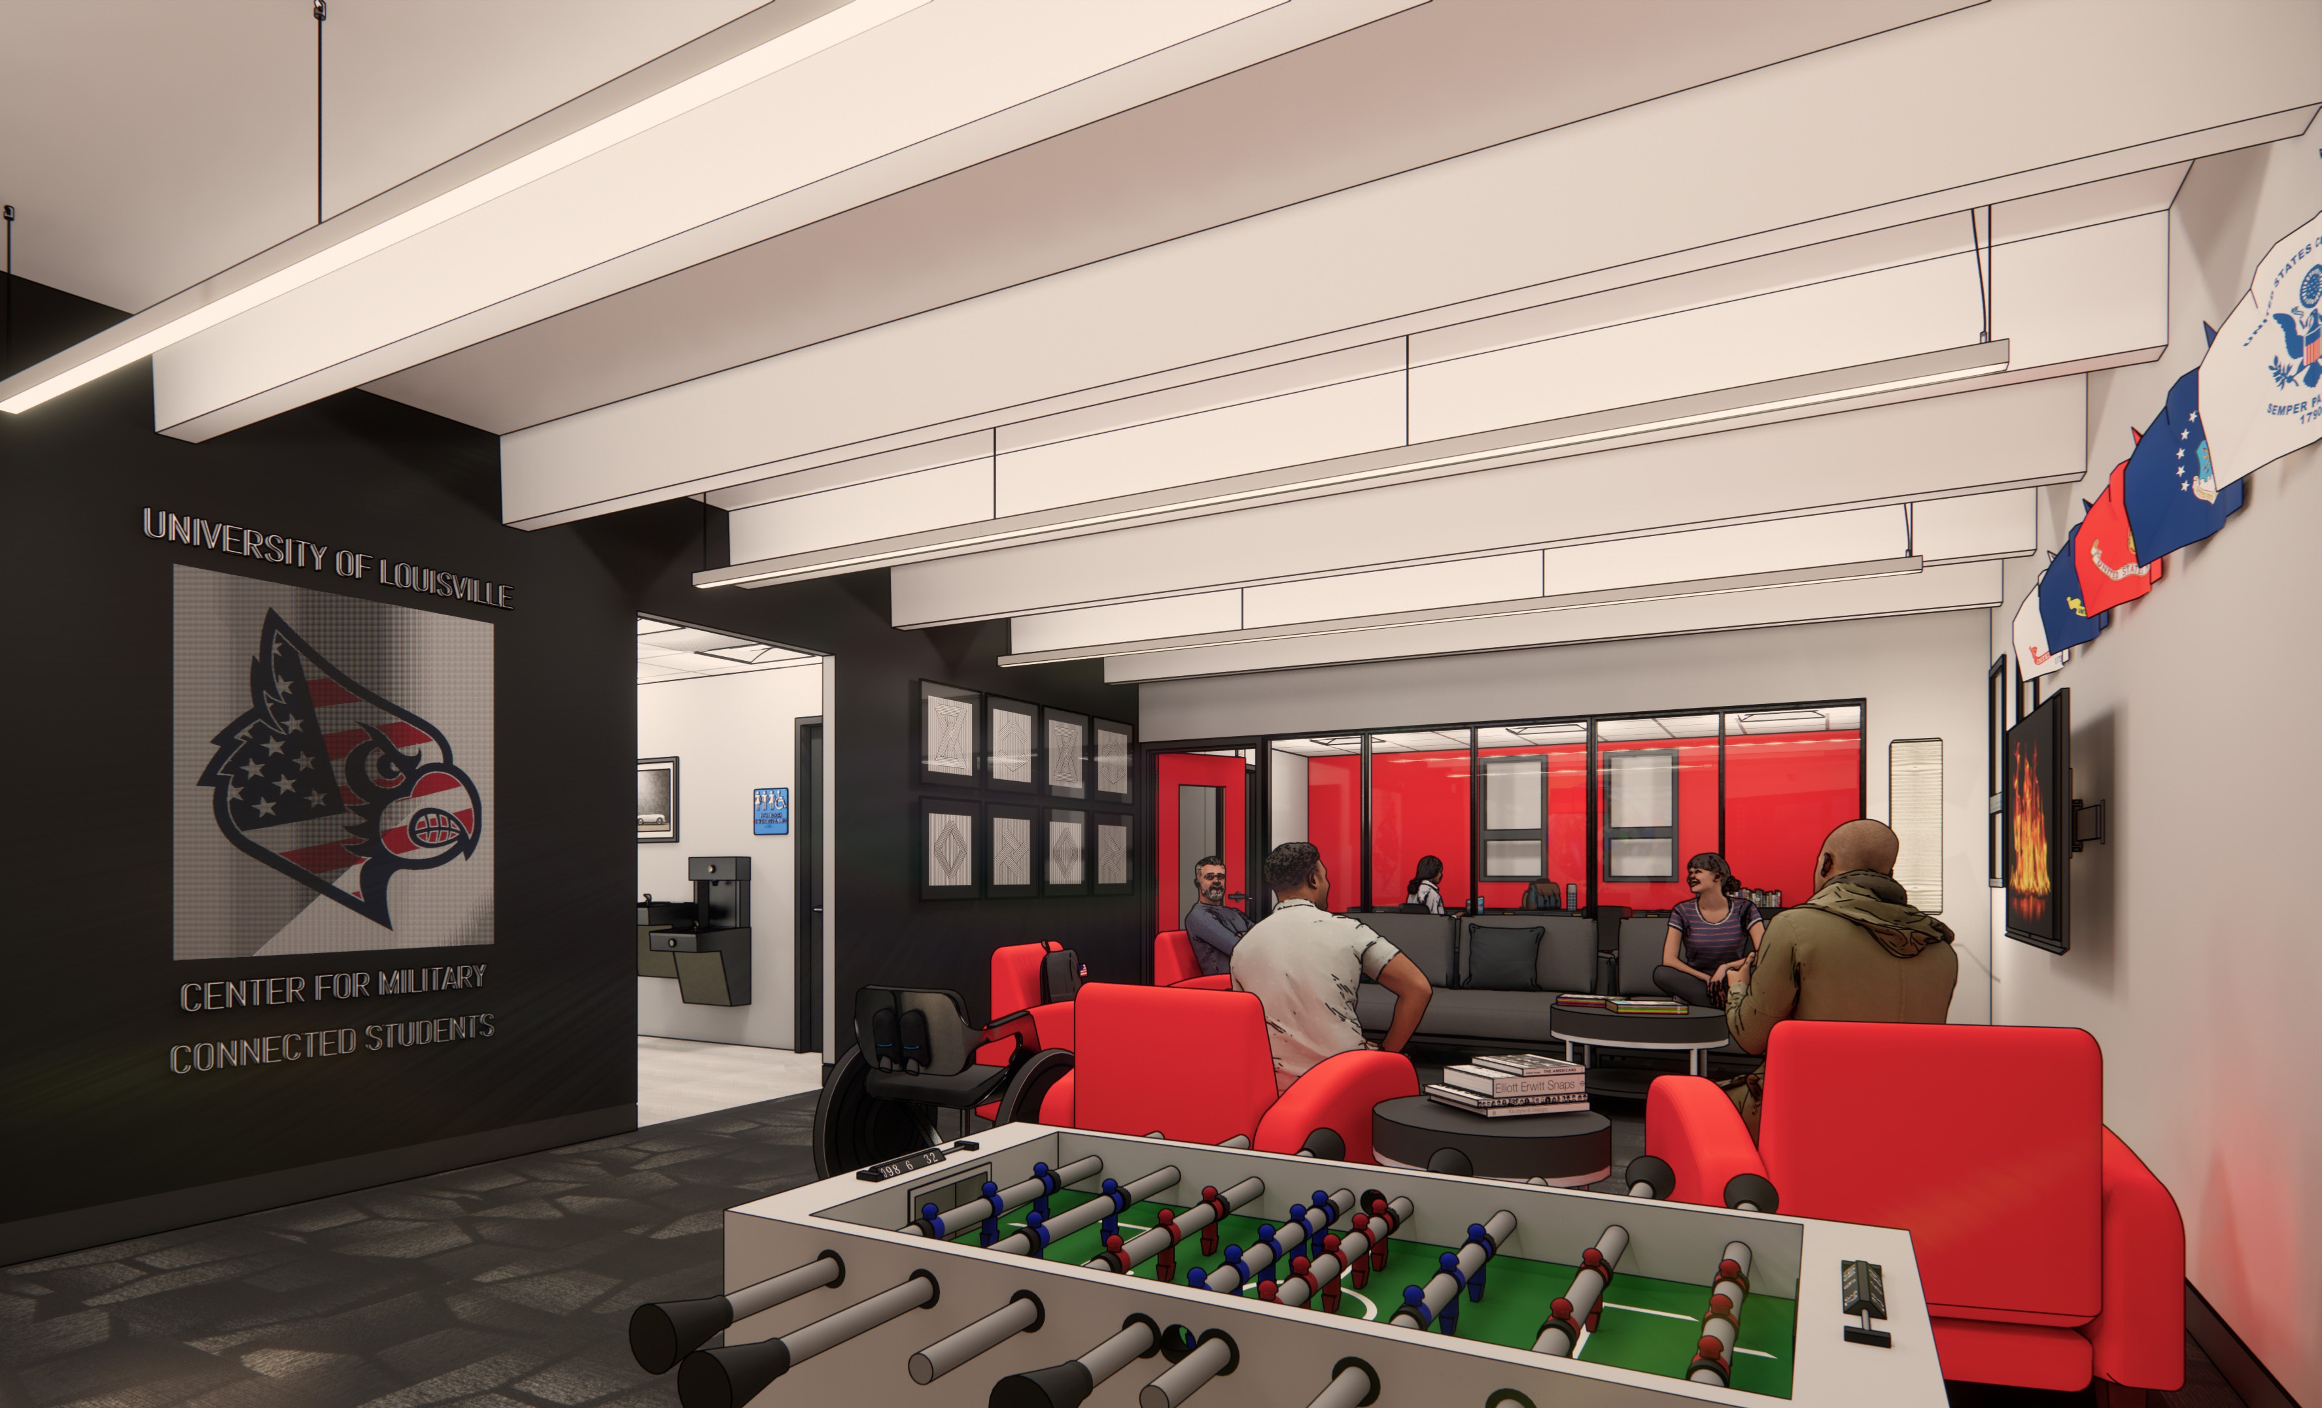
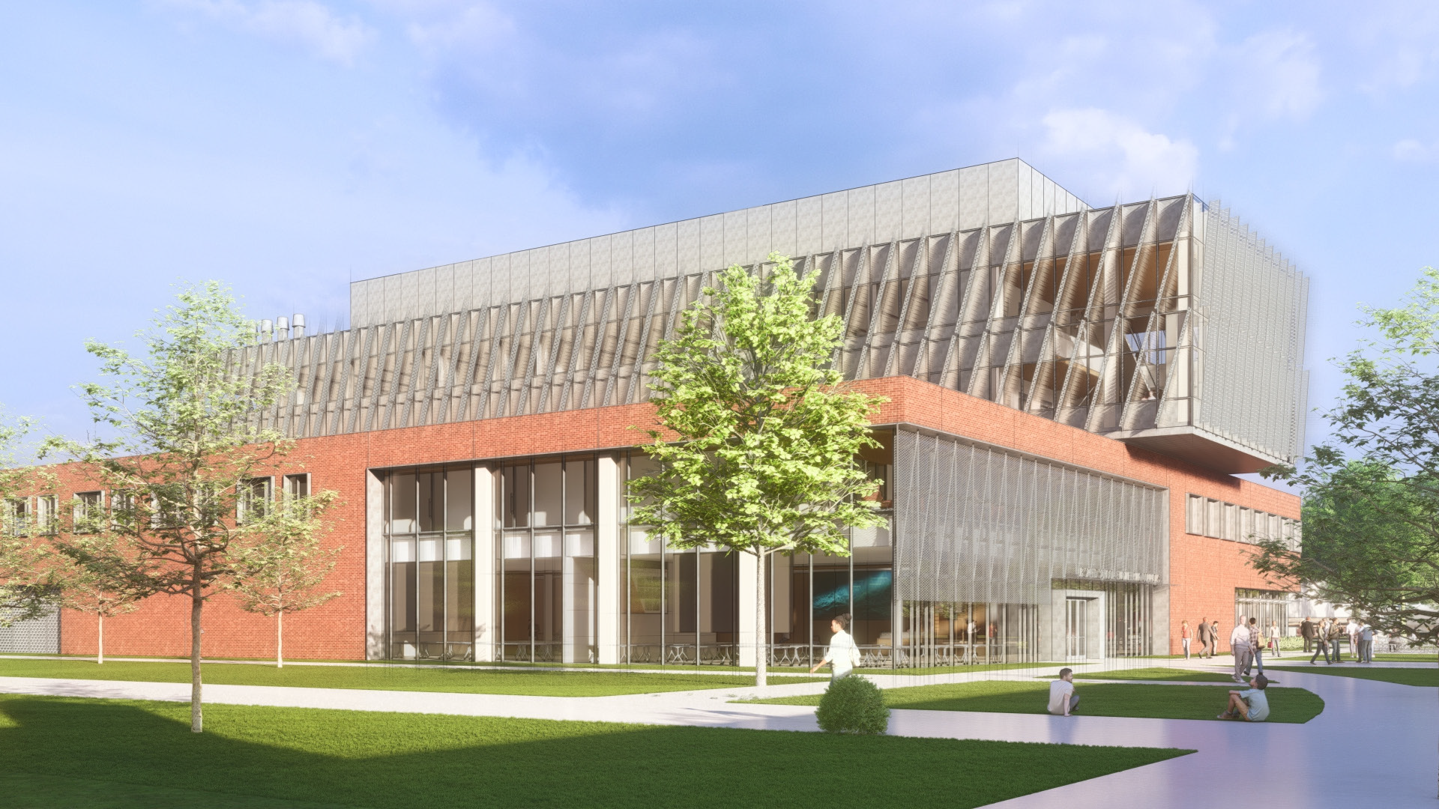
Appreciation of Current Capital-related Support
Asset preservation
Center for Military-Connected Students
Engineering building

Slide 3
UofL Capital Planning Process
UofL Capital Planning Drivers
Purposeful
Responsive
More than buildings
Strategic
State-mandated mission
UofL Strategic Plan
Great Place to Learn
Great Place to Discover
Great Place to Connect
Great Place to Work
Campus Master Plan

Slide 4
2024-26 Priority Requests
Health Sciences Simulation Center and Collaboration Hub
STEM Academic Center
Arts and Sciences Reinvention
Student Commons and Recreational Fields
Campus Infrastructure Modernization
Steam and Chilled Water Plant Modernization

Slide 5
HEALTH SCIENCES SIMULATION CENTER & COLLABORATION HUB
THE NEED: Kentucky faces a critical need for skilled health care workers. Located in the heart of Louisville’s downtown medical district, the Health Simulation Center and Collaboration Hub will bring together several academic health care disciplines and provide the latest training opportunities for UofL and for the health care community.
Provides advanced technology and educational resources, research labs, classrooms and meeting spaces
Expands multidisciplinary research opportunities in medicine, dentistry, nursing and public health
Interactive simulation lab to hone health care skills, refine advanced techniques and learn social, interactive patient care techniques
Labs engineered to address complex and varied situations across the healthcare spectrum, from telehealth to simulated operating rooms and intensive care units
Projected budget: $280 million

Slide 6
STEM ACADEMIC CENTER
THE NEED: Workers trained in STEM disciplines are central to the Commonwealth’s future economic growth and the state remaining competitive in regional, national, and global markets. UofL is ramping up its efforts to accommodate more students in these areas. The proposed Science, Technology, Engineering and Math building will provide desperately needed, modern space for academic program growth in STEM fields.
Accommodates anticipated increase in enrollment among STEM students
Provides a dynamic learning environment including enhanced teaching methodologies, advanced technology and interactive learning tools
Increases student retention in STEM fields
State-of-the-art academic center enables the university to compete with other states, which are building similar facilities
Projected budget: $142 million

Slide 7
COLLEGE OF ARTS & SCIENCES REINVENTION
THE NEED: Renovation and upgrades to classrooms, instructional laboratories, studios and student support areas in several critical academic buildings are vital to our students’ learning environment.
The College of Arts and Sciences is the largest college and graduates more students than any other school at UofL
Reimagining classrooms and labs to accommodate larger classes, new teaching techniques and technology needs unavailable in older, dated buildings
Improvements to mechanical, electrical and plumbing systems
Projected budget: $70 million

Slide 8
STUDENT COMMONS & RECREATIONAL FIELDS
THE NEED: Research shows physically active students fare better in the classroom and are more likely to graduate. This project will enhance the student experience through new and expanded extracurricular opportunities closer to many residence halls.
Thriving intramural program contributes to the overall health and wellness of students
Playing fields, basketball and tennis courts, walking/jogging paths, playground
Location near residence core will encourage participation, enhance student safety
Current campus space can’t accommodate all activities; construction eliminating some spaces
Cleans up park area adjacent to campus
Projected budget: $17 million

Slide 9
CAMPUS INFRASTRUCTURE MODERNIZATION
THE NEED: Aging buildings are in need of the continuation of long-overdue repairs and upgrades on all three campuses to ensure safety and improve the learning and research environment for students, faculty and staff.
Builds upon the positive impacts of the current Asset Preservation Program
Many structures have not been renovated in more than 30 years. Needs include:
Roof, flooring, window repair and replacement
Electrical, HVAC system upgrades
Technology upgrades
Will revitalize facilities that currently aren’t equipped for modern teaching and research activities
Ensures the long-term viability and quality of facilities, reducing the need for costly new construction
Projected budget: $100 million

Slide 10
STEAM & CHILLED WATER PLANT MODERNIZATION
THE NEED: UofL’s aging steam and chilled water plant heats and cools Belknap Campus classrooms, offices, labs and student areas. This upgrade will create a safer working environment and improve energy and operational efficiency.
Plant is more than 40 years old
Outdated electrical and plumbing systems
Inadequate insulation
Structural enhancements needed for future expansion
System failure at risk as plant ages, requiring costly repairs and maintenance
Upgrades will reduce power consumption and utility costs and improve long-term performance
Projected budget: $40 million

Slide 11
Summary of Other Capital Projects
Student Support
Residence hall construction, renovation, and acquisition
Expand/renovate student dining facilities
Expand/build student support facilities
Academic Support
Renovate libraries
Improve medical training and research facilities
Construct and renovate academic spaces
Campus operations
Implement new Enterprise Resource Planning system
Update IT networking, security, and research systems
Infrastructure improvements including ADA, utilities, and parking
Athletics
Venue construction, renovation and upkeep
Expansion, construction, and improvement of training and operation facilities

Slide 12
Thank you

