Slide 1
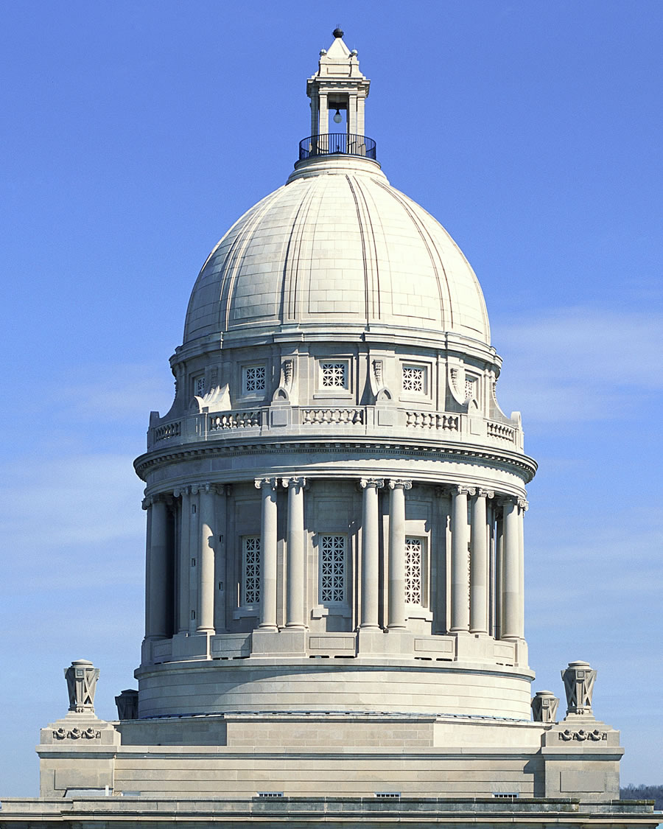
Capital Investment Priorities for Postsecondary Education
2024-2026
Kentucky Council on Postsecondary Education
Dr. Bill Payne, Vice President for Finance & Administration
Shaun McKiernan, Executive Director for Finance & Budget
Dr. Doyle Friskney, Senior Fellow

Slide 2
Overview
Background
Draft 2024 - 2026 Capital Request
Asset Preservation Projects
Information Technology Projects

Slide 3
Background

Slide 4
Background
Fast Facts
Kentucky Public Postsecondary Education System:
8 public universities
16 community and technical colleges
Over 28 million square feet in E&G facilities
More than 30,000 faculty and staff
Over 196,000 students
500,000+ alumni

Slide 5
Background
Drivers of Facilities Need
Historically, growth in enrollment and research have driven facilities needs
Metric | 1999 | 2022 | % Change
KCTCS FTE Students | 24,907 | 40,552 | 63%
University Undergraduate FTE | 71,800 | 77,642 | 8%
University Graduate FTE Students | 13,909 | 20,910 | 50%
Metric | 1999 | 2010 | 2021 | 1999-2021 % Change
Extramural Research (UK/UofL) | $124 M | $366 M | $437 M | 252%
Source: Higher Education Research and Development Survey
Over the last six years, enrollment growth has slowed, with most institutions experiencing a decrease
Campus capital plans reflect the need to maintain and modernize existing space and infrastructure

Slide 6
Background
Facilities Need and State Investment
Vanderweil Facilities Advisors (VFA) Study completed in 2007, updated in 2013
Identified investment needed to bring campus E&G facilities up to industry standards
Over the past ten years, the state spent $959.0 M on facilities renovation and renewal
This represents about 13% of the projected $7.3 billion system total asset preservation need

Slide 7
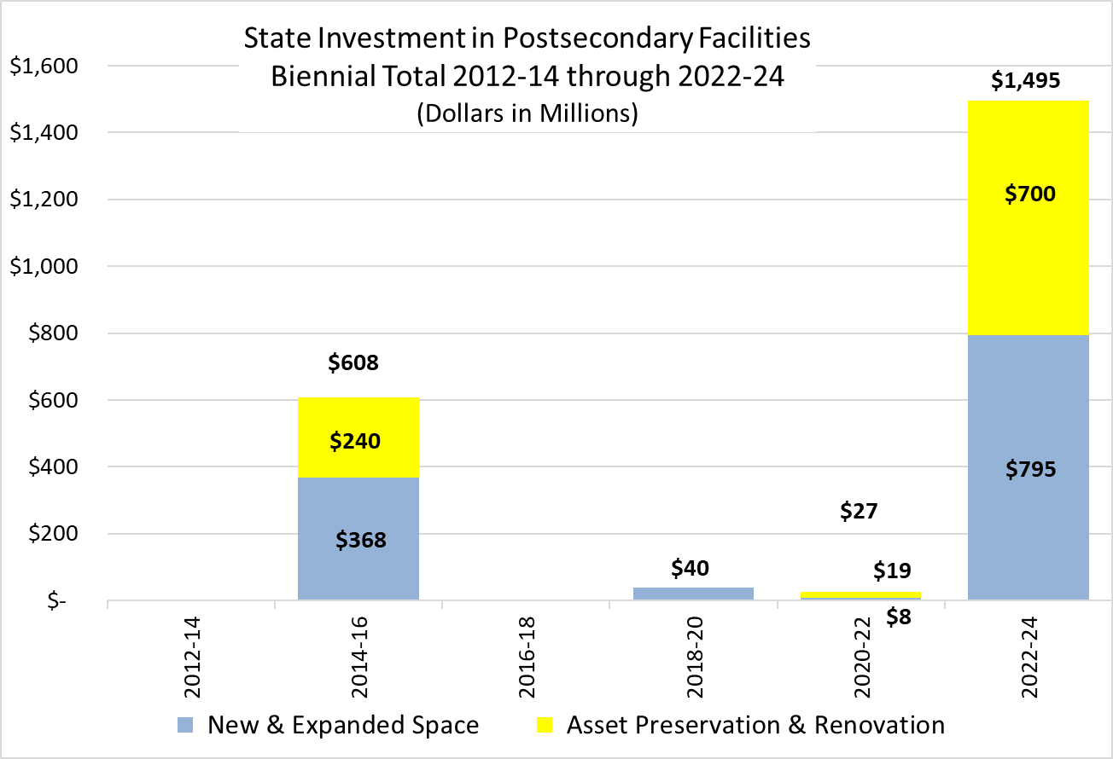
Background
Facilities Need and State Investment (Cont’d)
Over the past 12 years, Kentucky has invested:
$1.2 billion in new and expanded E&G facilities, $959.0 million in state funded asset preservation projects
Ratio of asset preservation to new construction spending was 1-to-1.2, aligning with VFA study recommendations
From 1998-2000 to 2010-12, ration of asset preservation to new construction was $255.0 M to $1.3 B, or 1-to-5

Slide 8
Draft 2024-2026 Capital Request

Slide 9
Draft 2024-2026 Capital Request
Process and Timeline
Collaborative process involving CPE staff, campus presidents, chief budget officers, and Council members
May 2023
Jun 2023
Jul 2023
Aug 2023
Sep 2023
Oct 1
Review budget components from previous biennium
Discuss budget timeline and key resource needs
Discuss budget components and request amounts
Update Council members on progress
Discuss budget components and request amounts
Update Council members on progress
Finalize request based on input from presidents
Work with institutions on messaging
Finance Committee endorses request
Council approves 2024-26 biennial budget request
CPE staff submits budget to OSBD and LRC staffs

Slide 10
Draft 2024-2026 Capital Request
Capital Investment Components
1
Estimated increase in construction costs on individual capital projects authorized during the 2022-2024 biennium. The requested $162.4 million represents 20% of $811.9 million authorized for new construction projects.

Slide 11
Capital Investment Components
New Construction
Features
CPE staff is not planning to include a request for new construction projects in the Council's 2024-2026 budget recommendation
However, campus officials will be free to propose funding for new projects to state policymakers and advocate for new and expanded space outside of the Council’s recommendation
Rationale
While some institutions have legitimate need for added facilities space, CPE staff and institutions want to emphasize the importance of renovating and renewing existing facilities (asset preservation)

Slide 12
Capital Investment Components
Construction Cost Increases
Features
Request for $162.4 million in bond funds that will allow institutions to offset cost increases on individual capital projects authorized in the 2022-2024 biennium
CPE staff will recommend that the full amount be provided in fiscal 2024-25 to facilitate completion of projects already underway
Rationale
If authorized, these funds would allow institutions to maintain the original scope of projects approved by the General Assembly in the current biennium (i.e., no scaling back, or phasing of projects)

Slide 13
Capital Investment Components
Construction Cost Increases (Cont’d)
Allocation
Requested funds represent 20% of $811.9 million in bond funds authorized for new construction projects in the 2022-2024 biennium
If funded, each institution would receive an allocation equal to 20% of previously approved bond funds

Slide 14
Capital Investment Components
Asset Preservation
Features
Request for $700 million in bond funds to finance renovation and renewal projects at postsecondary institutions
If authorized, requested funds would be the second installment of $700 million provided to address a $7.3 billion system total need
CPE staff will recommend that the funding be provided without any required institutional match
Rationale
Over the past decade, the state has provided $959 million for asset preservation, or about 13% of the estimated $7.3 billion need

Slide 15
Capital Investment Components
Asset Preservation (Cont’d)
Allocation
In 2022-2024, the General Assembly appropriated $350 million each year for asset preservation
Allocated based on each institution’s share of total Category I & II square feet
CPE staff will recommend that requested funds be allocated in similar fashion

Slide 16
Capital Investment Components
Information Technology Projects
Features
CPE staff will not include a request for information technology and equipment in the Council’s 2024-2026 budget recommendation
Rationale
Other capital investment components are perceived to be a higher priority for state funding than information technology and equipment projects

Slide 17
Asset Preservation Projects

Slide 18
Asset Preservation Projects
CPE staff was asked to identify capital projects that represent the highest priorities for the system
At this time, CPE capital priority is for 2024-26 is a second round of $700 M for asset preservation
Allocated based on each institution’s share of E&G space (same as 2022-24)
Our report includes the 99 asset preservation projects that include General Fund appropriations (total scope of $2.8 billion), though institutions submitted a total $6.9 billion in asset preservation projects for 2024-26
Projects were prioritized by the institutions, though these rankings are subject to change

Slide 19
Asset Preservation Projects (Cont’d)
Postsecondary Institution | 2024-26 Total Scope ¹
University of Kentucky | 200,000,000
University of Louisville | 289,452,000
Eastern Kentucky University | 530,250,000
Kentucky State University | 25,000,000
Morehead State University | 215,997,000
Murray State University | 164,737,000
Northern Kentucky University | 216,000,000
Western Kentucky University | 750,800,000
KCTCS | 359,200,000
Total | $2,751,436,000
¹ Total scope of proposed asset preservation projects for 2024-26 included in the institutions’ six-year capital plan that include a request state General Fund support. Totals reflect the correction of several projects’ categorization in Version 3 in the system.

Slide 20
Information Technology Projects

Slide 21
Information Technology Projects
Review of Campus Projects
CPE staff was asked to review information technology projects submitted by the institutions. An in-house evaluation committee was used
Review was limited given broad project descriptions. Most projects are pools that will allow institutions to make upgrades as needed
  35 projects were submitted for 2024-26, addressing network, applications, and systems. (31 university projects - $268M, 4 for UK Hospital - $350M)
  All projects were deemed “High Value”
  Projects focused on infrastructure, security, and system and application upgrades which evaluators considered the most important

Slide 22
Information Technology Projects
Review of Campus Projects (Cont’d)
Some institutions requested General Fund support for projects, but most proposed the use of institutional resources
2024-2026 draft budget proposal for the institutions does not include a request for General Fund support for IT projects
Reviewers asked that consideration be given to allow a portion (5%) of asset preservation funds to be used for IT infrastructure upgrades because of the importance of these projects for campus operations and student success
Campus-requested IT projects can be found in your materials

Slide 23
Information Technology Projects
Review Rubric
Project value rankings were determined by associating business value with the assessed risk of the proposed projects (COT methodology).
Lower Value Higher Value
High Value =
Higher Business Value
Lower Risk
Higher Business Value
Higher Risk
Business Value
Lower Business Value
Lower Risk
Lower Business Value
Higher Risk
Lower Risk Higher Risk
Risk Assessment

Slide 24
Information Technology Projects
Update on 2022-2024 CPE Project
→ Upgrade KyRON Infrastructure – funded in 2022-24 budget
This project is funding technology equipment to connect public universities and KCTCS to Kentucky Wired
Project Scope: $1,000,000
  The Kentucky Regional Optical Network connects the state’s postsecondary education community to national and international research through Internet2
  KyRON was upgraded from 10 gigabit to 40 gigabit, migrated from Windstream to KyWired
  Added a Second Internet2 network node in Cincinnati to provide redundancy to the Louisville Internet2 node

Slide 25
Questions?

Slide 26


Stay Connected
Twitter: CPENews and CPEPres
Data Center: cpe.ky.gov/data
Newsletter: cpe.ky.gov/news/subscribe

