Slide 1

CAPITAL IT PROJECT REVIEW
2026-2032
Jim Barnhart, Chief Information Officer
Commonwealth Office of Technology
June 11, 2025

Slide 2
Capital IT Planning – COT’s Role
Per Capital Planning Advisory Board Instructions
KRS Chapter 7A does not outline a specific role for the Commonwealth Office of Technology (COT) in the capital planning process.
However, it has been the Capital Planning Advisory Board’s stated policy and practice in prior years to utilize COT’s specialized expertise relative to the information technology projects submitted by the executive branch agencies, excluding postsecondary education institutions.

Slide 3
Capital IT Planning – COT’s Role
Per Capital Planning Advisory Board Instructions
An independent review panel, comprised of representatives from different agencies, will evaluate the projects.
COT will invite agency representatives to present an overview of their information technology needs and address any questions the review panel may have.
The panel will then develop an objective score for each project based on a set of well-defined criteria developed by COT.

Slide 4
Capital IT Planning – COT’s Role
Per Capital Planning Advisory Board Instructions
Capital Project Scoring Committee includes Ten (10) Scorers from:
  Personnel Cabinet
  Public Protection Cabinet
  Office of State Budget Director
  Tourism, Arts, & Heritage Cabinet
  Kentucky Transportation Cabinet
  Finance and Administration Cabinet
  Cabinet for Health and Family Services
Sixteen (16) Capital IT Project Requests totaling approximately $330.5 million

Slide 5
Capital IT Project Review 2026-2032
Scoring Process
Requesters submitted detailed information supportive of the criteria
Committee scored during oral presentations
Automated prioritization of projects based upon scores and weights favoring projects with high business values and low risk
Real-time review of variances in scores to ensure reviewers shared common:
  Understanding of the scoring criteria
  Details of the project

Slide 6
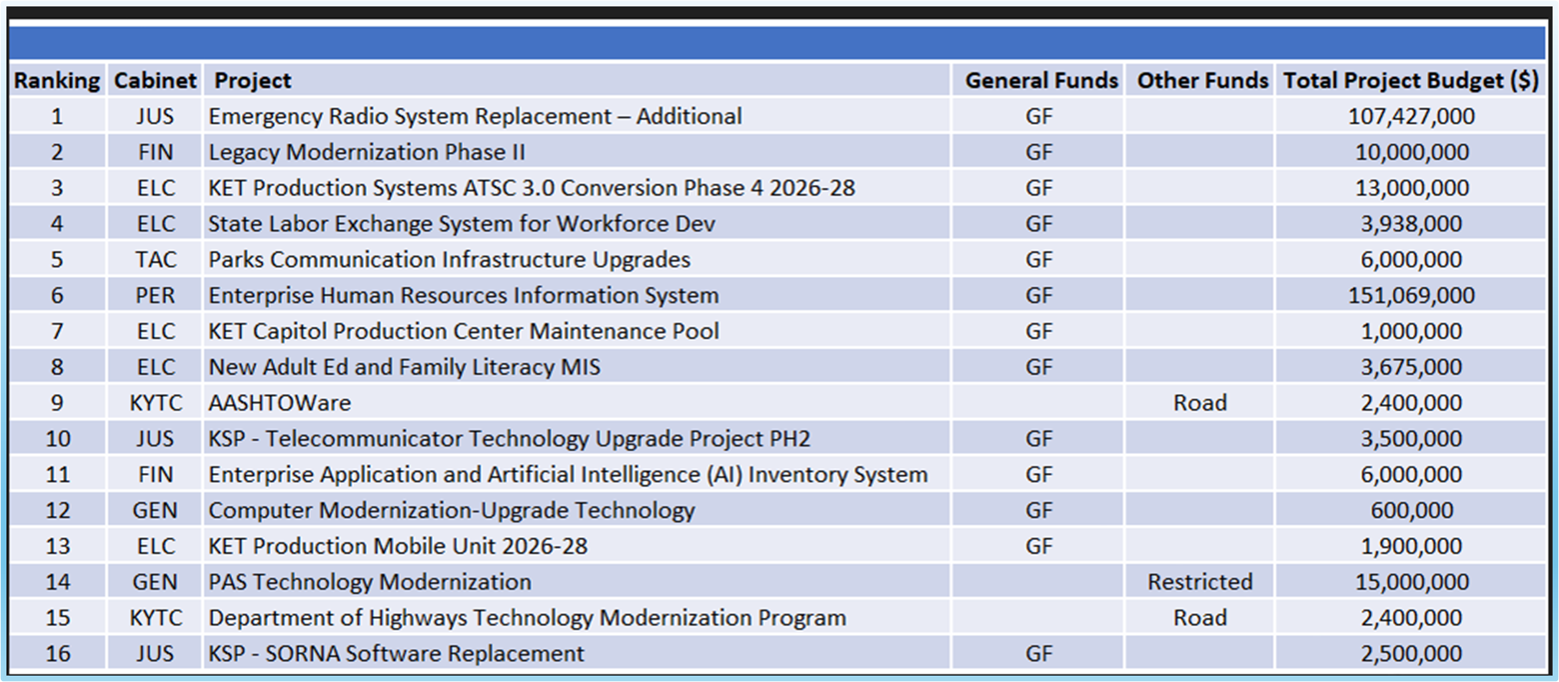
Capital IT Project Review 2026-2032
Funds Requested by Ranking

Slide 7
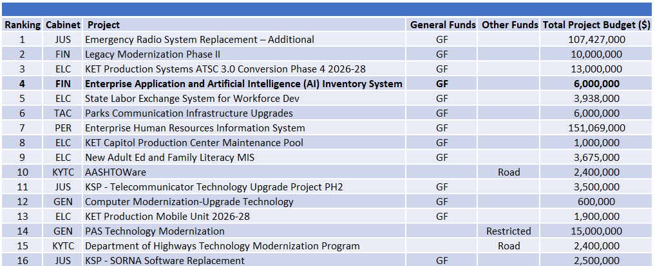
Capital IT Project Review 2026-2032
CIO Recommendations

Slide 8
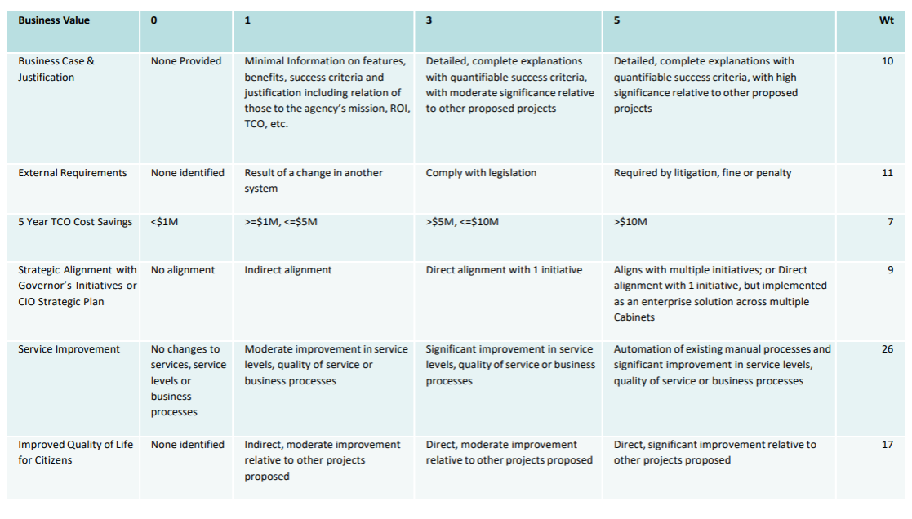
Capital IT Project Review 2026-2032
Scoring Criteria

Slide 9
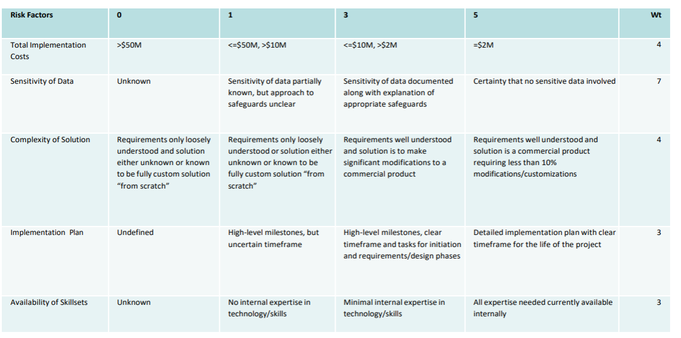
Capital IT Project Review 2026-2032
Scoring Criteria

Slide 10
Thank you!

