Slide 1

Capital Planning Advisory Board
June 11, 2025
Kentucky Tourism, Arts and Heritage Cabinet
Chief of Staff
Mona Juett
Director of Finance
Melissa Brewer

Slide 2

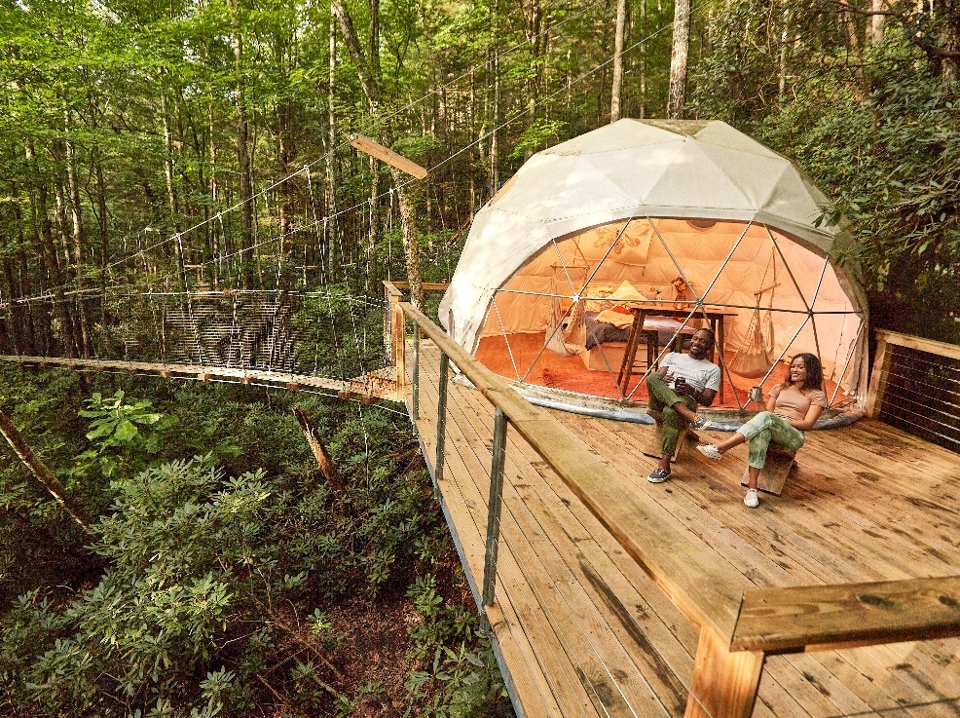
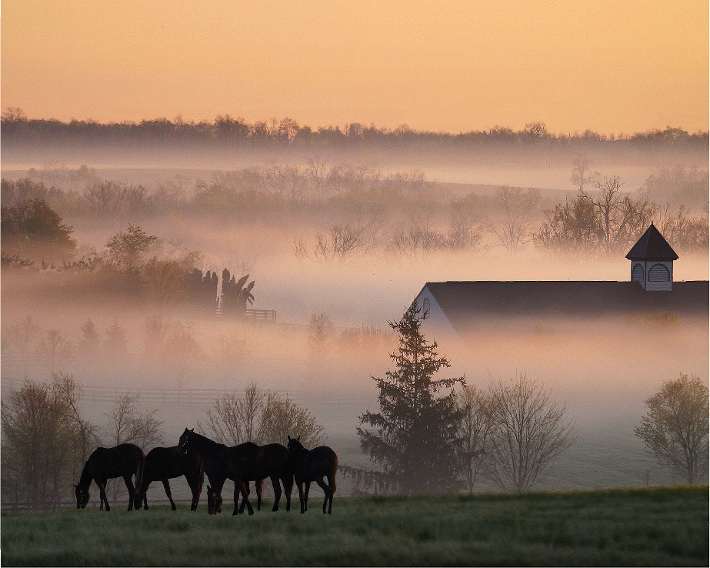
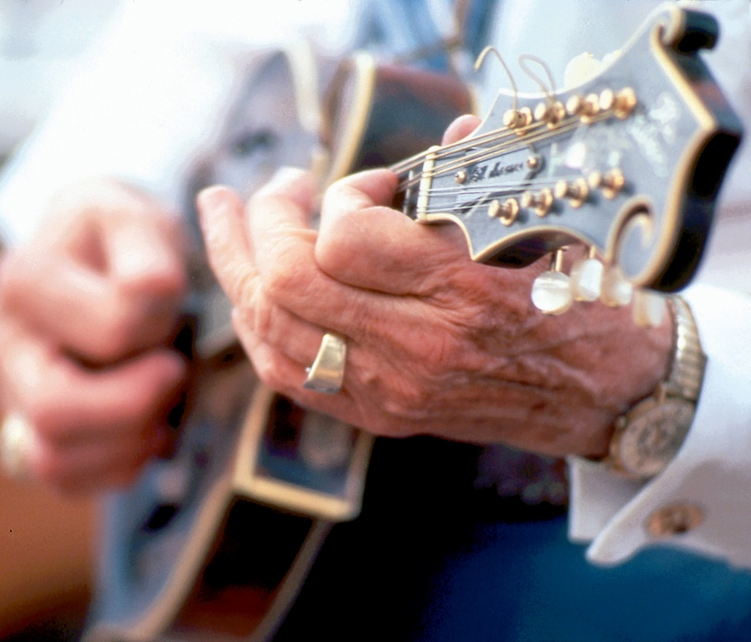
Our Mission
Support the promotion and development of Kentucky tourism, arts and heritage as a mechanism to foster economic growth, education and employment for communities throughout the commonwealth while appealing as a destination to a diverse audience at home, nationally and internationally.

Slide 3
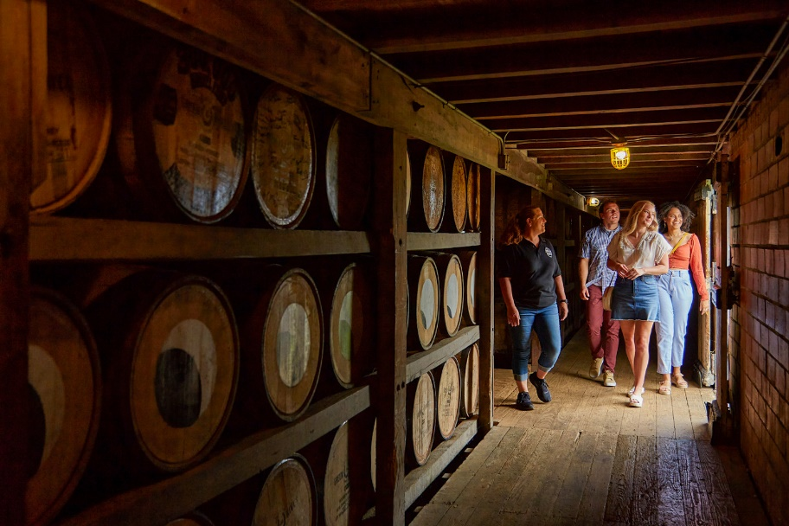
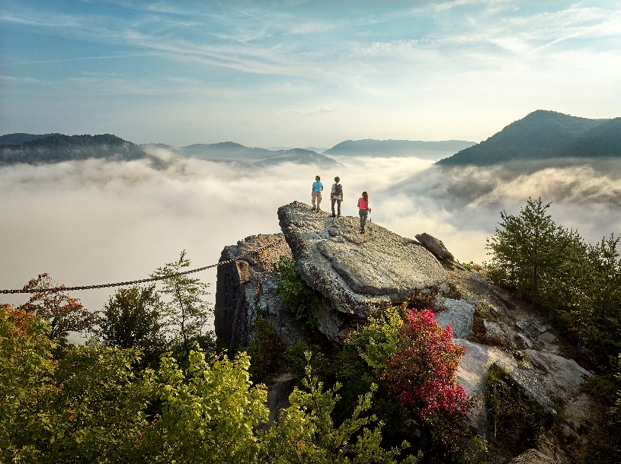
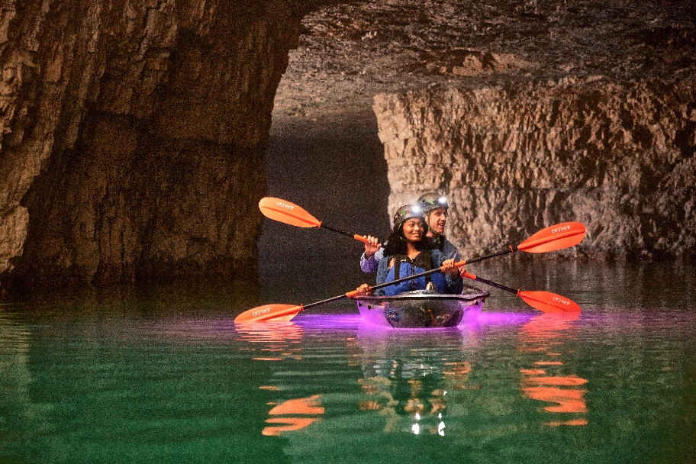
Cabinet Overview
The Kentucky Tourism, Arts and Heritage Cabinet is dedicated to fostering and promoting the state’s rich heritage as well as continuing Kentucky’s long history of being a premier travel destination for all travelers to enjoy.
The Cabinet serves as Kentucky’s top tourism agency and collaborates with local tourism partners to coordinate tourism, arts and heritage efforts through legislation, tourism development, and marketing/outreach.

Slide 4
2026 - 2028 capital plans
Maintenance Pools
$40,000,000 | Kentucky State Parks
$1,000,000 | Kentucky Artisan Center
$1,100,000 | Kentucky Center for the Arts
$5,000,000 | Kentucky Horse Park
$6,000,000 | Kentucky Venues

Slide 5

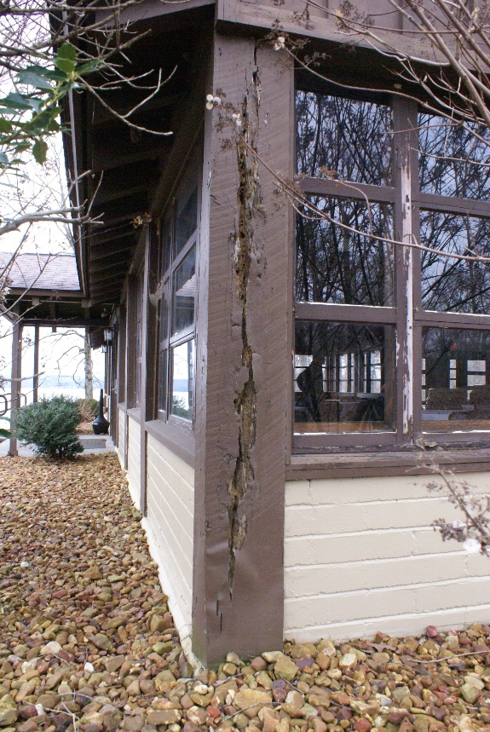
Kentucky State Parks
2026 – 28 Capital Plans
$149,380,000 | Resort Park Upgrades/Repairs
$20,600,000 | Statewide Campground Upgrades Ph 2
$31,350,000 | Pool Improvements and Repairs
$6,000,000 | Recreational and Historic Parks Restorations/Upgrades

Slide 6

Kentucky Artisan Center
2026 – 28 Capital Plans
$300,000 | Equipment
$1,000,000 | Accessible Family Restroom/Private Nursing Room
$1,000,000 | Outdoor Venue
$1,000,000 | Energy Innovation Project

Slide 7

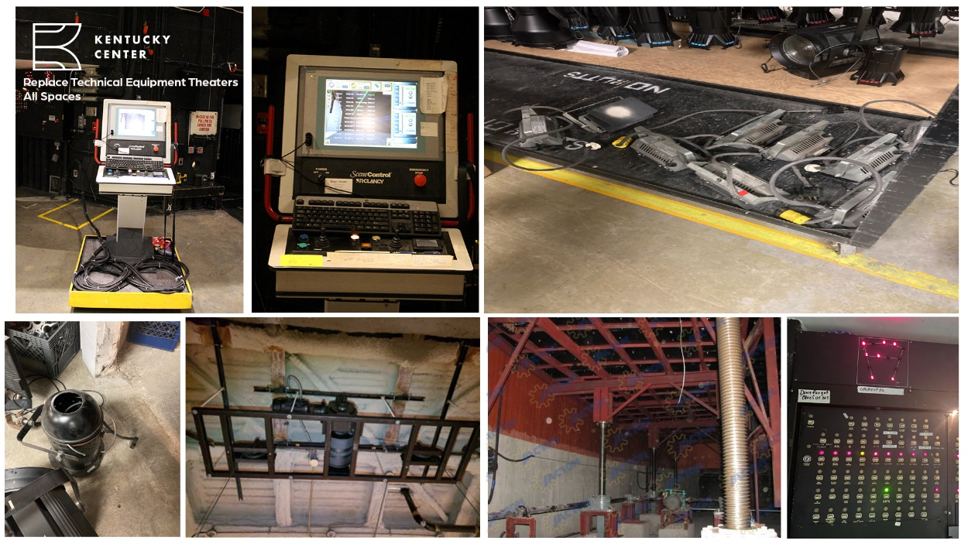
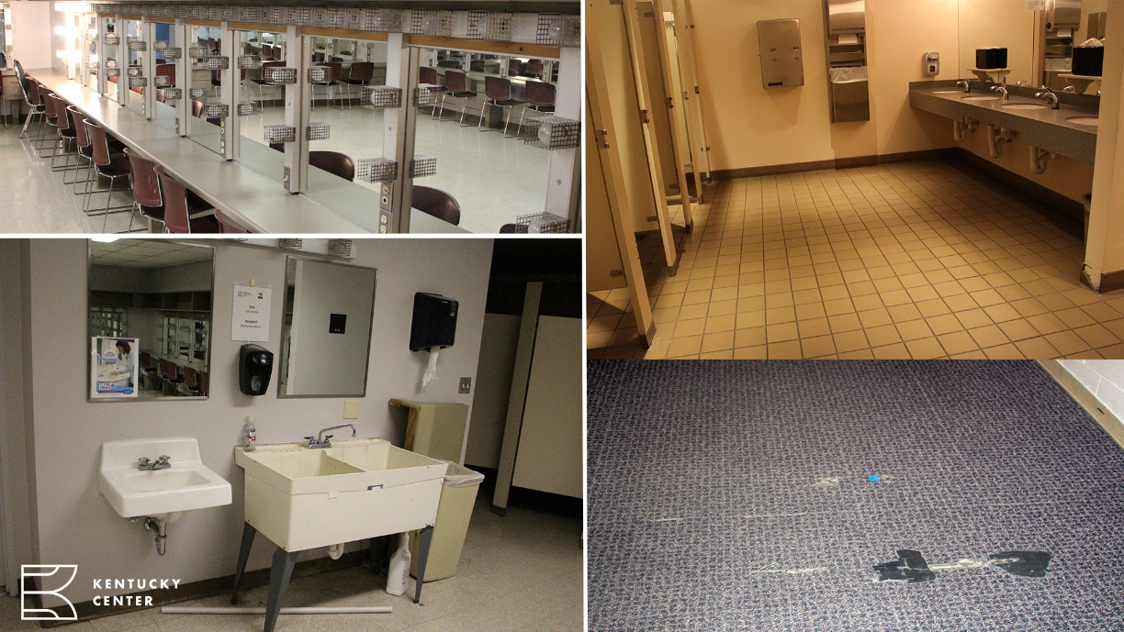
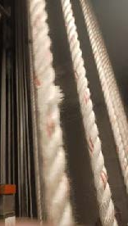
Kentucky Center for the Arts
2026 – 28 Capital Plans
$1,500,000 | Electrical Upgrades
$4,800,000 | Exterior Repair and Restoration - Building
$1,900,000 | Manual Counterweight Stage Rigging Repair
$6,500,000 | Replace Technical Equipment (all theaters)
$3,500,000 | Renovate Client and Patron Spaces

Slide 8

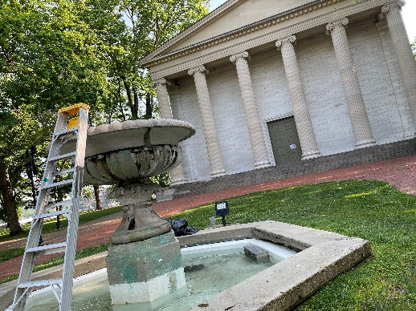
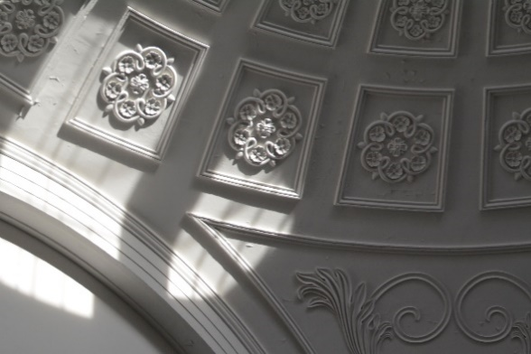
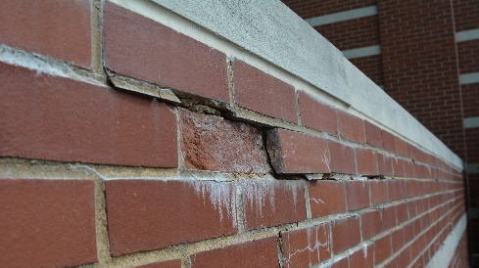
Kentucky Historical Society
2026 – 28 capital plans
$5,065,000 | Kentucky Old State Capitol Preservation
$6,431,000 | Thomas D Clark Center for KY History Museum Renovation
$1,175,000 | KHS Security Upgrade Project
$1,250,000 | Historic Frankfort Railroad Depot - acquisition

Slide 9

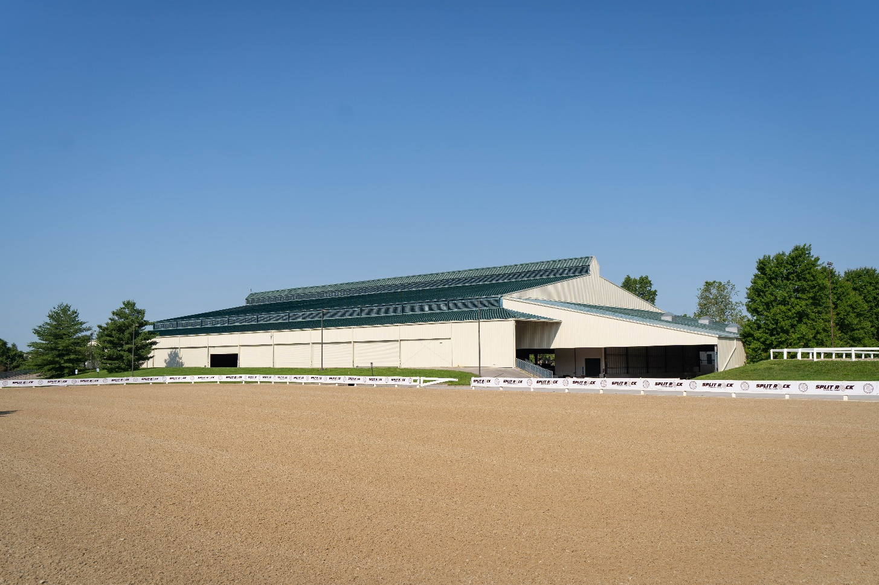
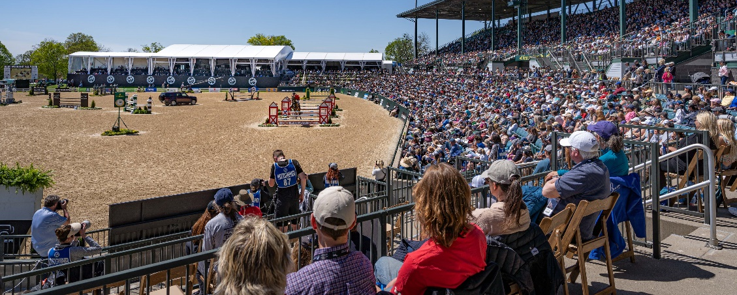
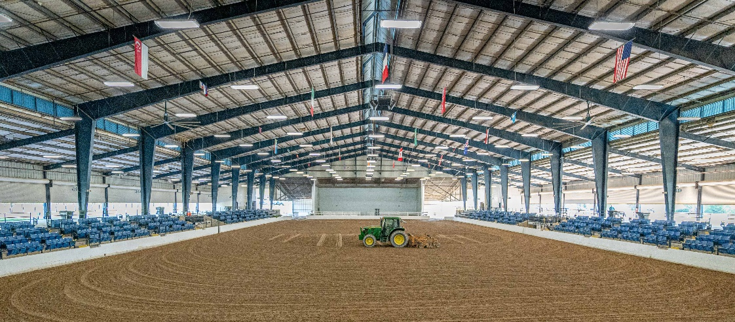
Kentucky Horse Park
2026 – 28 capital plans
$6,000,000 | Competition Arenas
$1,500,000 | Covered Arena Roof Replacement

Slide 10

Kentucky Venues
2026 - 28 capital plans
$300,000,000 | Phase III – Land Planning and Renovations
$2,650,000 | KEC/KICC Elevator and Escalator Repair/Replace
$1,000,000 | KEC Infrastructure Replacement (MAP)
$5,000,000 | KICC Pedway System Maintenance
$6,000,000 | KEC/KICC Lighting Replacement
$2,750,000 | Wayfinding Digital Signage
$1,000,000 | Louisville Transit Evaluation

Slide 11

Kentucky Fish and Wildlife
2026 - 28 capital plans
$10,000,000 | Ballard Wildlife Management Area Big Pump
$33,528,000 | New State Hatchery
$20,000,000 | Indoor Gun Range / LE Training Facility

Slide 12

Questions?

