Slide 1
EASTERN KENTUCKY UNIVERSITY

Slide 2
EKU IS KENTUCKY’S UNIVERSITY
EKU at a Glance
Enrollment: 15,673 - Largest regional university in Kentucky in degree-seeking students
43% of this year’s graduating class were Pell recipients or Pell-eligible
40% of EKU’s class of Spring 2025 are the first in their family to attain a higher education degree
No. 2 nationally for Military Friendly® Spouse Schools and top-ranked in Kentucky for Military Friendly® Schools
No. 1 University in Kentucky for retaining graduates for the Kentucky workforce
Signature programs:
Nursing
Occupational Therapy
Aviation
Manufacturing Engineering
Education
Criminal Justice

Slide 3
Center for Health Innovation - $330M
D.O. Accreditation Escrow - $50M

Slide 4
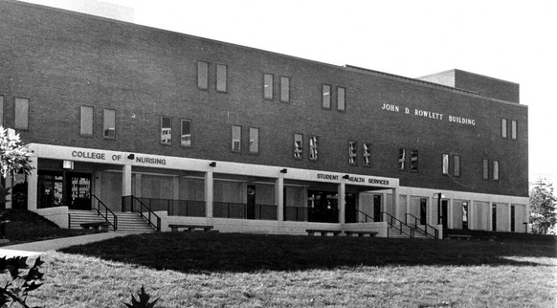
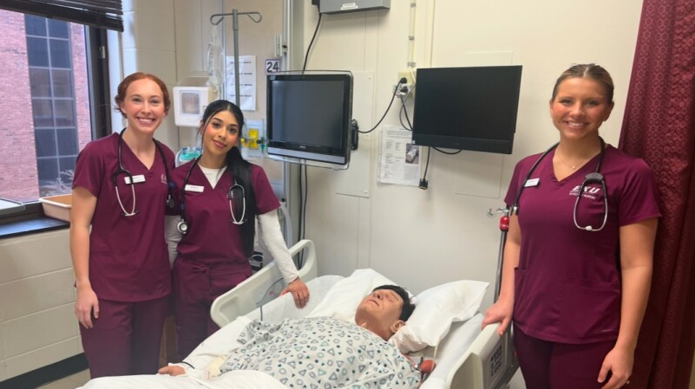
New instructional space for Osteopathic Medical Program & other health programs
Urgent need for more healthcare providers across the Commonwealth of Kentucky
EKU Student Success (2024 Pass Rates)
100% - BSN Nursing NCLEX
100% - ASN Nursing NCLEX
100% - Dr. of Occupational Therapy NBCOT
Fragmented, outdated facilities impact & limit instructional collaboration for almost 2,500 students pursuing degrees in programs like:
Doctorate in Clinical Psychology, nursing, mental health counseling, occupational therapy, public health, medical laboratory science, communication disorders, pre-med, paramedicine, biomedical sciences, and emergency medical care
New building to house 3,000+ students with spaces for immersive learning and collaboration
THEN - 1976.
NOW – 50 YEARS LATER.

Slide 5
Air Traffic Control & Aircraft - $10M

Slide 6
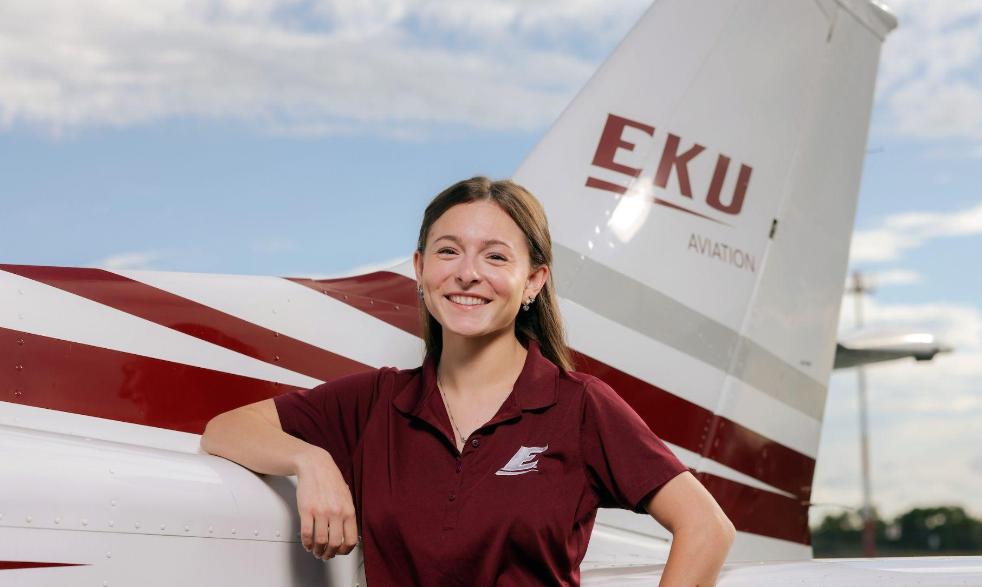
FAA AIR TRAFFIC CONTROL TRAINING PROGRAM - $5M Startup for Facility and Equipment
SB 87 directs CPE with the Transportation Cabinet to assess public universities’ capabilities of offering a Federal Aviation Administration-recognized air traffic control safety program
EKU would like to offer the program
EKU AVIATION - $5M for aircraft replacements
Kentucky’s only 4-year university-based flight program; enrollment nearly 500 students from 25 states
30 planes; average age of aircraft is 31 years old
Includes 4 leased aircraft (all manufactured before 1986 with avg. of 18,000+ flight hours)
Require high level of maintenance = increased cost and time out of commission
Includes 4 EKU-owned aircraft (manufactured in 1980, 1982, 1983, 1998 with avg. of almost 12,500 flight hours)
Replacing aging aircraft with newer models will standardize instrument training and ensure students train with modern avionics

Slide 7
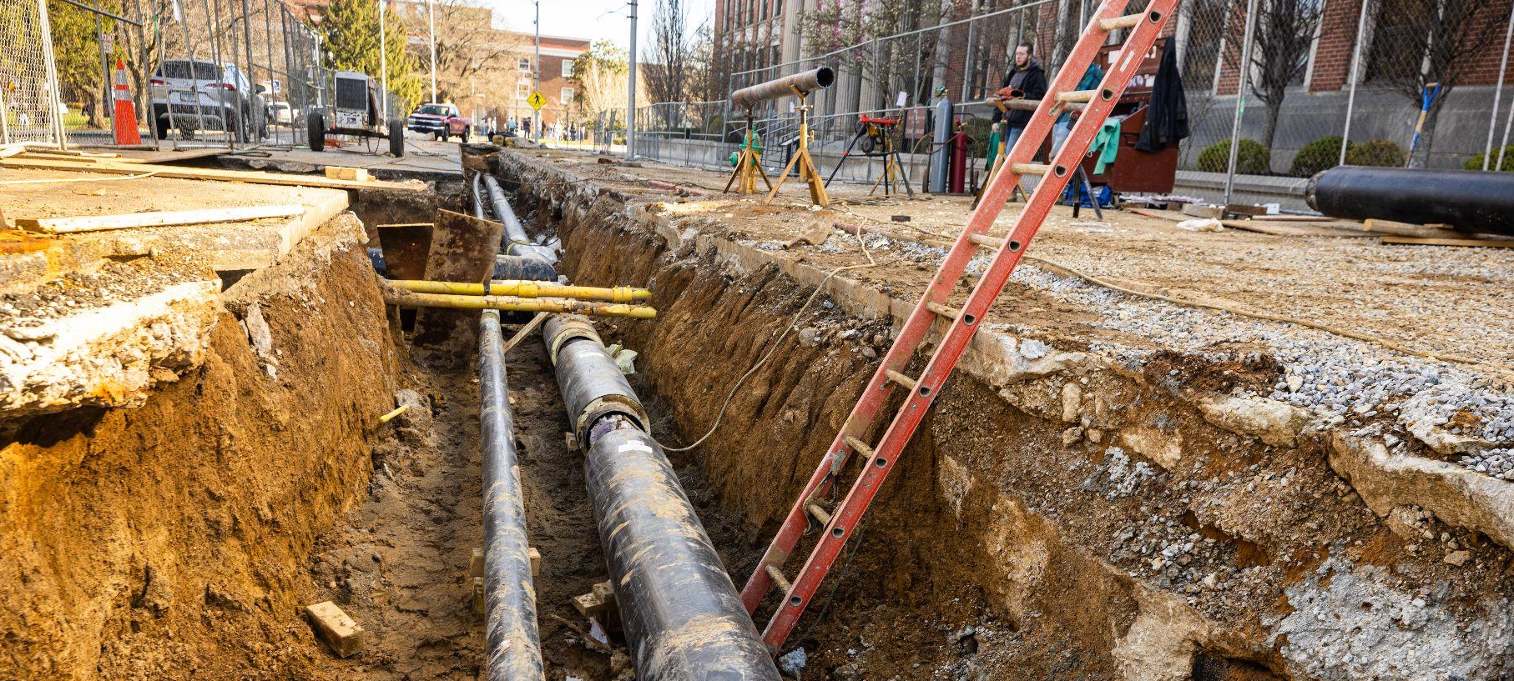
ASSET PRESERVATION - $75M

Slide 8
Total 2024 Asset Preservation Pool for EKU: $51.82M
$62.7M from the ‘22-24 pool
$43.5M from the ‘24-26 pool, approved by the Board of Regents, CPE and Office of the State Budget Director
Projects underway with the remainder in reserve for potential cost fluctuations
$75M requested for ‘26-’28 to assist with urgent maintenance needs
Critical campus infrastructure services
Heating, steam, water delivery systems
Electrical support systems
Elevator replacement
Building HVAC upgrades
Restoration of aged facility exteriors, roofs, and worn facility interiors

Slide 9
THANK YOU!
QUESTIONS?

