Slide 1

Capital Planning Advisory Board
2026-2032 Six Year Capital Plan Overview
July 9, 2025

Slide 2
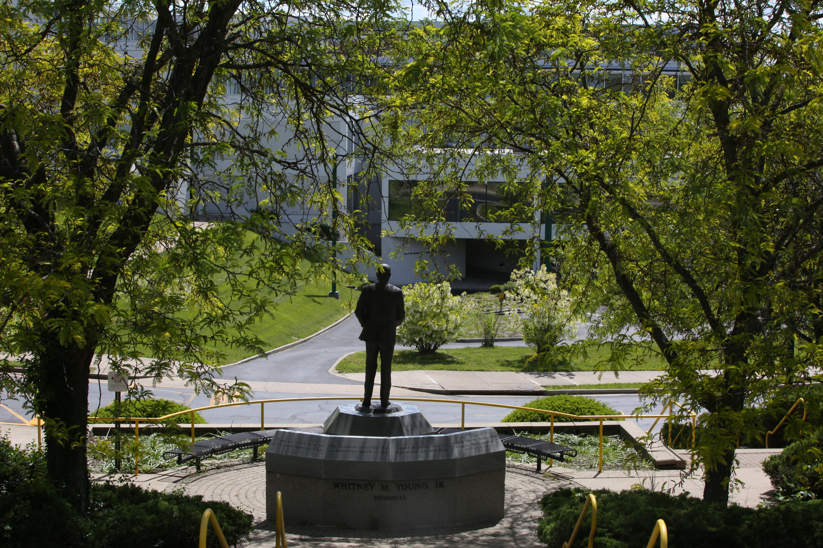

Slide 3

Completed Projects
Residence Hall
Roof Projects
Campus Renovations
Exum Athletic Center
Blazer Library
Carver Hall – Academics
Jordan Building – Facilities
The Halls – Residence Hall
McCullin Hall – Residence Hall
  Hume Hall
  Walkway Improvements & Misc. Repairs (Phase I)
  Bell Gym Exterior Stairs
  Shauntee Hall – HVAC Replacement
  Exum Athletic Center – Interior Renovations
  Bradford Hall – Academic Interior Renovations
Combs Hall (106 Beds)
Note: Campus Master Plan – Completed in 2023

Slide 4
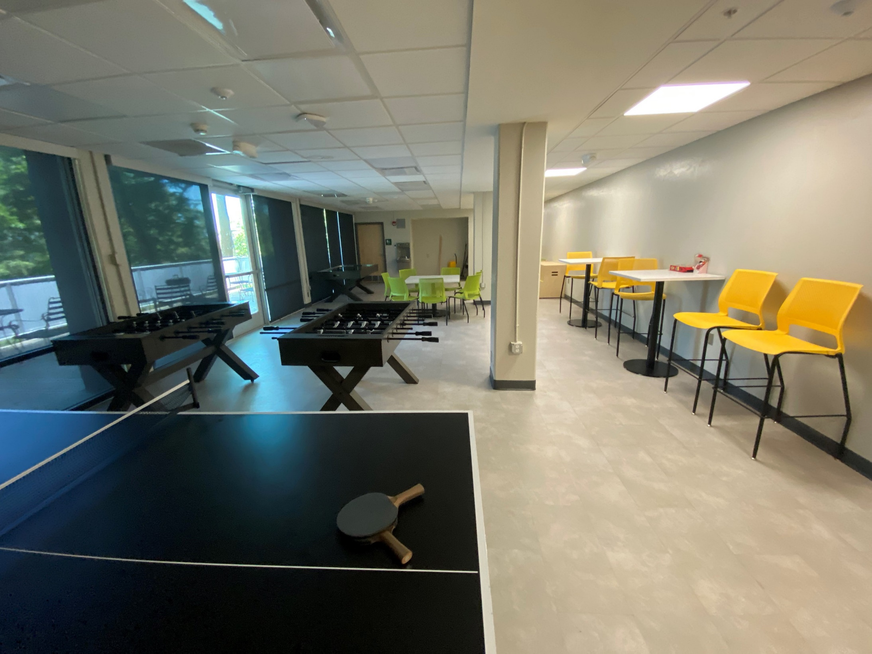
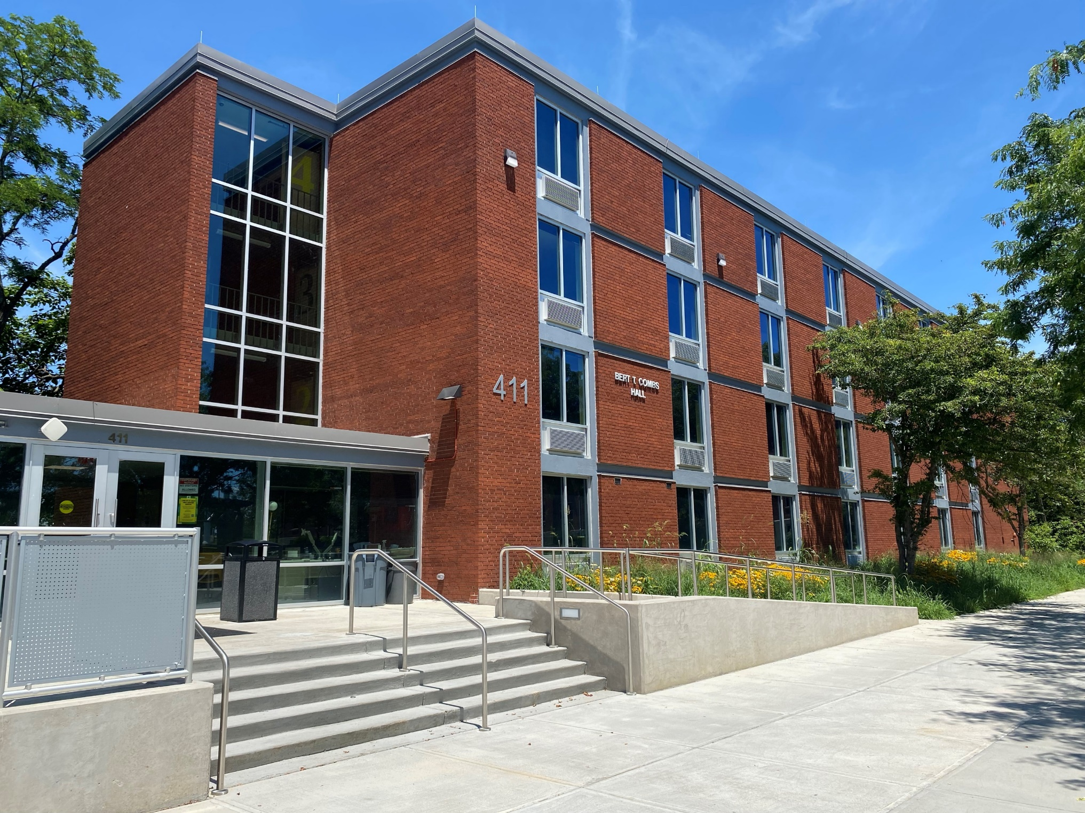
Combs Hall –Renovation

Slide 5
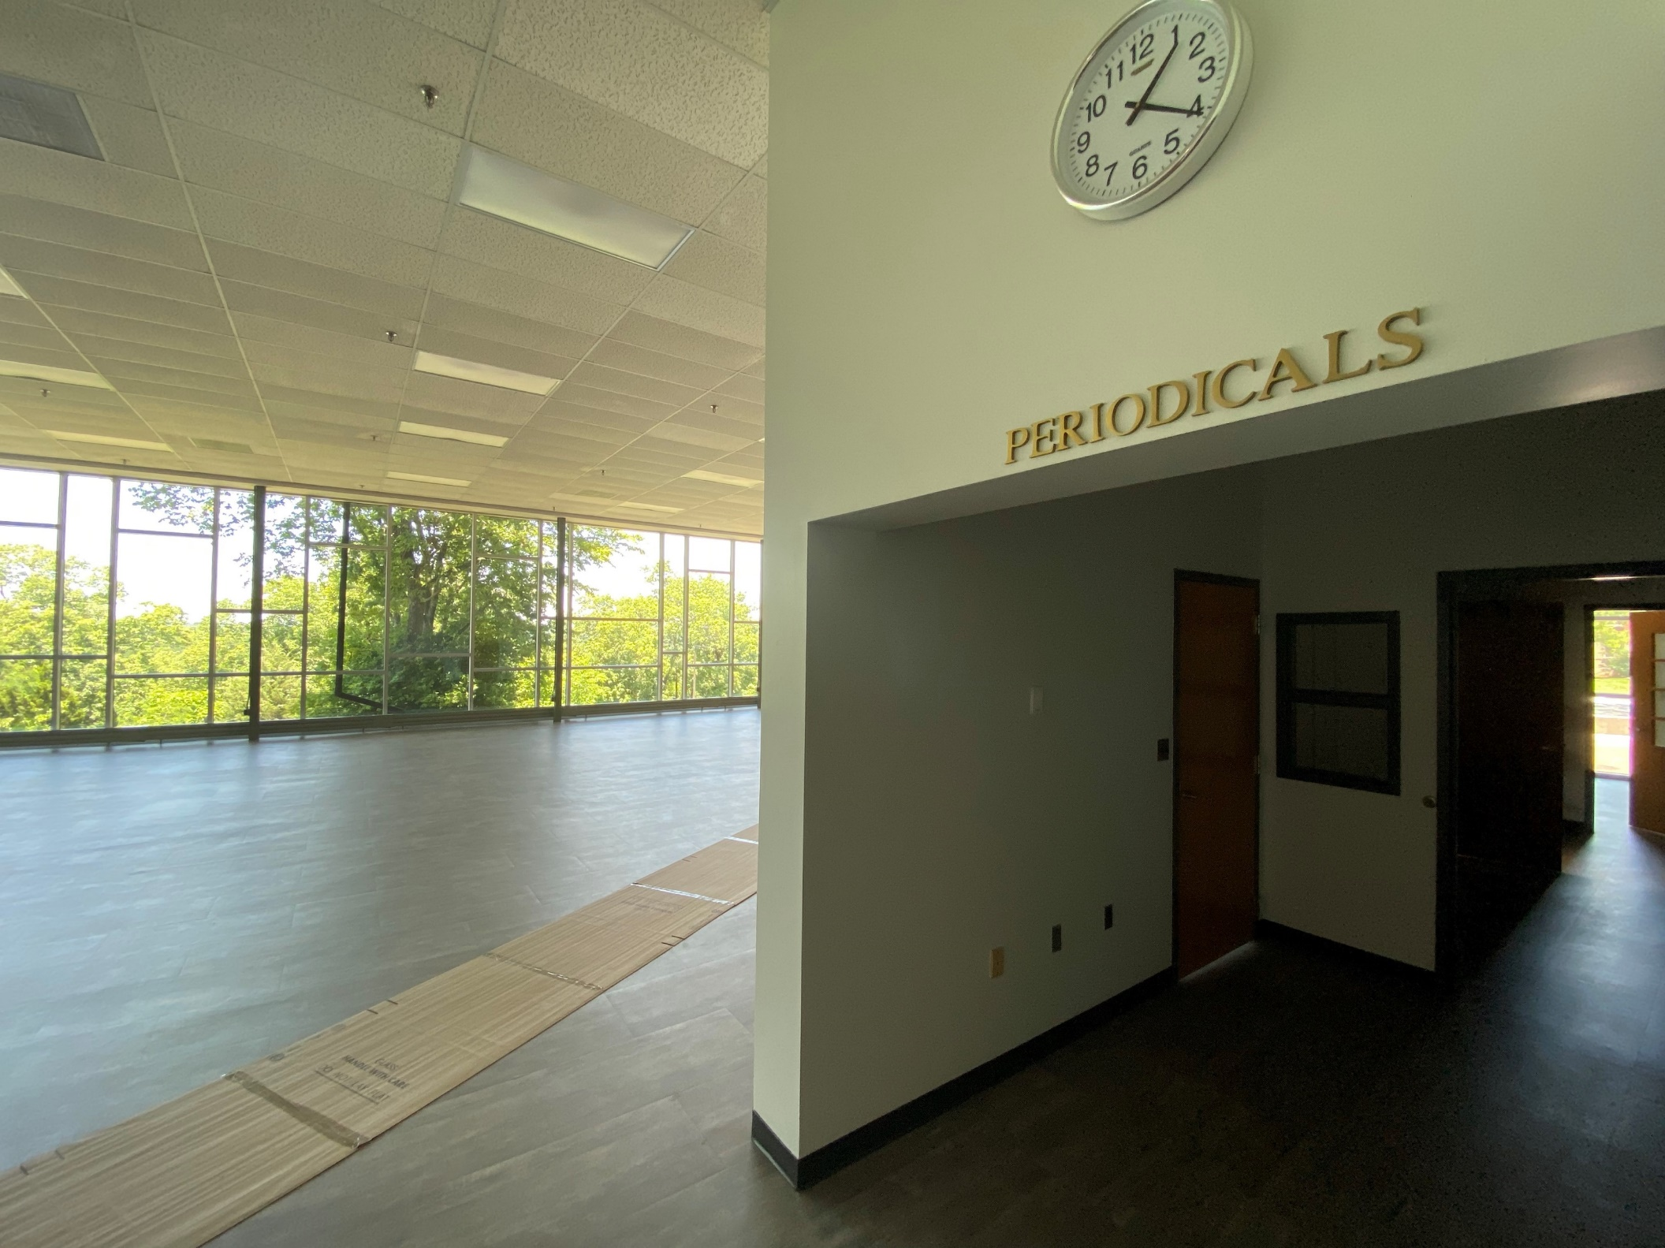
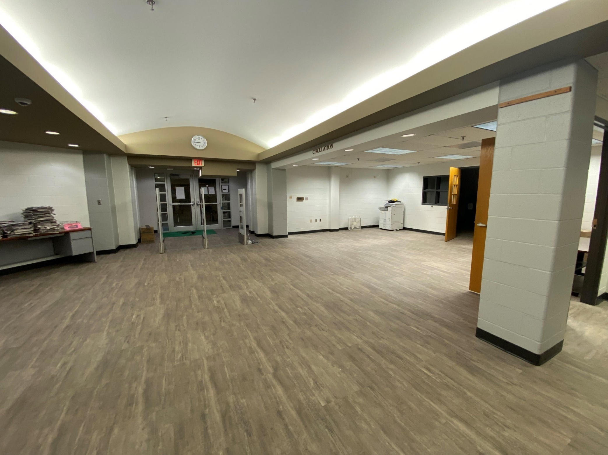
Blazer Library Renovation

Slide 6
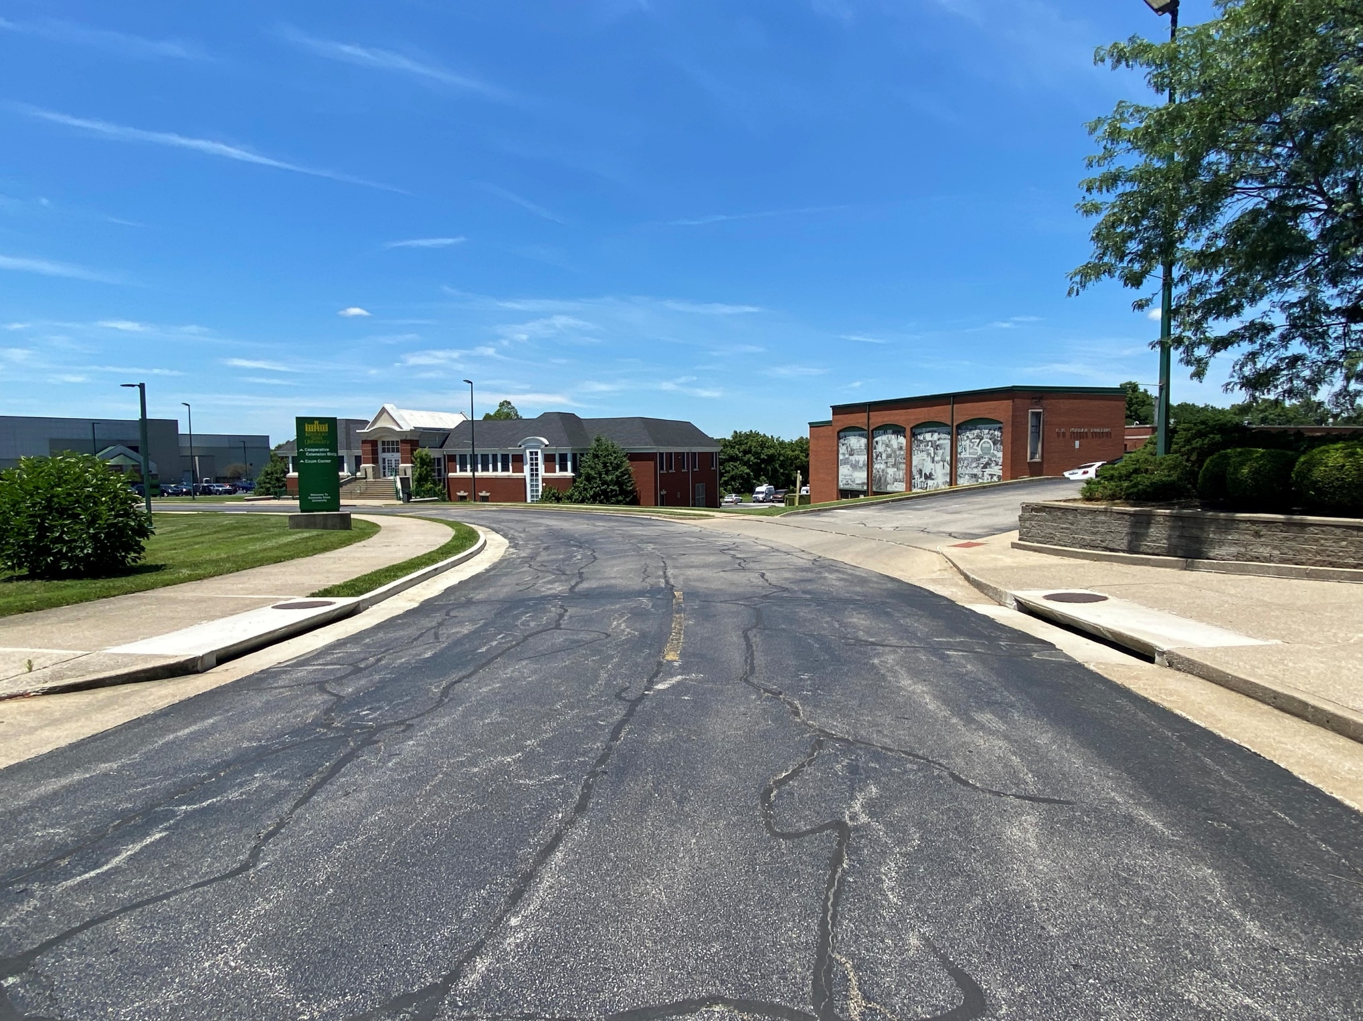
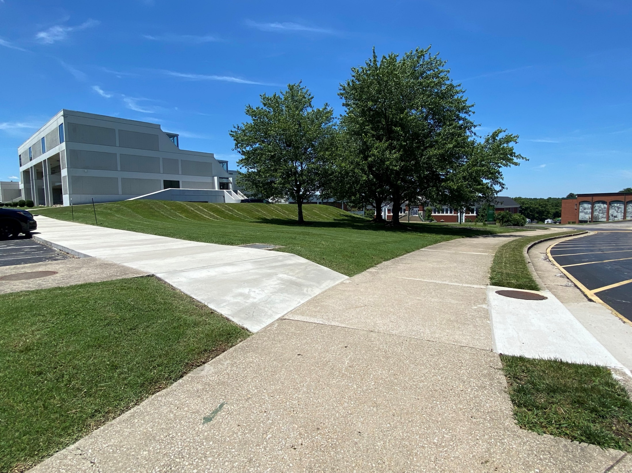
Walkways and Site Improvements Phase I

Slide 7
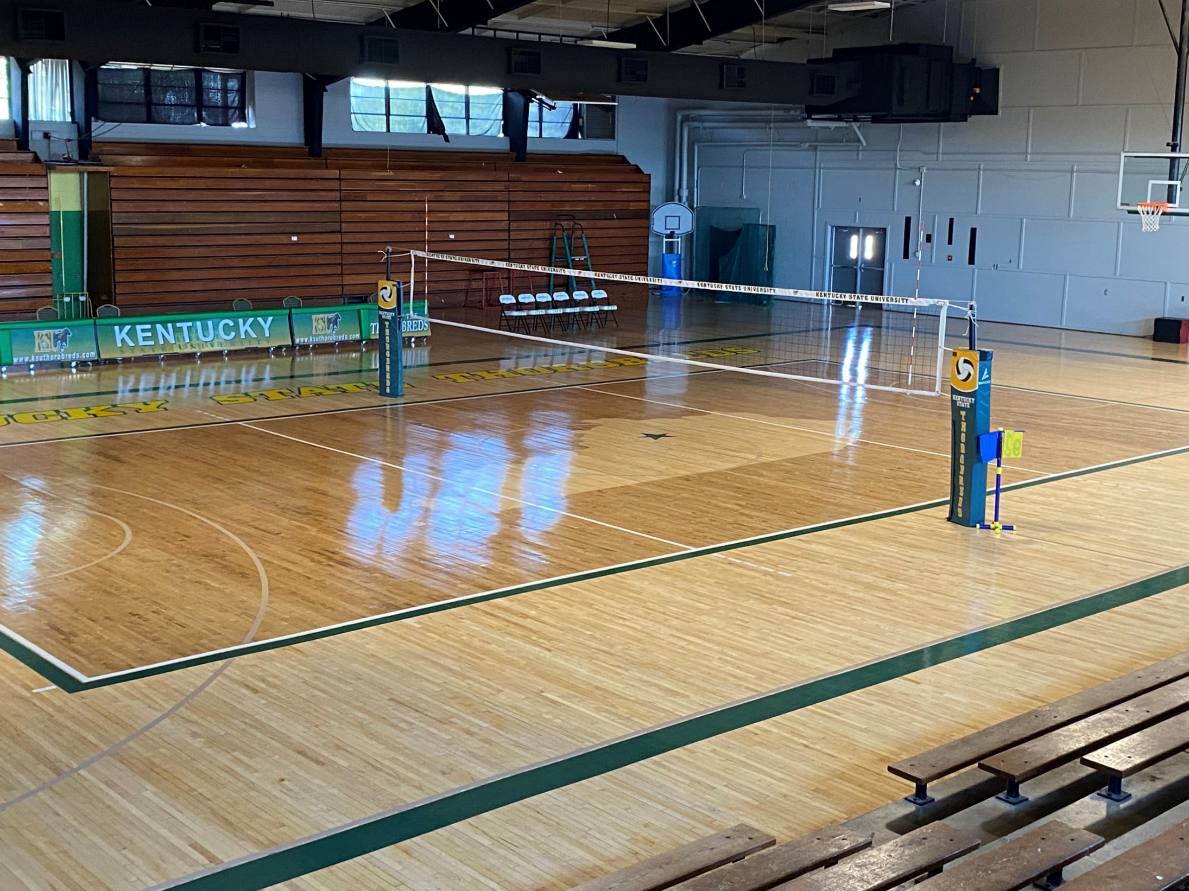
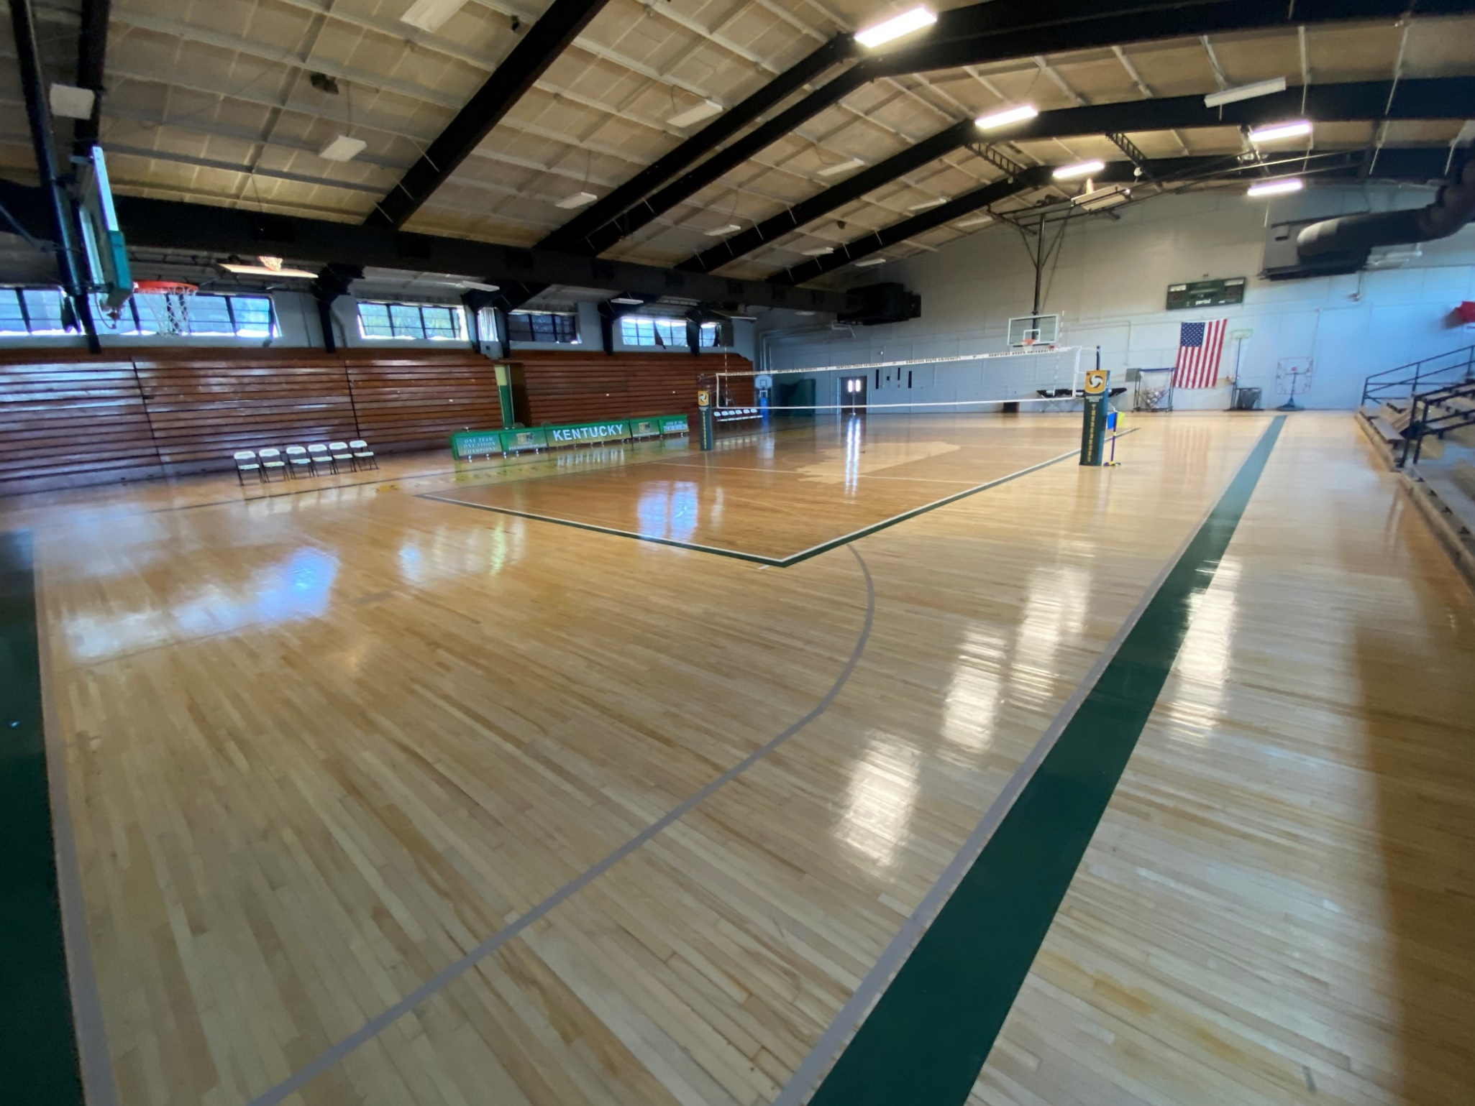
Bell Gymnasium Floors and Windows

Slide 8
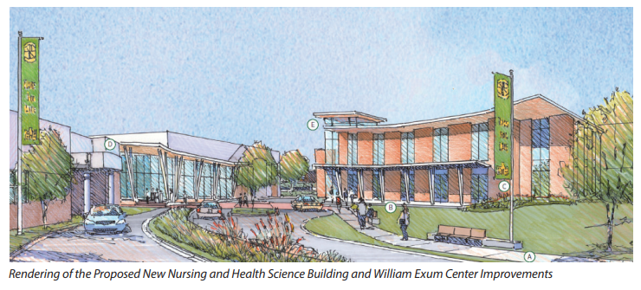
Priority 1 - Health Sciences Center - Design
KSU’s School of Nursing is poised to grow exponentially with the further development of present and new academic programs to help in making America healthy again.
The proposed multipurpose and functional space will include:
Modern classrooms and conference space
Learning laboratory (virtual hospital)
Debriefing rooms
Student study spaces
Offices for faculty and staff
Laboratory spaces for:
  Nutrition
  Research on chronic diseases
  General research in agriculture

Slide 9
Current Projects
  Chandler Hall: (Construction) - completion expected June 2026
  Hunter Hall Renovation: (Design) - completion expected January 2027
  Kentucky Hall Renovation: (Design) - completion June 2027
  McCullin Hall Exterior Repairs: (Design/Bid) - construction will occur Fall 2025
  Elevator Repairs - McCullin & Young Halls: (Design/Bid) - completion expected May 2026
Residence Halls
Roof Pool
  Bradford Hall: (Construction) - Substantial completion Fall 2025
  Academic Services Building: (Bidding) - Substantial completion July 2026
HVAC & System Upgrades
  Campus Wide HVAC Replacement: (Programming)
  Door Access Controls upgrade for Lockdown and system improvements: (Construction) - Implementation expected Fall 2025

Slide 10
Current Projects - cont’d
Campus Renovations:
  Walkway Improvements & Misc. Repairs (Phase II): (Design) - Completed Spring 2026
  Bell Gym Renovations: (Construction) - Completed Fall 2025
  Rosenwald Center - HVAC Replacement: (Construction) - Completed October 2025
  Exum Athletic Center - Exterior Renovations: (Bidding) - Completed April 2026
  Bradford Hall - Exterior Windows Renovations: (Construction) - Completed March 2026
  Academic Service Building - Exterior Windows Renovations: (Bidding) - Completed March 2026

Slide 11
Future Priority and Asset Preservation Projects -
Health Sciences Center Construction - $54M
STEM Academics Building
Asset Preservation Projects:
  The Halls Renovation (321 beds)
  Shauntee Hall Renovations
  Carver Hall – Academics
  Walkway Improvements & Misc. Repairs (Phase III)
  Campus Wide Asphalt Repair and Resurfacing
  Jackson Hall Interior Renovation
  Chappell Hall Interior Renovations
  Campus Wide HVAC/systems Replacement & Upgrades Implementation

Slide 12
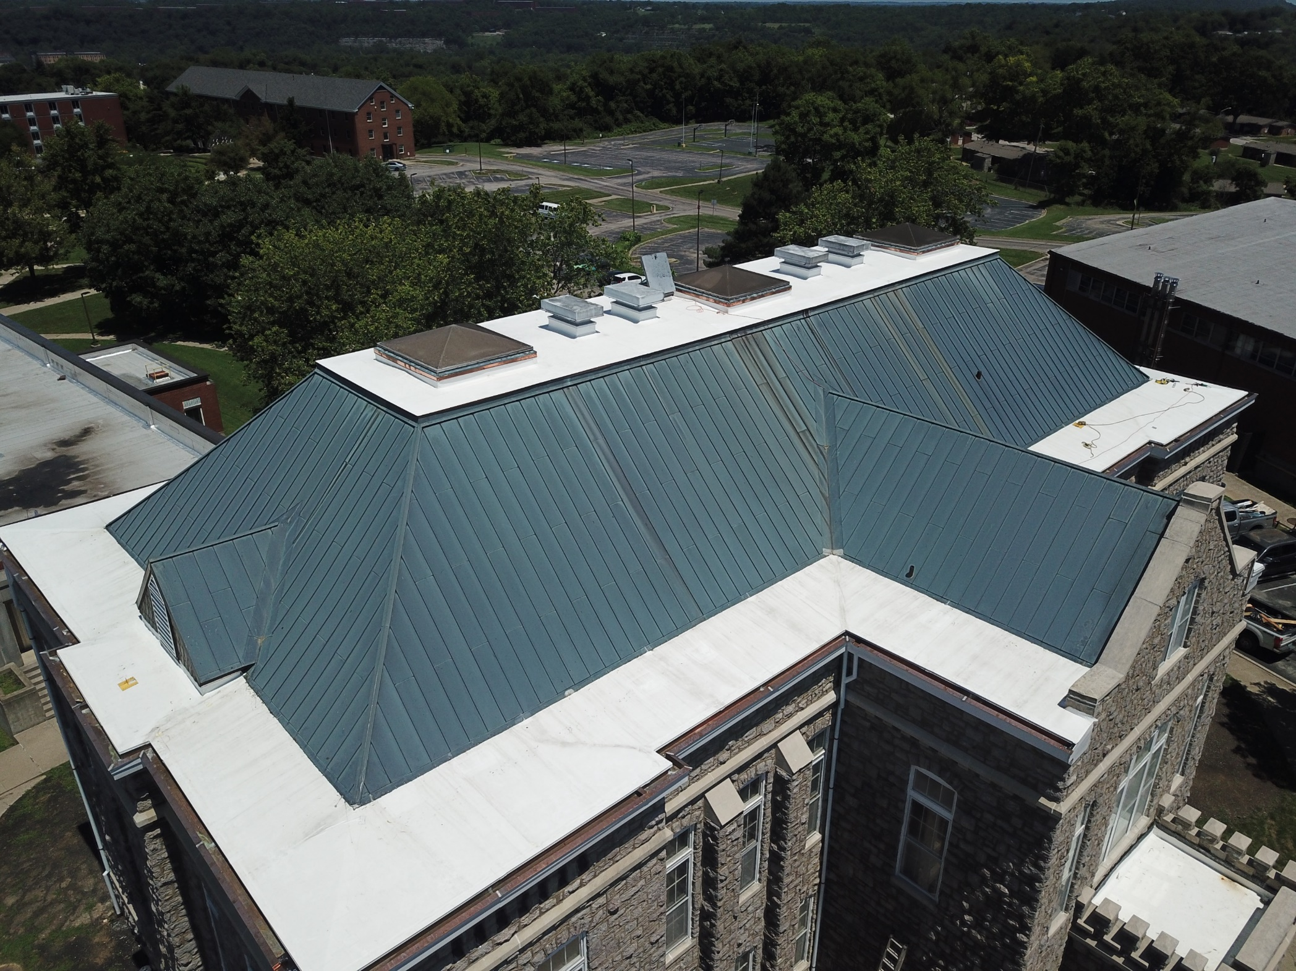
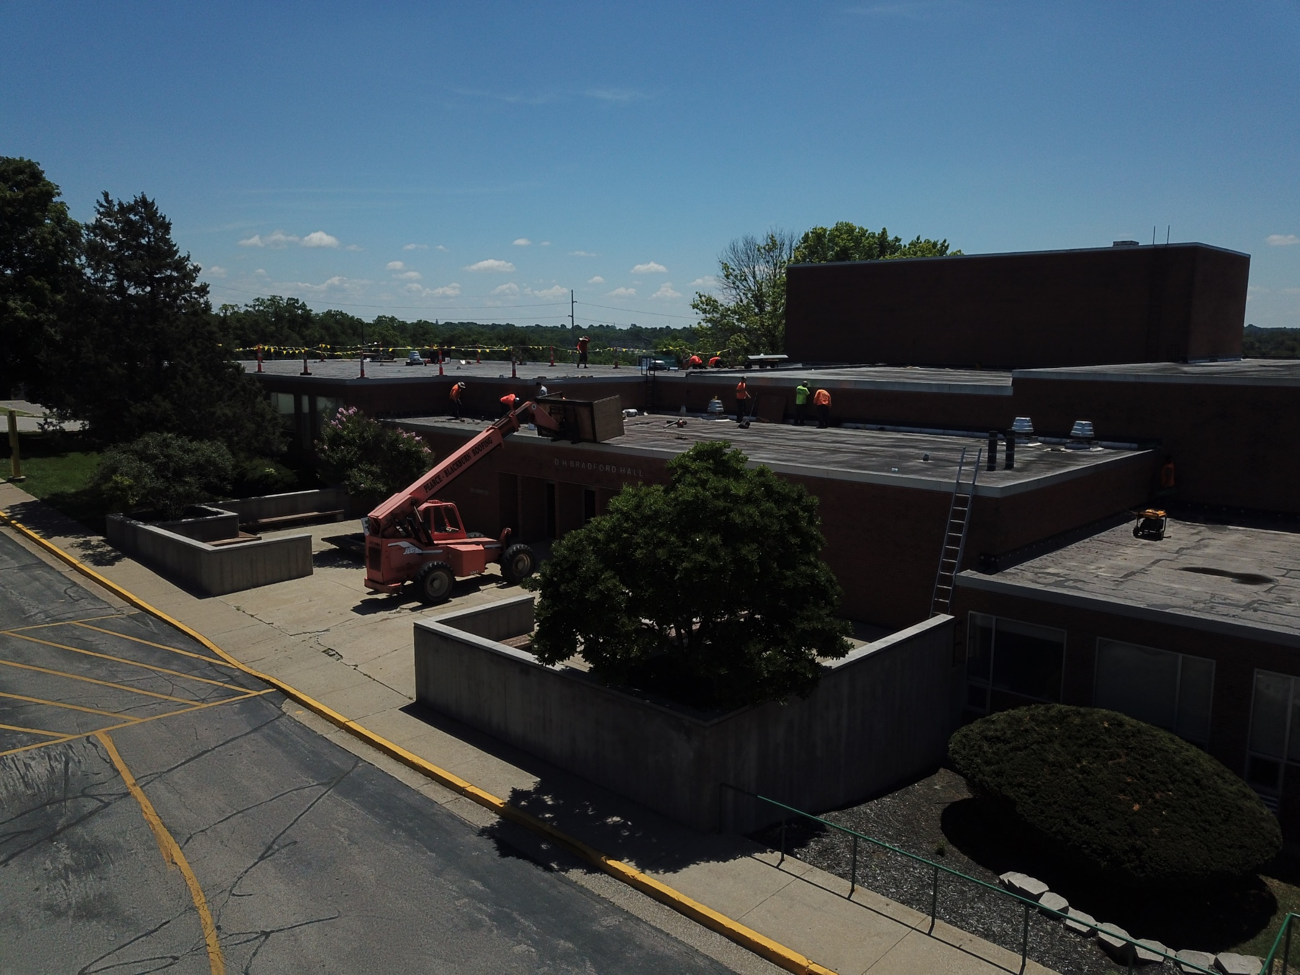
Bradford Hall and Hume Hall Roof Projects

Slide 13
Thank your for time and attention
Questions?

