Slide 1
2026-2032
Six Year Capital Plan
CPAB Presentation
July 9, 2025

Slide 2
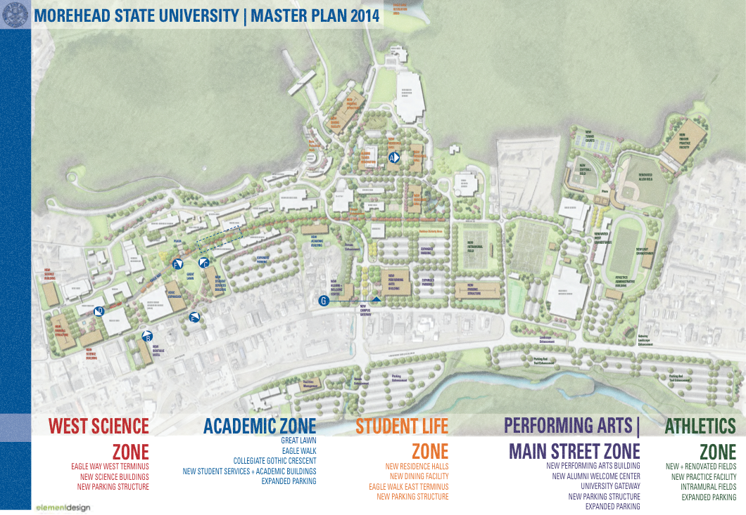
Overview Campus Master Plan Update 2025
Goal:
Enhance existing campus facilities
Better utilize existing facilities
Replace outdated facilities
Reduce building footprint & operational costs

Slide 3
Overview Campus Master Plan Update 2025
Since 2017:
Razed/Disposed 17 buildings = 290,000 SF
Reduced Operational Cost
Propose to Raze/Dispose 5 buildings = 450,000 SF
Replace With Highly Efficient Facilities

Slide 4
Overview Campus Master Plan Update 2025
Future:
29 General Fund Project Requests are for
the preservation of existing facilities
4 General Fund Project Requests are new construction to replace older facilities

Slide 5
Age of Morehead State University Facilities
MoSU Classroom/Lab Facilities
1920-1930 2 buildings 87,130 sq. ft.
1930-1940 1 building 101,343 sq. ft.
1950-1960 1 building 63,375 sq. ft.
1960-1970 4 buildings 288,844 sq. ft.
1970-1980 1 building 97,981 sq. ft.
2000-2010 1 building 48,452 sq. ft.

Slide 6
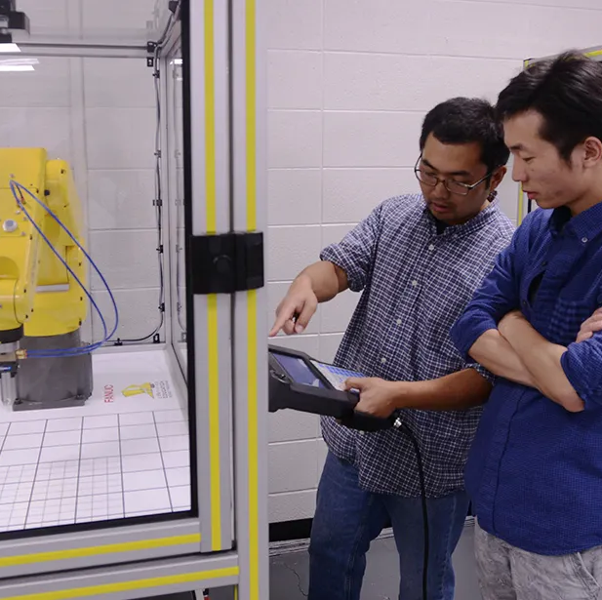
#1 Project Request Construct New Applied Science Building
Construct new 82,000 sq. ft energy efficient classroom & lab facility
Will include state of the art instructional technologies
Will provide new space for the applied science programs including; agriculture, psychology, surveying, construction management, computer technology and information systems, and technology management and marketing.
To be served by existing utility infrastructure
Reed Hall will be taken off-line once completed
General Fund Request- $79,400,000

Slide 7
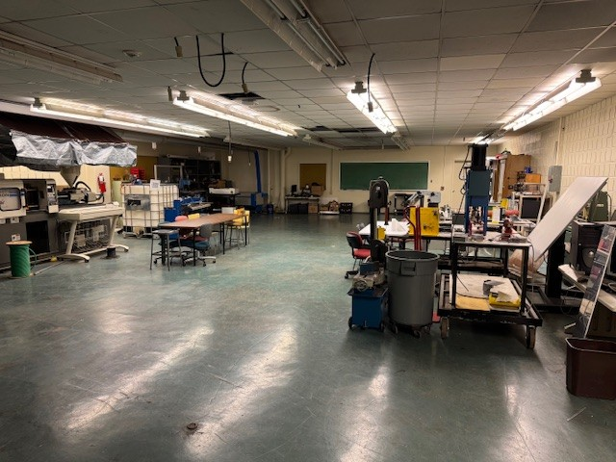
Existing Reed Hall

Slide 8
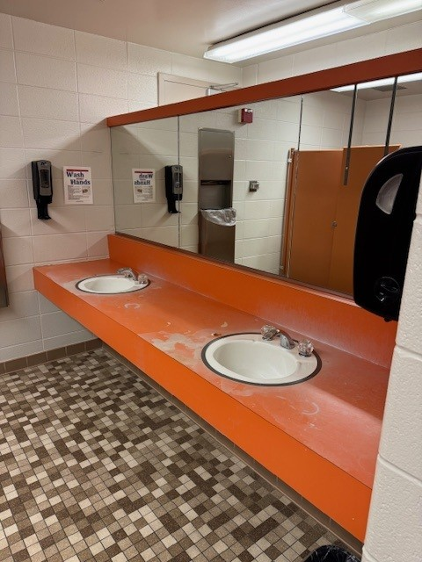
Existing Reed Hall

Slide 9
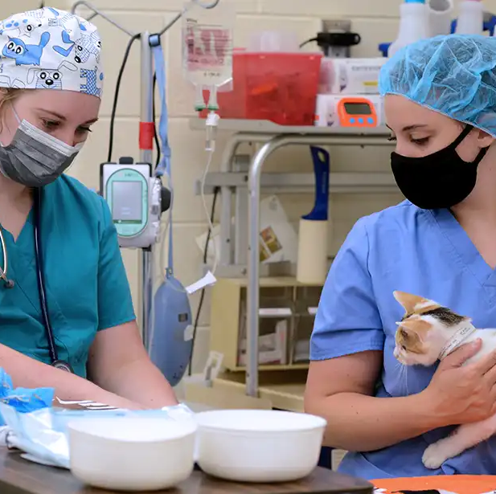
#2 Project Request Construct New Agricultural Science Building
Construct new 32,500 sq. ft energy efficient classroom & lab facility
Will include state of the art instructional technologies
Will provide new space for veterinary medicine, soil & plant science and other applied science programs
To be served by existing utility infrastructure
General Fund Request - $30,665,000

Slide 10
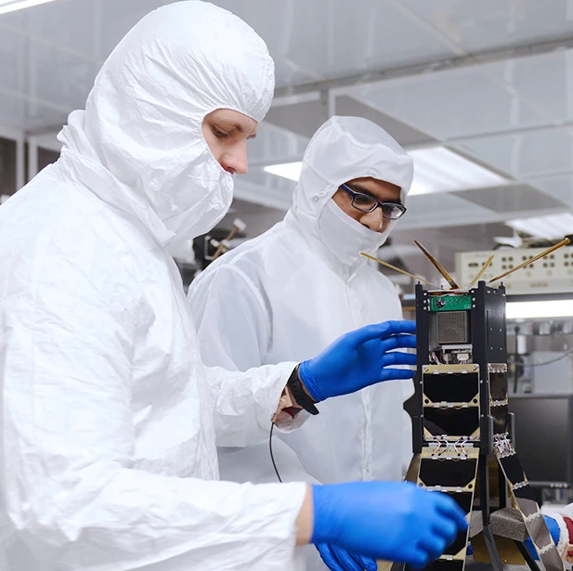
#3 Project Request Construct New Space Science & Emerging Technology Building
Construct new 21,500 sq. ft energy efficient classroom facility
Will include state of the art space systems instructional technologies
Will complement the existing Space Science Center by providing additional space to address this growing program
To be constructed on property currently owned by MoSU
To be served by existing utility infrastructure
General Fund Request - $24,000,000

Slide 11
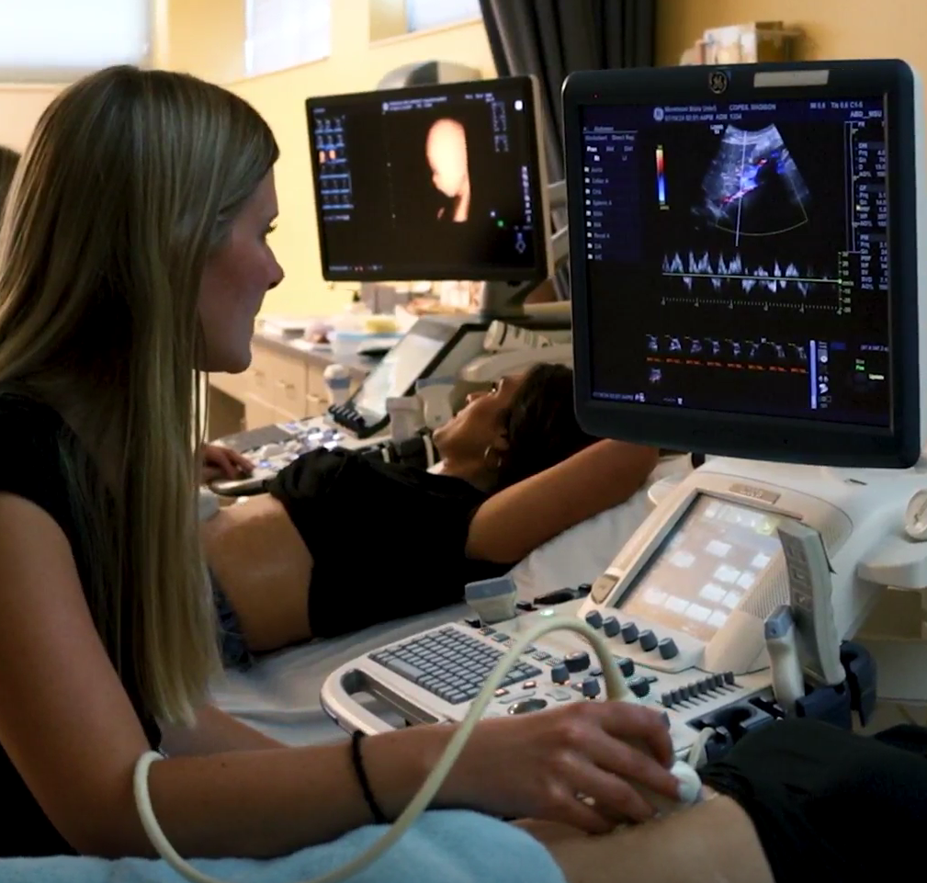
#4 Project Request Construct New Health Science Center
Construct new 20,000 sq. ft energy efficient classroom facility
Will include state of the art health systems instructional technologies
Will provide additional space for the growing Health Science including; Nursing, Diagnostic Imaging and other health related programs
To be constructed on property currently owned by MoSU
To be served by existing utility infrastructure
General Fund Request - $20,000,000

Slide 12
Top 5 AUXILIARY REQUESTS
Construct Residence Hall #3
Construct Residence Hall #4
Capital Renewal & Maintenance Pool
Auxiliary ADA Upgrades
Renovate & Replace Exterior Precast Panels – Nunn Hall

Slide 13
Questions?

