Slide 1


We are Racers
Capital Planning Advisory Board Meeting
Capital Plan Priorities
July 9, 2025
Dr. Ron K. Patterson, President

Slide 2
2026-2028 General Fund Priority Requests
New Construction, Capital Renewal, Life Safety, and Deferred Maintenance
New Construction for Priority Initiatives:
1. Emergency Veterinary & Teaching Clinic
4. UofL Medical Sciences Building Partnership
Building systems preservation/modernization, life safety & energy efficiency:
2. Asset Preservation Pool 2026-2028
3. E&G Building Systems Improvement Pool

Slide 3
2026-2028 General Fund Priority Requests
Capital Renewal, Deferred Maintenance, and Life Safety
$48,500,000 - Construct Emergency Veterinary & Teaching Clinic
$47,200,000 - Asset Preservation Pool – 2026-2028
$100,000,000 - E&G Building Systems Improvement Pool
$60,000,000 - Construct UofL Medical Sciences Bldg Partnership
$15,000,000 - Renovate Pogue Library
$ 7,000,000 - Replace Central Cooling Plant Equipment
$19,000,000 - Modernize Business Bldg. Elec, HVAC & Classrooms
$ 9,200,000 - Repair Stewart Stadium – Structural
$16,200,000 - Renovate Wells Hall
$ 7,500,000 - Renovate Blackburn HVAC PhII
$25,000,000 - Renovate Faculty Hall – Phase I
$ 3,270,000 - Upgrade Sparks Hall Electrical System
$ 3,500,000 - Replace Waterfield Windows and Doors

Slide 4
2026-2028 Agency Bond Requests
Agency Bond Priority #1
Construct Residential Housing
$47,000,000
Agency Bond Priority #2
Replace College Courts Apartments (1 to 5 Bldgs)
$30,000,000
Agency Bond Priority #3
Renovation/enhancement/construction of Athletic Facilities
$20,000,000
Agency Bond Priority #4
Asset Preservation Pool – Res Halls
$6,000,000

Slide 5
2026 General Fund Priority Requests
Emergency Veterinary & Teaching Clinic
School of Veterinary Medicine Program should be presented to CPE for approval in January 2026
Private gift of >$4M to support the program
MSU Foundation support of $2.5M
  MSU is not asking the General Assembly for start up funding for the School of Veterinary Medicine Program.
Emergency teaching clinic recommended by practicing veterinarians to support their needs during evenings and weekends
  This is not required for CPE program approval
Provide after hours emergency care for the State (value added approach)
Fully functional, state-of-the-art clinical facility to replicate actual practice

Slide 6
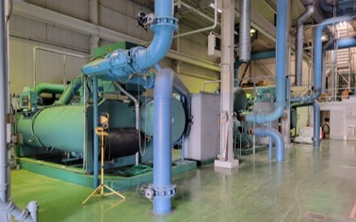
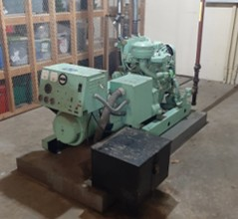
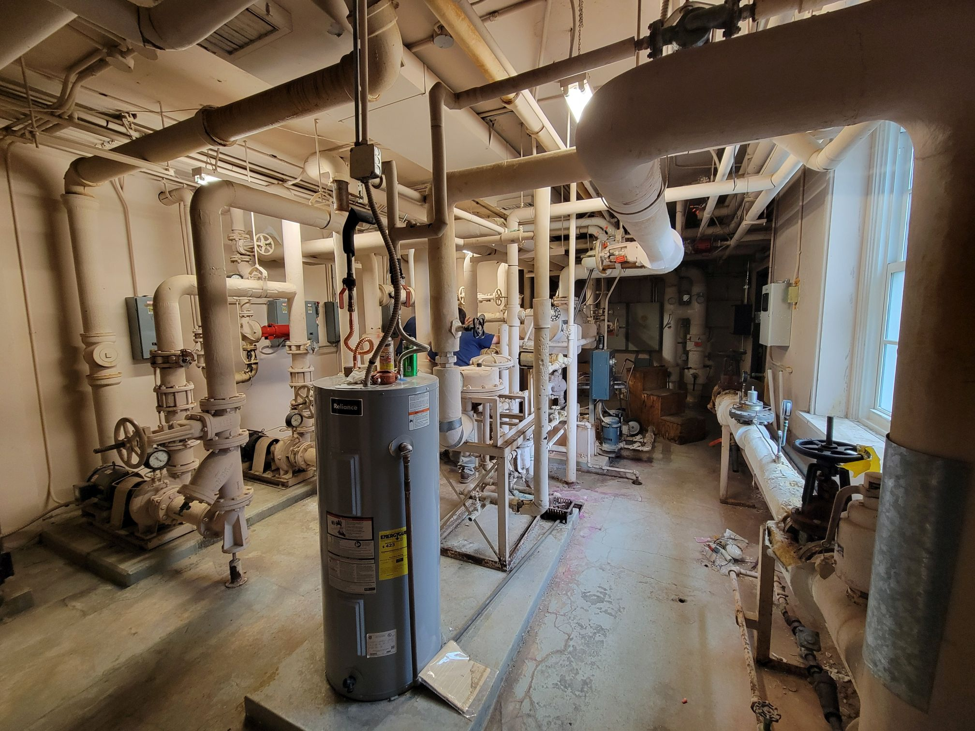
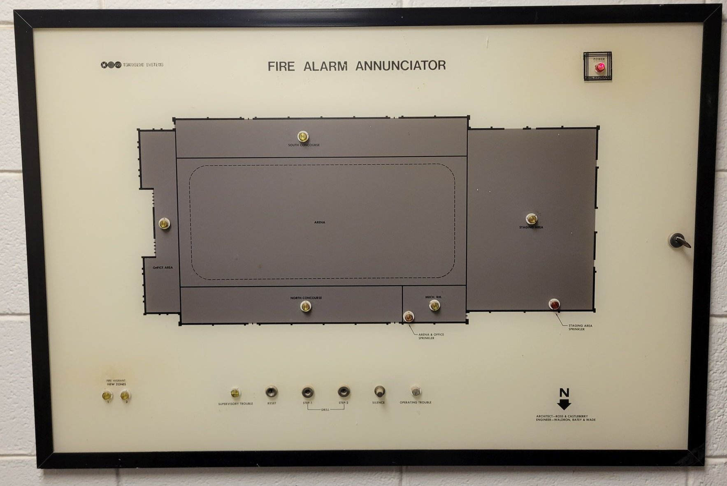
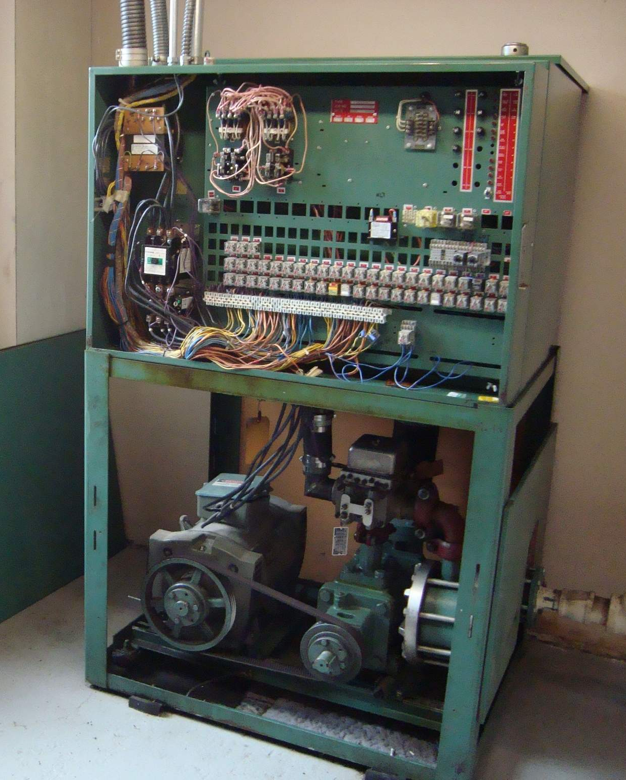
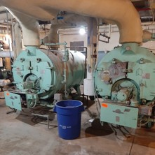
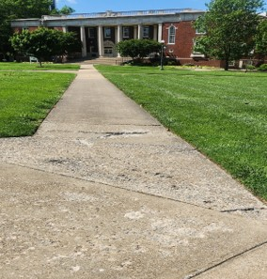
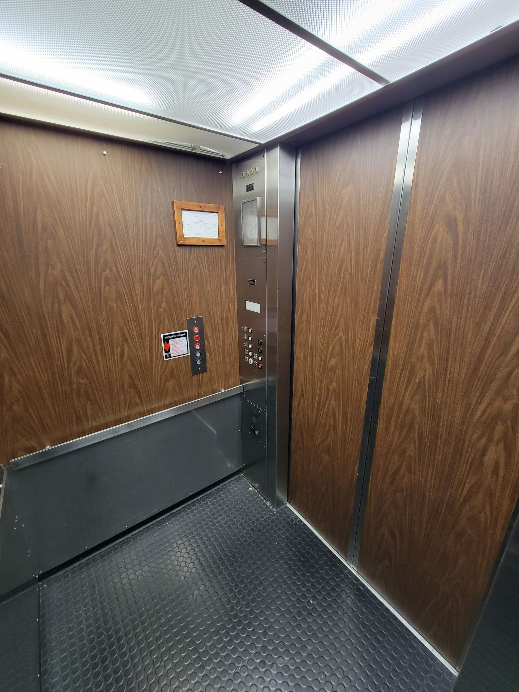
2026 General Fund Priority Requests
Asset Preservation
Building systems preservation/modernization, life safety, and energy efficiency

Slide 7
2026 General Fund Priority Requests
University of Louisville Medical Sciences Partnership Building
Partnership with the University of Louisville (UofL)
Construction the Medical Sciences Building at Murray State
Obtain 2+2 UofL medical school presence in Murray
Assist with the rural healthcare shortage in the region and state
Funding for the construction of the facility and needed medical teaching equipment

Slide 8
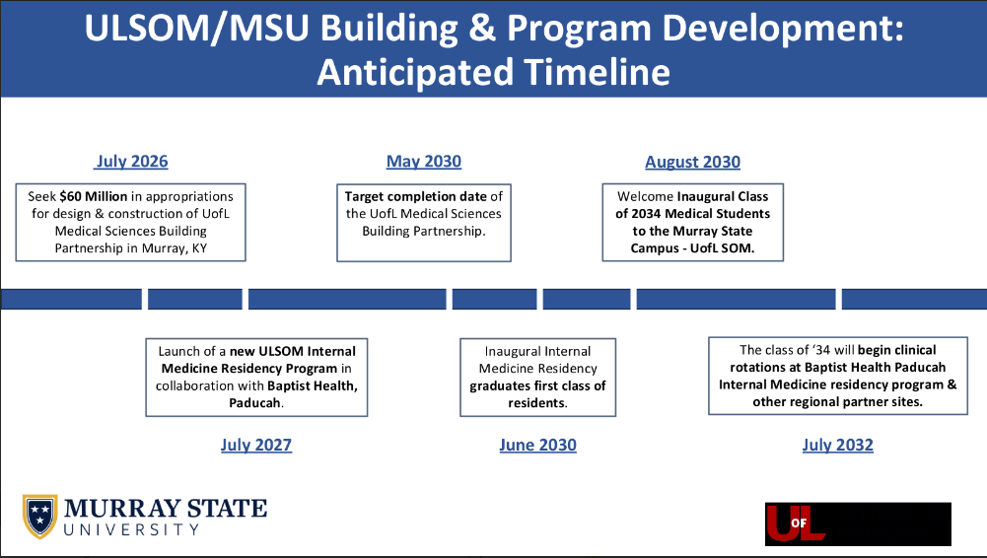
2026 General Fund Priority Requests
University of Louisville Medical Sciences Partnership Building

Slide 9
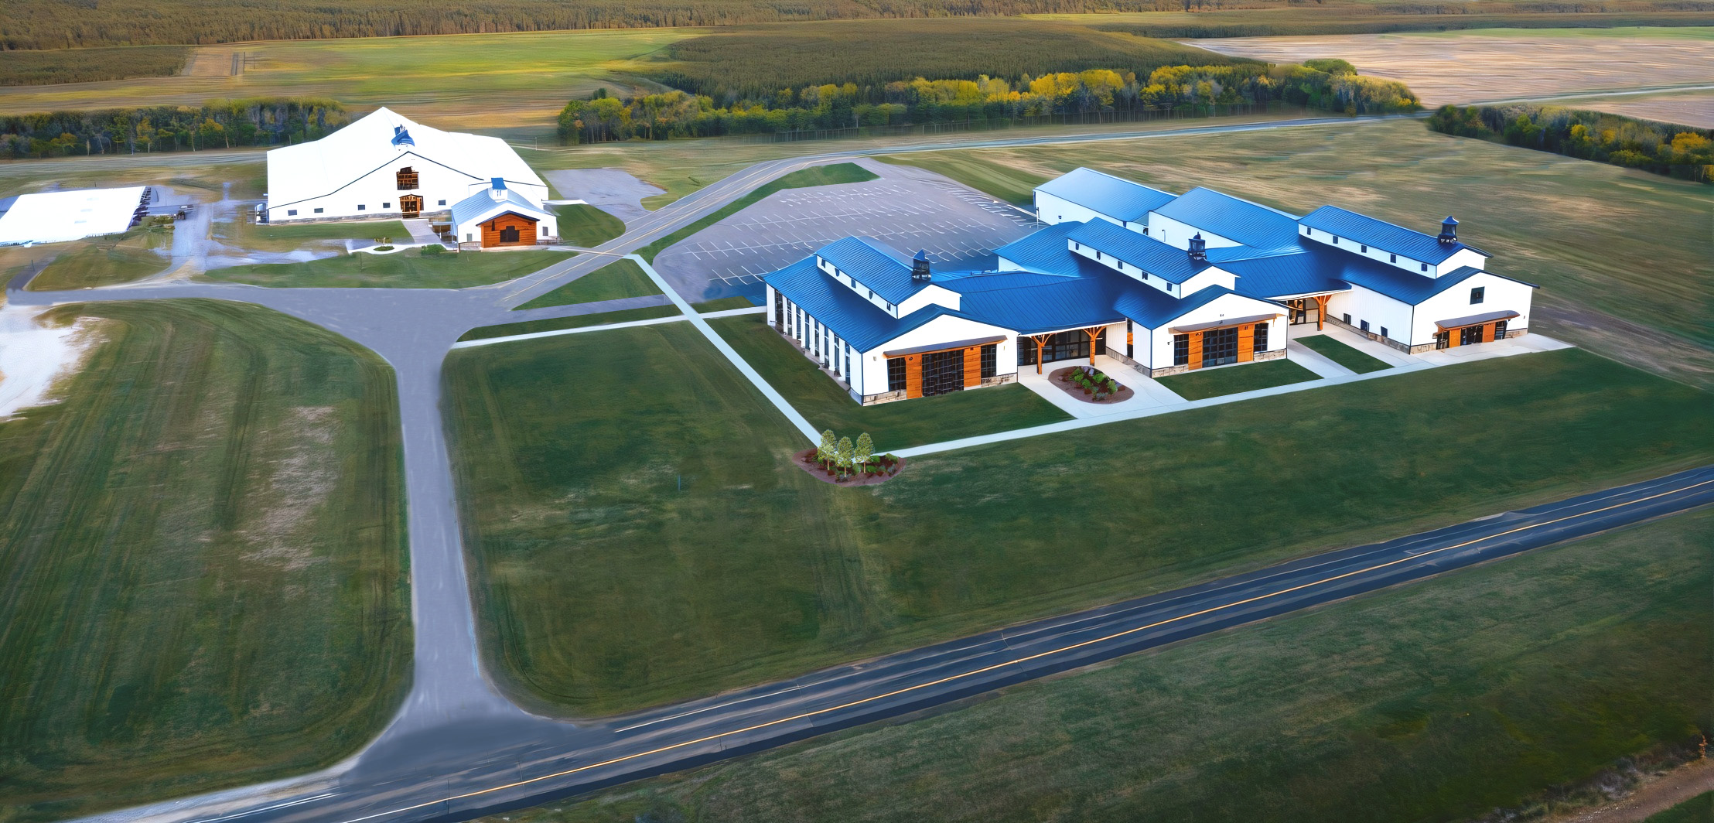
State-Funded Projects Update
Veterinary Sciences Building $60,000,000
Currently in design – Phase A
Planned new construction on the Murray State West Farm
Planned occupancy in August 2027
Conceptual Rendering

Slide 10
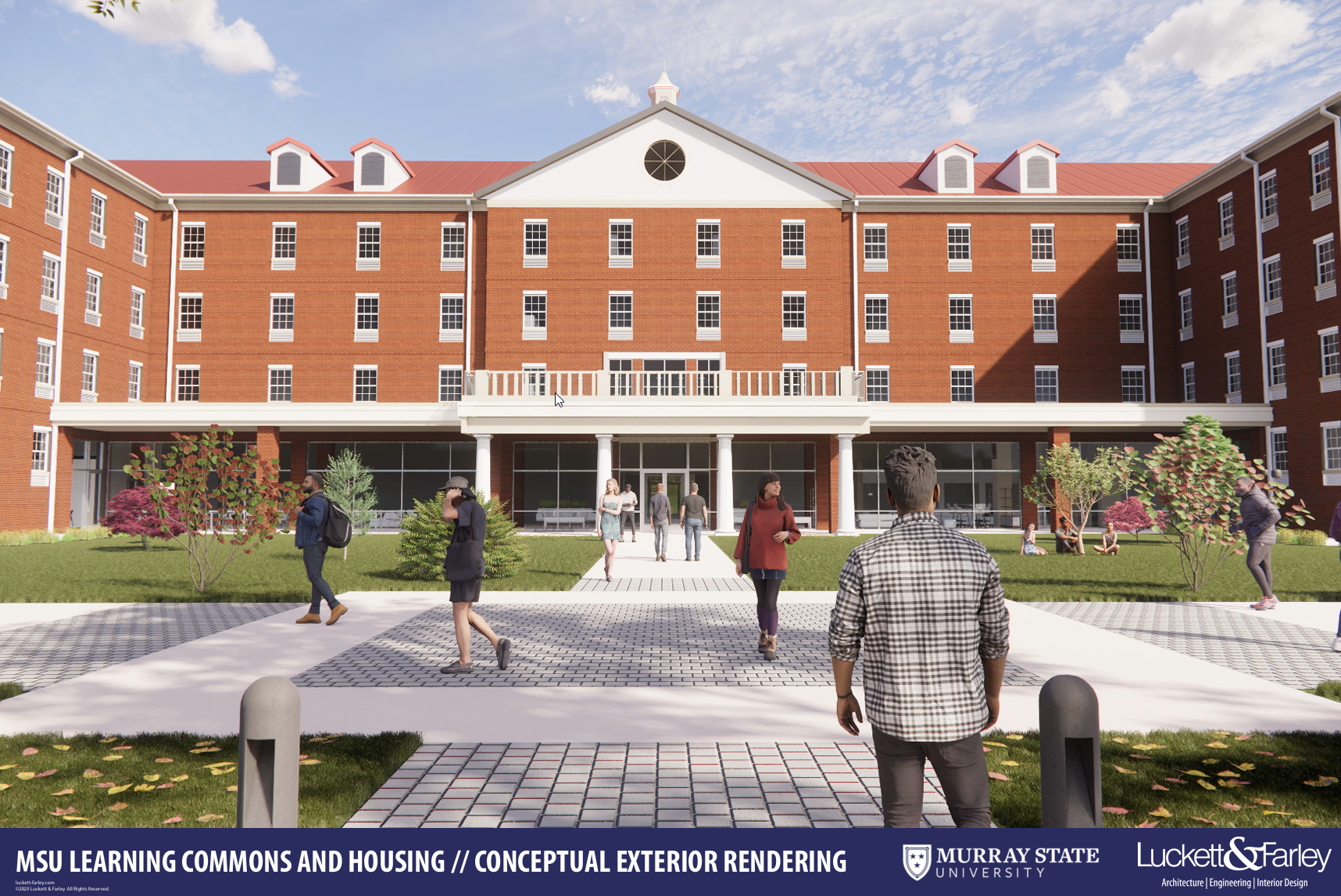
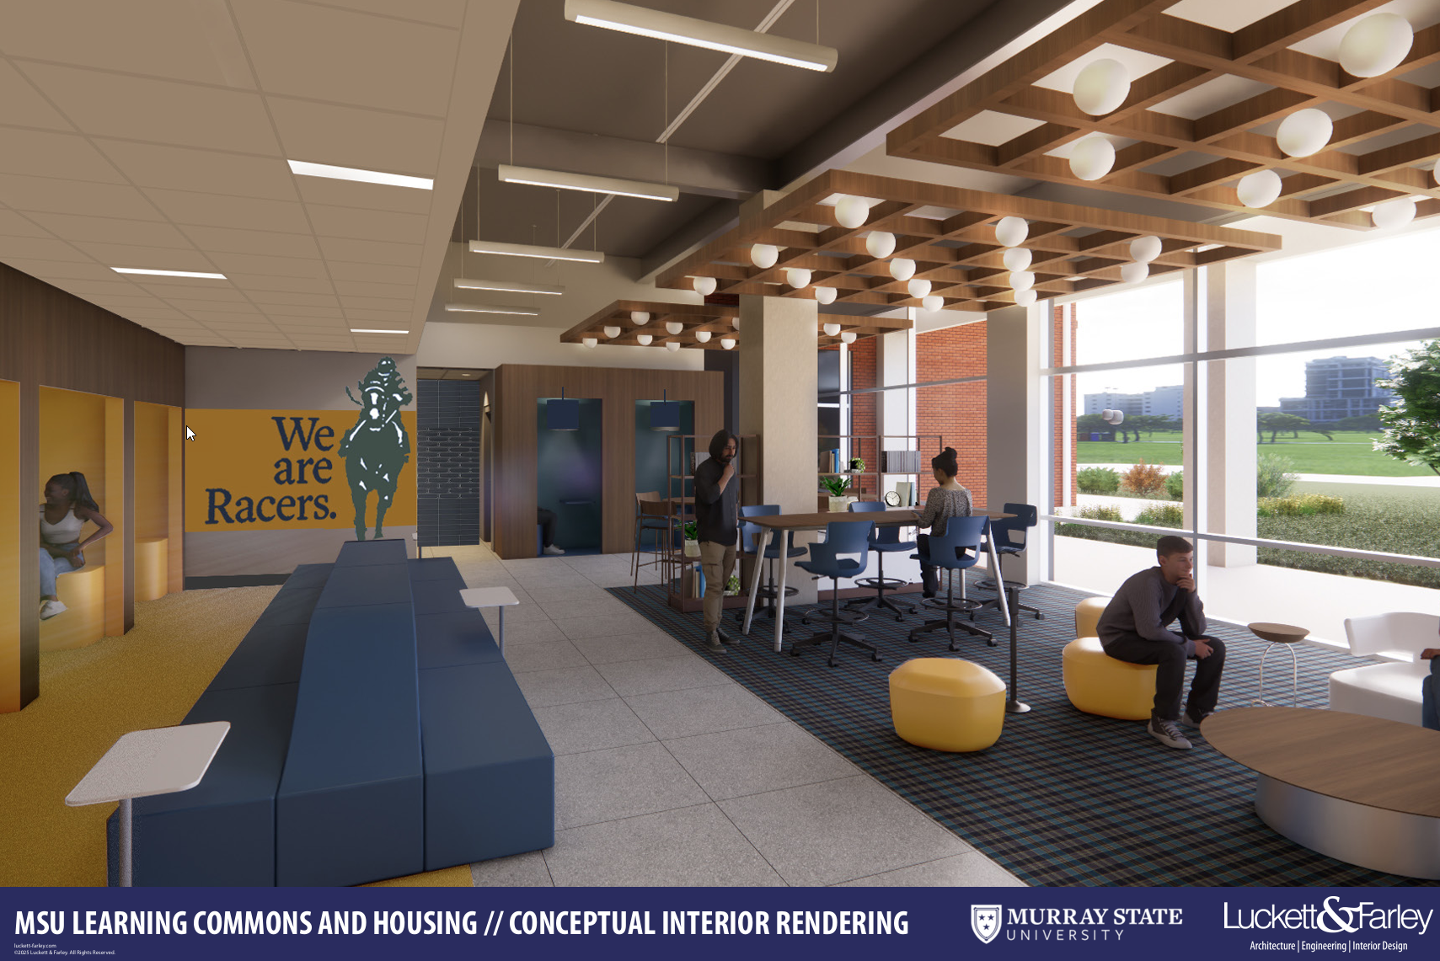
State-Funded Projects Update
Learning Commons w/Housing $38,000,000
Currently in design – Phase C
Planned new construction in the North main residential campus
83,370 SF – Student Success areas, dining amenities, and 254 beds
  Study rooms, meeting rooms, large classroom (120 people)
Planned occupancy in August 2027

Slide 11
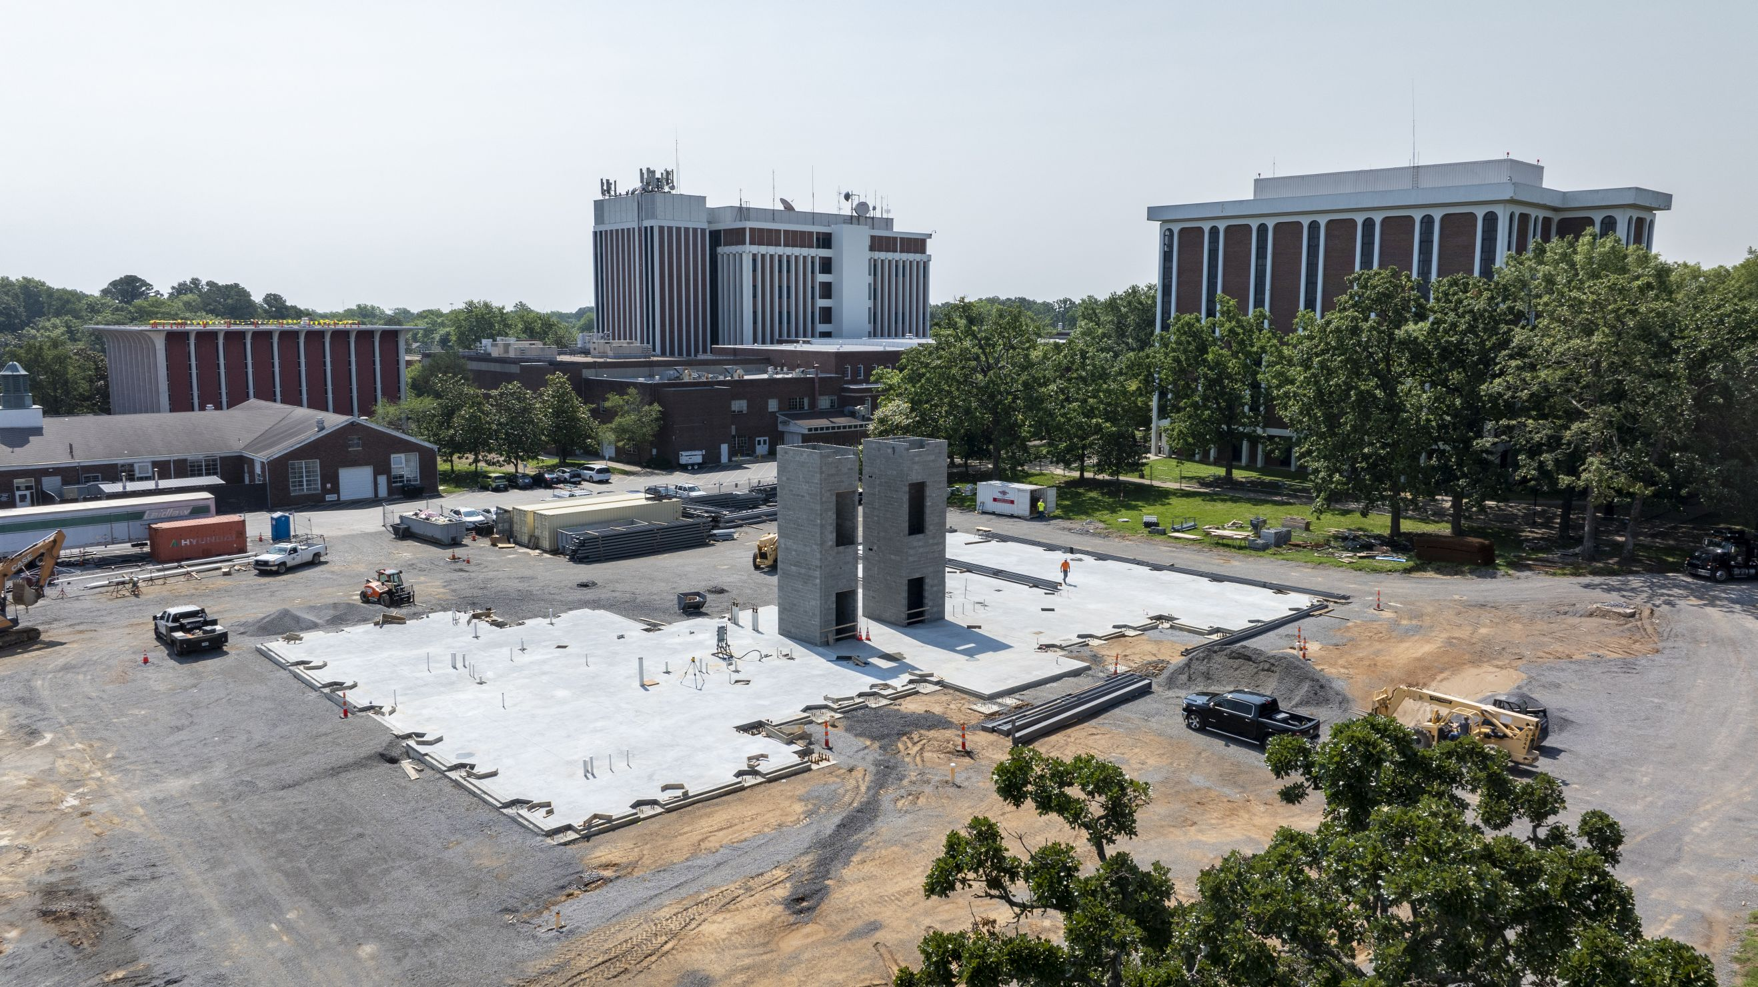
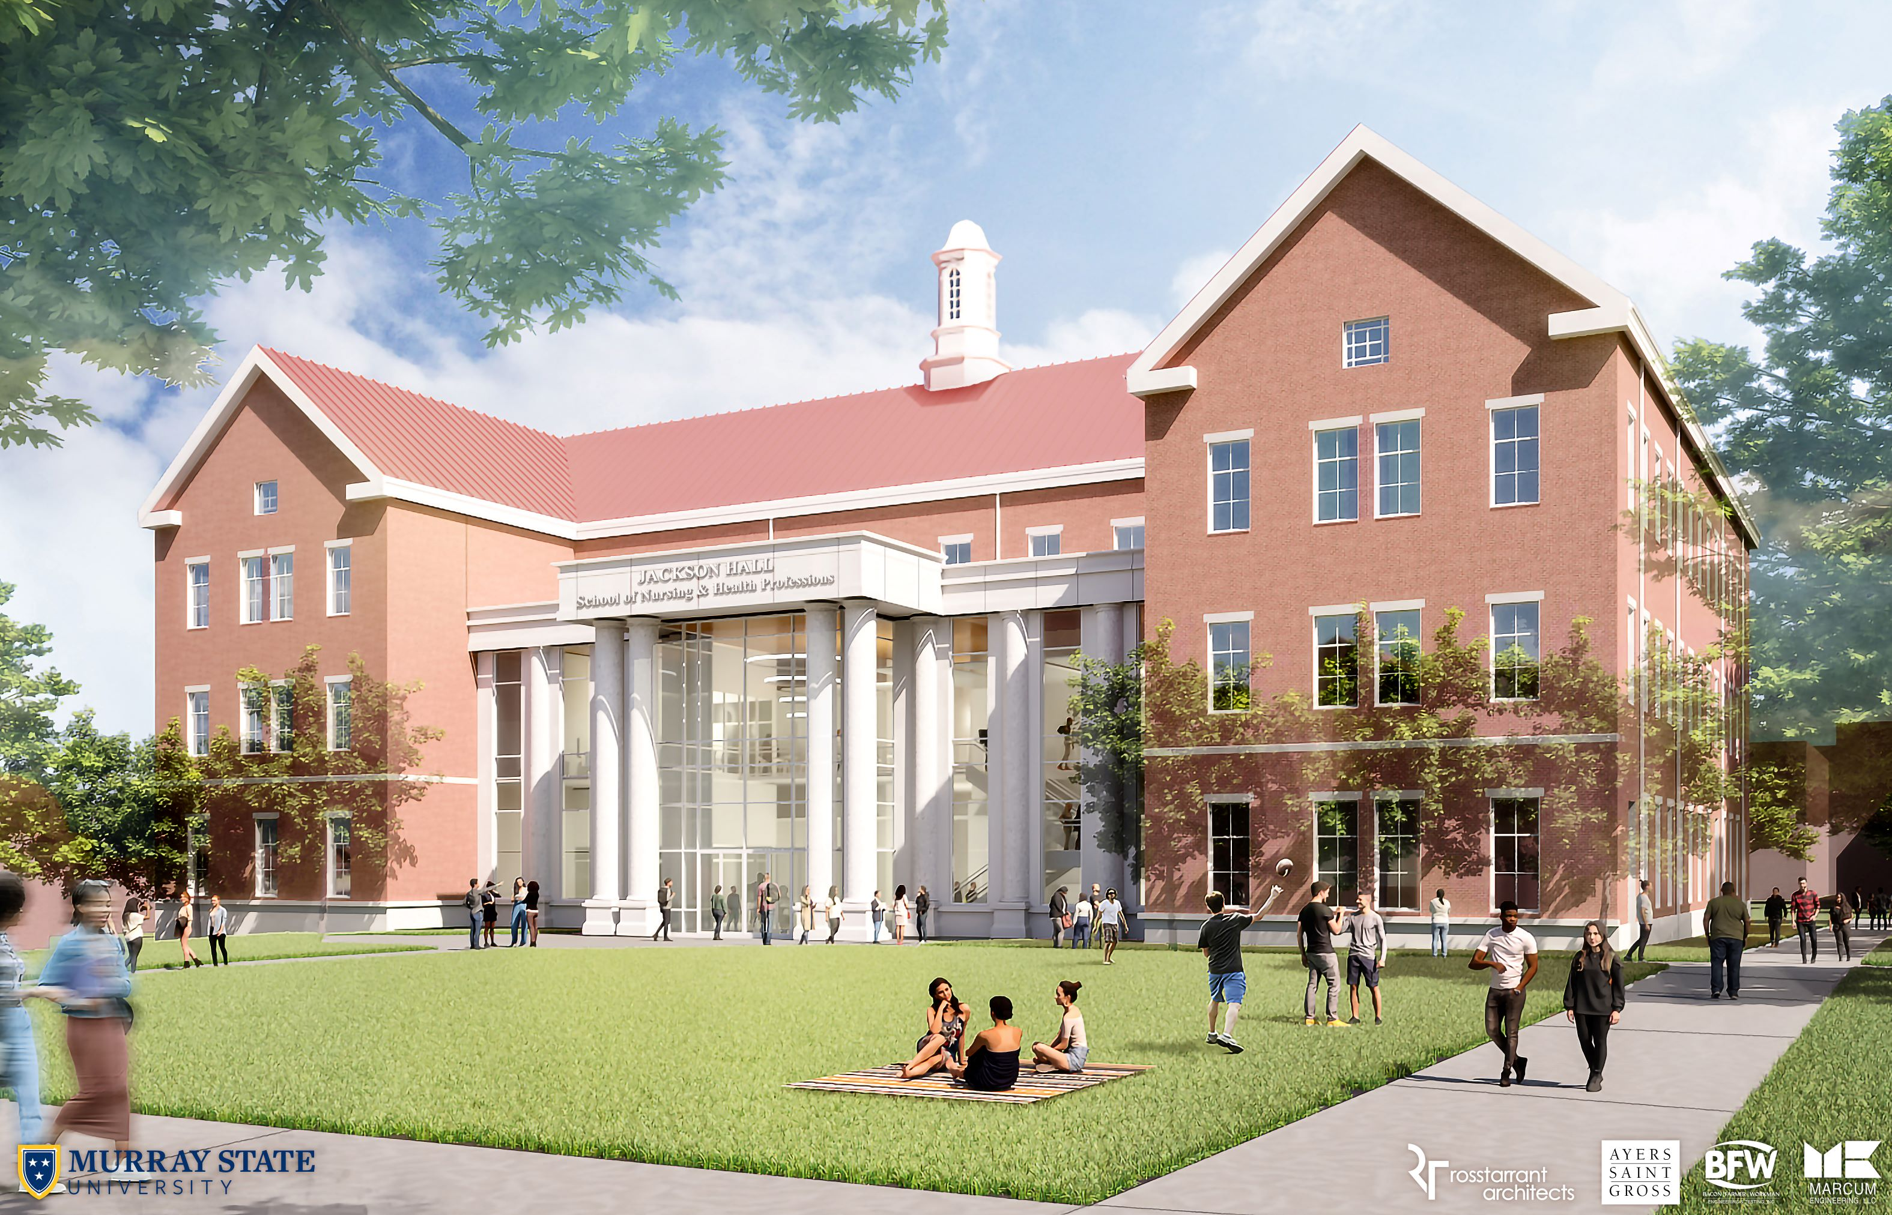
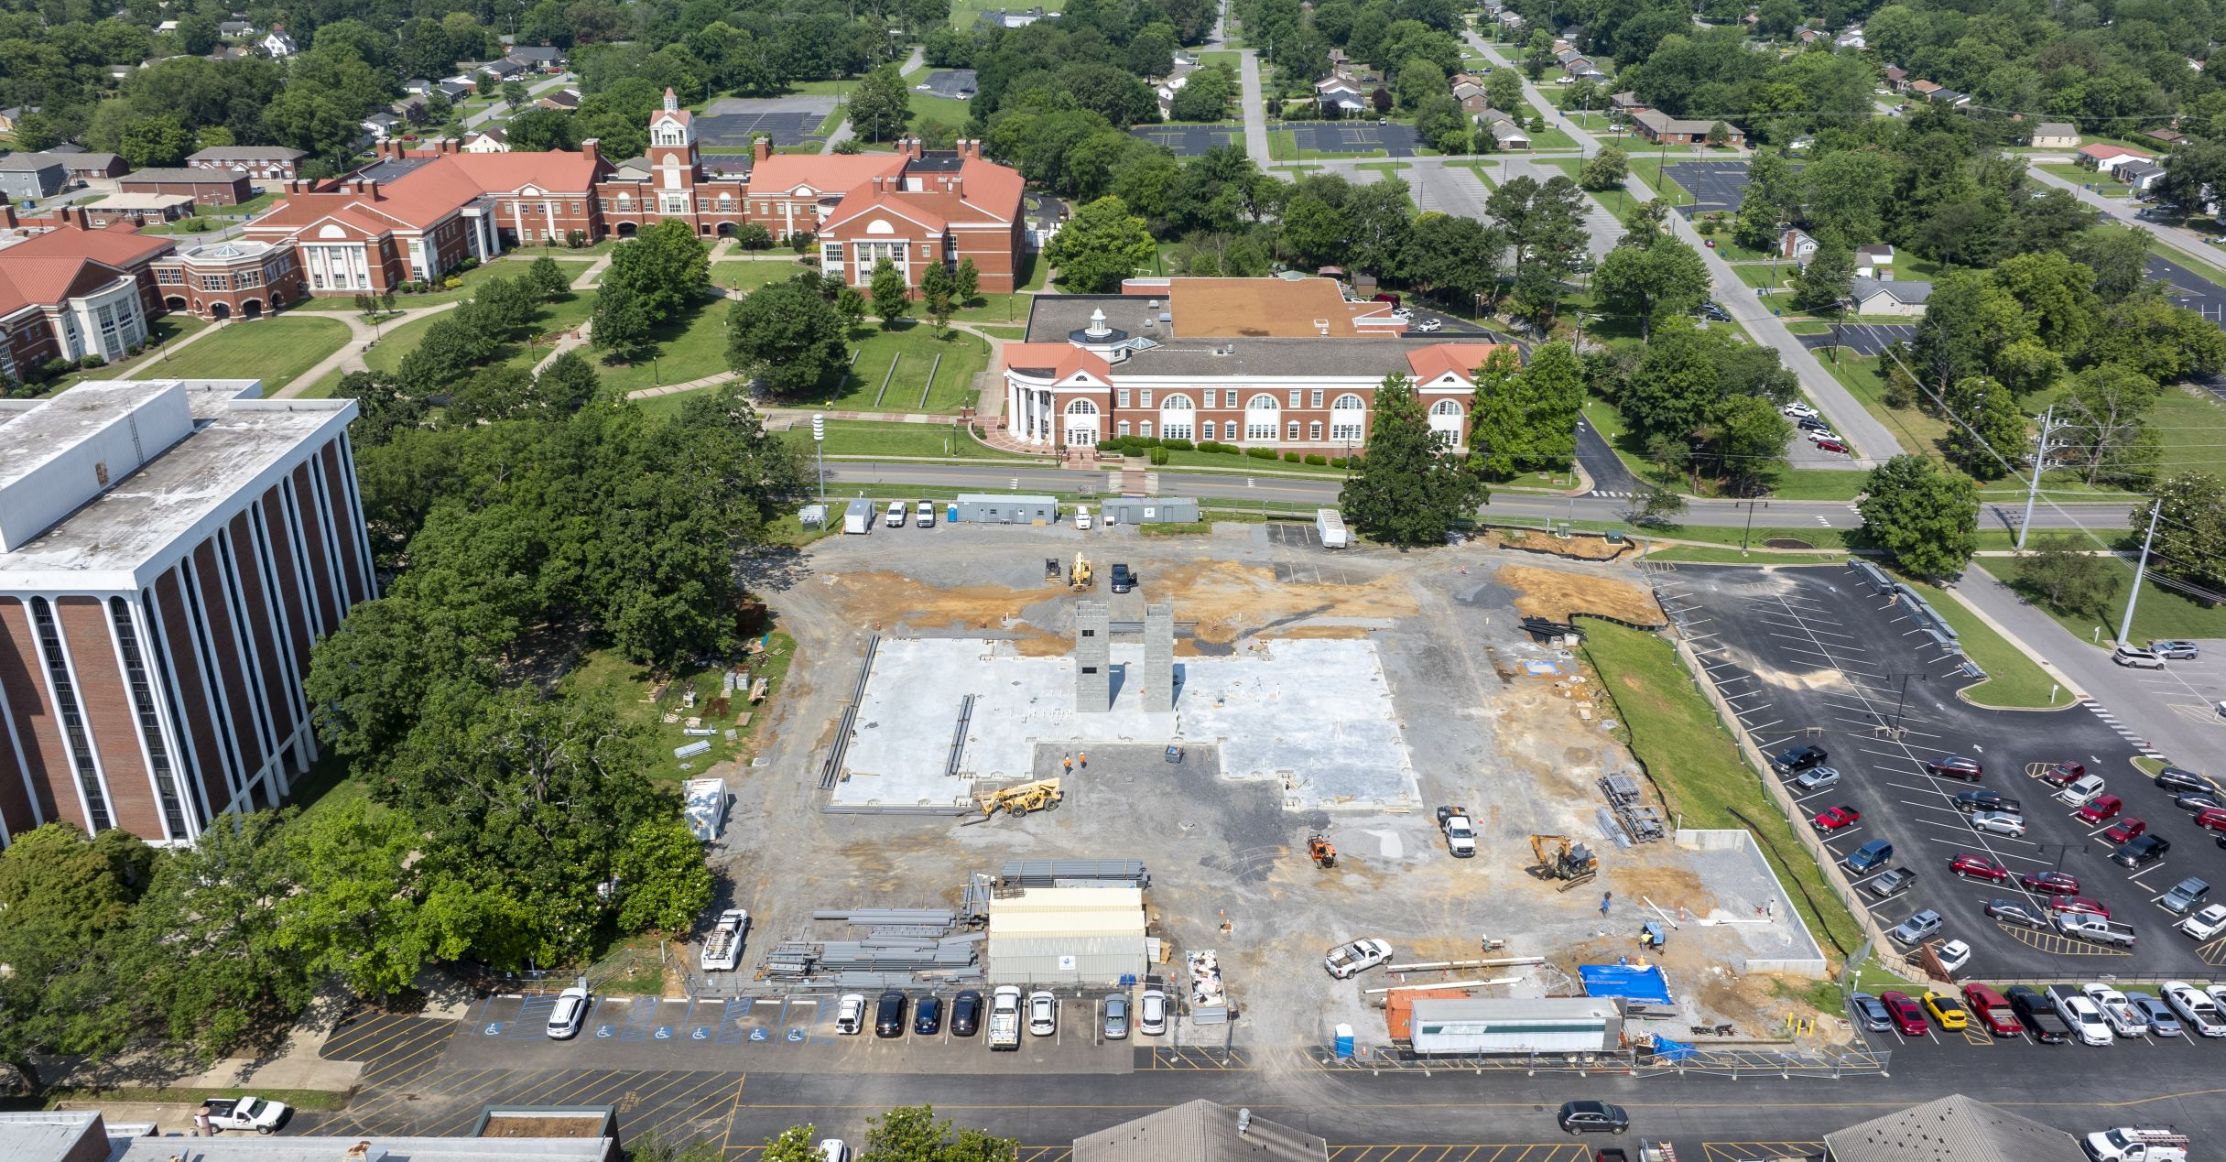
State-Funded Projects Update
Nursing and Health Professions Building – Jackson Hall $45,500,000
Currently under construction
Planned occupancy in August 2026

Slide 12
Asset Preservation Pool (funded in 2022 Regular Session)
with University-funded match
Applied Science Renovations (Agriculture) $13,000,000
Pogue Library HVAC & Electrical Upgrades $ 6,000,000
Curris Center Refresh, Renov., and Def. Maint. $ 5,500,000
Carr Hall HVAC & Electrical Upgrades $ 4,519,000
Wells Hall HVAC Upgrades $ 4,116,000
Science Complex Cooling Tower Replacement $ 3,750,000
Mason Hall ADA & Deferred Maintenance $ 2,997,082
Fine Arts HVAC Upgrades $ 2,900,000
RH White Hall Mechanical Deferred Maint. $ 2,835,000
Racer Arena HVAC & Electrical Upgrades $ 2,296,000
Hancock Biological Station HVAC Replacement $ 1,919,000
Doyle Fine Arts HVAC Upgrades $ 1,900,000
Waterfield Library HVAC Upgrades, Phase II $ 707,500
CFSB Center Cooling Tower Replacement $ 548,795
Regents Hall Resident Room Renovations $ 365,318
Carr Hall Emergency Generator Replacement $ 92,600

Slide 13
Asset Preservation Pool ($46.682M funded in 2024 Regular Session)
Electrical Infrastructure Upgrades $11,600,000
Mason Hall Renovations (Nursing) $ 9,000,000
Wilson Hall HVAC Upgrades & Ext. Improvements $ 3,818,000
Central Plant Chiller #2 Replacement $ 3,510,000
E&G Building Elevator Upgrades $ 2,500,000
Wrather Hall Windows and Ext. Improvements $ 2,474,000
Collins Ind. & Tech Em. Generator & HVAC Upgrade $ 2,140,000
Wellness Center HVAC & BAS Controls Replace $ 2,000,000
Blackburn Window Replacement $ 1,929,000
Science Complex - Biology Bldg Boiler Replacement $ 1,800,000
General Services Chiller Replacement $ 1,440,000
E&G Building BAS Upgrades $ 840,000
Alexander Hall Chiller Replace & Bldg Upgrades $ 800,000
E&G Building Fire Alarm Replacements $ 800,000
Carr Hall Window Replacements $ 720,000
Expo Center Boiler Replacement $ 640,000
Central Plant Boiler Controls Replacement $ 320,000

Slide 14
2026 General Assembly Action Requested
State General Funding for new construction.
State General Funding of capital renewal, deferred maintenance, and life safety projects.
Reauthorization of Agency (University paid) bonds for the renovation/replacement of residence halls, with bond payments funded from student fees.

Slide 15
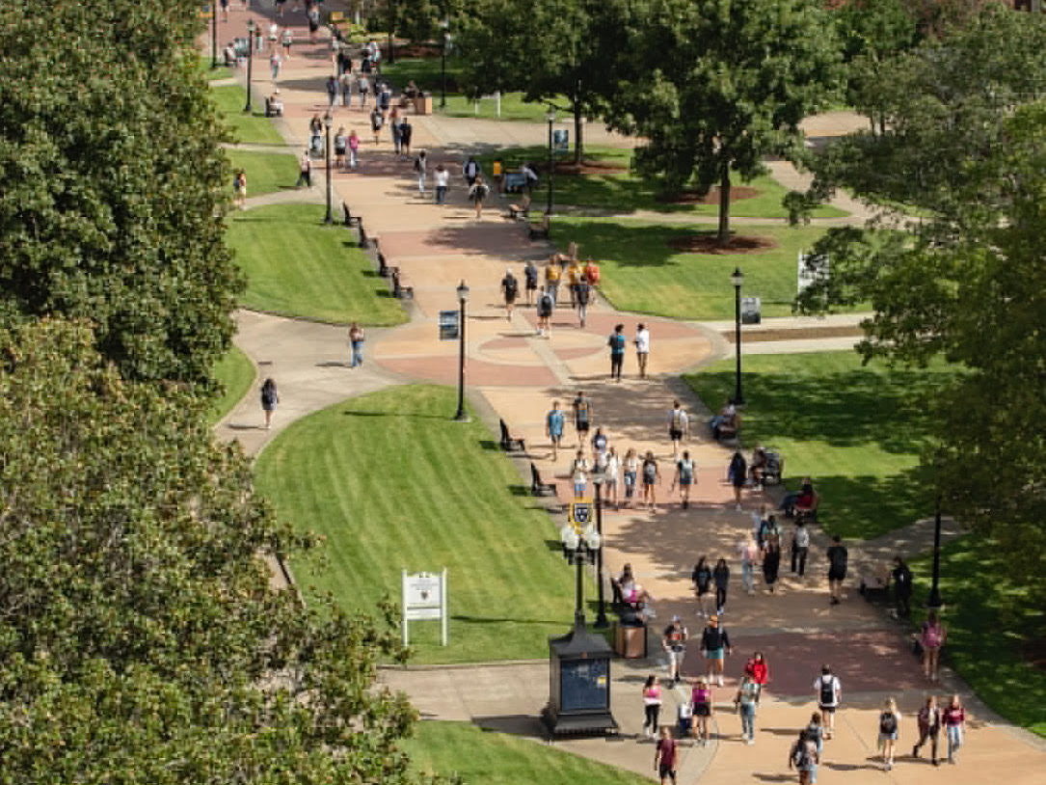
Thank you!
Questions?

