Slide 1
Capital Planning Advisory Board
July 9, 2025

Slide 2

FORWARD
TOGETHER
New Strategic Plan
Fall 2025
Our Colleagues
Our Community
Our Students

Slide 3

REGIONAL LEADERS
86,000 Alumni
81% Percent Stay in our Region
17% more first year students Fall 2024 than Fall 2023
All-time NKU graduation record
NKU students graduate in 4.2 years
Notes:
All-time record in graduation – NKU is succeeding in graduating and retaining students, driving more individuals into the workforce.
NKU’s six-year graduation rate has topped out at 54.1%, a nearly 5 percentage point increase from last year and a nearly 2.5 percentage point increase from our prior institutional record. For the second year in a row, NKU was recognized by the Wall Street Journal for “best value,” rising in the rankings to #29 out of 500 universities nationally. The publication’s measure of return on investment is based on how quickly a degree from NKU pays for its cost through the salary earned by students after graduation. NKU ranks highest among public universities in the commonwealth and our region.
NKU students graduate in 4.2 years, another institutional milestone
Overall fall retention rate was 75.4%.
NKU set another institutional record in 2025 with 91.1% for fall-to-spring retention.

Slide 4
Growing the Pipeline
  NKU launched multiple new degree programs aligned with workforce needs in the last year
NKU Best Value:
  For the second year in a row, NKU was recognized by the Wall Street Journal for “best value,” rising in the rankings to #29 out of 500 universities nationally
HIGH RANKINGS
Impact
Economic Mobility
ROI
Notes:
Growing the workforce pipeline – NKU launched multiple new degrees this past year, all aligned to meet the workforce needs of our region and Commonwealth.
Minor in Artificial Intelligence
Minor in Military and Veteran Leadership
Bachelor’s degree in Sales Analytics
Master’s degree in Supply Chain Analytics
Master’s degree in Cybersecurity
Master’s degree in Cardiovascular Perfusion
Master’s degree in Computer Science
Growing the workforce pipeline – NKU launched multiple new degrees this past year, all aligned to meet the workforce needs of our region and Commonwealth.
Minor in Artificial Intelligence
Minor in Military and Veteran Leadership
Bachelor’s degree in Sales Analytics
Master’s degree in Supply Chain Analytics
Master’s degree in Cybersecurity
Master’s degree in Cardiovascular Perfusion
Master’s degree in Computer Science

Slide 5
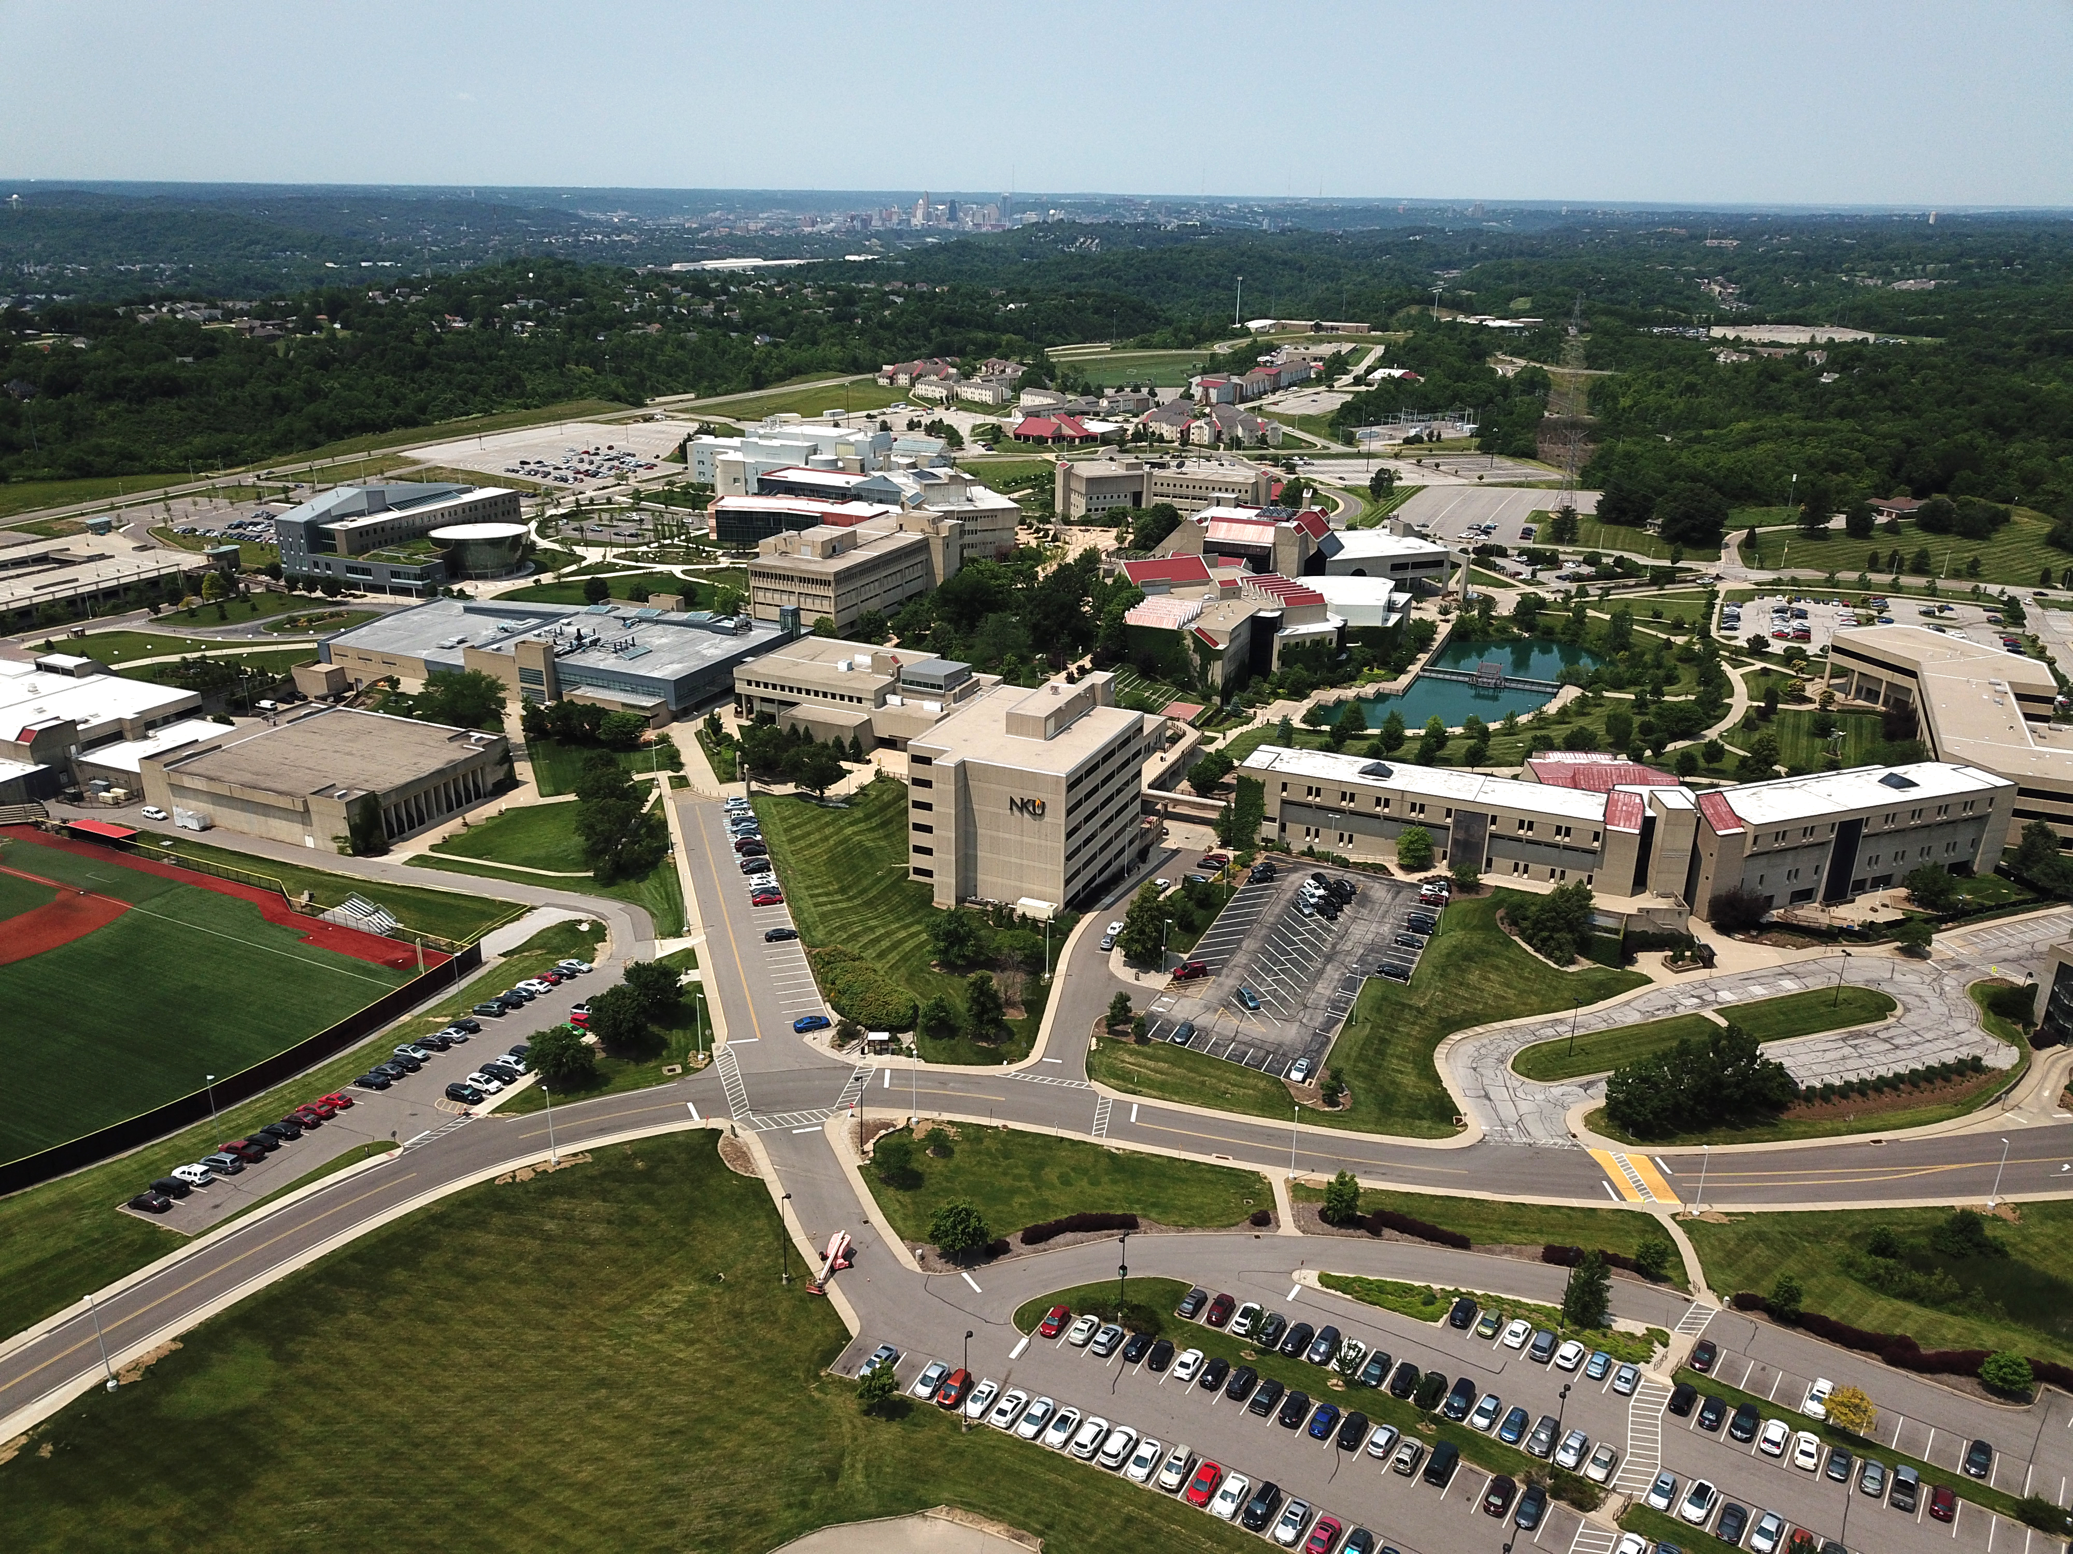
MASTER PLAN UPDATE
Increase Science Labs and Opportunities for STEM Careers
Repurpose Legacy Buildings for New Ways of Learning
Eliminate Capital Renewal Issues
Create Innovative Learning Spaces
Increase Opportunities for Student Engagement

Slide 6
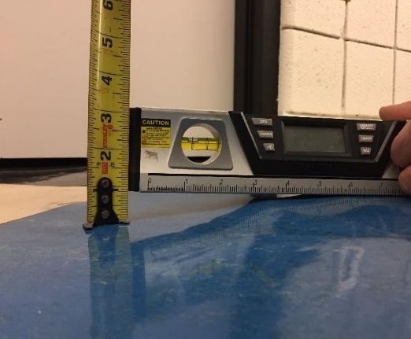
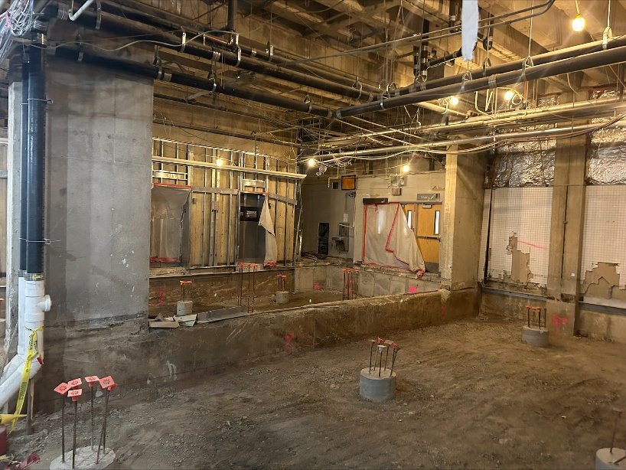
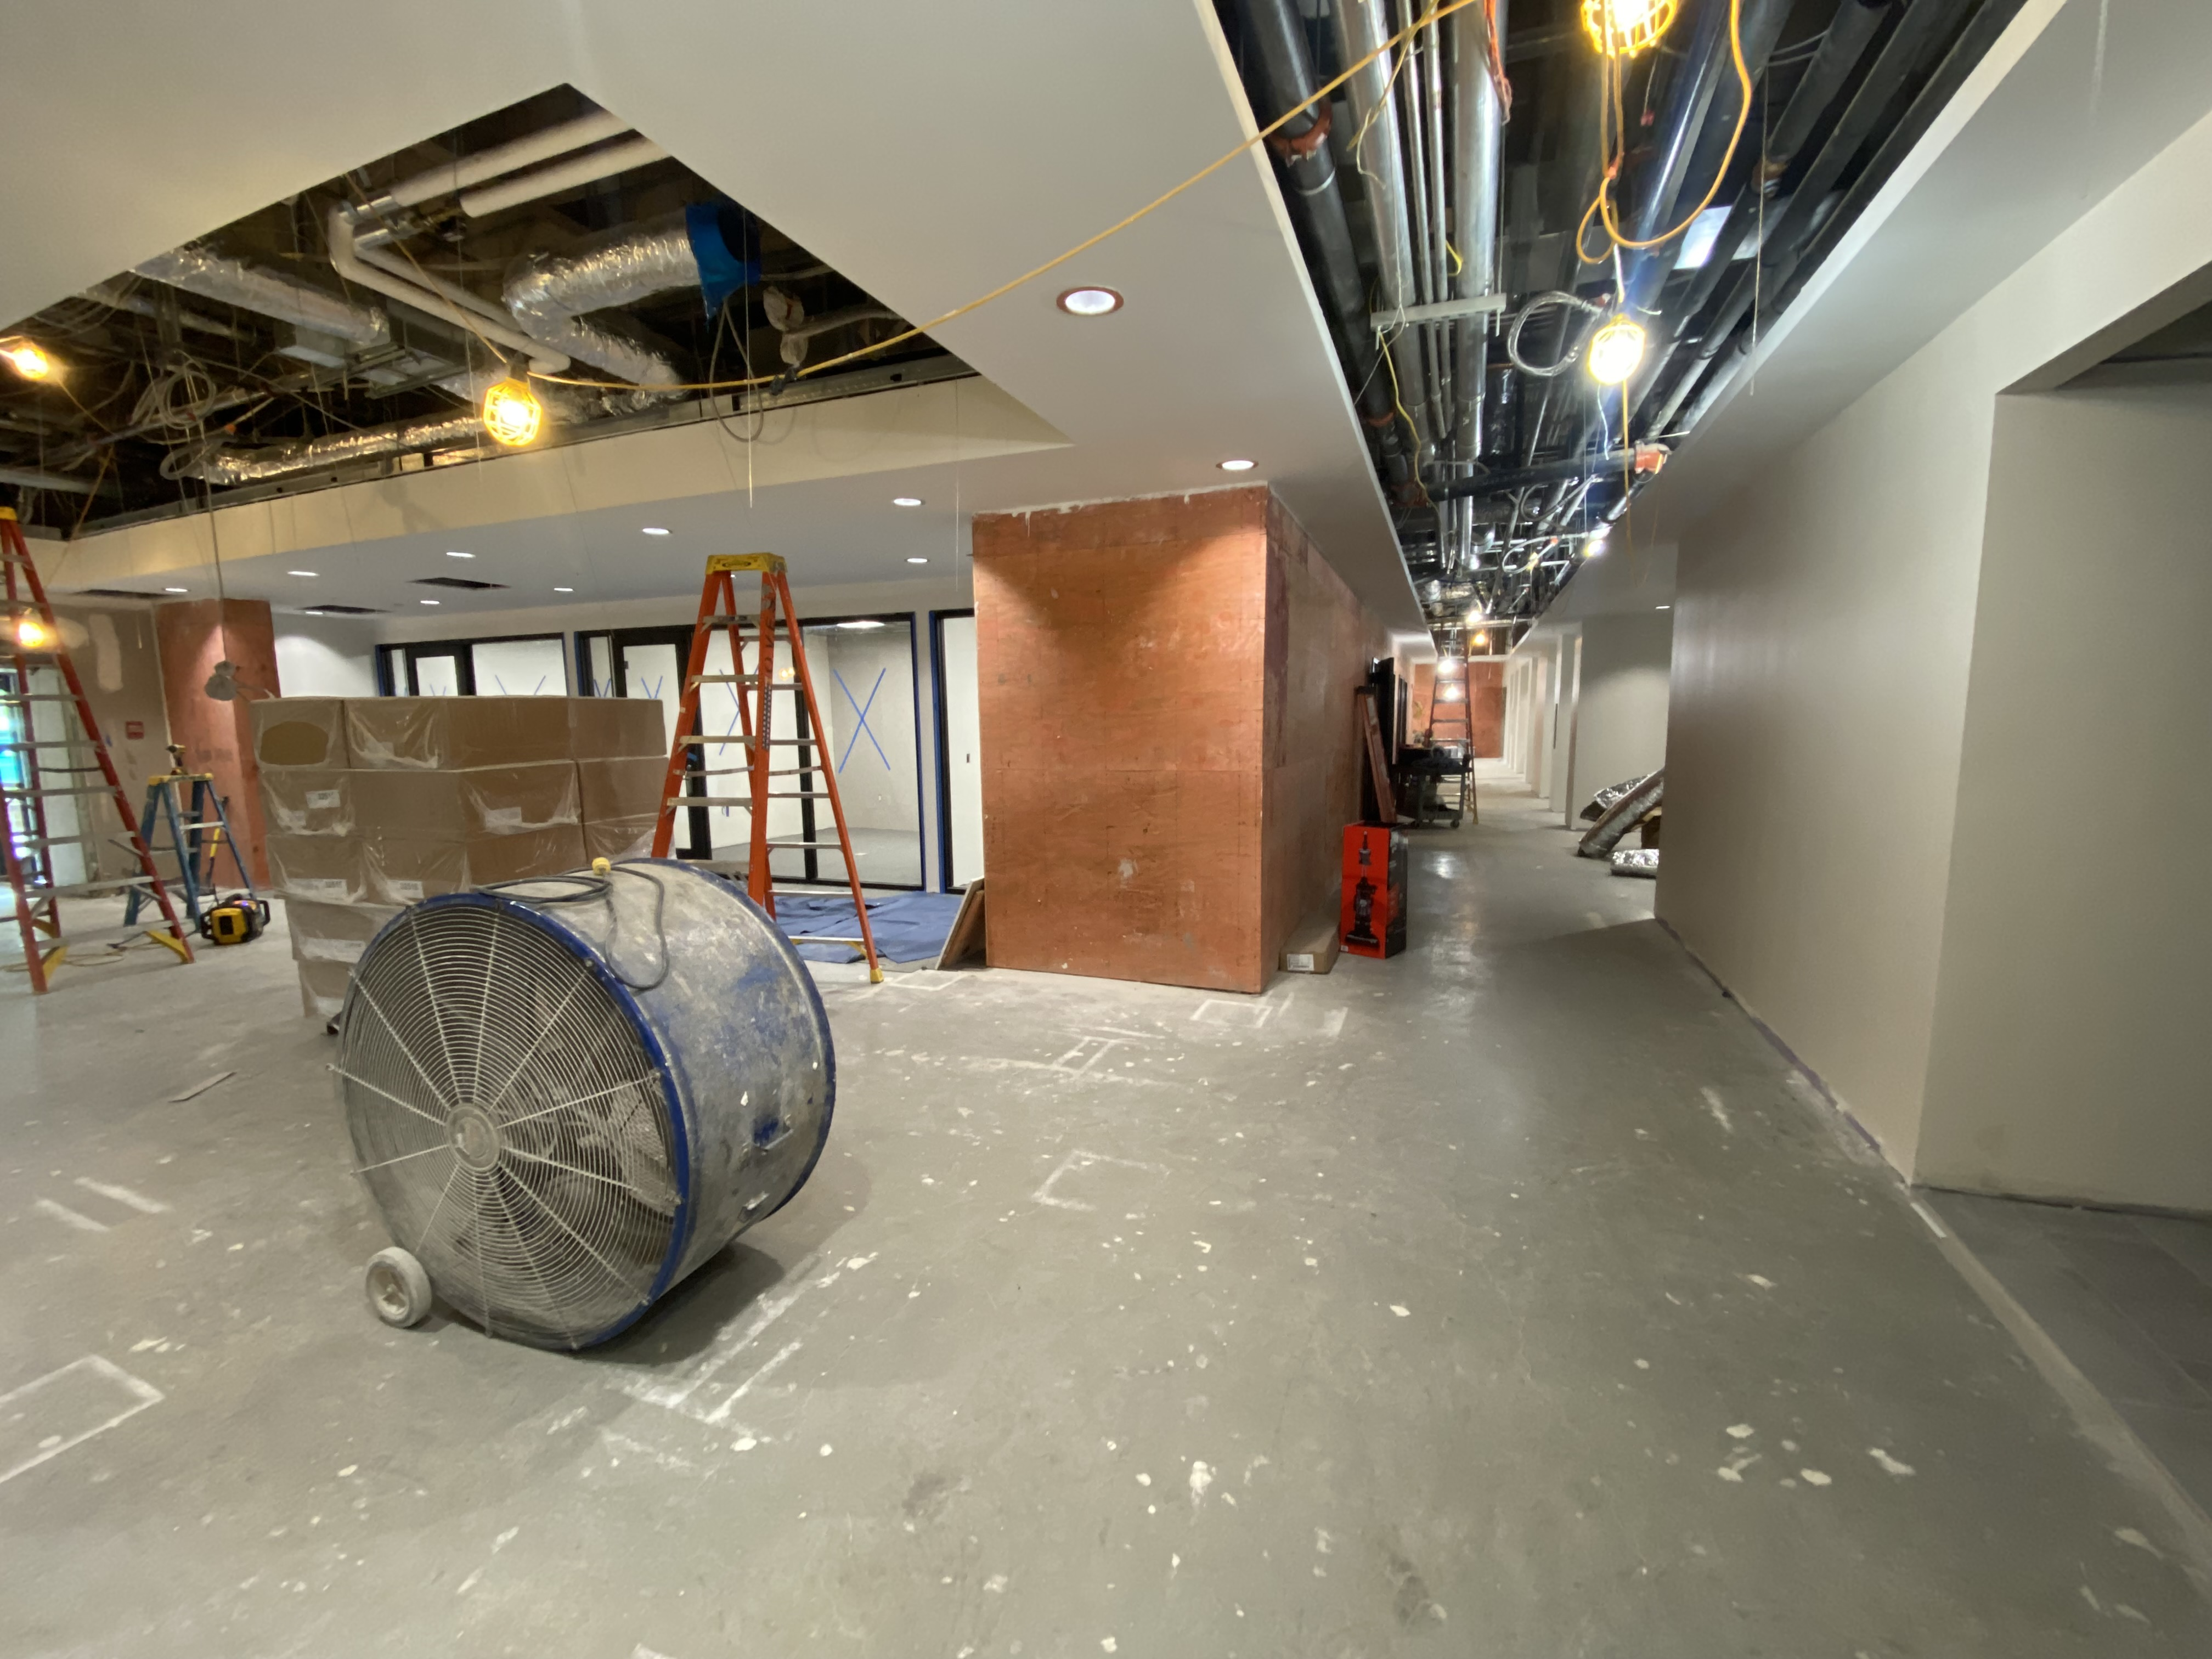
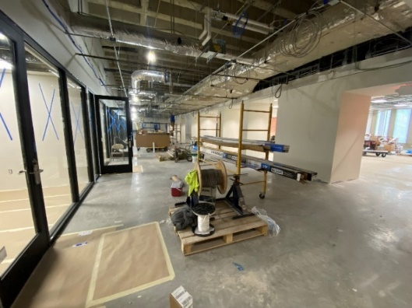
2022-2024 & 2024-2026 ASSET PRESERVATION FUNDS
2022-2024: $46.8M in State Bonds Matched with $7M NKU Funds = $53.8M AP Funds
$24.4M dedicated to floor heaving repairs, HVAC and other upgrades in Nunn Hall & Fine Arts.
Critical infrastructure and renewal projects
2024-2026: $46.15M in State Bonds
Critical capital renewal projects
Major systems upgrades

Slide 7
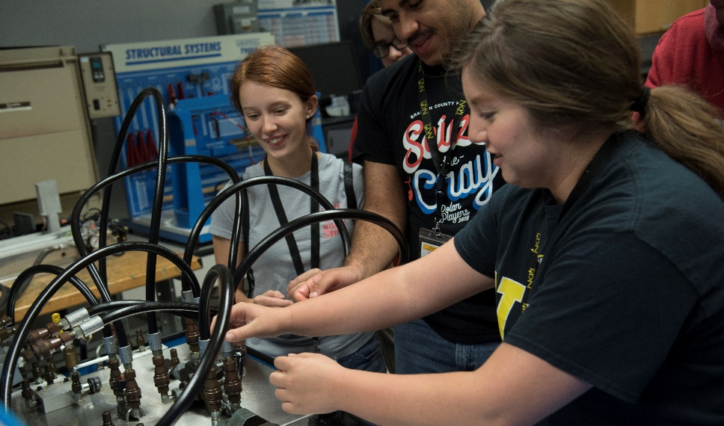
CAPITAL PROJECT
HERRMANN SCIENCE CENTER EXPANSION
87,000 square-foot addition
Addresses urgent need for STEM + H
Currently in Construction
$79.9M project funding

Slide 8
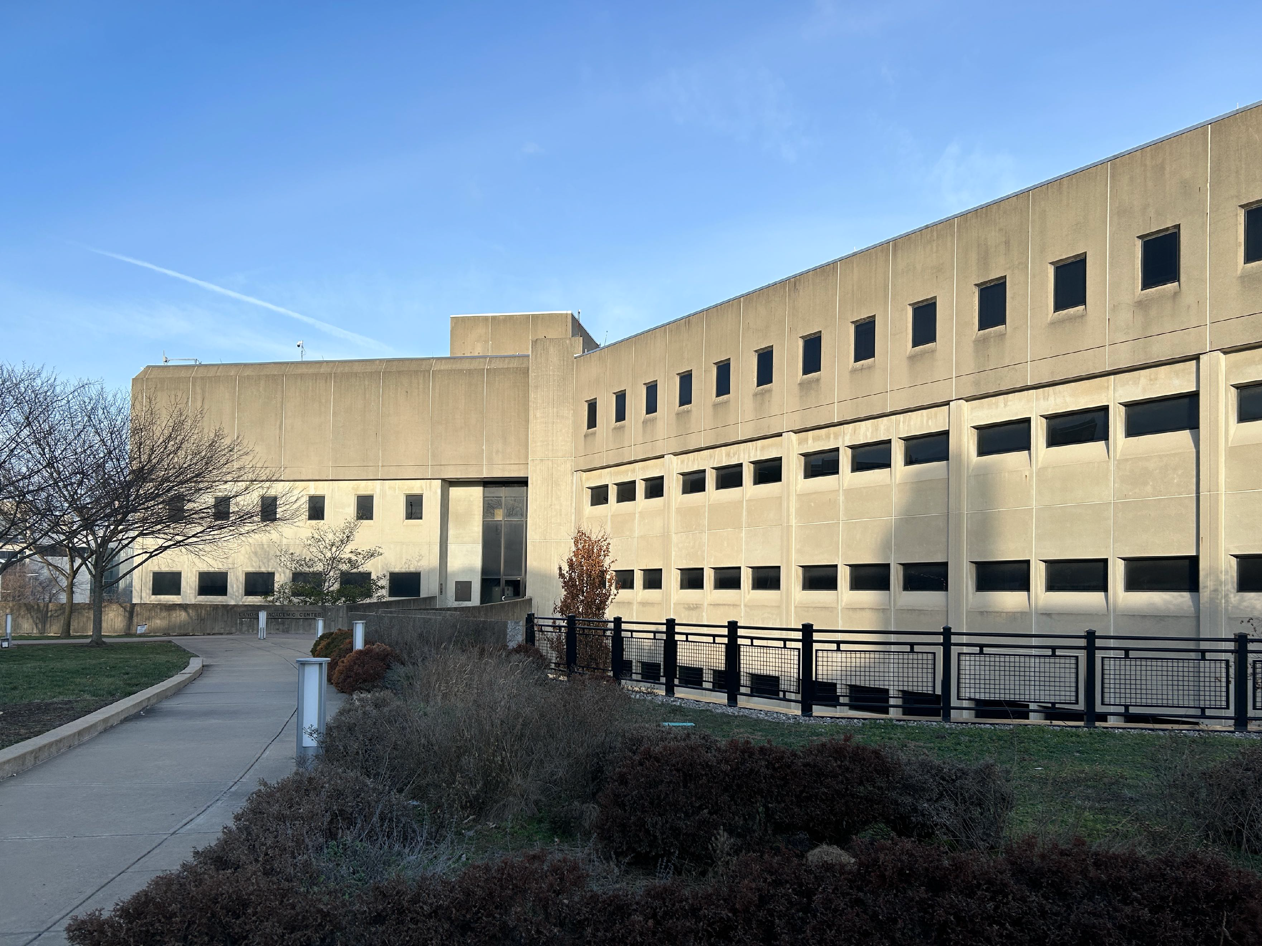
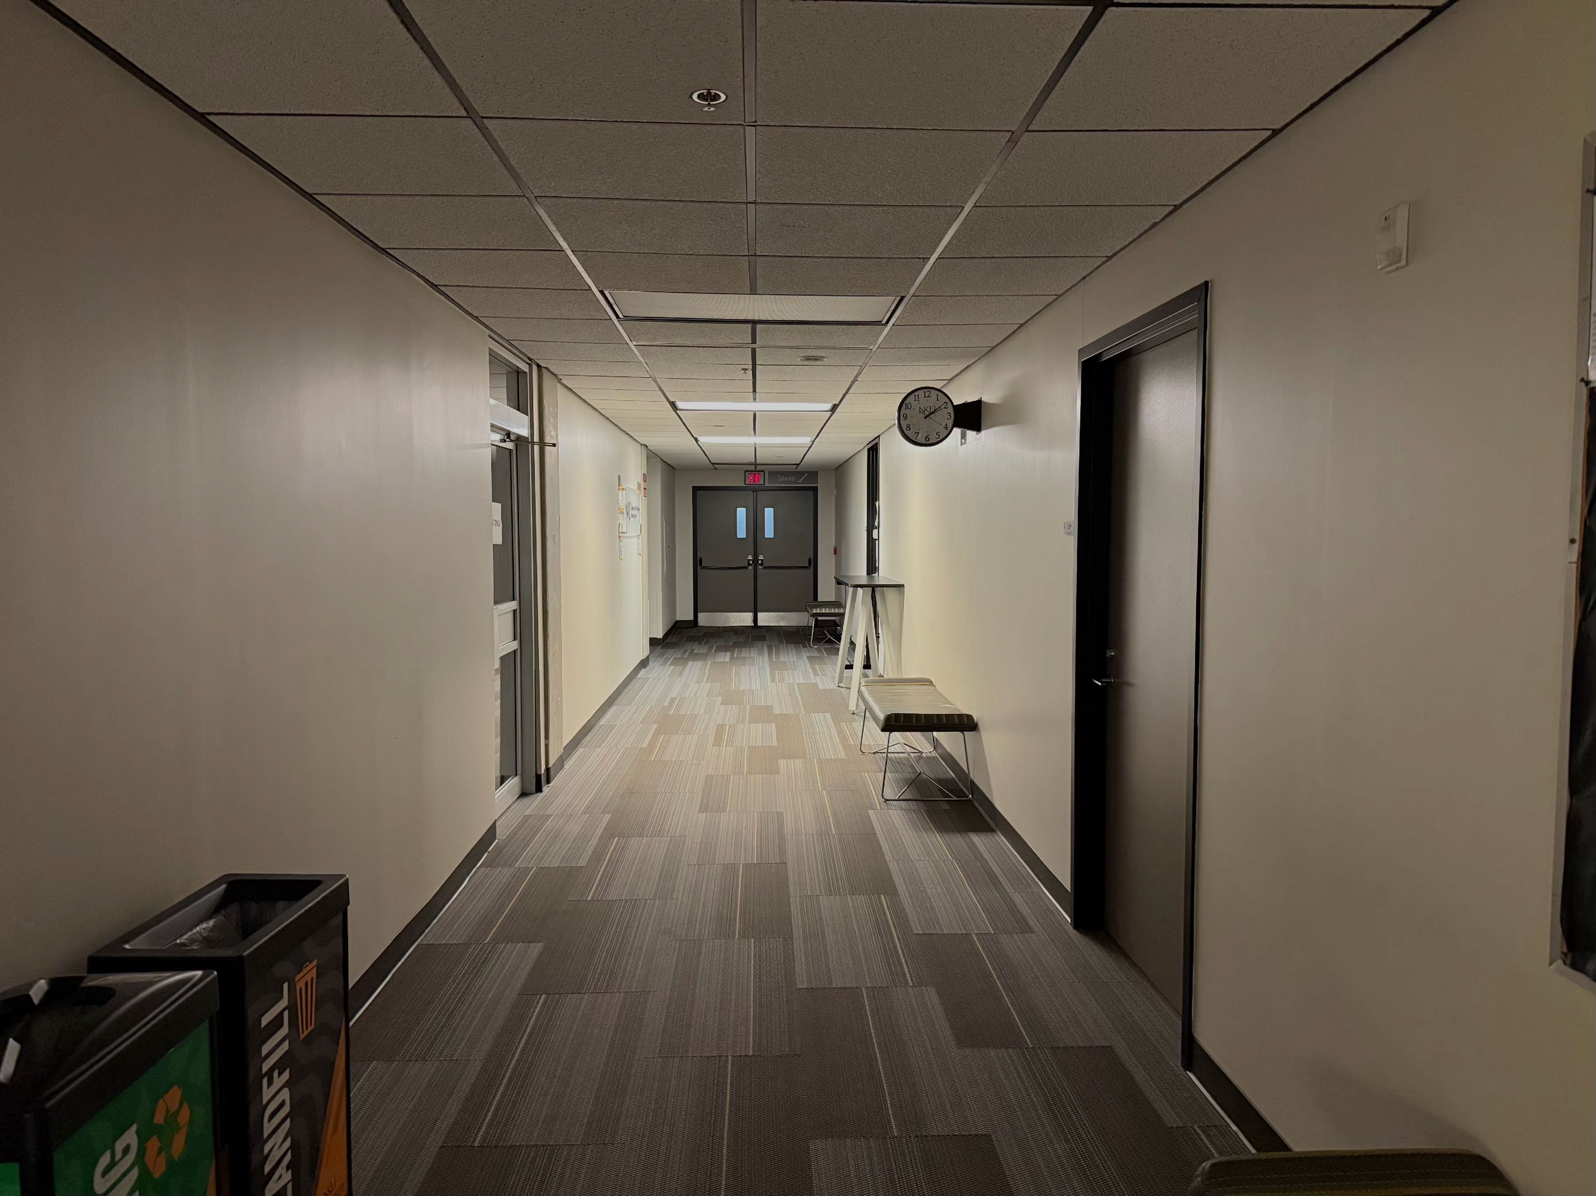
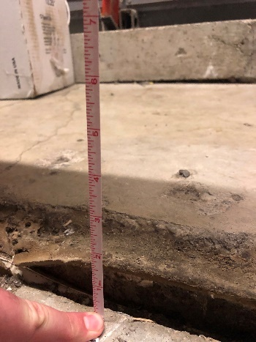
CAPITAL PROJECT
Landrum Academic Center Renewal
Urgent need for Capital Renewal
Full life-cycle renewal, including floor heaving repair
  Full FkFloor
Design Phase A
$49M project funding

Slide 9
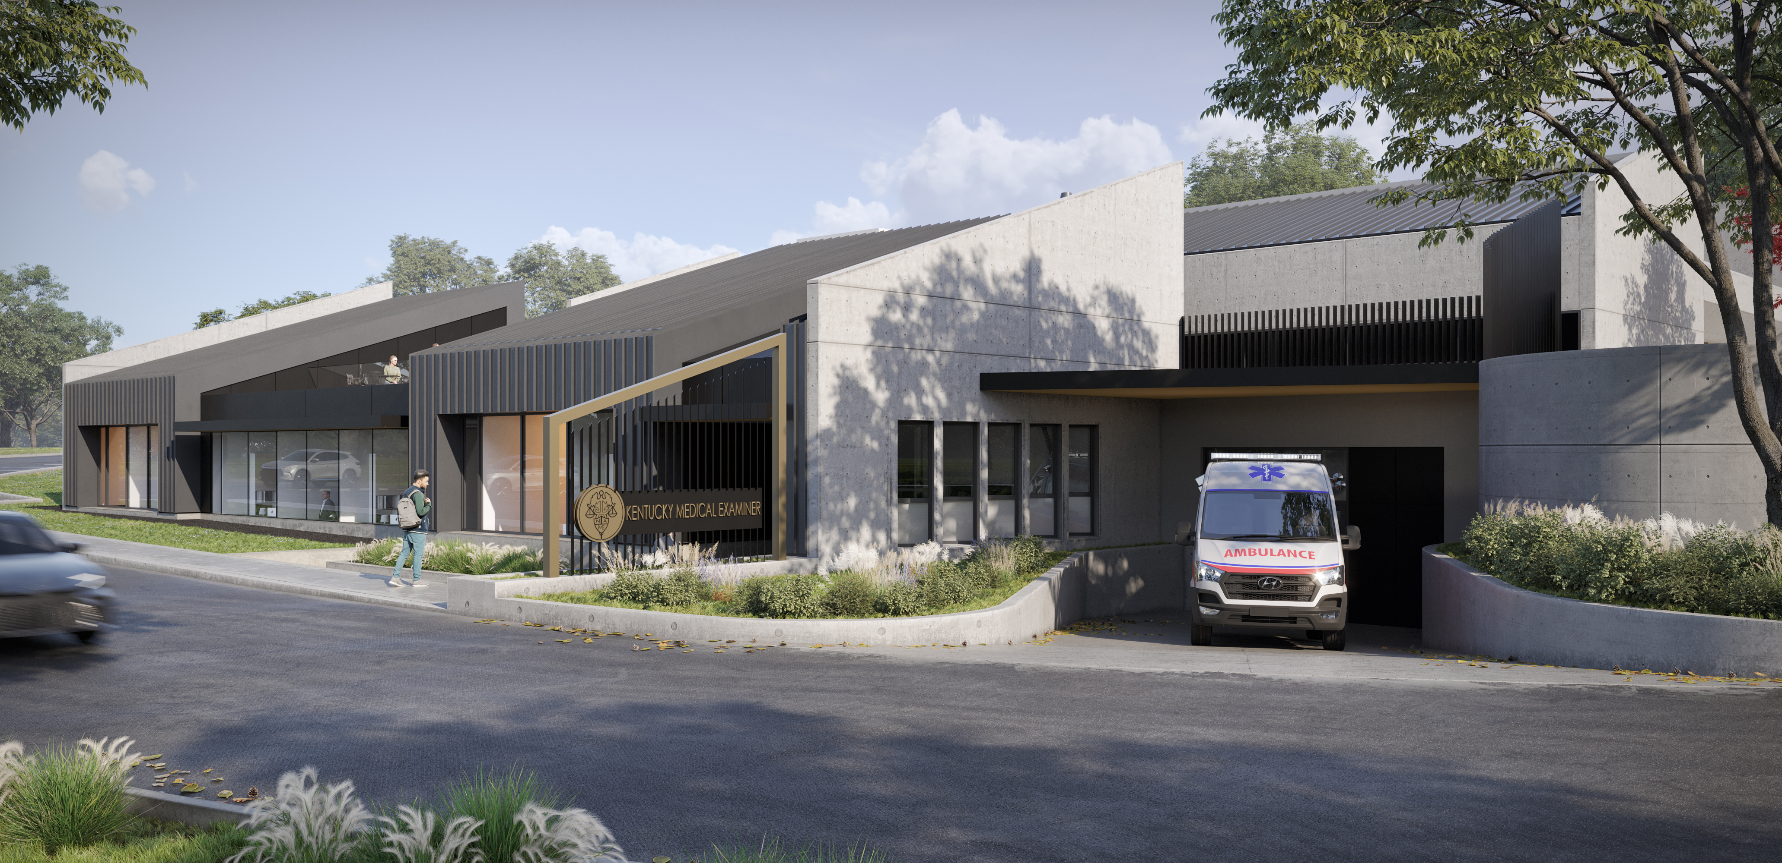
CIVIC CENTER CONVERSION FOR NKY MEDICAL EXAMINER & CRIME LAB
$17.3M State Bonds & $3.7M in NKU AP Funds
Long Term Lease
Design will be complete in August, bidding will follow
Joint effort of Justice Cabinet and NKU

Slide 10
Business Academic Center
  Renewal/Modernization and full Life Cycle Renovation of all building systems
  Lacks modern instructional spaces
  Very little student engagement space
  Former Engineering Technology space requires full renovation
  Life Science Innovation Labs
  Structural floor heaving requires remediation
College of Business is nationally recognized
  Ranked among the Best Undergraduate Business Programs (2025) by U.S. News & World Report
  #66 in the nation for Best Online Master’s in Business Program
  Many other recognitions and commendations
Nunn Hall
  Current occupant – Chase College of Law, Chase will move to Covington (CCBE project)
  Renovate Nunn Hall for new academic uses
  Will relieve space shortages in other areas of campus and allow for innovation in key areas
2026-2028
CAPITAL PRIORITIES
Renew/Modernize Business Academic Center
Repurpose Nunn Hall
ASSET PRESERVATION
Many asset preservation needs remain
Need Exceeds $300M
Notes:
Ranked among the Best Undergraduate Business Programs (2025) by U.S. News & World Report — placing 316th out of 532 programs nationwide.
Ranked by U.S. News & World Report (2025):
#122 in Best Online MBA Programs in the nation
#72 in Best Online MBA Programs for Veterans in the nation
#66 in the nation for Best Online Master’s in Business Program
Named among the Best On-Campus MBA Programs (2025) by The Princeton Review.
Ranked #14 globally for Supply Chain Management by University HQ (2023).

Slide 11
Partnership of UK College of Medicine NKY Campus and NKU Chase College of Law
Project Status - Programming Complete
  Total Square Feet: 110,000
  Total Project Scope: $125M
Phase A Design – pending stakeholder sign-off and site selection
Project to be bid to Design/Build Firm following completion of Phase A Design
COMMONWEALTH CENTER FOR BIOMEDICAL EXCELLENCE
Location: Covington, KY
Negotiations underway on multiple sites
Lead Agency: Northern KY Port Authority

