Slide 1
UNIVERSITY OF KENTUCKY
CAPITAL PLANNING ADVISORY BOARD July 9, 2025
ANGELA S. MARTIN
Vice President for Financial Planning Chief Budget Officer
BARRY SWANSON
Interim Vice President for Facilities Management
Interim Chief Facilities Officer
KEVIN LOCKE
Associate Vice President Planning, Design & Construction
Facilities Management

Slide 2
Our Guiding Principles
“We dream of a state that tomorrow is healthier, wealthier and wiser than it is today.”
─ Eli Capilouto, President of the University of Kentucky
Our mission, forged more than 160 years ago, is our state’s future — the health and well-being of her people. Simply put, our north star is to advance the state we were created to serve.
In partnership with the state, UK continues a strategy of preservation and construction — classrooms and labs, living and learning spaces, health care and athletics facilities — to increase our ability to meet Kentucky’s current and future needs.
2
Capital Planning Advisory Board | July 2025

Slide 3
2026-28 Priority Funding Requests
Research Facility
Asset Preservation
Enterprise Data Center
3
Capital Planning Advisory Board | July 2025

Slide 4
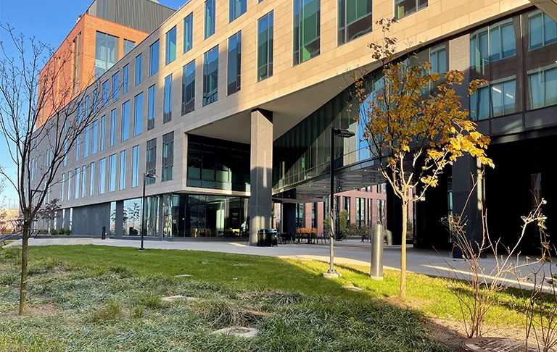
Priority Funding Request: Research Facility
The science research facility will provide state-of-the-art research space for multidisciplinary studies such as health sciences, chemistry, physics, earth sciences, psychology, biomedical engineering, nutrition, material science, and nanotechnology
300,000 +/- square feet
Scope: $500 million
$450 million State Bonds
$ 50 million Restricted Funds
4
Capital Planning Advisory Board | July 2025

Slide 5
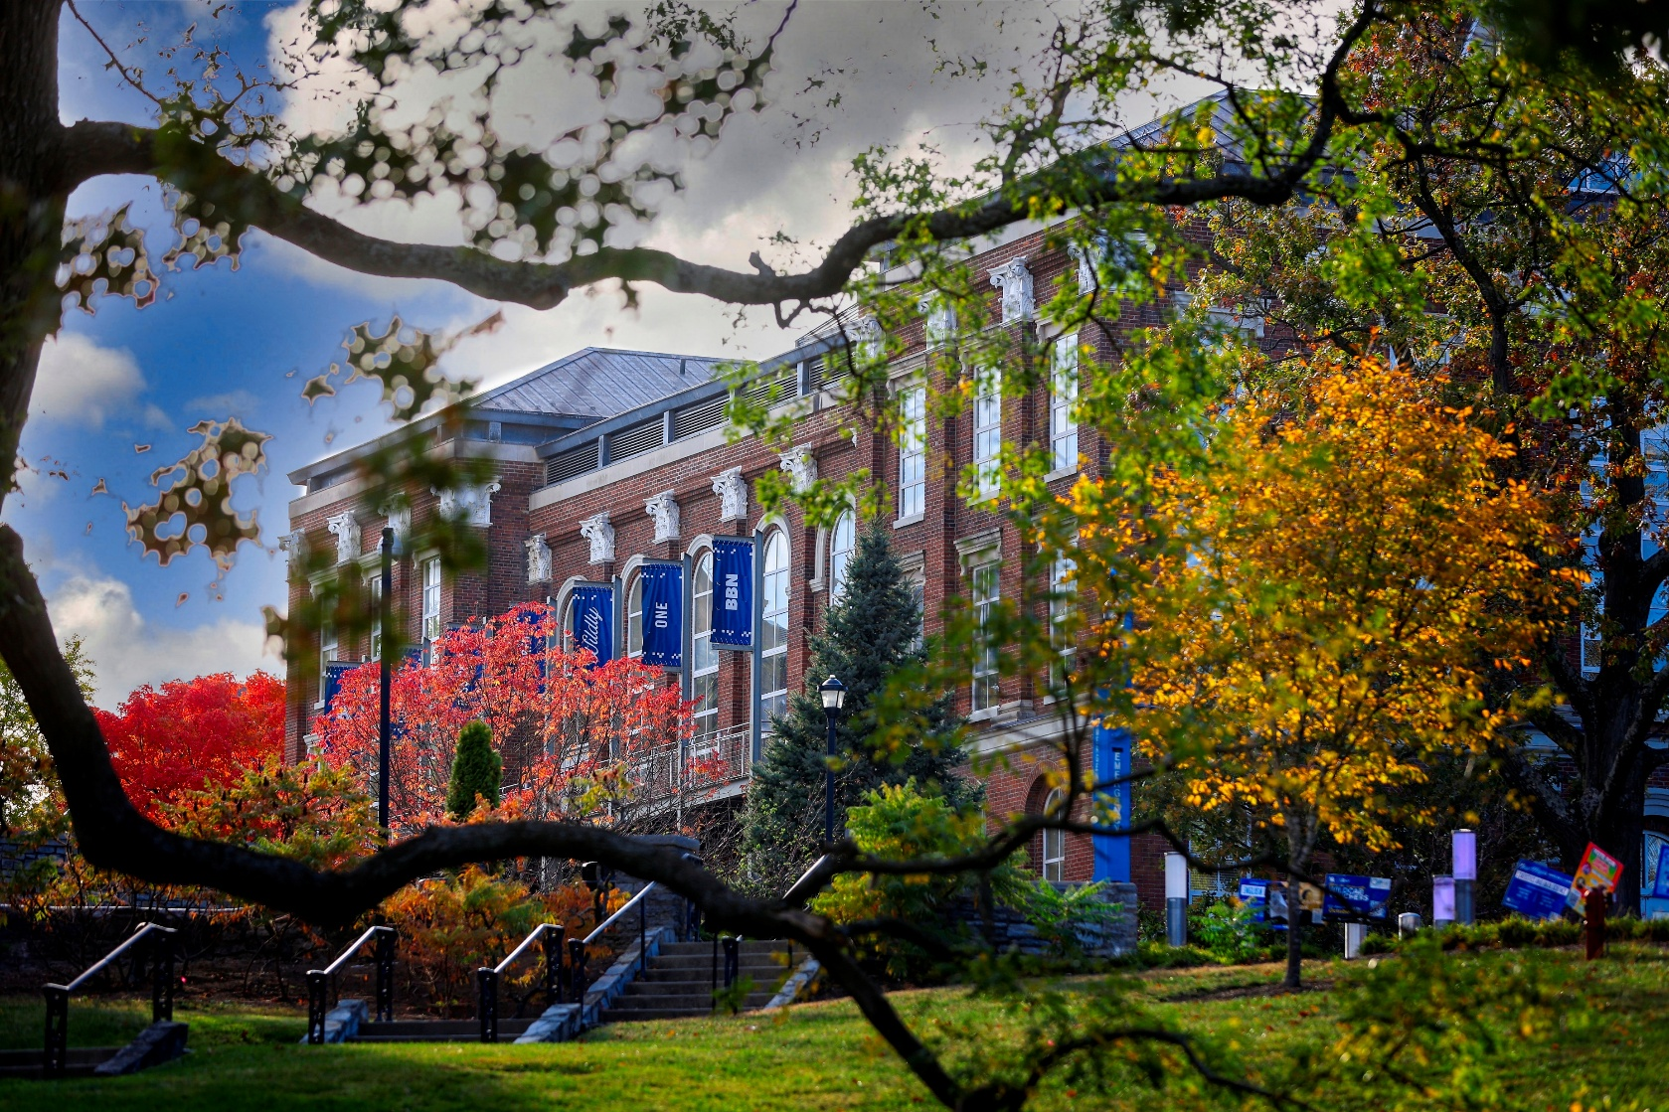
Priority Funding Request: Asset Preservation
Projects that preserve, renovate or renew campus facilities and campus infrastructure
Improve campus to help create a unified sense of place, enhancing student success
Manage escalating repair and maintenance costs, lowering operating costs and future maintenance expenses
Scope: $250 million State Bonds
5
Capital Planning Advisory Board | July 2025
5

Slide 6
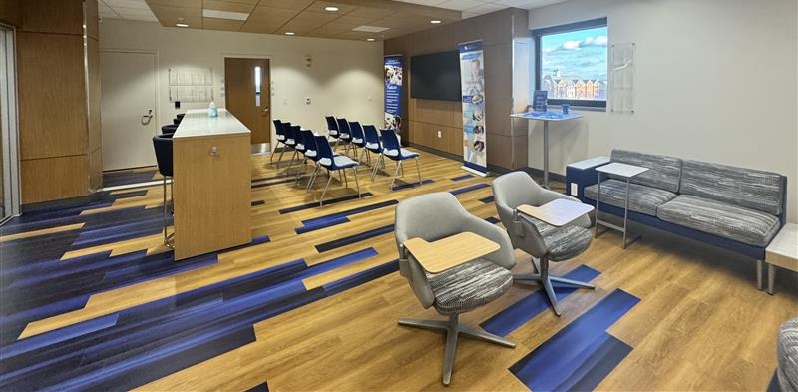
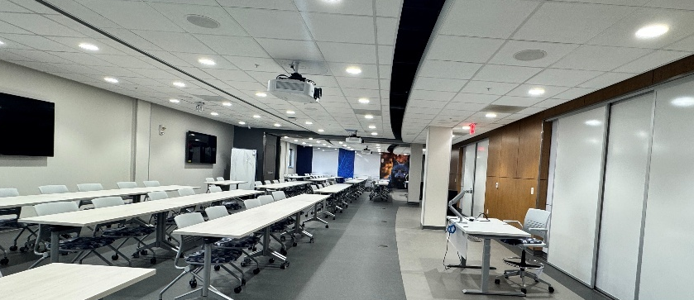
2022-24 Asset Preservation Update Delivering on Commitments: Multi-Disciplinary Science Building 5th Floor
The Multi-Disciplinary Science Building (constructed in 1985) saw former pharmacy lab spaces transformed into modern facilities for the Colleges of Nursing and Health Sciences — featuring skills labs, exam rooms, a welcome center, offices, and a flexible 100-person classroom
The project included complete replacement of 5th floor mechanical, electrical and plumbing systems, upgraded air handling units, and a new steam-to-hot-water heat exchanger
Scope: $13 million
$ 9,999,938 State Bonds
$ 3,000,062 Agency Bonds
Project completion: April 2025
6
Capital Planning Advisory Board | July 2025
6

Slide 7
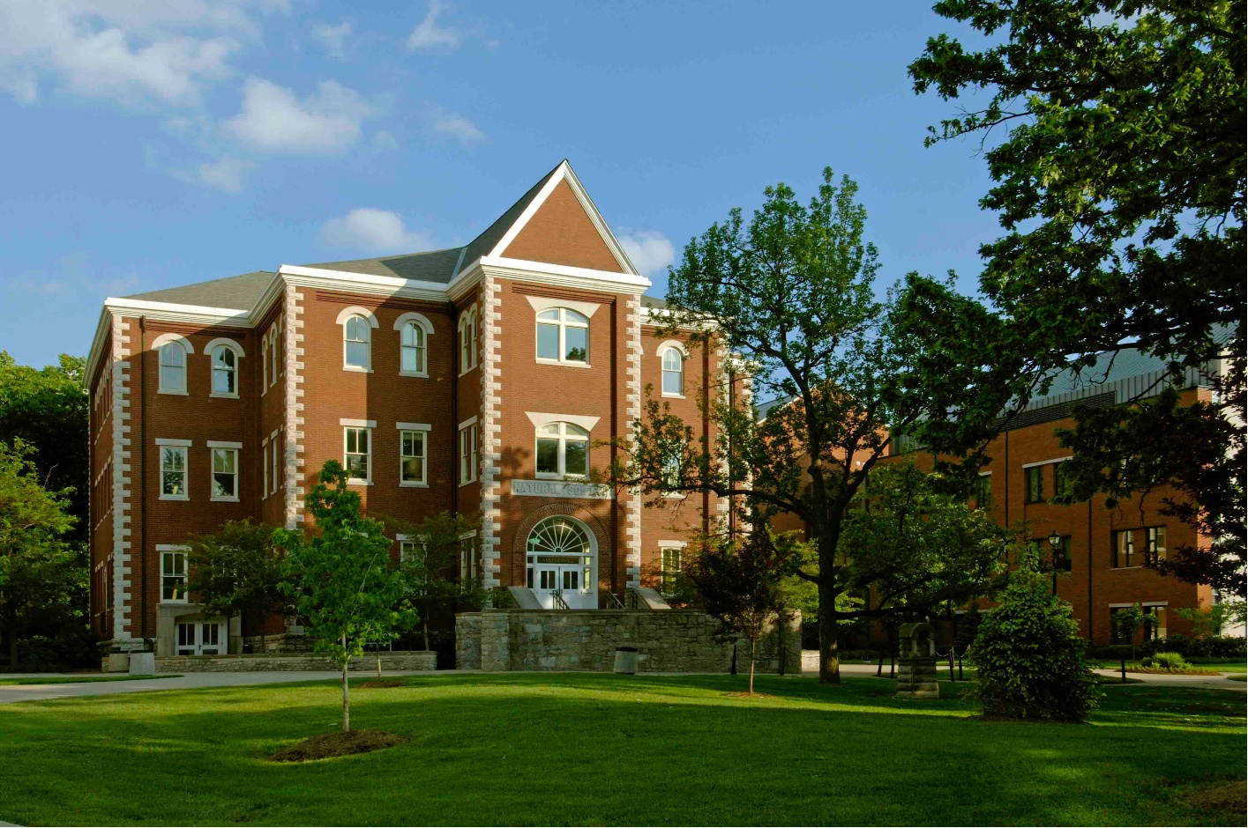
2022-24 Asset Preservation Update Delivering on Commitments: Miller Hall
Miller Hall (constructed in 1898) has been renovated to provide new classrooms, meeting rooms, a conference room, offices, and an administrative suite to support the Martin School of Public Policy, relocated from Patterson Office Tower
New student commons and gathering areas support collaboration and community
Scope: $4.5 million
$ 3,461,517 State Bonds
$ 1,038,483 Agency Bonds
Project completion: June 2025
7
Capital Planning Advisory Board | July 2025
7

Slide 8
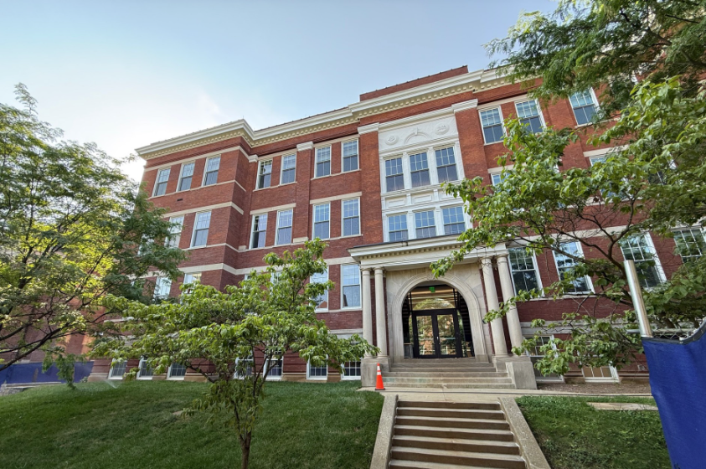
2022-24 Asset Preservation Update Delivering on Commitments: Pence Hall
Pence Hall (constructed in 1909) will house the College of Communication and Information, providing classrooms, an auditorium, labs, a studio, and indoor/outdoor spaces for collaboration
Together with McVey Hall and Lucille Caudill Little Library, Pence Hall will create a cohesive communications and information neighborhood at the heart of campus
Scope: $32 million
$ 24,615,232 State Bonds
$ 7,384,768 Agency Bonds
93% complete as of June 1, 2025
Expected completion: July 2025
8
Capital Planning Advisory Board | July 2025

Slide 9
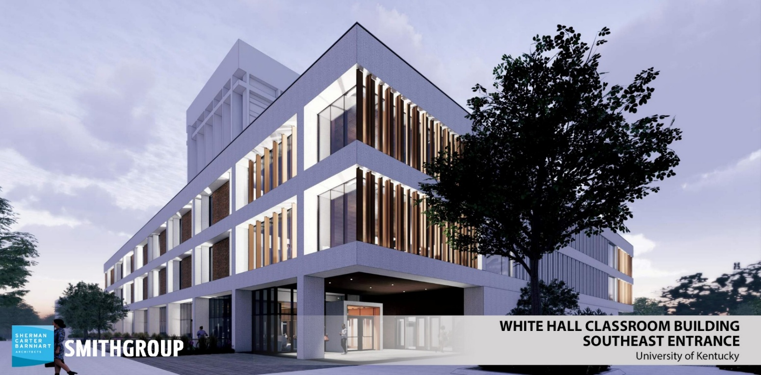
2022-24 Asset Preservation Update Delivering on Commitments: White Hall Classroom Building
White Hall Classroom Building (constructed in 1969) is a vital academic hub, serving thousands of students daily across many disciplines
The project delivers larger, flexible classrooms, collaborative spaces, and social areas to enhance learning, teaching and campus connections
Scope: $74 million
$ 56,922,724 State Bonds
$ 17,077,276 Agency Bonds
30% complete as of June 1, 2025
Expected completion: Summer 2026
9
Capital Planning Advisory Board | July 2025

Slide 10
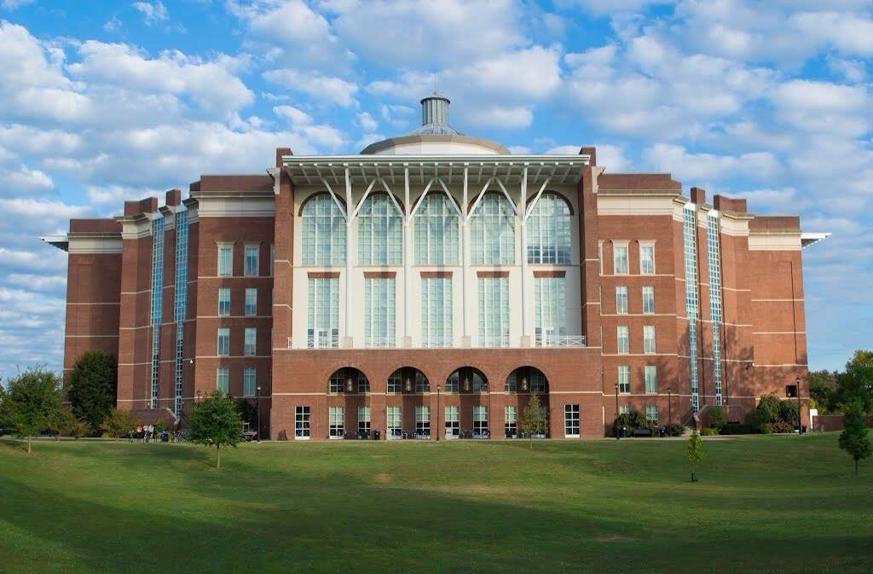
The W.T. Young Library (constructed in 1998) renovation will transform the basement space into a dynamic, student-centered hub that redefines how students engage with academic and support services
The project will introduce classrooms, tutoring spaces, student success programs, offices, and resources — all designed to foster collaboration, innovation, and achievement
This inviting and modern environment will become a cornerstone of undergraduate learning
Scope: $8 million
Expected completion: July 2027
2024-26 Asset Preservation Update Delivering on Commitments: W.T. Young Library
10
Capital Planning Advisory Board | July 2025

Slide 11
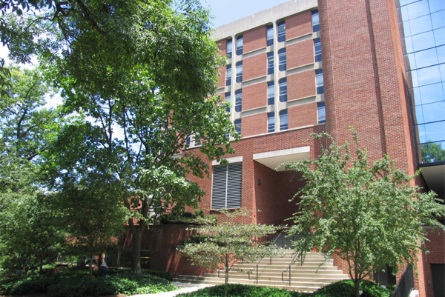
2024-26 Asset Preservation Update Delivering on Commitments: Anderson Tower
Anderson Tower (constructed in 1966) will upgrade mechanical and control systems to enhance building performance, safety, and reliability to enhance indoor air quality and temperature control
Scope: $7.6 million
Expected completion: August 2027
11
Capital Planning Advisory Board | July 2025

Slide 12
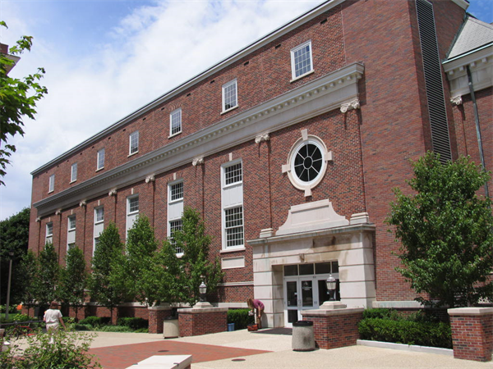
2024-26 Asset Preservation Update Delivering on Commitments: M.I. King Library
The M.I. King Library (constructed in 1909) renovation will create student-focused spaces with enhanced accessibility, seamless connectivity, and modern systems that ensure comfort and efficiency
The reimagined first and second floors will deliver dynamic spaces — including classrooms, tutoring centers, student success programs, and library services — designed to foster academic achievement and support every student’s journey
The project will create a future-ready facility that aligns with institutional priorities while remaining flexible for evolving needs
Scope: $59 million
Expected completion: May 2028
12
Capital Planning Advisory Board | July 2025

Slide 13
The Enterprise Data Center will support state-of-the-art high-performance computing, AI technologies, and data-intensive research while improving system reliability, scalability, and security
Will strengthen disaster recovery and reduce operational risks — especially for UK HealthCare
Scope: $300 million
$175 million State Bonds
$ 50 million Agency Bonds
$ 75 million P3 Funds
Priority Funding Request: Enterprise Data Center
13
Capital Planning Advisory Board | July 2025

Slide 14
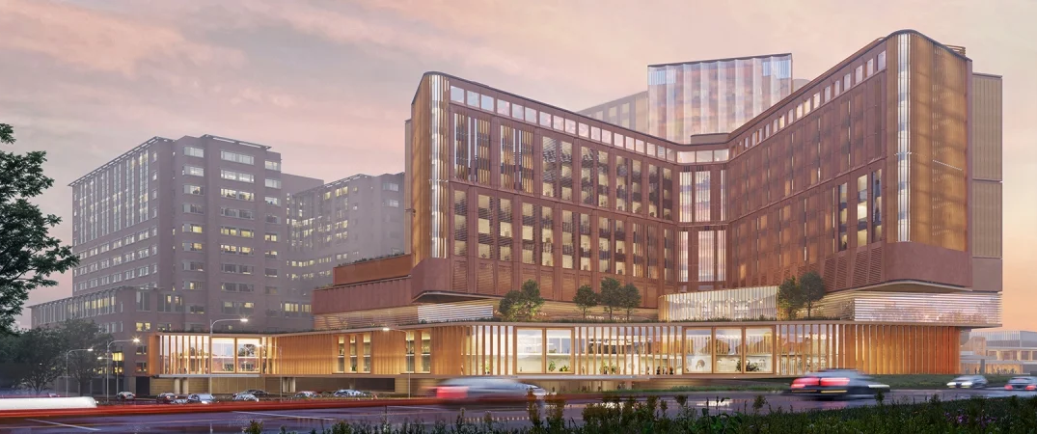
UK HealthCare Chandler Expansion Update
The UK Chandler Expansion will add 500 patient beds, which is critical to continuing to provide high-quality, accessible healthcare for all Kentuckians
14
Capital Planning Advisory Board | July 2025

Slide 15
Questions?
Research Facility
Asset Preservation
Enterprise Data Center
15
Capital Planning Advisory Board | July 2025

