Slide 1

University of Louisville
Capital Plan and Priorities
2026-28
Capital Planning Advisory Board
July 9, 2025

Slide 2

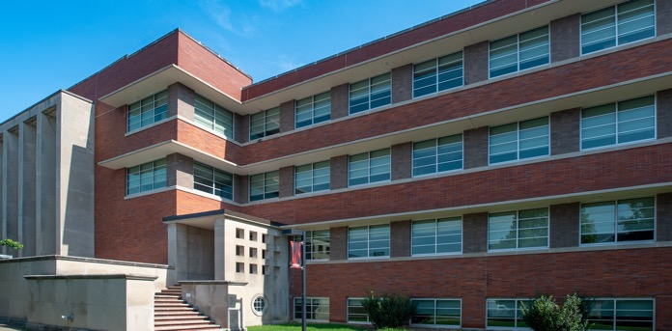
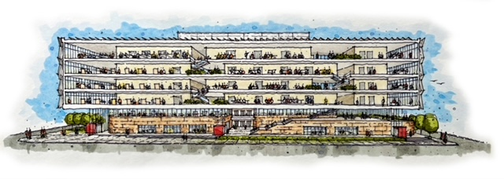
Appreciation of Current Capital-related Support
  Asset preservation
  Renovation of Natural Sciences building
  Health Sciences Center academic and simulation building
Renovation of Natural Sciences building
Health Sciences Center academic and simulation building

Slide 3
UofL Capital Planning Process
UofL Capital Planning Drivers
  Purposeful
  Responsive
  ROI for each project
  Strategic focus on retention and recruitment
  State-mandated mission
  UofL Strategic Plan
  Great Place to Learn
  Great Place to Discover
  Great Place to Connect
  Great Place to Work
  Implementation of Campus Master Plan

Slide 4
2026-28 Priority Requests
  STEM academic center
  Center for AI Excellence and comprehensive information technology (IT) upgrades
  Renovation of Miller Information Technology Center (MITC)
  Campus infrastructure modernization
  College of Arts and Sciences lab and classroom renovations

Slide 5
STEM ACADEMIC CENTER
THE NEED: Enrollment and graduation rates for UofL Science, Technology, Engineering and Math (STEM) majors are on the rise with undergraduate credit hour enrollment in STEM courses increasing by 12.2% since Fall 2014. The proposed STEM building will create vital, modernized learning spaces that foster academic program growth in high-demand disciplines and beneﬁt the broader community by cultivating workforce development across the commonwealth and beyond.
Provides necessary infrastructure to foster a collaborative and dynamic learning environment that includes enhanced teaching methodologies, interactive learning tools and learning spaces that encourage interdisciplinary teamwork
Serves as new home of UofL’s cybersecurity center, accelerating the cybersecurity degree program with improved curriculum development and collaboration between the College of Arts & Sciences, the J.B. Speed School of Engineering and external entities
Prepares an educated, strong STEM workforce essential for Kentucky’s sustainable development and economic growth and to ensure the commonwealth remains competitive in an ever-evolving global economy
Projected budget: $142 million

Slide 6
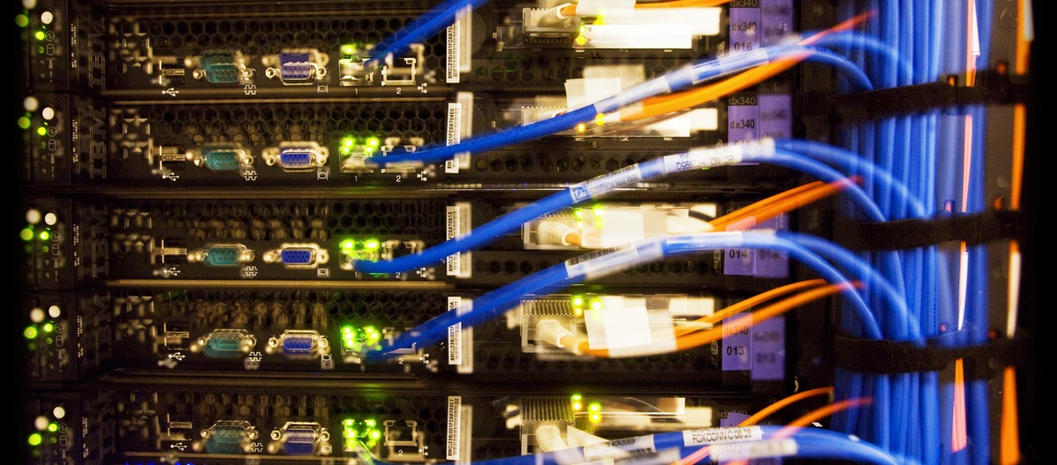
CENTER FOR AI EXCELLENCE AND IT INFRASTRUCTURE UPGRADE
THE NEED: The field of artificial intelligence (AI) is rapidly evolving and UofL is positioning Kentucky to be a national leader in the space. A dedicated center and infrastructure improvements will support the development and growth of AI in student success, research, innovation and economic development.
Creates the Center for AI Excellence which will provide students with personalized AI tools, AI-driven concierge service, tailored advising and student support chatbots and training programs to enhance students’ AI skills
Serves as a state resource for AI in the areas of data privacy and security, economic development, healthcare, training and research
Improves infrastructure:
  Data Center update
  Networking system enhancements
  Computer processing system and storage enhancements
  Security and firewall infrastructure enhancements
Projected budget: $75 million

Slide 7
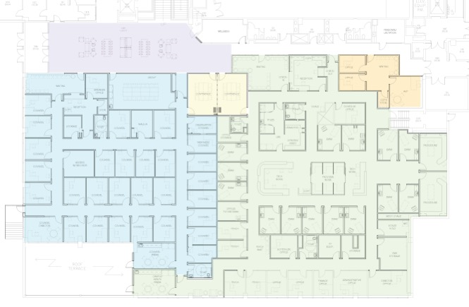
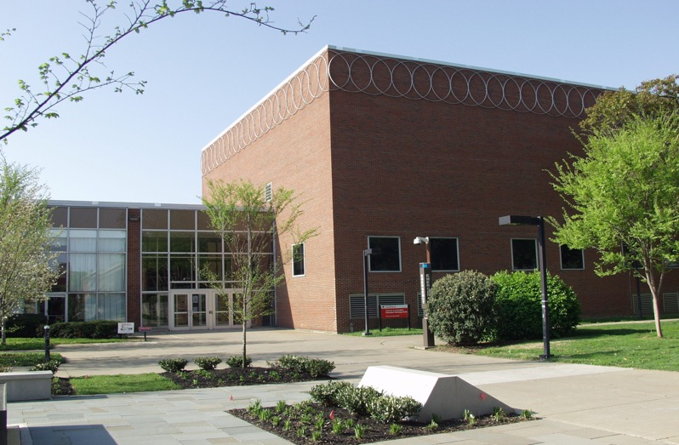
RENOVATION OF MITC (STUDENT HEALTH CENTER & OPERATIONS)
THE NEED: To learn at their best, students need to be physically and mentally healthy. UofL student responses to a national health assessment support providing physical and mental health support services in one centrally located campus center. Seventy-three percent of students reported visiting a medical provider in the last year, and 54% reported receiving mental health services.
Makes all student health services easily accessible at one stop
Removes logistical barriers, such as inconvenient campus location, that students say affects their willingness to seek medical help when needed
Consolidates several additional operations functions (human resources, information technology, finance support) closer to students, faculty and staff
Projected budget: $40 million

Slide 8
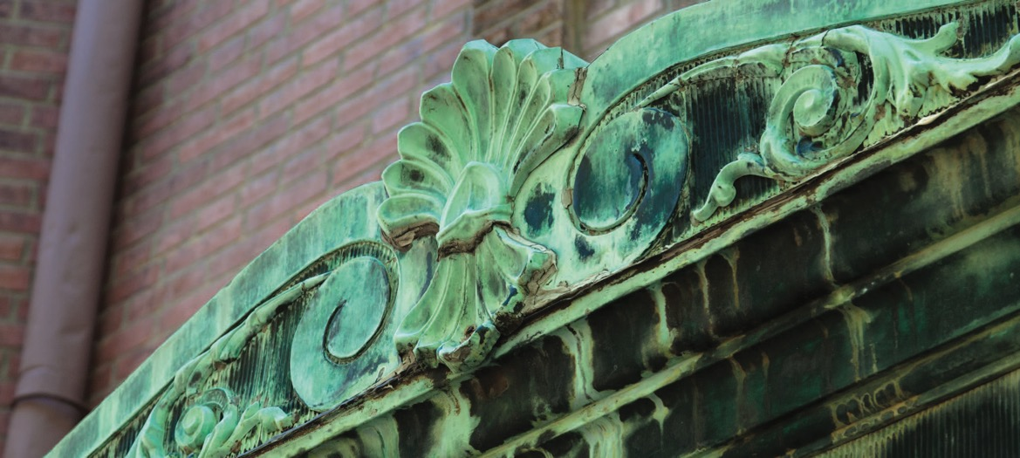
CAMPUS INFRASTRUCTURE MODERNIZATION
THE NEED: Aging buildings on all three UofL campuses require long-overdue repairs and upgrades to ensure safety and improve the learning and research environment for students, faculty and staff.
Builds upon the positive impacts of the current Asset Preservation Program
Reinvigorates structures that have not been renovated in more than 30 years. Specific projects include:
  Roof, flooring, window repair and replacement
  Electrical, HVAC system upgrades
  Technology upgrades
Revitalizes facilities that aren’t equipped for modern teaching and research activities
Ensures the long-term viability and quality of facilities, reducing the need for costly new construction
Projected budget: $200 million

Slide 9
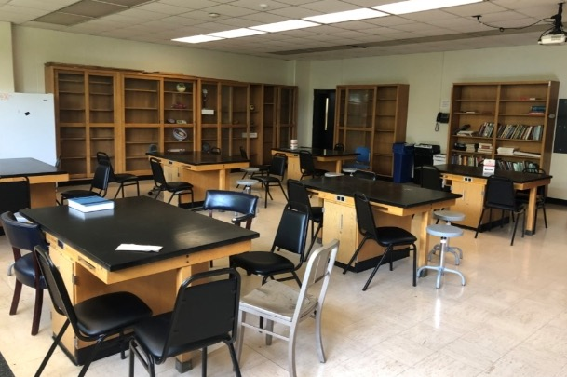
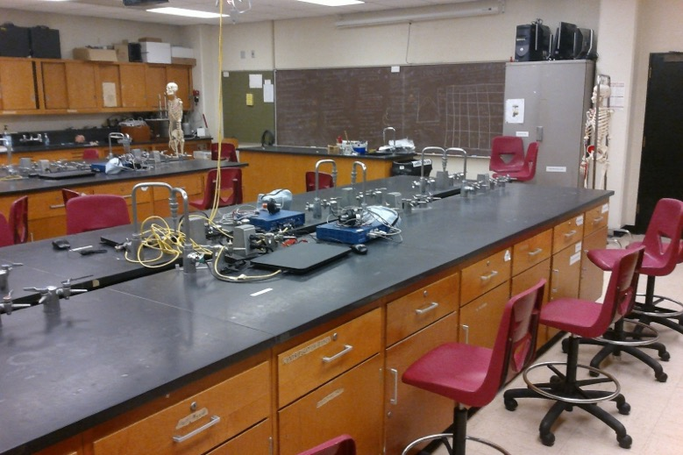
COLLEGE OF ARTS & SCIENCES LAB AND CLASSROOM UPGRADE
THE NEED: Twenty-first century learning requires updated facilities that not only attract students but also meet the needs and goals of the university mission. Renovation and upgrades to instructional laboratories, studios and student support areas in several critical academic buildings used by the College of Arts & Sciences are vital to our students’ learning environment.
Reimagines classrooms and labs to accommodate larger classes, new teaching techniques and technology needs unavailable in older, dated buildings
Assists with retention and recruitment of students, faculty and staff
Supports the College of Arts and Sciences as the largest college on campus, graduating more students than any other UofL school
Projected budget: $100 million

Slide 10
Summary of Other Capital Projects
Student Support
  Residence hall construction, renovation and acquisition
  Expand/renovate student dining facilities
Academic Support
  Construct Belknap Campus Parking Garage
  Construct Medical Sciences Research Building
  Law School renovations
  Refresh academic spaces on HSC campus
Campus operations
  Stormwater mitigation improvements
  Implement code improvement plans
Athletics
  Renovations and upkeep
  Improve training and operation facilities

Slide 11
Thank you

