Slide 1
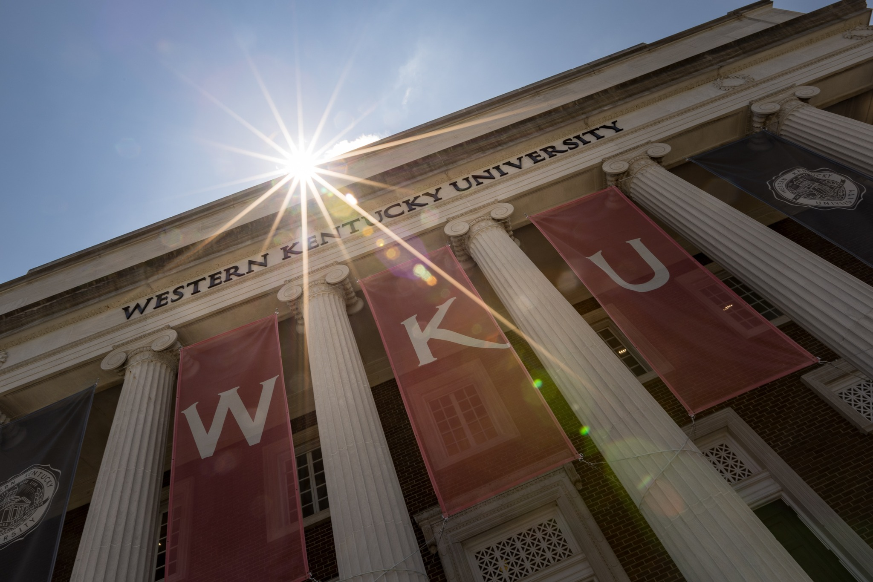
Western Kentucky University
Capital Plan and Priorities
FY 2026-2032
Capital Planning Advisory Board | July 9, 2025

Slide 2
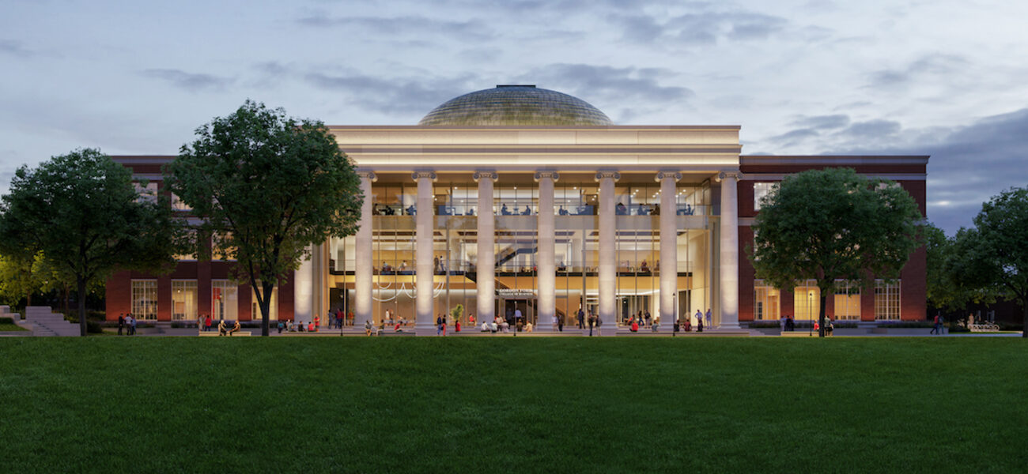
New home for the Gordon Ford College of Business Made possible by a capital project allocation in the 2022 budget.

Slide 3
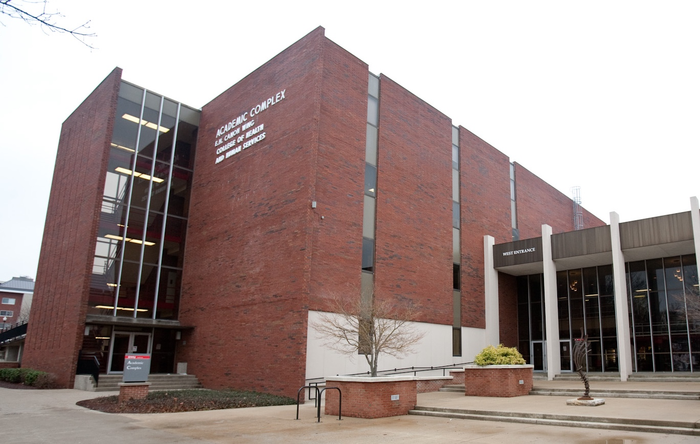
Academic Complex Facility Replacement
The current Academic Complex Facility is home to several programs in WKU’s College of Health and Human Services.
CHHS is WKU’s largest Academic College and prepares graduates to improve the quality of life in their communities and beyond.
In 2024, the General Assembly allocated $160M to replace Academic Complex.
Site selection and design work in progress.

Slide 4
Asset Preservation Work on The Hill
Roof replacements
Mechanical System Upgrades
Life safety/ADA improvements

Slide 5
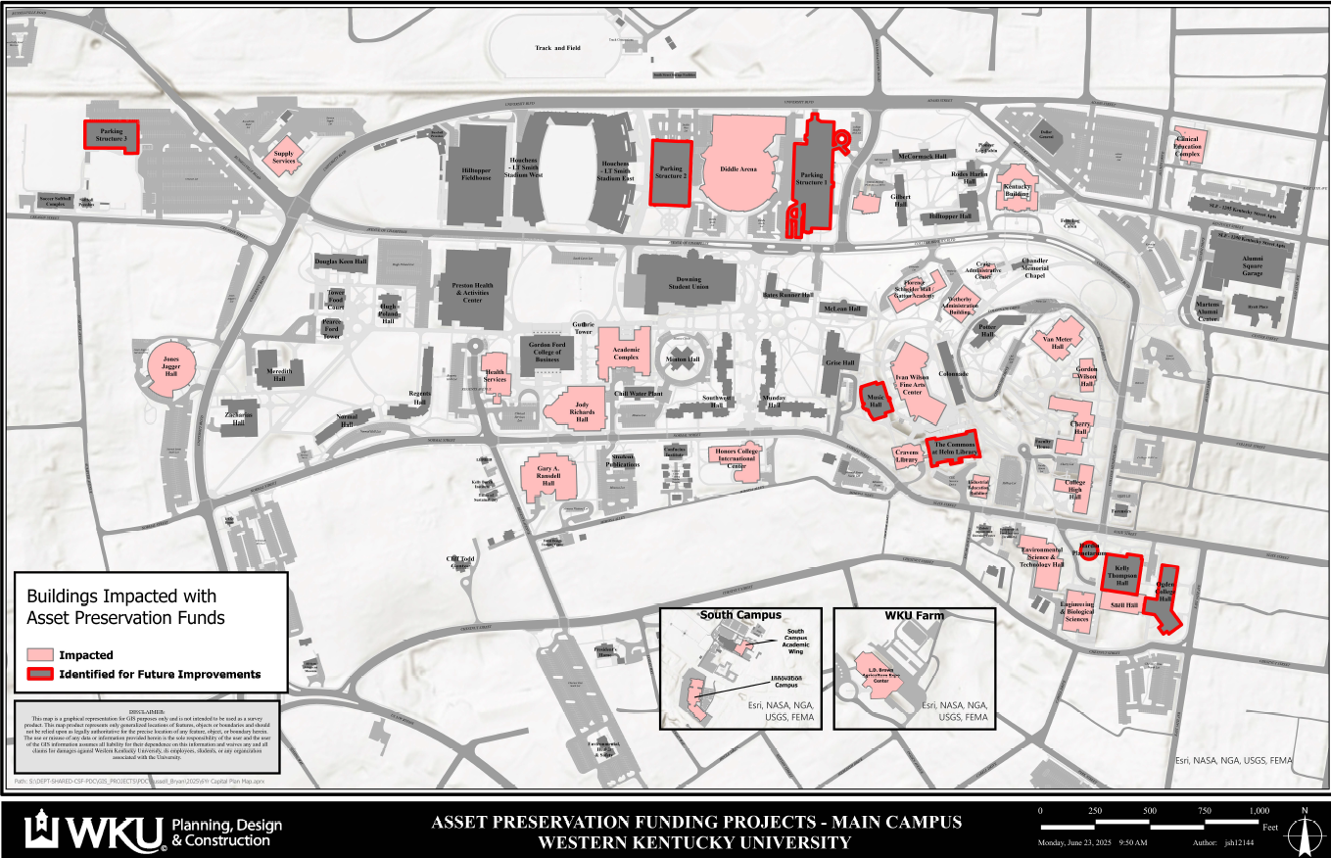

Slide 6
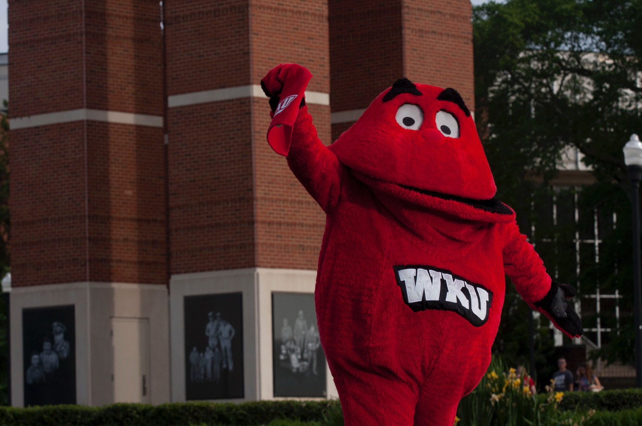
Top 5 Capital Project Priorities
Construct Potter College of Arts and Letters Facility
Construct Environmental Science and Technology Building
Renovate Ogden College of Science and Engineering
Demolition of Grise Hall and Improve Site
Renovate College High Hall

Slide 7
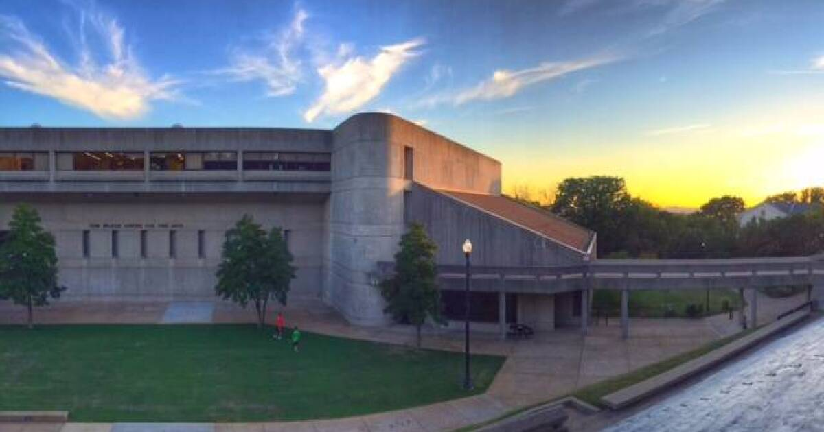
#1 Construct Potter College of Arts & Letters Facility
$280 Million Investment
Improves accessibility and quality of learning environment for one of WKU’s most used facilities.
Advances WKU’s work to create hands-on, applied learning experiences across multiple disciplines.
Modernizes outdated systems and obsolete technologies to advance creative and professional opportunities for students.

Slide 8
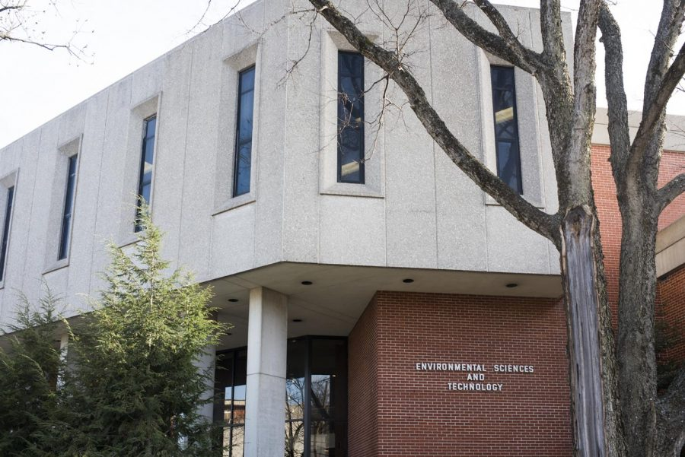
#2 Construct Environmental Science
and Technology Facility
$250 Million Investment
Expands hands-on learning opportunities in high-demand science fields.
Creates interdisciplinary lab space to support practical and real-world preparation for students.
Addresses critical facility needs in one of WKU’s oldest science buildings.

Slide 9
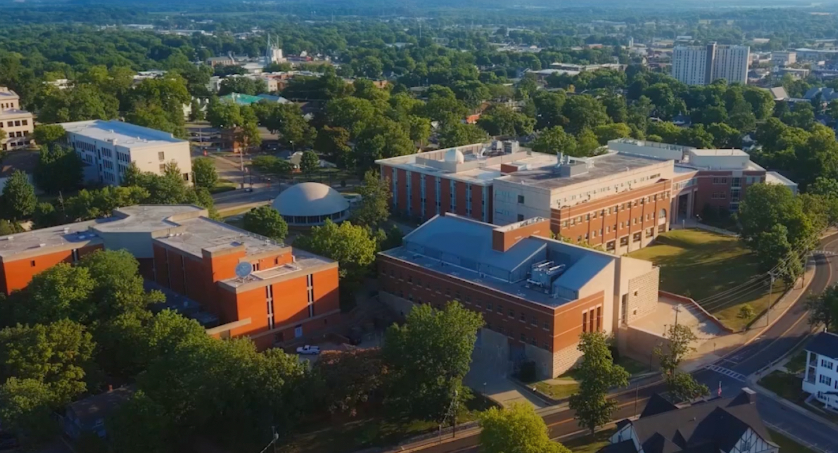
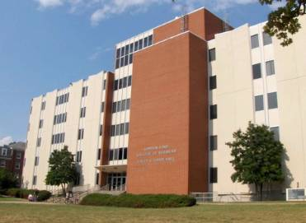
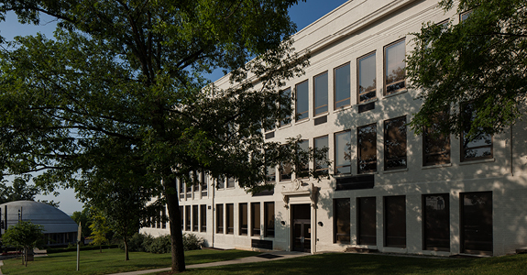
#3 Renovate Ogden College of Science and Engineering
$250 Million Investment
This project will serve a broad range of students each year, supporting hands-on instruction and research across science, technology, and related disciplines.
#4 Demolition of Grise Hall and Improve Site
$5 Million Investment
The Grise Hall demolition and site improvement project will remove the outdated academic building and prepare the site for future development, enhancing the functionality of this part of campus.
#5 Renovate College High Hall
$48 Million Investment
This project will ensure College High Hall continues to provide a state-of-the-art environment that meets the evolving needs of students.

Slide 10
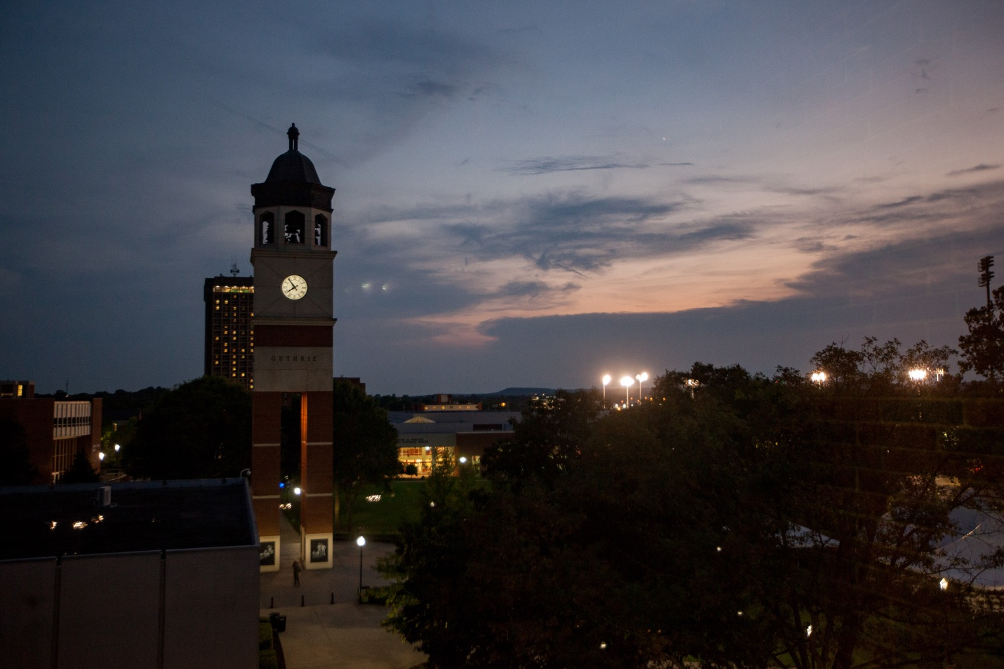
Thank you
We appreciate your continued investment in WKU’s future and the success of our students.

