Slide 1
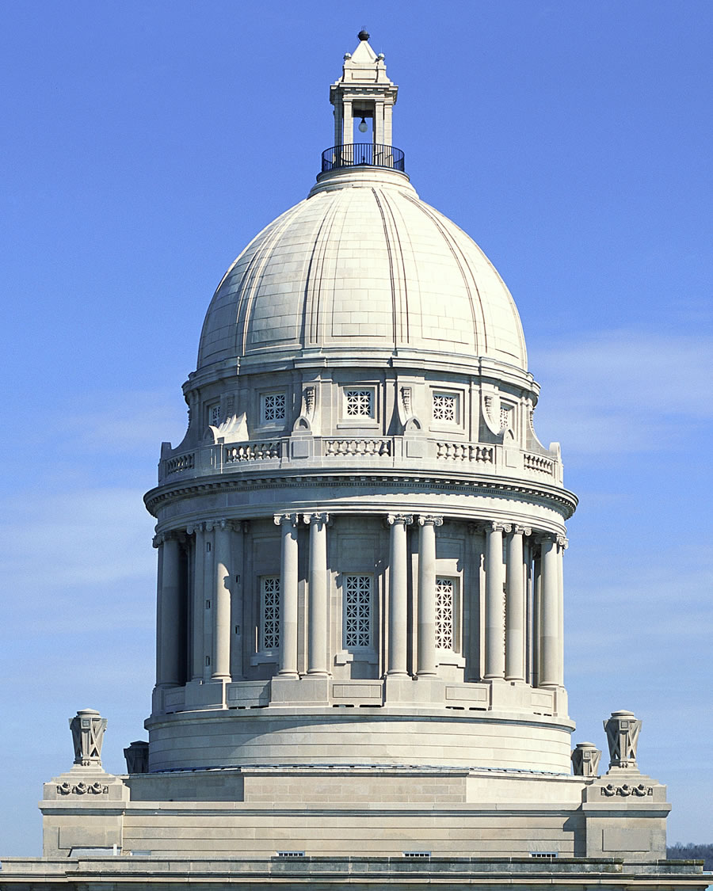
Capital Investment Priorities for Postsecondary Education
2026-2028
Kentucky Council on Postsecondary Education
Greg Rush, Assistant Vice President for Finance Policy and Programs
Adam Blevins, Associate Director for Finance Policy and Programs
Dr. Cody Bumgardner, KyRON Advisor

Slide 2
Overview
KyRON Project Update
Background
Draft 2026 - 2028 Capital Request

Slide 3
KyRON Update

Slide 4
Kentucky Regional Optical Network (KyRON)
Kentucky’s Research and Education Network (R&E)
R&E networks are deployed in over 40 states, providing high-speed network infrastructure for academic and research communities.
1998: Kentucky Postsecondary Education Network (KPEN)
2000: Connected to Internet2
2007: Internet2 offers Commercial Peering Services
2009: Kentucky Regional Optical Network (KyRON)
2013: Increased 10X performance @ 80% the cost
2022: 2X Internet2 connectivity @ 200GB
2025: Transitioned from Windstream to KCNA transport
2025: AI Research Servers deployed @ COT

Slide 5
Kentucky Regional Optical Network (KyRON)
Network Services beyond basic connectivity
KyRON serves eight public universities and sixteen community and technical colleges across over 70 sites
Provides Internet2 services to the entire postsecondary education community and extends services to public hospitals and Agricultural extension offices statewide
  High-speed communications to 80% of the Internet at a fraction of the cost of commercial providers
  Cloud Connect: dedicated connections to major cloud providers Amazon Web Services (AWS), Microsoft Azure, Google Cloud, etc.
  InCommon: Federated Identity and Access Management
  Eduroam: Global roaming Wi-Fi services

Slide 6
Kentucky Regional Optical Network (KyRON)
New AI Inference Services
One of the first R&E Networks to deploy AI services to its community
AI Services
  Models costing hundreds of millions of dollars to train are publicly available for those with technical expertise and sufficient computational infrastructure
  Inference is the process of “running” an AI model, such as chatbot
  Privacy and cost are driving factors in self-hosted AI models

Slide 7
Kentucky Regional Optical Network (KyRON)
Value Proposition
Why AI services?
A single chatbot for county extension
Frontend:
Azure App Service → $1,900.92/mo
Azure Blob Storage → $75,000/mo (at rest)
              Write → $2,280/mo
    Read → $1,900/mo
Backend:
2 x Azure H200 VM → $ 71,773.60/mo
TOTAL: $152,854.52/mo
Why the network?
Without KyRON tens of millions would be spent on connectivity alone across higher education
InCommon and Eduroam provide identity services that are invaluable for collaborative research, shared services, and community services
KyRON has become a vital link to cloud providers for not just research and education, but also for UK Healthcare

Slide 8
Background

Slide 9
Background
Fast Facts
Kentucky Public Postsecondary Education System:
8 public universities
16 community and technical colleges
Over 20 million square feet in E&G facilities
More than 50,000 employees
Over 212,000 students
Nearly 74,000
degrees and credentials
last year

Slide 10
Background
Facilities Need Drivers - Enrollment Growth and Research
Historically, growth in enrollment and research have driven facilities needs
Metric | Fall 2019 | Fall 2024 | % Change
KCTCS FTE Students | 43,531 | 45,902 | 5.4%
University Undergraduate FTE | 81,645 | 82,690 | 1.3%
University Graduate FTE Students | 18,756 | 21,530 | 14.9%
Student STEM+H Headcount (Total Enrollment) | 57,073 | 57,927 | 1.5%
Source: Kentucky Postsecondary Education Data System (KPEDS). Figures include dual credit enrollment.
Metric | 2019 | 2023 | % Change
R&D Expenditures (State) | $431,783,000 | $530,130,000 | 22.8%
National Science Foundation HERD Survey.
Capital plans reflect a need for asset preservation and new construction to support priority areas of growth.

Slide 11
Background
Facilities Need Drivers – Increased Construction Costs

Slide 12
Background
Facilities Need – State Investment in Asset Preservation
Vanderweil Facilities Advisors (VFA) Study completed in 2007, updated in 2013
Identified $7.3 B investment needed by 2021 to bring campus E&G facilities up to industry standards
Over the past two biennia, the state spent $1.25 B on facilities renovation and renewal pools
  $683.5 M in 2022-2024
  $563.0 M in 2024-2026
This represents about 17% of the projected $7.3 B system total asset preservation need
  Additional appropriations provided for line-item projects (e.g., $16.5 M KCTCS)

Slide 13
Background
Facilities Need - Summary
As of June 2025, nearly all of 2022-2024 and the majority of 2024-2026 Asset Preservation Pool funds are obligated
  2022-2024: 99.1%
  2024-2026: 65.5%
Increased construction costs have strained both asset preservation and new construction projects
Draft 2026-2028 request prioritizes renovation and renewal, but recognizes the need for new construction on campuses
  Must adapt to an evolving, technology-driven workforce
  Not all facilities can be retrofitted to meet institution and industry needs

Slide 14
Draft 2026-2028 Capital Request

Slide 15
Draft 2026-2028 Capital Request
Process and Timeline
Collaborative process involving CPE staff, campus presidents, chief budget officers, and Council members
May 2025
Jun 2025
Jul 2025
Aug 2025
Sep 2025
Oct 1
Review budget components from previous biennium
Discuss budget timeline and key resource needs
Discuss budget components and request amounts
Update Council members on progress
Discuss budget components and request amounts
Update Council members on progress
Finalize request based on input from presidents
Work with institutions on messaging
Finance Committee endorses request
Council approves 2026-2028 biennial budget request
CPE staff submits budget to OSBD and LRC staffs

Slide 16
Draft 2026-2028 Capital Request
Capital Investment Components

Slide 17
Asset Preservation

Slide 18
Capital Investment Components
Asset Preservation - Request
Proposal
Request for $700 M in bond funds to finance renovation and renewal projects at postsecondary institutions
If authorized, requested funds would be the third major installment of asset preservation funds to address a $7.3 B system total need
CPE staff will recommend that the funding be provided without any required institutional match
Over the past two biennia, the state has provided $1.25 B for asset preservation, or about 17% of the estimated $7.3 B need

Slide 19
Capital Investment Components
Asset Preservation – Allocation Process
In 2024-2026, the General Assembly appropriated $281.5 M each year for asset preservation
Allocated based on each institution’s share of system total Category I & II square feet
CPE staff will recommend that requested funds be allocated using the same methodology in 2026-2028

Slide 20
Capital Investment Components
Asset Preservation – 2026-2028 Proposed Projects
Total scope of proposed asset preservation projects for 2026-2028 submitted with the institution’s six-year capital plan. Includes only projects identifying appropriated general fund dollars. Total reflects changes in categorization within Version 4 of the Capital Planning System

Slide 21
New Construction

Slide 22
Capital Investment Components
New Construction - Overview
Proposal
CPE staff plans to include a request for new capital construction projects in the Council's 2026-2028 budget recommendation
  Public universities - highest priority project
  KCTCS – top 10 highest priority projects
Approximately $1.73 B in general fund appropriation
Statewide priority is still asset preservation, but institutions require periodic investment in new capital as some space needs cannot be addressed by expanding or retrofitting older facilities

Slide 23
Capital Investment Components
New Construction – Projects and Allocation

Slide 24
Information Technology (IT) and Equipment

Slide 25
Information Technology Projects
Review of Campus Projects
CPE staff were asked to review information technology projects submitted by the institutions. An in-house evaluation committee was used
Utilized COT scoring criteria
Institutions submitted 48 projects for 2026-2028
  IT pools, infrastructure upgrades, compliance and security-related projects
  $1.39 B in total IT project scope; $215.5 M in state dollars
  $322.6 M in total equipment scope; $6.0 M in state dollars

Slide 26
Capital Investment Components
Information Technology Projects
Proposal
Although IT and equipment needs are vitally important for campuses, CPE is not planning to include a request for such projects in the Council’s 2026-2028 budget recommendation
Other capital investment components are perceived to be a higher priority for state funding than information technology and equipment projects
  CPE staff found IT projects included in the Capital Planning System to be relevant, with clear alignment to business needs
  Only a few IT projects requested General Fund appropriation

Slide 27
Questions?

Slide 28


Stay Connected
Twitter: CPENews and CPEPres
Data Center: cpe.ky.gov/data
Newsletter: cpe.ky.gov/news/subscribe

