Slide 1

Capital Planning Advisory Board
August 13, 2025
Pension Administration System (PAS) Modernization
Rebecca Adkins, Deputy Executive Director
Mike Lamb, CFO
Dominique McKinley, Enterprise and Technology Services Director

Slide 2




KPPA Overview
WHO WE ARE
The Kentucky Public Pensions Authority (KPPA) administers retirement benefits for public employees across the Commonwealth.
SYSTEMS ADMINISTERED
KPPA oversees three retirement systems: County Employees Retirement System (CERS) Kentucky Employees Retirement System (KERS) State Police Retirement System (SPRS)
MEMBERSHIP SCOPE
KPPA serves over 433,000 members, including active, inactive, and retired public service employees.
RETIREE IMPACT
More than 128,000 retirees currently receive $2.2 billion annually in benefits from the systems KPPA administers.
GOVERNANCE STRUCTURE
Effective April 1, 2021, the CERS Board of Trustees is responsible for governance of the CERS pension and insurance plans for Hazardous and Nonhazardous. The governance of the KERS Hazardous and Nonhazardous pension and insurance plans and the SPRS pension and insurance plans are the responsibility of the Kentucky Retirement Systems (KRS) Board of Trustees. Administrative responsibilities of all these systems is provided by an 8-member board, the KPPA Board, which is composed of trustees from the CERS and KRS boards.

Slide 3
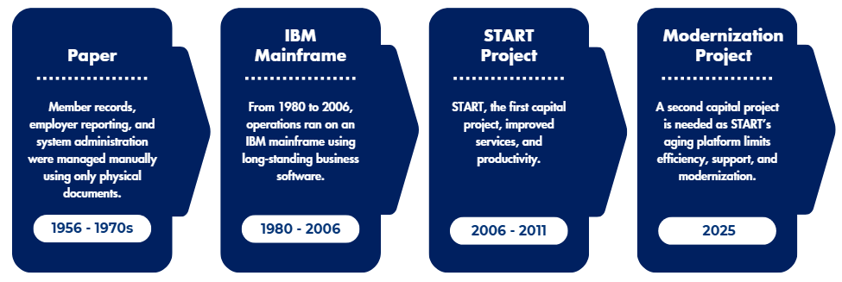
History of Technology Systems at KPPA

Slide 4
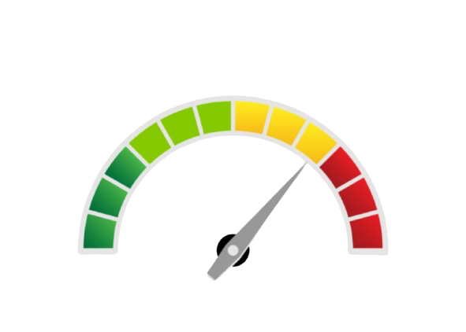
The Case for Change
The START system was built using a programming language called VB.NET. This language is how the system “speaks” to the technology behind the scenes.
Microsoft will no longer be evolving VB.NET, which means:
  It won’t be updated or improved anymore
  Fewer developers will know how to work with it
  Fixing problems or making updates will become harder and more expensive
Because of this, we can’t keep relying on the same foundation. We need to move to a newer, supported language that will be easier to maintain, more secure, and compatible with modern tools.
Modern Platform / Easier Support / Scalable
Outdated language / Fewer Developers / Security Concerns

Slide 5
Capital Project Phases
Total Estimated Amount: $75 Million (RESTRICTED FUNDS)
PLANNING PHASE (FY 2027 & 2028)
KPPA will work with the IV&V vendor to develop a phased modernization plan based on the completed technology assessment. This plan will align identified needs with the agency’s strategic goals and include obtaining necessary board approvals. Estimated Amount: $15,000,000.
IMPLEMENTATION PHASE (FY 2029 & 2030)
Significant modernization or full replacement of KPPA’s current PAS, including system design, development, testing, data migration, integration with existing platforms, and phased deployment across the agency. Estimated Amount: $50,000,000.
CLOSURE PHASE (FY 2031 & 2032)
System stabilization, performance validation, documentation, staff training, and formal project closeout. This phase ensures a smooth transition to ongoing operations. Estimated Amount: $10,000,000.

Slide 6


Modernization is Necessary & Strategic
This capital project addresses critical system limitations to ensure long-term reliability, operational efficiency, and consistent delivery of KPPA services.
Modernizing the Pension Administration System will allow KPPA to be more:
Efficient | Flexible
Responsive | Integrated
Adaptable | Streamlined
Accurate | Transparent
Supportive | Sustainable
Strategic | Reliable
Accessible to members, retirees, & employers | Prepared for automation (AI)
The current software will no longer be enhanced, yet it provides critical services to the commonwealth and the 433,000 members and retirees, including benefits payments of
$2.2 billion annually across all 120 counties.

