Slide 1

Justice & Public Safety Cabinet
2026-2032 Six Year Capital Plan
Presentation to the Capital Planning Advisory Board
May 21, 2025
Keith Jackson, Secretary,
Justice & Public Safety Cabinet
Rebecca Norton, Executive Director, Office of Financial Management

Slide 2
Justice and Public Safety Cabinet Overview
Six Departments
  Department of Juvenile Justice
  Department of Corrections
  Department of Criminal Justice Training
  Kentucky State Police
  Department of Public Advocacy
  Department of Justice Administration
    Office of Drug Control Policy
    Office of the State Medical Examiner
    Parole Board
    Child Fatality and Near Fatality Panel
Over 8,000 Employees
900+ Physical Structures
10,000+ Acres
40+ counties
24/7 Public Facing and Residential Facilities

Slide 3
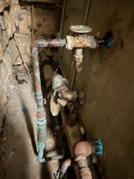
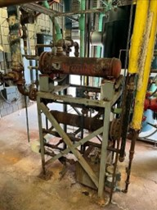
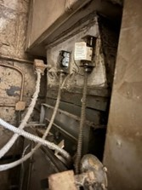
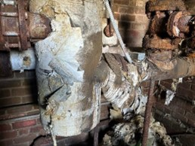
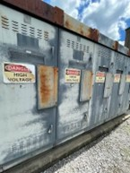
2026-2028 Maintenance Pool Requests
Department of Juvenile Justice: $14.4 Million
Department of Corrections: $48 Million
Department of Criminal Justice Training: $9 Million
Kentucky State Police: $13 Million

Slide 4
Cabinet and Department
Priority Projects
2026-2028 Biennium

Slide 5
Department of Juvenile Justice
High Acuity Mental Health Treatment Facility
Youth in DJJ Custody
(Youth Detention Centers & Youth Development Centers)
Treatment Focused Housing General Housing
High Acuity
Transition
Outpatient
Wellness
STATUS
Youth with Severe and Persistent Mental Illness (SPMI)
Youth without Severe and Persistent Mental Illness (SPMI)
Treatment Facility
Or
Pediatric Hospital
Transition Housing Unit at Detention Facilities
Counseling and Program Rooms at Detention Facilities
Programs
SPACE
CRITICAL NEED
A High Acuity Treatment Facility is necessary to fill this gap in facility and care options available to youth in DJJ custody

Slide 6
Department of Juvenile Justice
Two Female Detention Facilities
Peak: 46
May 2025 Average: 40

Slide 7
Department of Corrections
Projects Requested in the 2026-2028 Biennium Based on Facility Assessments:
Mechanical, Electrical, and Plumbing Lifecycle Replacements at all 11 Institutions
Roof Replacements at 5 Institutions
Building Repairs/Renovations at 6 Institutions
Additional projects are included in the 28-30 and 30-32 bienniums to fully address the deficiencies identified in the facility assessment reports.

Slide 8
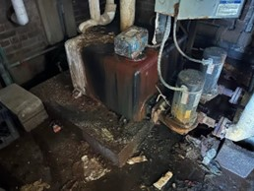
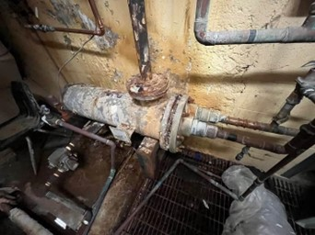
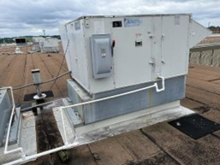
Department of Corrections
Kentucky State Penitentiary Utilities Infrastructure Replacement
Eastern Kentucky Correctional Complex HVAC and Façade Replacements
Eastern Kentucky Correctional Complex Kitchen Replacement
Kentucky Correctional Institution for Women New Dormitory Design
New Level 4 Prison – Eastern Kentucky

Slide 9
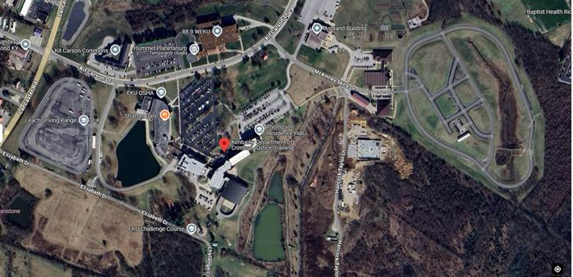
Department of Criminal Justice Training
Richmond Campus:
  Flat Track Replacement
  Campus Access Road

Slide 10
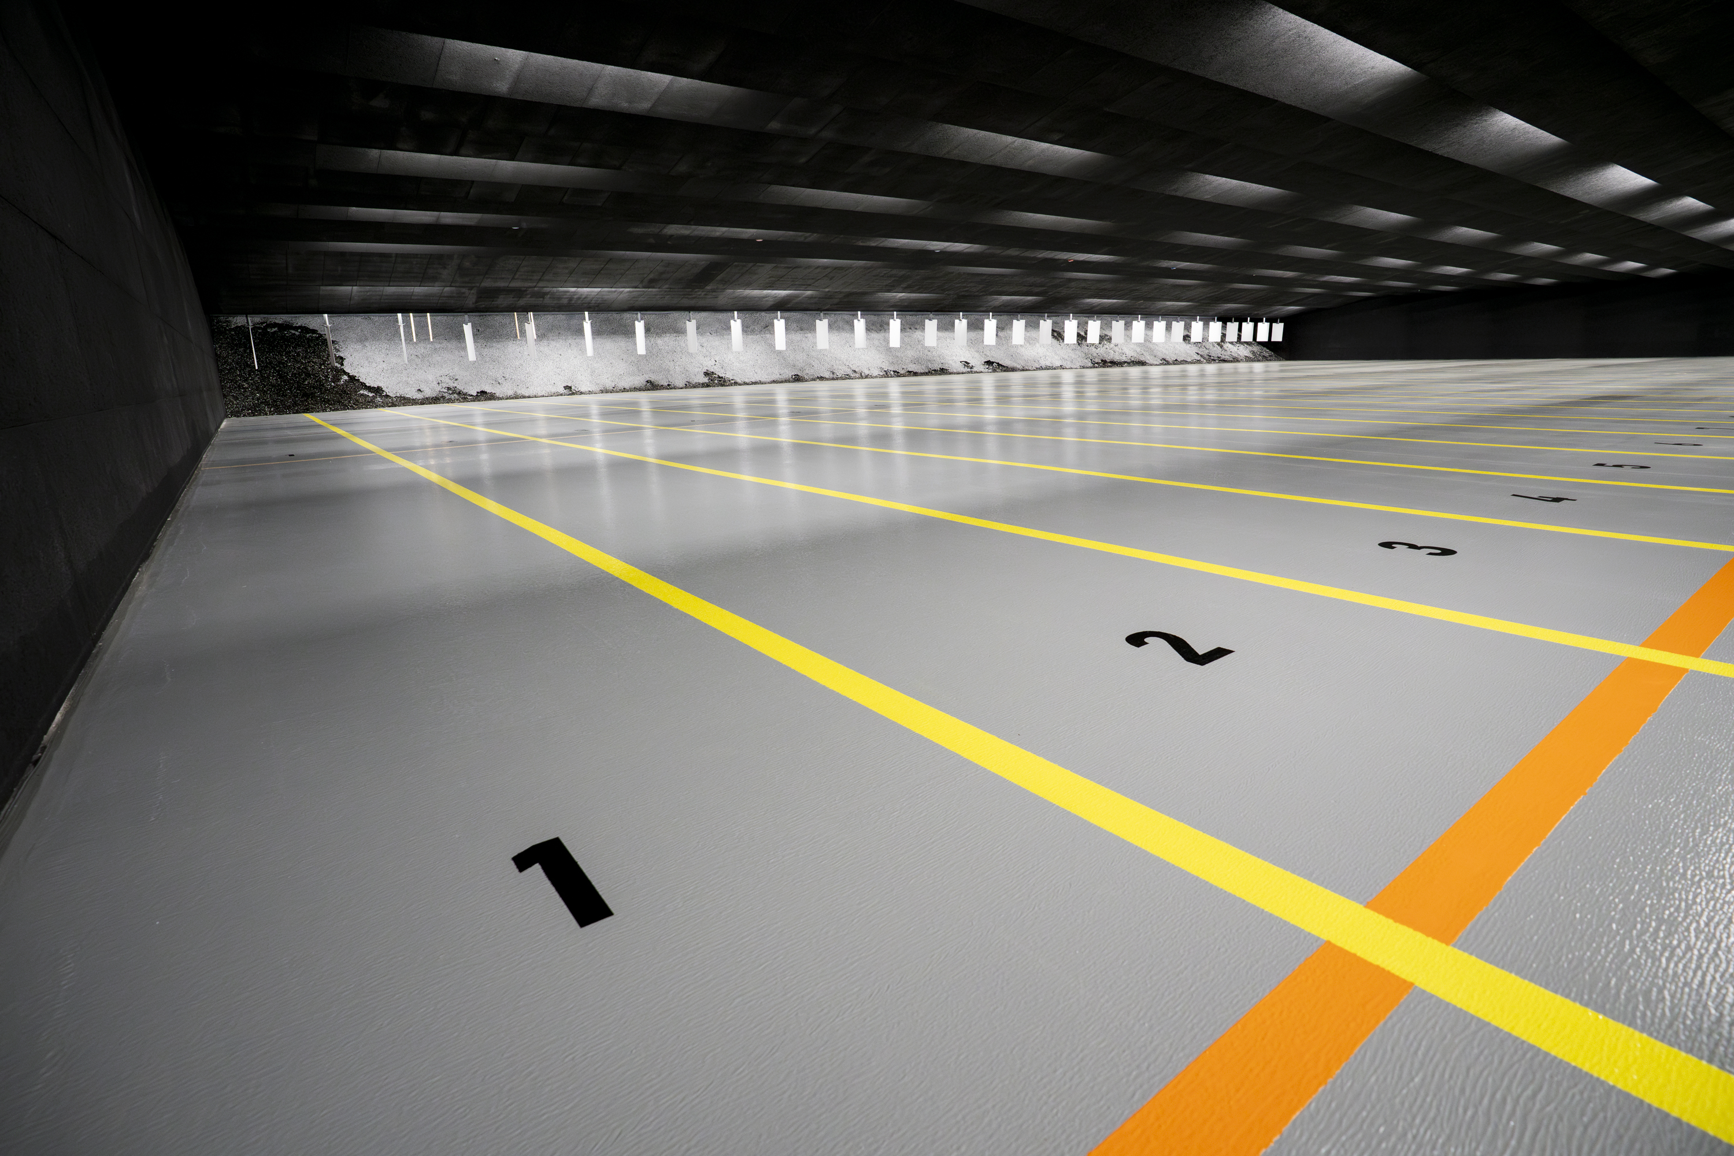
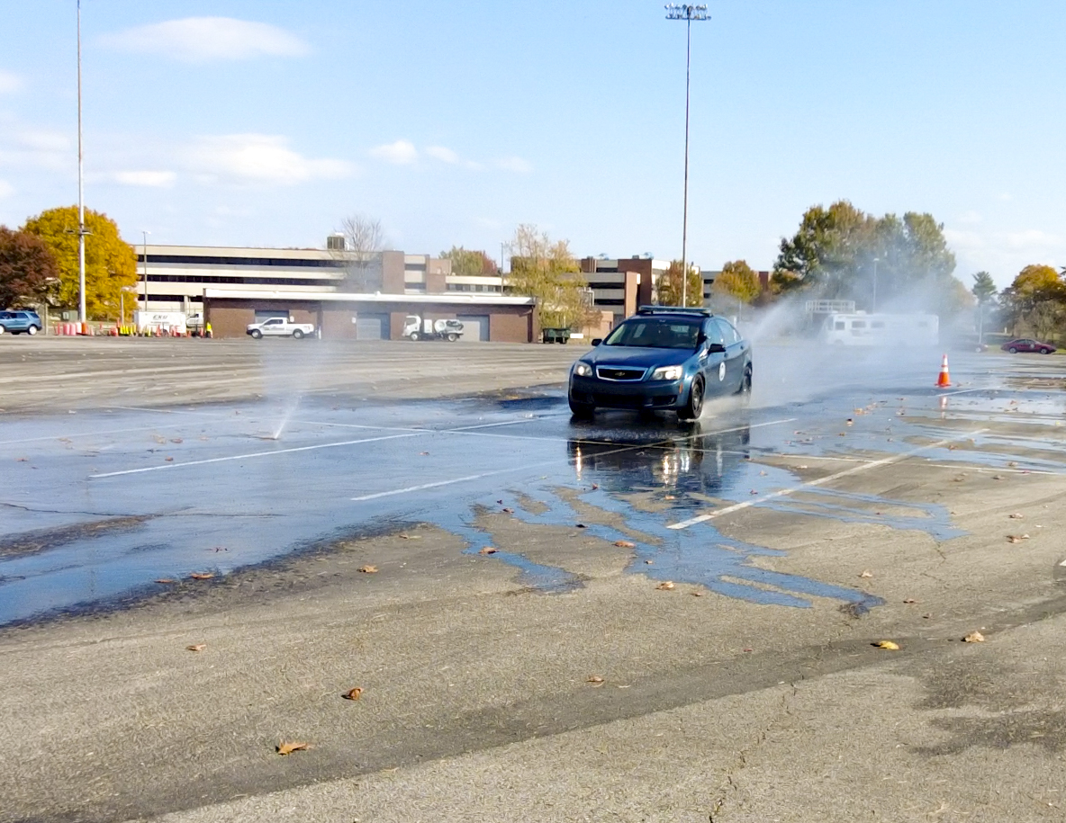
Department of Criminal Justice Training
Madisonville Campus Additions:
  Flat Track
  Indoor Firing Range

Slide 11
Kentucky State Police
Completion of SERVS Emergency Radio System

Slide 12
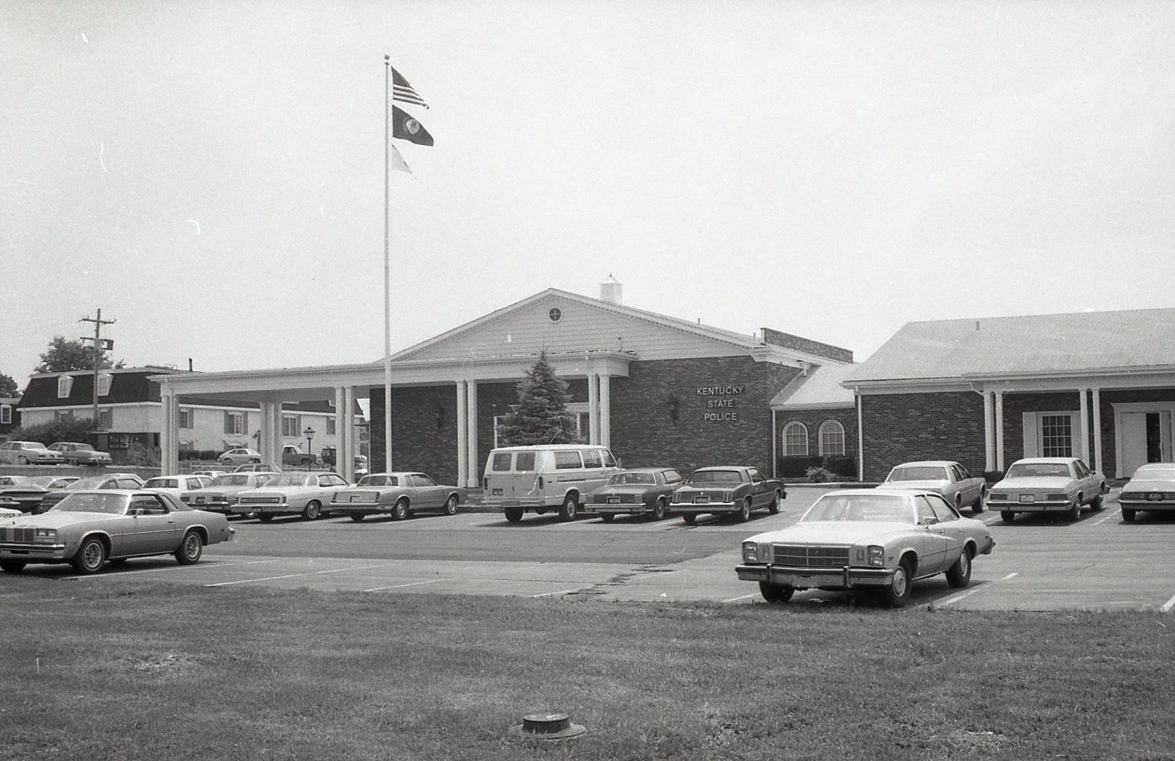

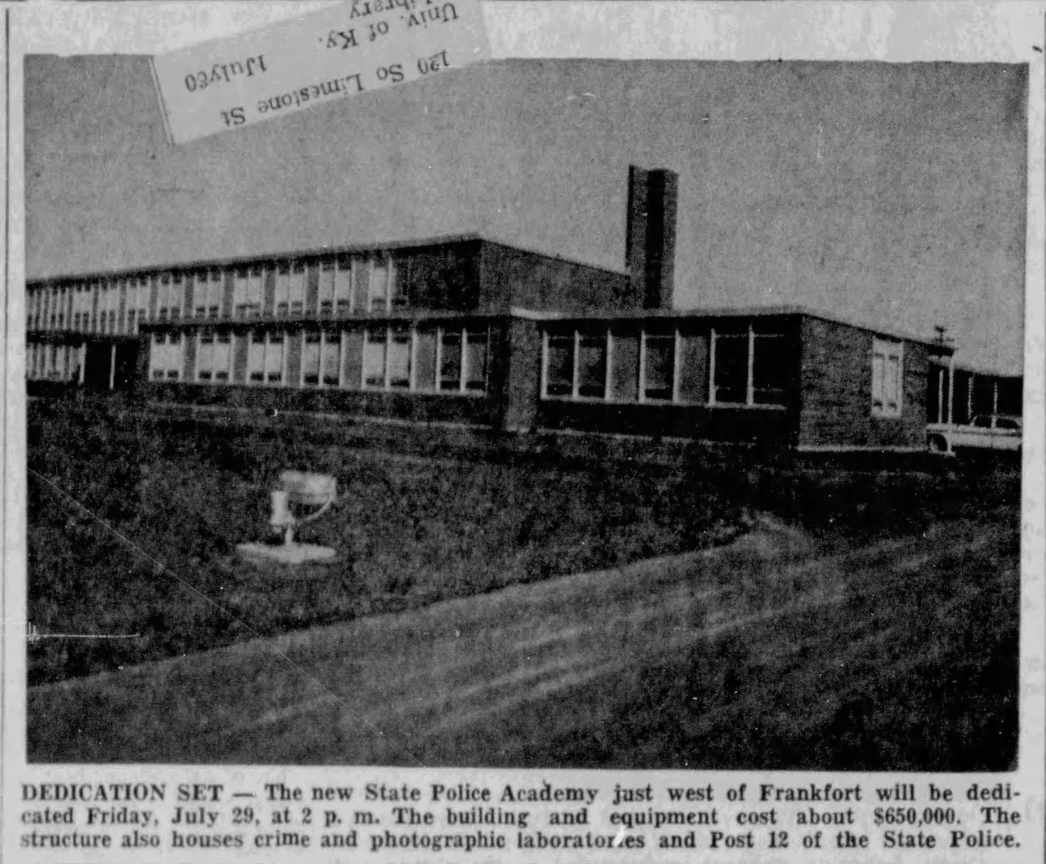
Kentucky State Police
Completion of Post 7 Richmond and Post 10 Harlan Replacements
Replacement of Post 12 Frankfort and KSP Headquarters with Combined Modern Facility
Replacement of Jefferson County Crime Lab Leased Facility with State Owned, Expanded Facility

Slide 13
Thank You

