Slide 1
School Facilities Construction Commission (SFCC) 2026-2032 Six-Year Capital Plan
Kristi Russell, executive Director
Krystal Smith, Executive advisor
200 Mero Street, Frankfort, KY 40601
Notes:
2025 Version

Slide 2
SFCC
The School Facilities Construction Commission was established in 1985 as an independent corporate agency. SFCC provides an equitable distribution of state fundi​ng for school construction and technology based on the unmet needs of Kentucky’s 171 school districts.

Slide 3
Background Status of Recently Completed & On-Going Projects
Offers of Assistance 2024-26: $40,000,000
SFCC is authorized to make an additional $40 million in offers of assistance during the 2024-26 fiscal biennium in anticipation of debt service availability during the 2026-28 fiscal biennium.
- Operating Budget Impact - General Fund $3,210,000

Slide 4
New Request Of Funding – 2026-28 Biennium Status of Recently Completed & On-Going Projects
Potential Amendment $60,000,000
SFCC requests additional regular offer of assistance of $60 million during the 2026-28 fiscal biennium in anticipation of debt service availability during the 2026-28 fiscal biennium.
- Operating Budget Impact – General Fund $4,800,000
Secondary Area Technology Center Pool Facility Grants 2026-28: $167,000,000
SFCC requests additional funding of $167 million to allocate to districts that applied for funding under HB 6 (2024 RS).
- Operating Budget Impact – General Fund $13,321,000

Slide 5
New Request Of Funding – 2028-30 Biennium Status of Recently Completed & On-Going Projects
SFCC Bonding Continued 2026
SFCC requests offer of assistance of $100 million during the 2026-28 fiscal biennium in anticipation of debt service availability during the 2028-30 fiscal biennium.
- Operating Budget Impact – General Fund $8,024,000
Career & Technical Education (CTE) Pool Facility Grants 2028-30: $100,000,000
SFCC request a funding pool of $100 million to assist K-12 school districts with five (5) or more CTE pathways that need to update, expand, or renovate their facilities to provide adequate technical education to their students.
- Operating Budget Impact – General Fund $8,024,000

Slide 6
New Request Of Funding – 2030-32 Biennium Status of Recently Completed & On-Going Projects
SFCC Bonding Continued 2028
SFCC requests offer of assistance of $100 million during the 2028-30 fiscal biennium in anticipation of debt service availability during the 2030-32 fiscal biennium.
- Operating Budget Impact – General Fund $8,024,000

Slide 7
SFCC’s appropriation takes the form of general funds supported bond funds, which the SFCC converts to a commitment of debt service participation for school districts General Assembly authorizes the SFCC to make offers of assistance in each fiscal biennium & then funds the offers of assistance in the next General Assembly has never failed to fund previously authorized offers of assistance
SFCC Construction Offers of Assistance

Slide 8
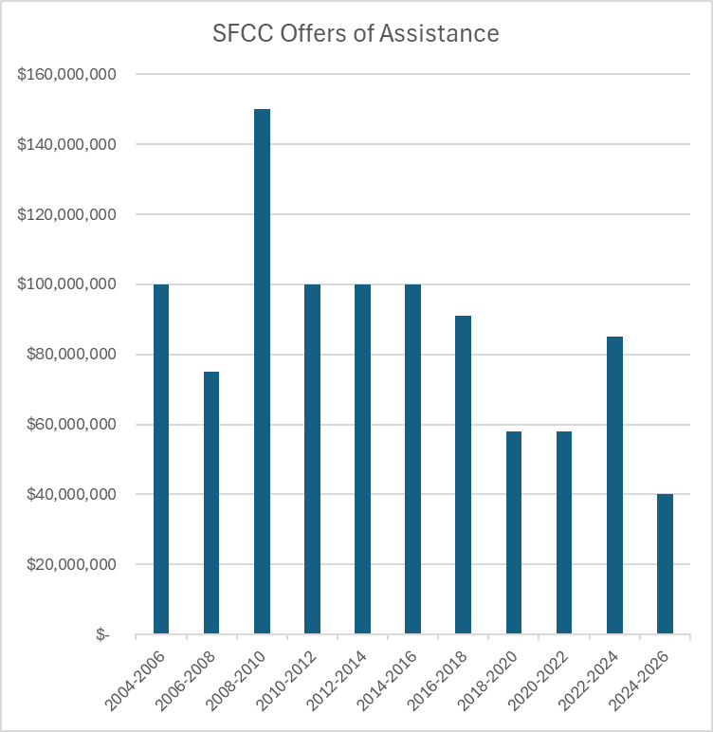
Offers of Assistance Over the Years

Slide 9
Contact us! SFCC Website (502) 564-5582 Kristi Russell, Executive Director at Kristi.Russell@ky.gov or Krystal Smith, Executive Advisor at Krystal.Smith@ky.gov

