Slide 1
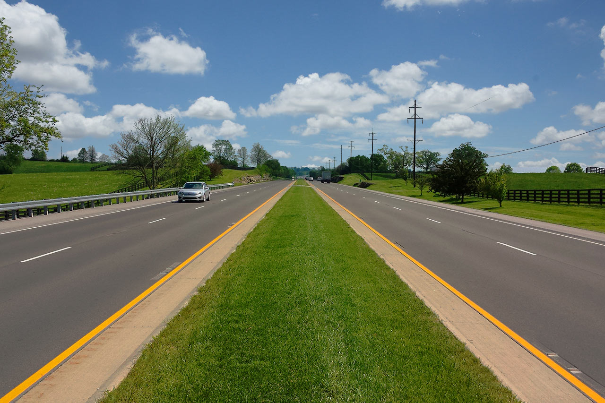
Kentucky Department of Vehicle Regulation
June 5, 2018
Drive.ky.gov

Slide 2
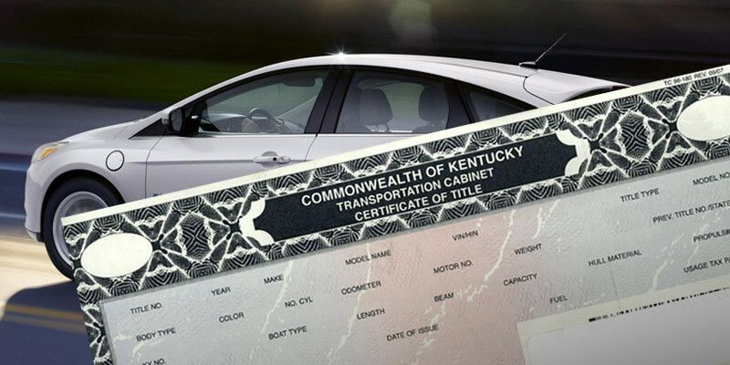
Titling Process

Slide 3
Titling Process
County Clerk
Customer/Dealer presents title documentation to County Clerk. It is scanned and emailed to KYTC
KYTC
Title documentation is received and reviewed by Vehicle Regulation and is sent to ABN
American Bank Note
Prints title and mails to customer

Slide 4
Titles received per month
Month & Year | Total # Applications Received per Month
Jan. 2017 | 75,635
Feb. 2017 | 79,146
Mar. 2017 | 104,329
Apr. 2017 | 83,451
May 2017 | 92,862
Jun. 2017 | 95,896
Jul. 2017 | 88,683
Aug. 2017 | 101,293
Sep. 2017 | 89,360
Oct. 2017 | 94,446
Nov. 2017 | 86,022
Dec. 2017 | 82,555
Jan. 2018 | 91,446
Feb. 2018 | 102,610
Mar. 2018 | 135,715
Apr. 2018 | 137,135
342,561
466,906

Slide 5
Titles completed per month
Month & Year | Total # Applications Completed per Month | Average # Days to Complete per Month
Jan. 2017 | 73,135 | 18
Feb. 2017 | 76,866 | 14
Mar. 2017 | 101,410 | 14
Apr. 2017 | 80,992 | 14
May 2017 | 90,050 | 14
Jun. 2017 | 92,949 | 13
Jul. 2017 | 85,852 | 12
Aug. 2017 | 97,904 | 13
Sep. 2017 | 86,096 | 12
Oct. 2017 | 90,833 | 11
Nov. 2017 | 82,240 | 14
Dec. 2017 | 78,037 | 16
Jan. 2018 | 86,504 | 10
Feb. 2018 | 96,895 | 9
Mar. 2018 | 125,038 | 17
Apr. 2018 | 43,724 | 18

Slide 6
Staffing
Division of Motor Vehicle Licensing—Title Branch—Verification Sections:
2 permanent employees
19 temporary employees
Benchmark: Employees review an average 400 applications per day.
Historical employee numbers:
Currently: MVL has 51 employees
Early 2000’s: MVL had 102 employees

Slide 7
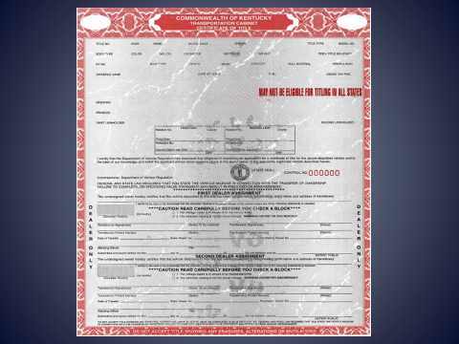
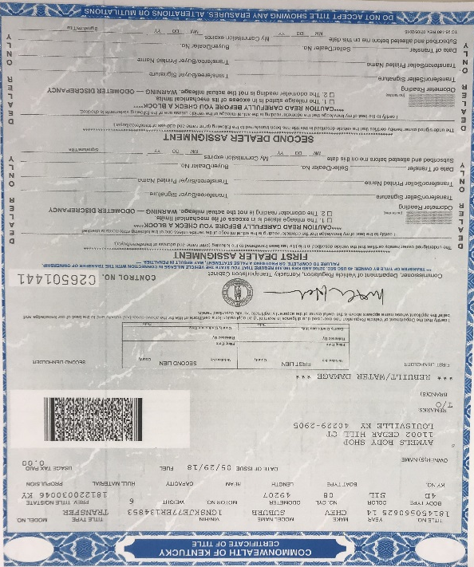
Processing Rebuilt Titles
Un-rebuildable
Rebuilt

Slide 8
Rebuilt Titles
Only four states accept other state’s junk, parts only, title certificates to be rebuilt and retitled (KRS 186A.530, section 5):
California, Kentucky, Pennsylvania and Vermont
Total number of rebuilt titles processed:
2015—49,219
2017—52,113
2018 (January-April)—24,468
Staffing—Number of employees processing rebuilt titles:
3 permanent employees
5 temporary employees

Slide 9
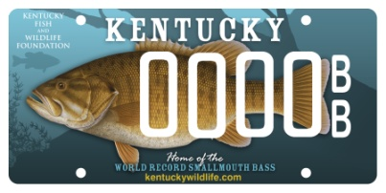
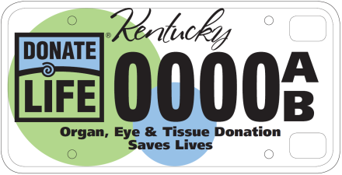
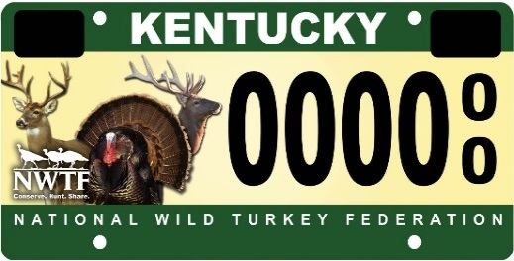
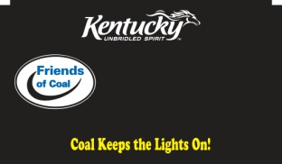
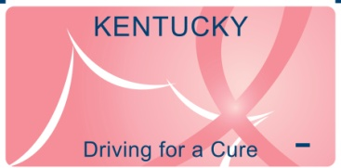
Special License Plates

Slide 10
Special License Plates
June 1, 2016—Moratorium placed on special license plates due to production costs
Kentucky spends approximately $36,000 to plate/replate/redesign an organization’s plate.
Process includes:
Plate sheeting: A roll generally produces 1750 plates
Cost; $2.96 x 1750 plates = $5,180
AVIS Programming: Approximately 296 hours
Cost: 296 hours X $85/hour = $25,160
User Acceptance Testing and Analyst Support: Approximately 80 hours
Cost: 80 hours X $65/hour = $5,200

Slide 11
Additional issues
900 signatures required
Kentucky has 105 special license plates
Low number of purchased plates in 2017:
KY Dental Association—428
KY Chiropractor Association—158
Increased number of customers opting out of voluntary donation to organization:
Friends of Coal—2017: 68,496 Plates sold; 35,290 did not donate; Opt out percentage: 51.52%
Masonic Plate—2017: 3881 Plates sold; 1417 did not donate; Opt out percentage: 36.51%
Farm tag—2017: 186,993 Plates sold; 103,549 did not donate; Opt out percentage: 55.4%

Slide 12
Suggestions moving forward
Organization to pay all cost upfront to produce plates
No minimum applications required
Establish threshold for organization to achieve and maintain number of plates after 2 years of availability
Mandatory donation to organization

Slide 13
Questions

