Slide 1
KAVIS Update
Heather Stout
Executive Director, Office of Information technology, KYTC

Slide 2
Agenda
Point of Sale Overview
Implementation Challenges
Project Status and Timeline

Slide 3
Point of Sale Overview
State-Wide Point of Sale Solution-Complete March 2018
Automatically record all AVIS Transactions into KAVIS
Improved ease of learning
Access to 5 years worth of data versus 1 year
Configurable at the county level
Improved processes for reconciliation, mid-day sweeps, NSF management
Ability to e-mail receipts (paper reduction)
Support revolves around bookkeeping, reports and normal operations with AVIS processes and procedures
Enable use of automated cash drawers
Jan 1 to May 31, 2018
Receipts Checked Out: 1,452,325
Total Sales Items Processed: 8,001,198
Citizens Served: 1,679,062
Revenue Collected: $438,654,260

Slide 4
Implementation Challenges
January 2nd Implementation
Clerks were ready, business application functionality was well-tested
End to End Load testing was not performed
System Optimization was needed
Rollback on January 2nd/3rd
Configuration of more robust end to end load testing tools found optimizations needed within the application and infrastructure
Solutions required multiple agencies to work on the same problems together
Created an environment for success through collaboration
Developed Technical Solution to allow a phased approach for implementation county by county
Prepared the teams to handle testing and communication differently with future module releases

Slide 5






2 January: Production Launch
Beginning 1st QTR
Boats Month
2 January-22 January: Rollback; Regroup; Relaunch
3rd and 4th QTR 2018
23 January: Jefferson County was first to volunteer
12 February: 1st Wave 19 Counties volunteered
19 February: 2nd Wave 41 Counties volunteered to follow early adopters
22 February: 3rd Wave 54 Counties volunteered to be the largest wave
26 February: 4th Wave (1 county)
9 April: Last Wave (4 counties)
20 Days
3rd and 4th QTR 2018: Training and Acclimation
2 January
23 January – 26 February
Beginning 1st QTR: BTR Release
Notes:
Project Timeline Example 2

Slide 6
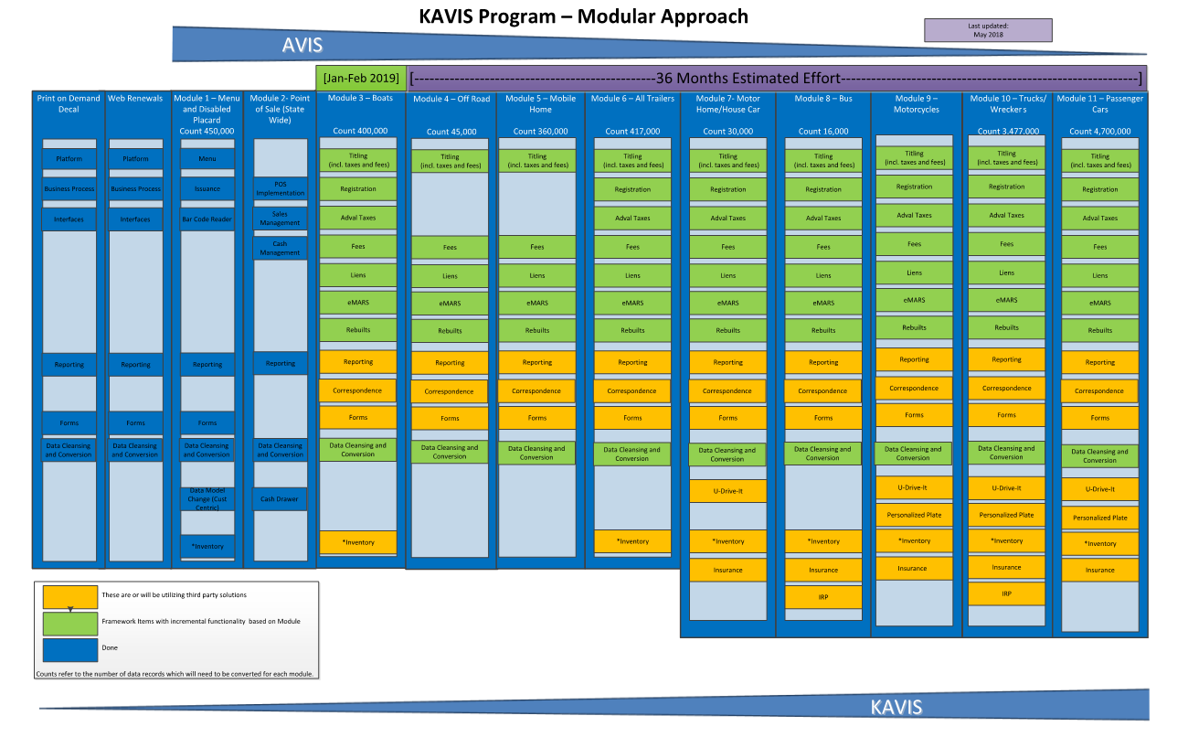

Slide 7
Project Overview
Print on Demand Vehicle Decal-Complete May 2015
Immediate Access to Documents by multiple agencies
Decrease time in office for customers
Eliminate double entry of data for clerks
Reduce paper handling and archiving
Reduce postage for clerks and MVL
Reduce annual audit time
Greatly improve access to vehicle documents
Print on Demand Boat Decal-Complete March 2018
Web Renewal Enhancement Phases - Complete
New web renewal site deployed Summer 2015
Enhanced Usability through design improvements
Clerks receive money collected immediately
All eligible plates renewable online (Mid-year 2016)
Streamlined process for clerks to approve renewals (EOY 2016)
Disabled Placard-Complete January 2016
Transition to a Web Based Application Solution
Shift from vehicle centric model to Customer Centric Model
Hardware and software implementations to drive accuracy and precision of data
Bar Code Reader Deployment – 2016
DL Verification (integration between DL and KAVIS)
Merge customer functionality (data cleanup)

Slide 8
Project Overview
State-Wide Point of Sale Solution-Complete March 2018
Stable and reliable environment
Improved ease of learning
Access to 5 years worth of data versus 1 year
Configurable at the county level
Automatically record all AVIS Transactions into KAVIS
Improved processes for reconciliation, mid-day sweeps, NSF management
Ability to e-mail receipts (paper reduction)
Support revolves around bookkeeping, reports and normal operations with AVIS processes and procedures
Enable use of automated cash drawers
Currently in Development BTR Module
Foundational Application Functionality
Continual hands-on feedback throughout development process focusing on iterative releases to Test and UAT environments
Target Implementation early 2019

Slide 9

“Prior to being elected to Fayette County Clerk, I had a long career in software development. I have managed many projects just like this one. I am speaking as both a Clerk and as a former project manager when I say that this project is one of the best run developments I have seen.” – Don Blevins, Fayette County Clerk
“As a member of the Steering and working committees, I have full confidence that this KAVIS system will meet the expectations of Kentucky County Clerks…They make changes that will benefit all counties. It is very user friendly and much less cumbersome than AVIS or the previous version of KAVIS.” Linda Furnish, Harrison County Clerk
“Just wanted to say you guys are awesome! I really enjoy the new program…I think that you all did a fantastic job! Thank you so much for this.”- Sarah McKaig Deputy Clerk, Anderson County
“I just wanted to personally tell you that I love this KAVIS system. I had my doubts at first, but now that I’m getting use to it, I really find it user friendly and easy to maneuver. So could you please let everyone know that they’ve done a great job please” - JCCO Dealer Department – Bobbie Bell
“Wooohoo!!! Kavis is working smoothly GOOD JOB guys!”- Boyd County-Carrie Culp

