Slide 1
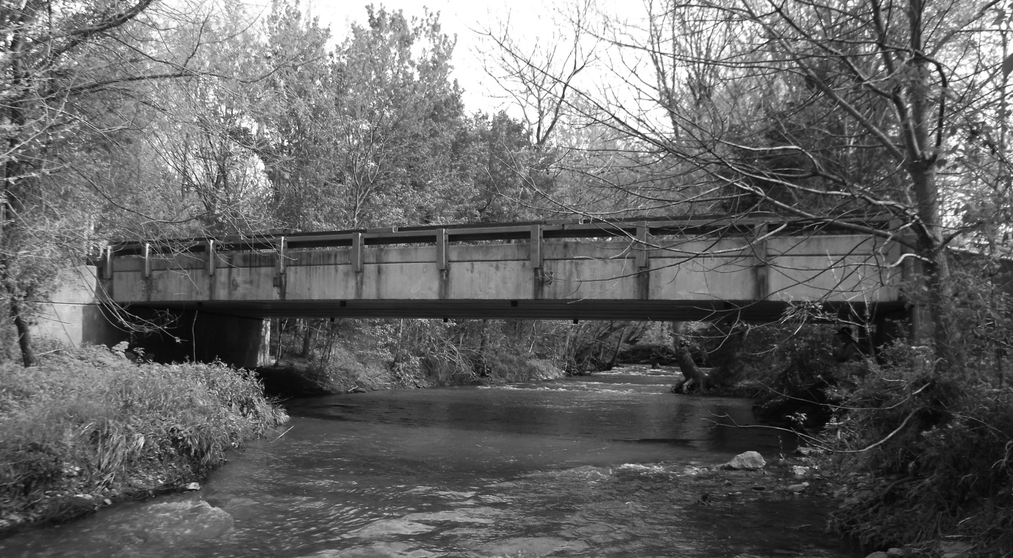


BRIDGING KENTUCKY
Restore | Renew | Replace
Progress Report
Interim Joint Committee on Transportation
Royce Meredith, KYTC Program Manager
Date: August 6, 2018 :

Slide 2


Program Overview
Date:
$700M
Major Impact
Estimated $700 million over six years
Rehabilitate, repair, or replace more than 1,000 critical structures
Deliver all bridges for construction
by 2024
1,000 bridges
6 years
BRIDGING KENTUCKY
Restore | Renew | Replace

Slide 3
Program Overview
Date:
BRIDGING KENTUCKY
Restore | Renew | Replace

Slide 4
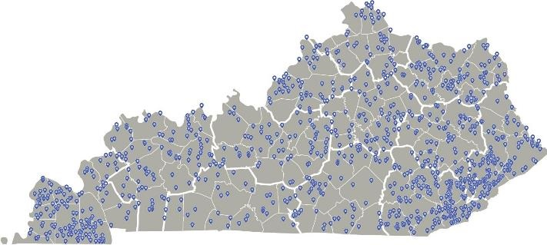
Program Overview
Date:
Statewide Initiative
Bridges in all 120 counties
Distributed across the Commonwealth
Focus on bridges
in biennium
BRIDGING KENTUCKY
Restore | Renew | Replace
This Photo by Unknown Author is licensed under CC BY-SA

Slide 5
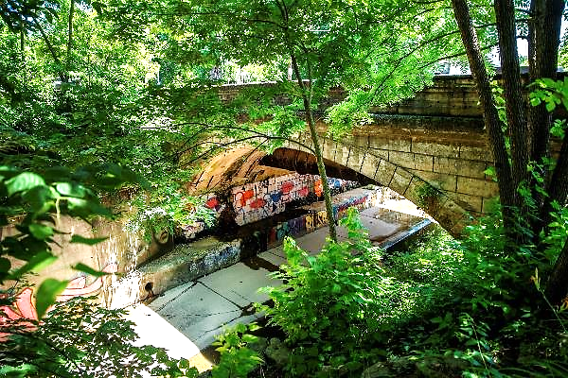
Progress to Date
Date:
Building the Program
Assembled strong team
Quick-start, 120-day plan
Setting up program and systems
Starting evaluations simultaneously
BRIDGING KENTUCKY
Restore | Renew | Replace

Slide 6
Progress to Date
Date:
Preparing for Construction
“We’re not going to rehab a bridge that should be replaced, and we’re not going to replace a bridge that should be rehabbed.”
Screening / evaluating bridges
Using data-driven, life-cycle cost approach
Determining rehabs vs. replacements
Industry forums
BRIDGING KENTUCKY
Restore | Renew | Replace

Slide 7
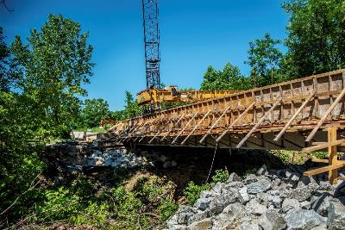
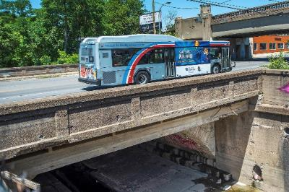
Program Overview
Date:
Prioritization
Focus on three factors
  Budget
  Condition of structure
  Project challenges
Address closed bridges
Biennium bridges first
BRIDGING KENTUCKY
Restore | Renew | Replace

Slide 8
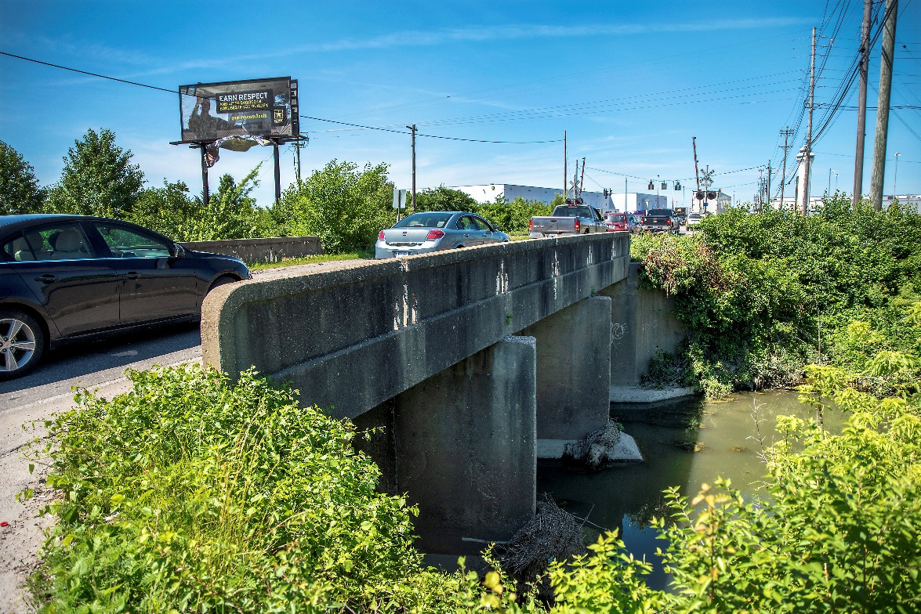
Next steps
Date:
Biennium Bridges
$340 million approved
in FY 2018-19
Nearly 350 bridges
Deliver to construction
in 2019-20 biennium
BRIDGING KENTUCKY
Restore | Renew | Replace

Slide 9
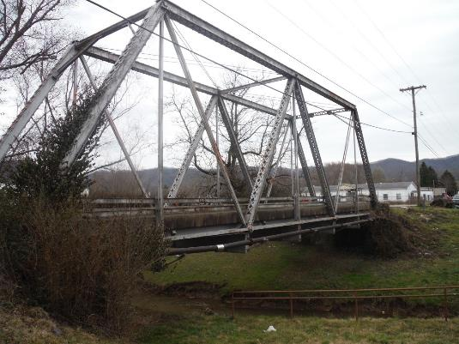
Next steps
Date:
Work Starting Fast
Finalize program setup
Bridge Screening Wrapping Up
Move projects to construction
BRIDGING KENTUCKY
Restore | Renew | Replace

Slide 10
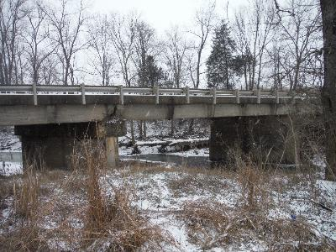
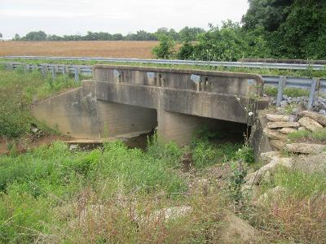
Next steps
Date:
Construction Phase
Several bridges under construction
Starting rehab
projects this year
Large volume of
rehabs/replacements
in 2019
BRIDGING KENTUCKY
Restore | Renew | Replace

