Slide 1


Slide 2

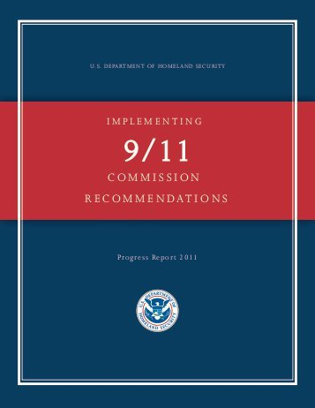
THE SITUATION
In October 2020, standard licenses will no longer meet federal REAL ID Act requirements for Kentuckians to board U.S. domestic flights or enter select federal facilities.
New security standards for identity credentials were recommended by the 9/11 Commission to prevent the fraudulent use and reproduction of licenses and IDs.
The U.S. Department of Homeland Security will begin enforcing the 9/11 Commission’s recommended security standards in October 2020.

Slide 3

THE SITUATION
Kentucky has been working to come into compliance with the federal requirements, and in response, will begin offering two new versions of all identity credentials:

Slide 4
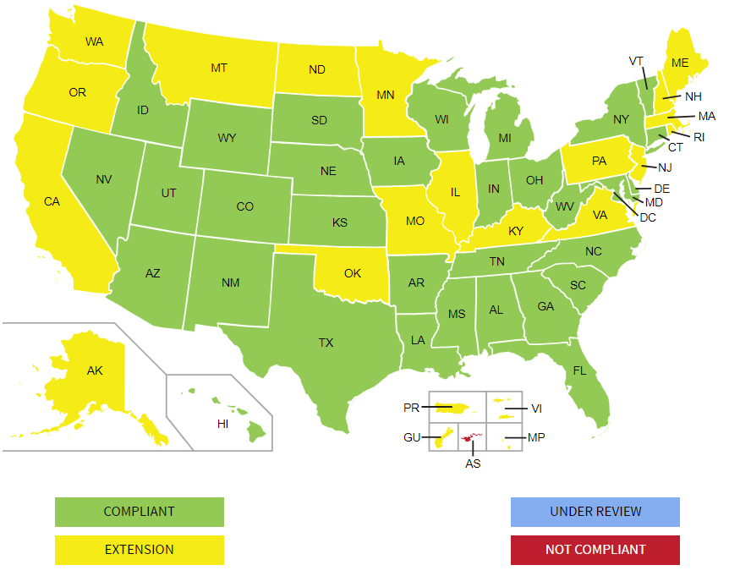
THE SITUATION
Kentucky is one of 22 states and U.S. territories operating under an extension from the Department of Homeland Security.
This allows federal agencies to continue accepting Kentucky licenses, permits and IDs to board U.S. flights, enter military bases and enter restricted federal facilities, like the White House.
Via U.S. Department of Homeland Security

Slide 5

THE SITUATION
A phased, statewide rollout of the new credentials will start in January 2019 and end by spring. All credentials will feature:
MAILED DELIVERY: Arrive in the mail after applying with your local Circuit Court Clerk
OPTIONAL LIFESPAN: Optional double lifespan of 8 years
UPGRADED SECURITY: A new look and among the most state-of-the-art security features in the U.S.

Slide 6

THE SITUATION
MAILED DELIVERY
After applying, you’ll leave with a temporary document, an altered version of your current credential and receive the permanent card in the mail 5-10
business days later.
OPTIONAL LIFESPAN
For the first four years of issuance, non-CDL applicants and those 21 and older can choose between a 4- or 8-year credential. Starting Jan. 1, 2023, all applicants will receive an 8-year credential.

Slide 7

THE SITUATION
UPGRADED SECURITY
While Kentucky’s current credentials
meet security standards, the main area
of non-compliance with REAL ID Act
requirements is our issuance model. By
moving production of all credentials from
over-the-counter at more than 140 locations
to one central, secure location – as well as adding
state-of-the art card security features – we will reduce
the risk of license and ID fraud.

Slide 8

The standard credential is state-maintained but not federally compliant. Standard licenses and IDs will always be acceptable for:
  Voting
  Age-restricted purchases
  Accessing federal and social benefit services like VA hospitals, Social Security offices, federal courthouses and more
Until federal enforcement begins in 2020, as long as Kentucky remains under extension standard licenses and IDs can be used for:
  Flying in the U.S.
  Visiting military bases and restricted federal facilities

Slide 9



The Voluntary Travel ID is a state-maintained, federally compliant license that will always be acceptable for:
  Voting
  Age-restricted purchases
  Accessing federal and social benefit
  services like VA hospitals, Social Security
  offices, federal courthouses and more
  Flying in the U.S.
  Visiting military bases and restricted
  federal facilities

Slide 10

Voluntary Travel ID | Standard Credential
All first-time applicants and anyone requesting a Voluntary Travel ID credential will need to present:
  Proof of identity (Birth certificate, U.S. passport, Permanent Resident Card, etc.)
      One (1) required for both standard credential and Voluntary Travel ID
  Proof of Social Security number (Social Security card, W-2 form)
      One (1) required for both standard credential and Voluntary Travel ID
  Proof of residency (Utility bill, lease, pay slip, voter registration card, etc.)
      One (1) required for standard credential; two (2) required for Voluntary Travel ID
To RENEW any standard credential, applicants will only need to surrender their current license or ID and have a new photo taken.

Slide 11
Voluntary Travel ID | Standard Credential
IMPORTANT NOTICE: If your current
legal name, date of birth, or gender
is different than what is displayed
on your identity or lawful status
document, you must show legal proof
of the changes (i.e. marriage license).
A full list of acceptable proof documents is available
on our website at drive.ky.gov/confidentky.

Slide 12
Voluntary Travel ID | Standard Credential
All credentials will have new pricing to account for the longer
shelf-life and security improvements:
  A new 8-year Voluntary Travel ID license will be $48
  A new 8-year standard driver’s license will be $43
    Non-U.S. citizens are eligible to apply for a new standard
    license or ID and pay the cost of the credential plus a $30
    application fee. They are not eligible for a Voluntary Travel ID.
4-year credentials are half the cost of an 8-year credential.
More pricing information, including pricing for typical CDL endorsements, is available at drive.ky.gov/confidentky.

Slide 13
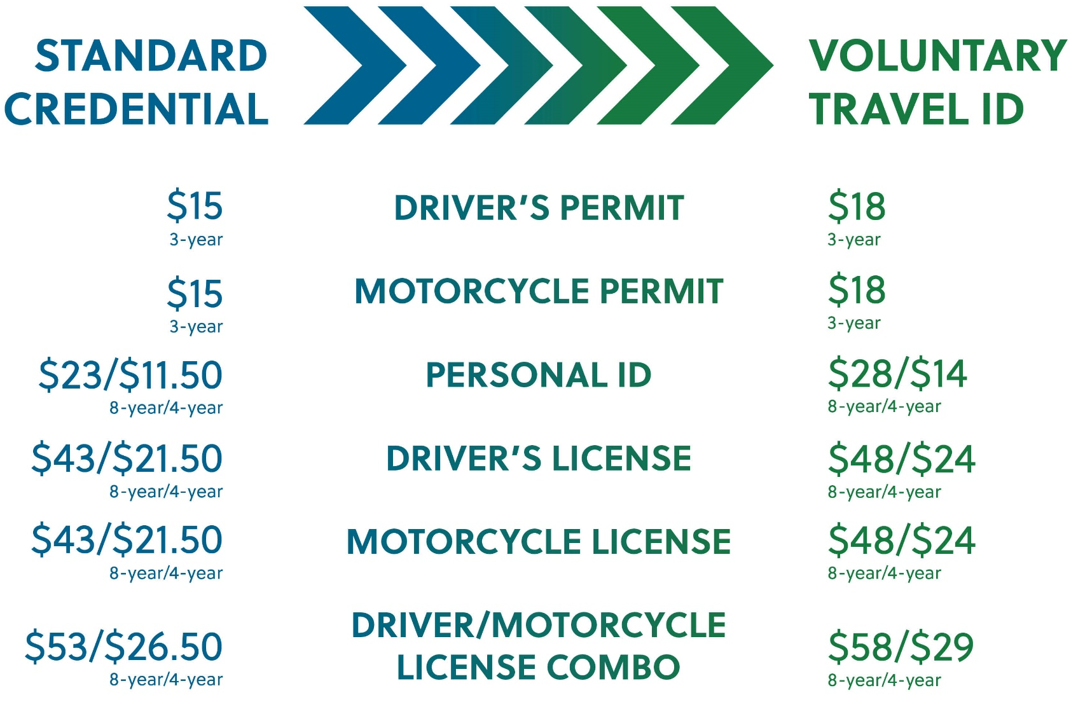
Voluntary Travel ID | Standard Credential

Slide 14

WHAT’S NEXT?
New design and security features unveiled
Implementation schedule released
Take a minute to pull our your license now and check your expiration date. Begin gathering and updating your required documentation and encourage your friends, family and constituents to do the same. Don’t apply on the fly!

Slide 15


Slide 16

CONTACT INFORMATION
Matt Henderson, Commissioner
Matt.henderson@ky.gov
Twitter: @drivekygov
Facebook: /drive.ky.gov
DRIVE.KY.GOV/CONFIDENTKY

