Slide 1

I-Move Kentucky Design-Build Project
Expedited Approach Provides Cost Savings, Reduces Impact for Priority Projects
Transportation Secretary Greg Thomas Interim Joint Committee on Transportation June 3, 2019

Slide 2



Project Objectives
Improve safety & relieve congestion on busy freight corridor
Provide lower-cost solution to build priority projects
Lessen construction impact for local/regional travelers
TRANSPORTATION.KY.GOV

Slide 3

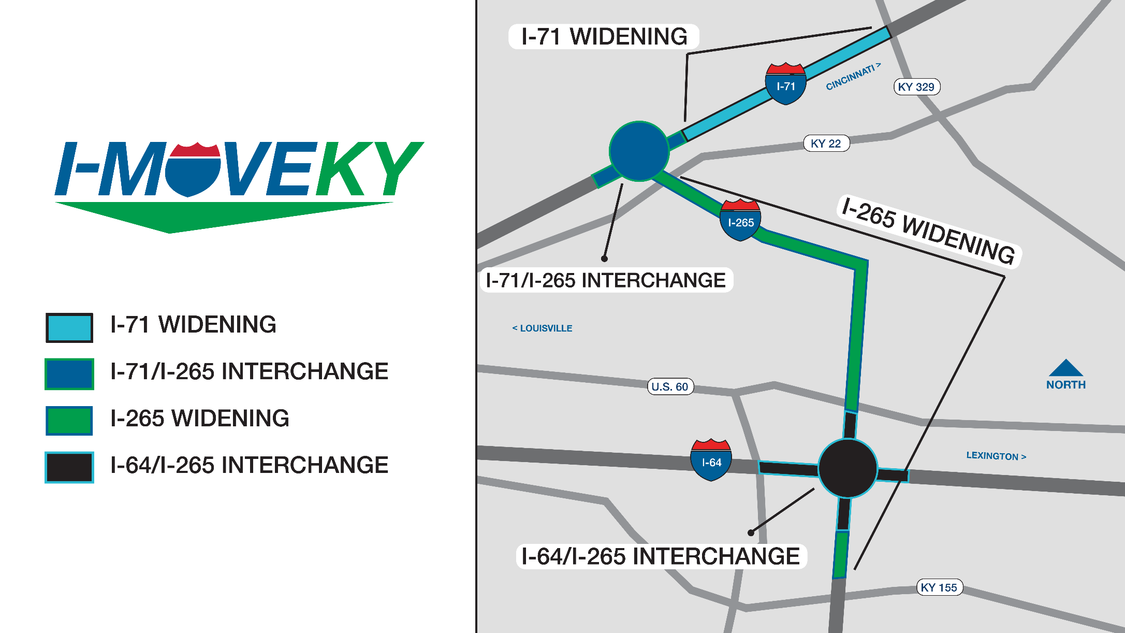

Slide 4
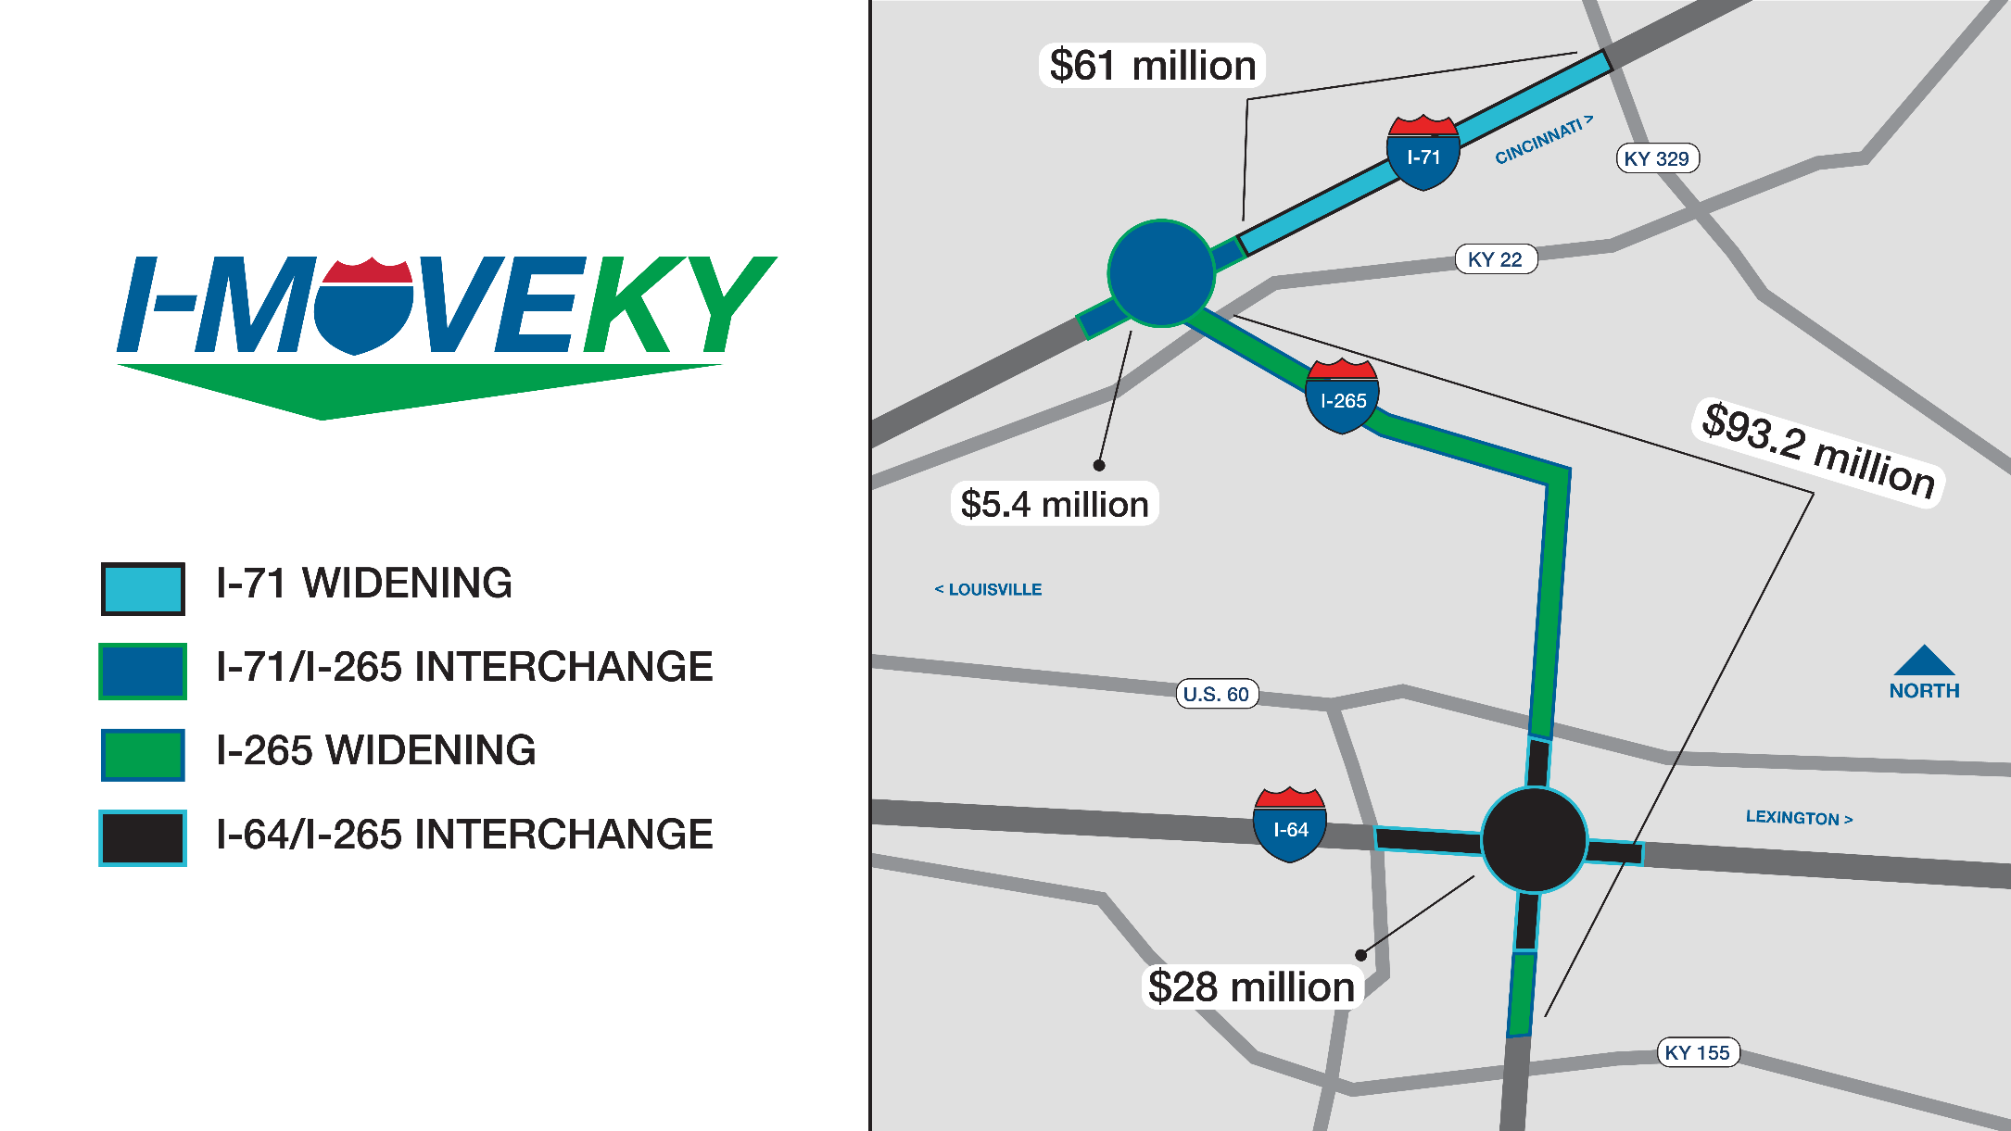

Slide 5
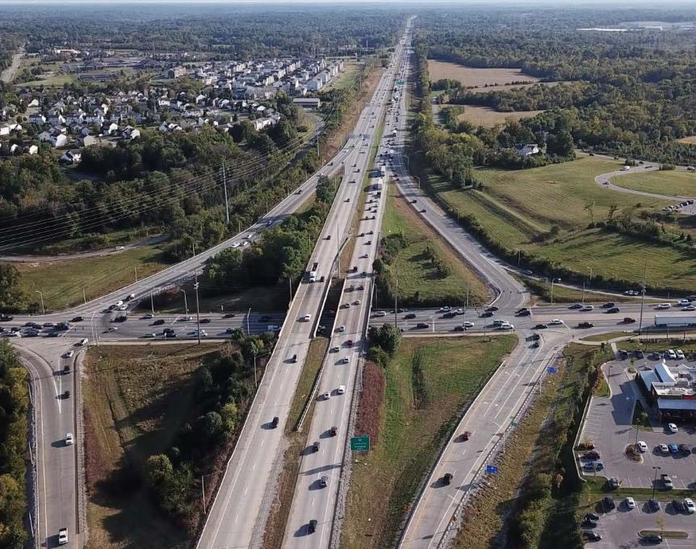
I-265 Widening Project
Project:
Expand I-265 to six lanes
Widen bridges
Address bridge/ pavement needs
SYP cost estimate: $93.2 million
TRANSPORTATION.KY.GOV

Slide 6
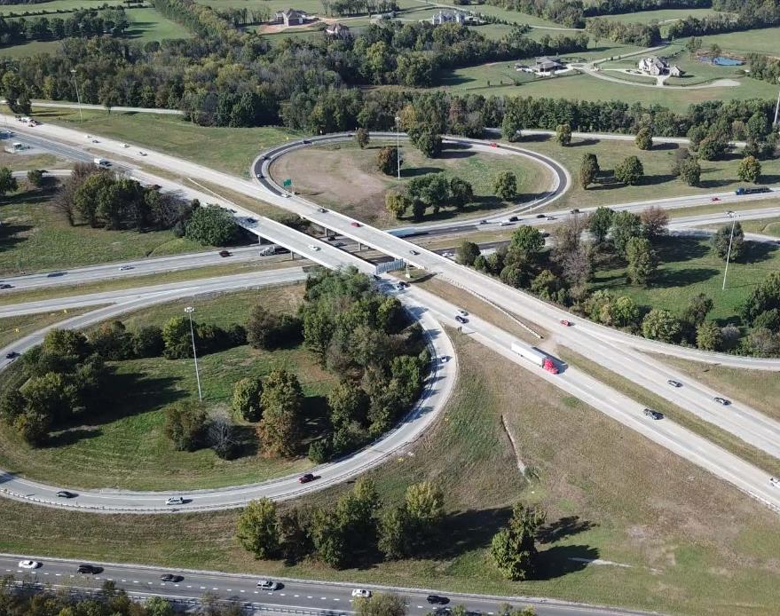
I-71/I-265 Interchange Project
Project:
Add collector-distributor lane for I-71 southbound
Improve safety and mobility
SYP cost estimate: $5.4 million
TRANSPORTATION.KY.GOV

Slide 7
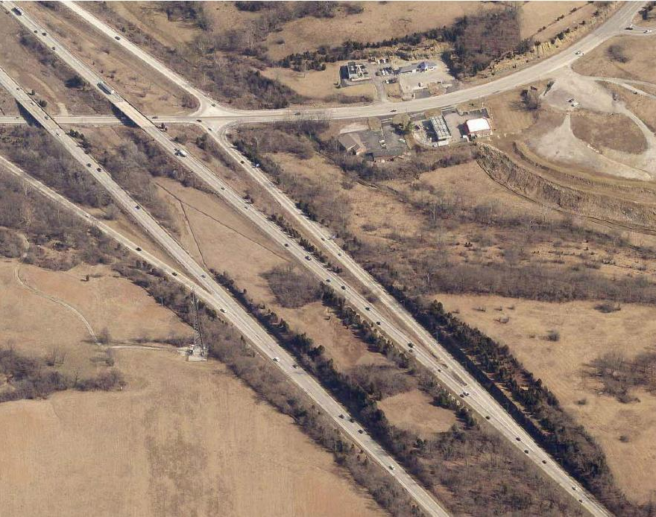
I-71 Widening Project
Project:
Expand I-71 to six lanes from I-265 to KY 329
Reconstruct five bridges
Significantly reduce congestion
SYP cost estimate: $61 million
TRANSPORTATION.KY.GOV

Slide 8
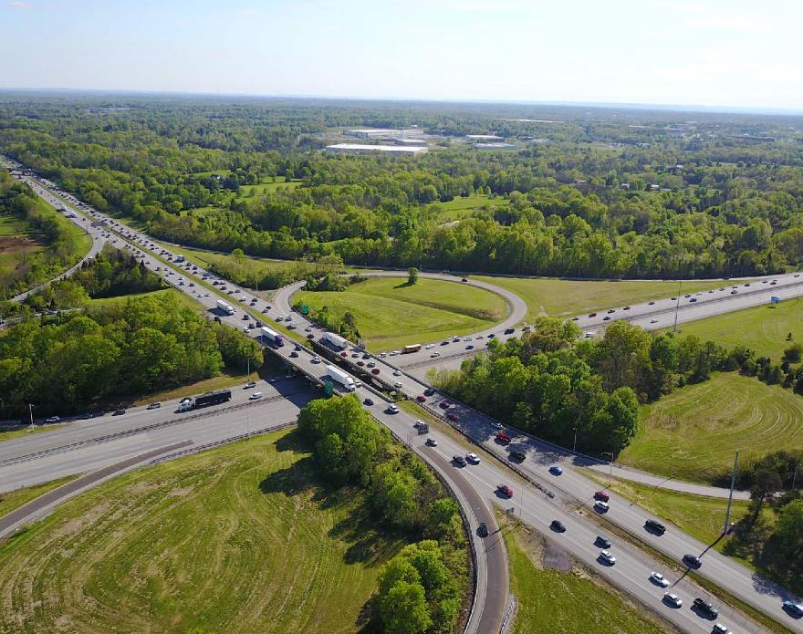
I-64/I-265 Interchange Project
Project:
Reconstruct major interchange
Improve safety and reduce congestion
SYP cost estimate: $28 million
TRANSPORTATION.KY.GOV

Slide 9

Design-Build Approach
Utilizes increased Design-Build authorization (2018 HB 385)
Improves coordination during construction
Accelerates projects to lower actual costs
Encourages innovation and creativity from teams
Avoids bridge and pavement maintenance items

Slide 10
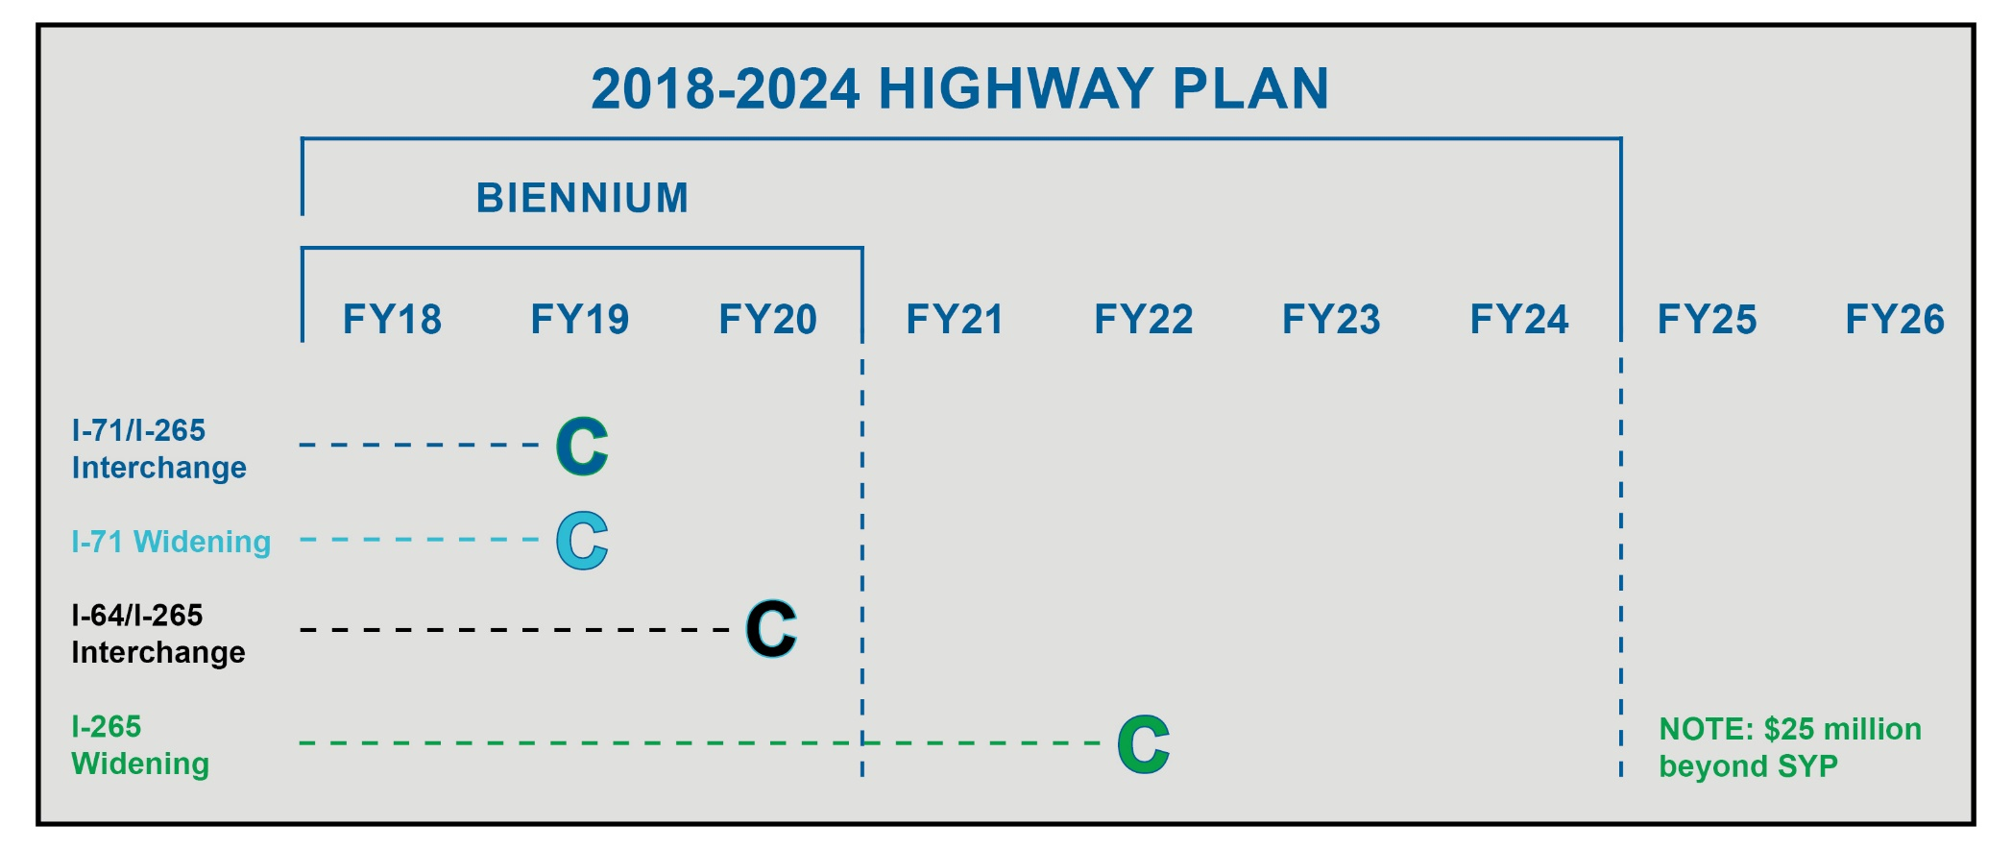
SYP Construction Funds Schedule

Slide 11
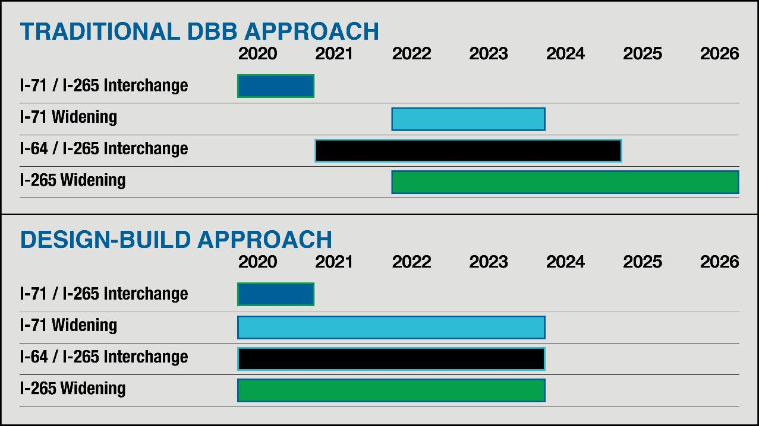
Compressed project schedule

Slide 12


