Slide 1
BR 136 An Act Relating To School Bus Safety
STOP-ARM CAMERAS ON SCHOOL BUSES

Slide 2
BR 136 An Act Relating To School Bus Safety
STOP-ARM CAMERAS ON SCHOOL BUSES

Slide 3
STOP-ARM CAMERA
A device installed on the exterior of a school bus for the purpose of capturing recorded images of motor vehicles passing the school bus from any direction when the bus is stopped with the stop arm fully extended and signal lights activated. KRS 189.370(1)

Slide 4
Do we have an illegal passing problem?
2018 survey by the National Association of State Directors of Pupil Transportation Services reports the prevalence of illegal school bus passing in 38 states including Kentucky.
The 2,667 participating Kentucky school bus operators reported on April 25th 2018
  728 illegal passes
    270 morning
    64 midday
    394 evening
    489 passed from rear 239 passed from front
    705 passed on left 23 passed on right

Slide 5
Illegal Passing
728 observed with 27% participation 2667 buses
9854 buses in inventory
  If all buses participated we would expect to see 2689 illegal passes on the survey date
  If we have 180 school days potentially we could expect to see 484,020 illegal passes annually

Slide 6
Current KRS
KRS 189.370 (illegal school bus passing) are set forth in KRS 189.990(5)
First Offense:
  Fine: $100-$200; and or
  Imprisonment: 30-60 days; and
  At least 6 points assessed against driving record
Second Offense:
  Fine: 300-500; and / or
  Imprisonment: 60 days – 6 months; and
  At least 6 additional points assessed against driving record (12 points = suspension)

Slide 7
Proposed changes
Adding civil penalty option
  First offense: $200
  Second offense: $500 within 3 years
  Civil penalty must be issued within 30 days of offense
  Civil penalty must be paid within 30 days of offense
  Failure to pay results in immediate suspension of vehicle registration

Slide 8
Implementation
Install stop-arm cameras by August 1, 2023
1) District may contract with third party
2) Create procedures for submitting and processing
3) 90 day emergency replacement window
4) Exceptions and extensions

Slide 9
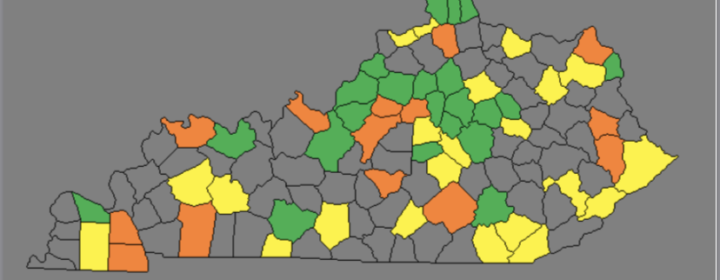
School districts that are 100 percent below the average statewide population density
Gray counties are below 60%
Yellow counties have population density between 60-80 % of statewide average
Orange counties are between 80-100% statewide average population density
Green counties are above statewide average

Slide 10
Cost
Cost will vary depending on district size and purchase
  Examples:
    Single stop-arm camera system could be as much as $1200
    Integrating stop-arm camera in to current existing system may only cost $300-$350

Slide 11
Funding
Projections suggest stop-arm cameras could generate as much as 96,804,000 annually
  77,443,200 to school districts
  9,680,400 to Kentucky Department of Education
  9,680,400 to Transportation Cabinet

Slide 12
Distribution of funds
Eighty percent of funds collected shall be immediately forwarded to the school district in which the violation occurred for the purchase or lease, installation, operation, and maintenance of the school stop arm cameras
  Many third party contractors will lease equipment to the districts for a percentage of the citation, capped at 80% or $160.
Ten percent forwarded to Kentucky Department of Education for inspection cost and promotion of school safety
Ten percent to the Transportation Cabinet

Slide 13
Many counties already implementing stop-arm technology
Currently at least 12 counties have stop-arm cameras installed on buses in their fleet.
  Ballard, Barren, Crittenden, Edmonson, Trimble, Greenup, Hardin, Bullitt, Green, Harrison, Trigg
  What are the rest waiting on ?

Slide 14
Questions?

Slide 15
STOP-ARM CAMERA
A device installed on the exterior of a school bus for the purpose of capturing recorded images of motor vehicles passing the school bus from any direction when the bus is stopped with the stop arm fully extended and signal lights activated. KRS 189.370(1)

Slide 16
Do we have an illegal passing problem?
2018 survey by the National Association of State Directors of Pupil Transportation Services reports the prevalence of illegal school bus passing in 38 states including Kentucky.
The 2,667 participating Kentucky school bus operators reported on April 25th 2018
  728 illegal passes
    270 morning
    64 midday
    394 evening
    489 passed from rear 239 passed from front
    705 passed on left 23 passed on right

Slide 17
Illegal Passing
728 observed with 27% participation 2667 buses
9854 buses in inventory
  If all buses participated we would expect to see 2689 illegal passes on the survey date
  If we have 180 school days potentially we could expect to see 484,020 illegal passes annually

Slide 18
Current KRS
KRS 189.370 (illegal school bus passing) are set forth in KRS 189.990(5)
First Offense:
  Fine: $100-$200; and or
  Imprisonment: 30-60 days; and
  At least 6 points assessed against driving record
Second Offense:
  Fine: 300-500; and / or
  Imprisonment: 60 days – 6 months; and
  At least 6 additional points assessed against driving record (12 points = suspension)

Slide 19
Proposed changes
Adding civil penalty option
  First offense: $200
  Second offense: $500 within 3 years
  Civil penalty must be issued within 30 days of offense
  Civil penalty must be paid within 30 days of offense
  Failure to pay results in immediate suspension of vehicle registration

Slide 20
Implementation
Install stop-arm cameras by August 1, 2023
1) District may contract with third party
2) Create procedures for submitting and processing
3) 90 day emergency replacement window
4) Exceptions and extensions

Slide 21
School districts that are 100 percent below the average statewide population density
Gray counties are below 60%
Yellow counties have population density between 60-80 % of statewide average
Orange counties are between 80-100% statewide average population density
Green counties are above statewide average

Slide 22
Cost
Cost will vary depending on district size and purchase
  Examples:
    Single stop-arm camera system could be as much as $1200
    Integrating stop-arm camera in to current existing system may only cost $300-$350

Slide 23
Funding
Projections suggest stop-arm cameras could generate as much as 96,804,000 annually
  77,443,200 to school districts
  9,680,400 to Kentucky Department of Education
  9,680,400 to Transportation Cabinet

Slide 24
Distribution of funds
Eighty percent of funds collected shall be immediately forwarded to the school district in which the violation occurred for the purchase or lease, installation, operation, and maintenance of the school stop arm cameras
  Many third party contractors will lease equipment to the districts for a percentage of the citation, capped at 80% or $160.
Ten percent forwarded to Kentucky Department of Education for inspection cost and promotion of school safety
Ten percent to the Transportation Cabinet

Slide 25
Many counties already implementing stop-arm technology
Currently at least 12 counties have stop-arm cameras installed on buses in their fleet.
  Ballard, Barren, Crittenden, Edmonson, Trimble, Greenup, Hardin, Bullitt, Green, Harrison, Trigg
  What are the rest waiting on ?

Slide 26
Questions?

