Slide 1
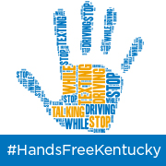

MOVING TOWARD A HANDS-FREE KENTUCKY
Jennifer Smith, CEO

Slide 2
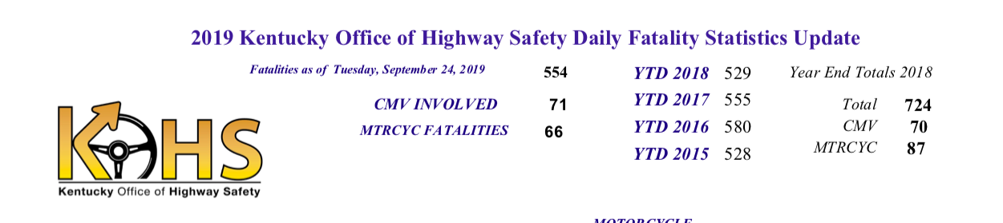
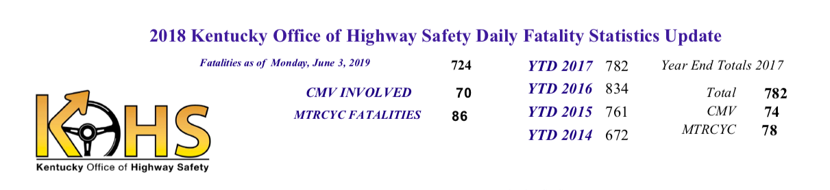
2017 data: 300 Lives could be impacted immediately
85 Motorcycle
7 Bicycle
98 young driver
27 children
83 pedestrian

Slide 3
Building the Case: Results of Distracted Driving
Smartphone Addicts Behind the Wheel
Drive Car Insurance Rates Higher
Insurers increasingly blame distracted drivers as costs related to crashes
outpace premium increases, Wall Street Journal
Since 2011, the average insurance premium has jumped 16% to $926
Insurance companies say the sharp spike is partly caused by more drivers distracted on their smartphones and getting into crashes.
Allstate said in Feb. 2017 there’s a “striking” correlation between the rise
in smartphone use and crashes.

Slide 4
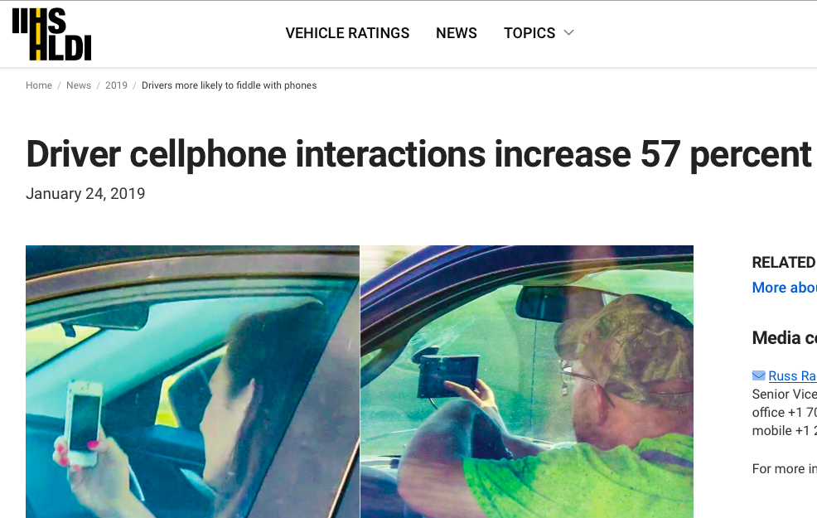

IIHS data 1/17/2019- Americans are using their phones in riskier ways while driving, worsening the nation’s crisis- according to a new reporting.
Drivers were observed manipulating their phones 57% more than they were in 2014.
People are talking on the phone less but manipulating more which includes texting, browsing, shopping, etc...

Slide 5
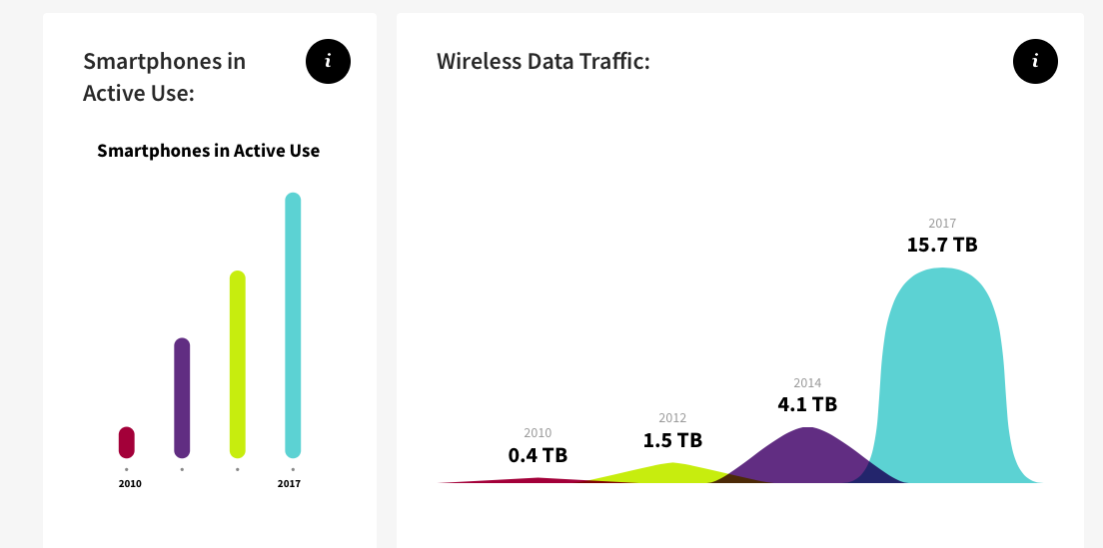
Source: CTIA

Slide 6

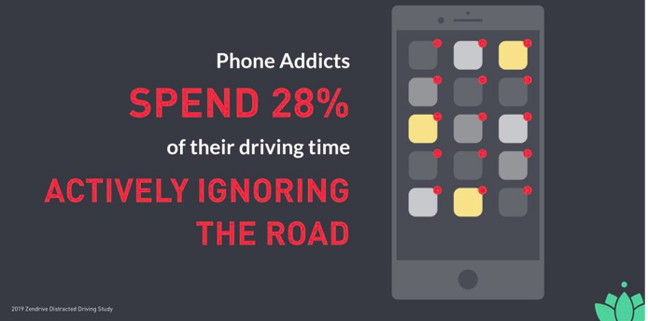
2019 Snapshot
Over 160 billion miles analyzed
Distracted driving is 10X worse over 2018

Slide 7
Tennessee
Would you support or oppose enacting a “hands-free” law that would prohibit holding a phone to talk or text while driving?
Support Oppose Undecided
Statewide 91% 6% 3%
Democrat 93% 5% 2%
Republican 89% 7% 4%
Independent 91% 6% 3%
** No Organized Opposition!!

Slide 8

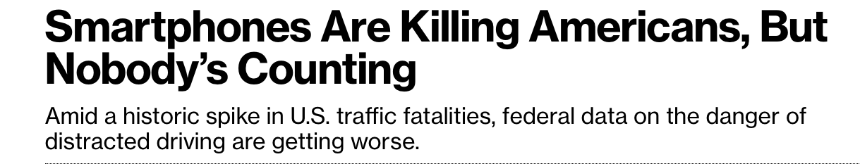
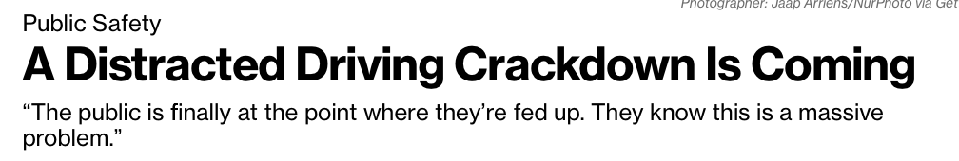
Captain Derick Durden, a George state trooper. “The law has teeth … and the compassion period is over; we’re going to be aggressively enforcing it now.”
Insurance rates had risen 12.6% in that same time period and now rates have either stabilized or have gone down up to 2.5% in the state.

Slide 9
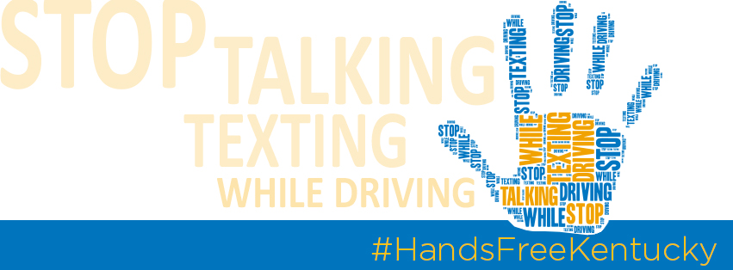
The proposed legislation will ban the use of hand held cell phones while driving. You can still use gps and make & take calls hands-free.
Hands-free laws give law enforcement and the public a clear interpretation of the law, if the phone is in your hand then you are in violation. No more grey areas or loopholes this law makes enforcement easy and possible.
Nationwide: Currently, 20 states, D.C., Puerto Rico, Guam and the U.S. Virgin Islands ban hand held cell phone use for all drivers.

Slide 10
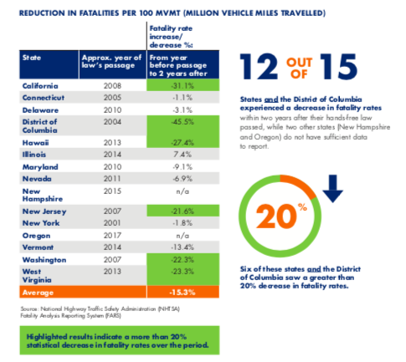
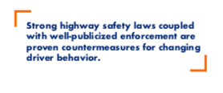


Slide 11
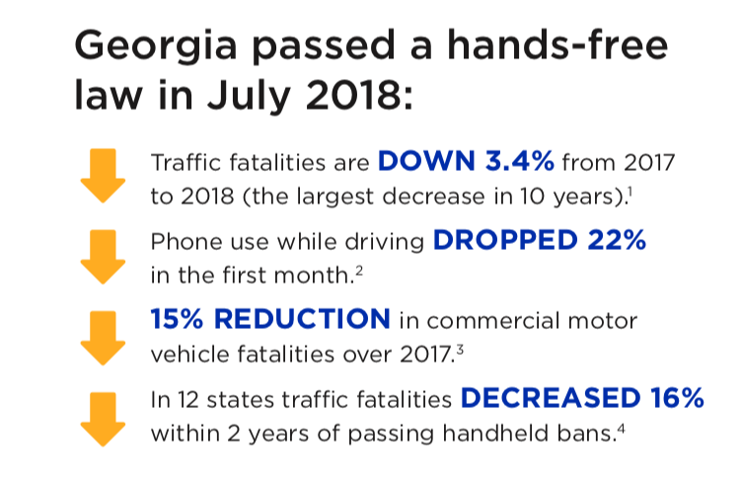

Slide 12
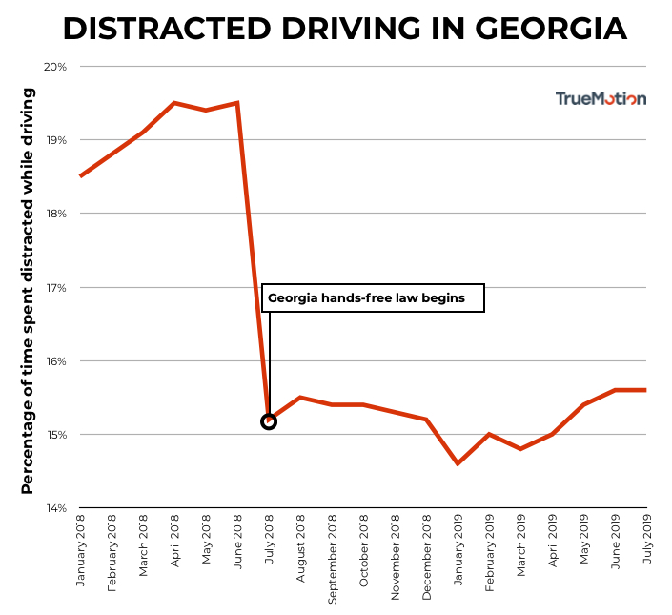

Slide 13
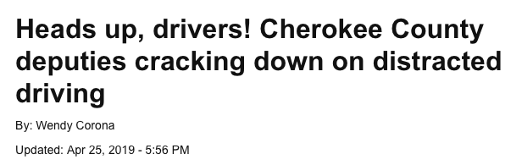
34 fatalities in 2017.
18 fatalities in 2018 (hands-free law went into effect 7/1)
1 fatal crash in 2019 (as of 4/25)
“Usually then, they'll try to minimize it and say, 'Well, yeah, I was holding my phone but I wasn't texting on it. I was just holding it,'” Turcotte said. “We're trying to take as much corrective action as we can to keep people safe on the roads. We've only had one fatality this year and we'd really like to keep it that way."

Slide 15
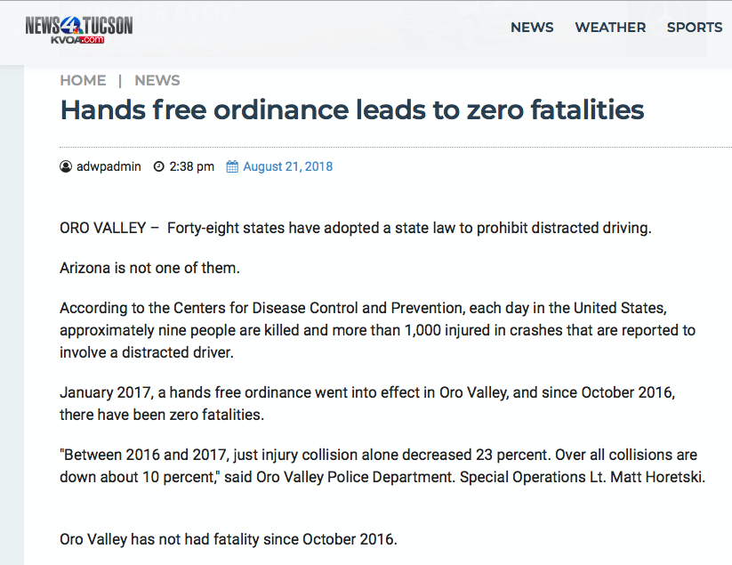

Slide 16
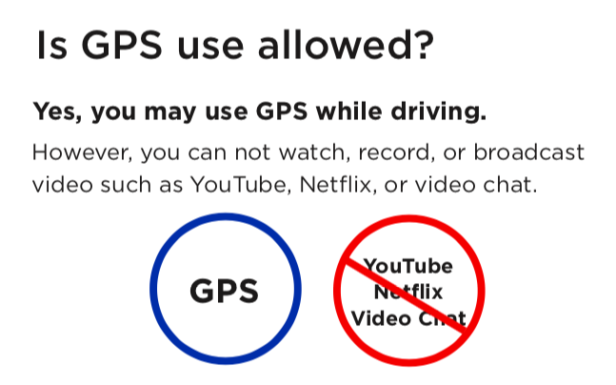

Slide 17
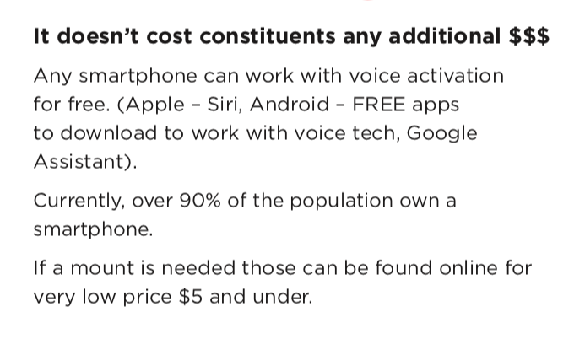

Slide 18


Law enforcement has training developed already on how to enforce these laws. This is offered as a free course through NHTSA/DOT Traffic Safety Services.
Texting laws are unenforceable and obsolete. It is too difficult to see what the driver is doing on their phone (texting, dialing, holding, etc) The laws are outdated and obsolete due to drivers taking the word texting literally. They claim they are not texting, instead they are snapchatting or on social media.

Slide 19
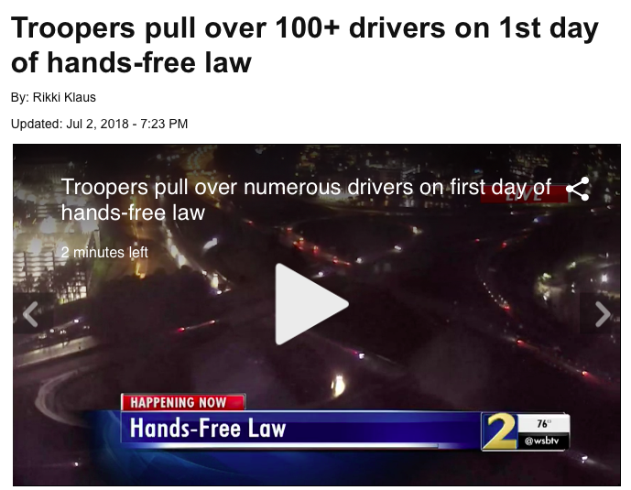
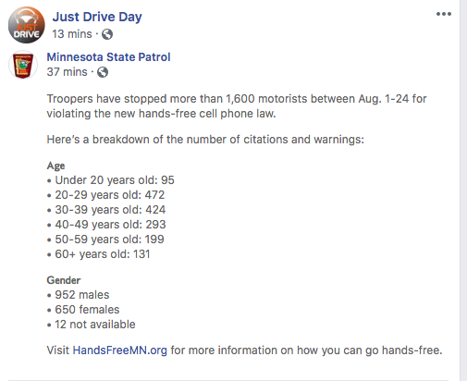
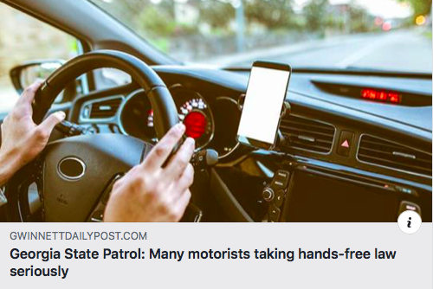

Slide 20
Key Points for Support
Current laws are unenforceable, need expanded language. People don’t just “text” anymore
No organized opposition
No individual opposition
Overwhelming public support – Polling #’s
Broad coalitions pushing legislation
The law will work! Data on reduction in crashes, fatalities, insurance rates, & use (telematics data)

Slide 21
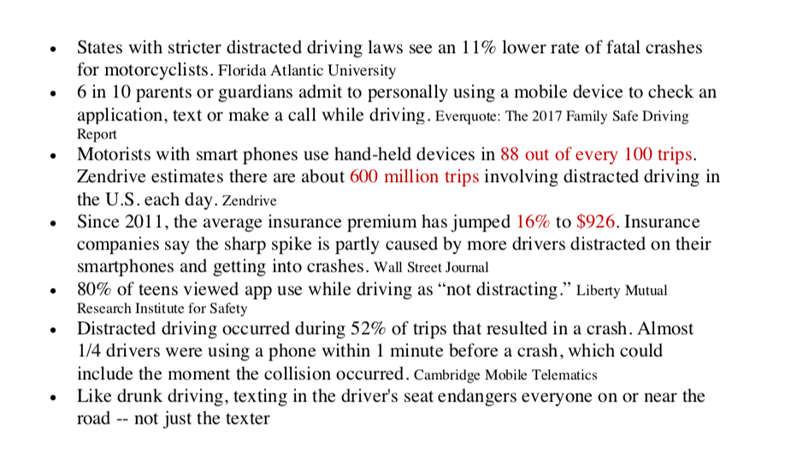

Slide 22
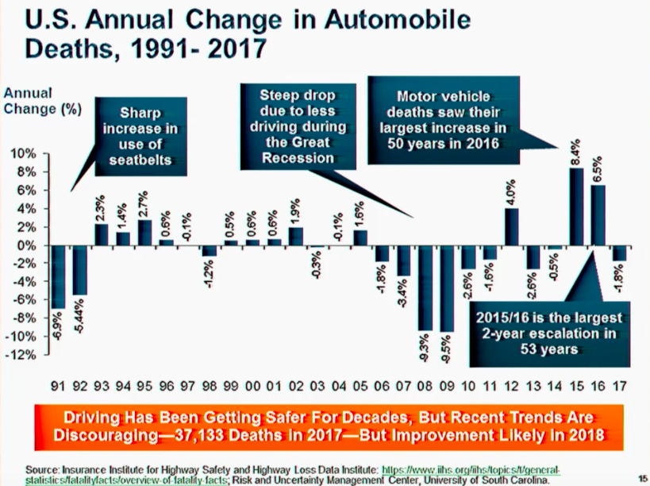

Slide 23
