Slide 1
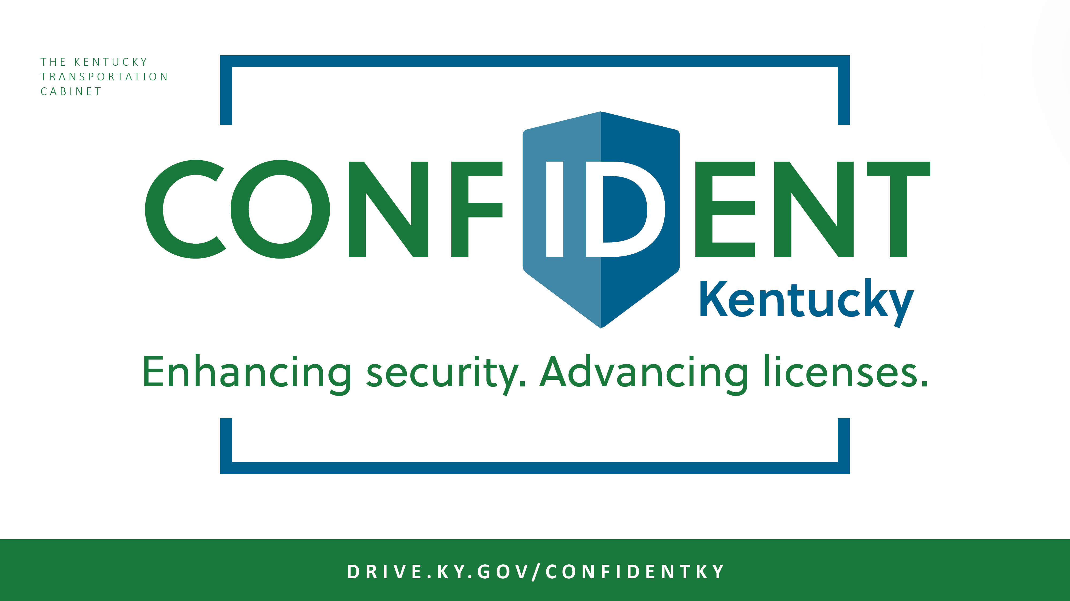

Slide 2

Groundwork to date
KYTC opened a regional office concept location to Franklin county residents at our headquarters in September.
Expanded REAL ID access to Anderson County residents on October 8; will expand access to Scott County residents next.
Gradually expand access to surrounding counties.
As of November 1, more than 3,500 Kentuckians have applied for REAL ID compliant credentials.

Slide 3
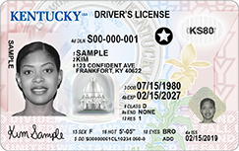
Fine-tuning
Technology
We have worked with IDEMIA to fix previous speed issues. Right now, transaction times average 8-10 minutes.
Documentation
We have expanded the list of acceptable proof documentation for Kentuckians applying for a first time or REAL ID-compliant credential.

Slide 4
Moving forward
KYTC-staffed regional offices are only path forward to ensuring citizens across the state have the opportunity to obtain a REAL ID-compliant credential before the October 2020 federal enforcement date.
To accelerate the process and minimize expenses, we focused on identifying existing state buildings rather than pursuing new construction. We also prioritized using KYTC field offices that are already staffed. Other considerations included: drive times, capacity, parking, accessibility.
Notes:
Advance to next slide to show them the highway district map that you’re using as starting point to identify locations

Slide 5
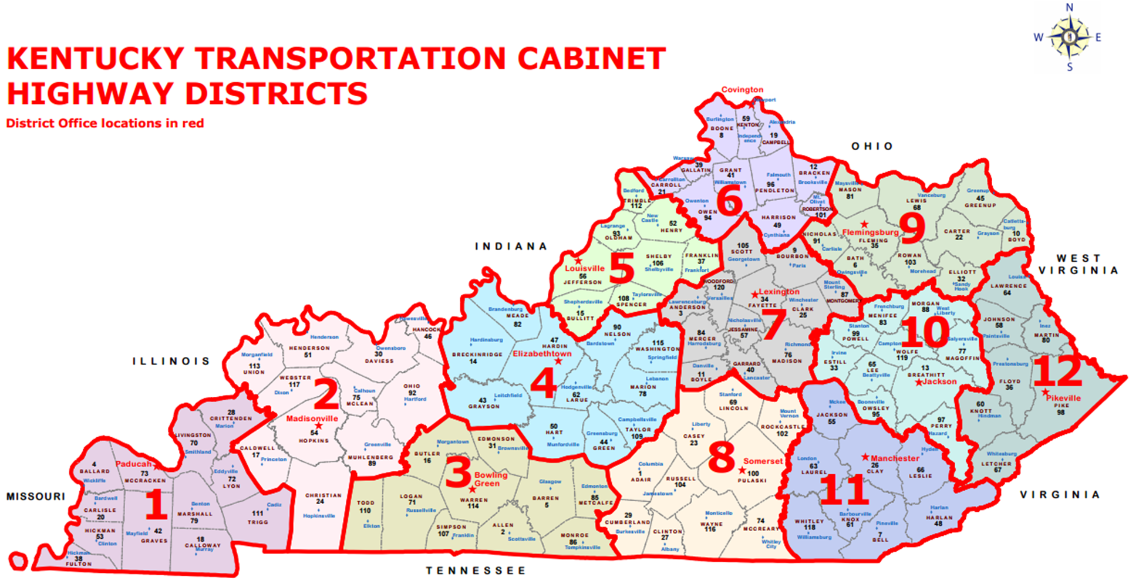

Slide 6
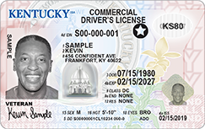
Moving forward
Staffing
Hired and trained first wave of staff to serve at these regional locations.
Legislation
The necessity remains for legislative action to formalize the issuance transition from Circuit Court Clerks to KYTC.

Slide 7


