Slide 1

Kentucky Aviation
Economic Development Fund &
Supplemental Maintenance Fund
Commissioner Todd X. Bloch
Deputy Commissioner Brad Schwandt
State Aviation Engineer Craig Farmer
KYTC DEPARTMENT of AVIATION

Slide 2

Department of Aviation
Promoting economic development through the support of aviation
The Commonwealth’s resource for all aviation issues
Airport project oversight
Federal and state airport inspections
UAS development
Fleet services
Economic development
STEM/aviation education advocacy
Homeland security
Airport zoning
KYTC
DEPARTMENT of AVIATION

Slide 3
State airport system
57 public airports
99 private airports
138 private heliports
2 military air facilities
23,392 on-airport jobs
$1.4 billion payroll for on-airport jobs
KYTC
DEPARTMENT of AVIATION

Slide 4

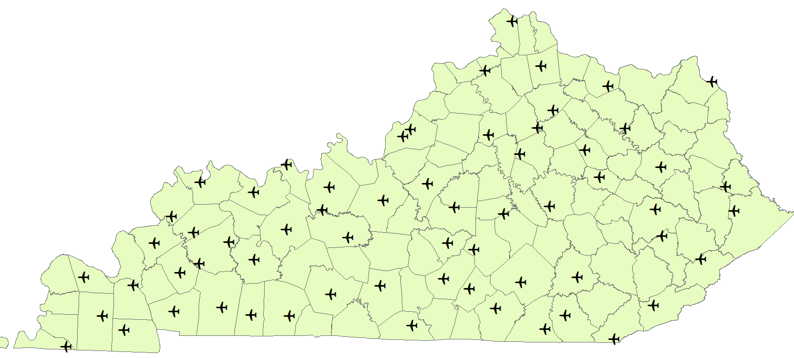
Kentucky’s public airports
KYTC DEPARTMENT of AVIATION

Slide 5
Airport funding sources
Economic Development – comes from Jet Fuel Tax
  Approximately $8,000,000 per year
  Used for airport, terminal, and runway improvements
  Supports a portion of the local share of federal grants
Airport Maintenance Fund – legislative approved funding
  $9,700,000 per year
  Specifically targets pavements for runways, taxiways, aprons
FAA funded grants from the Airport Improvement Program (AIP)
Local matching share (city and county). No match is required on state grants.
KYTC
DEPARTMENT of AVIATION

Slide 6
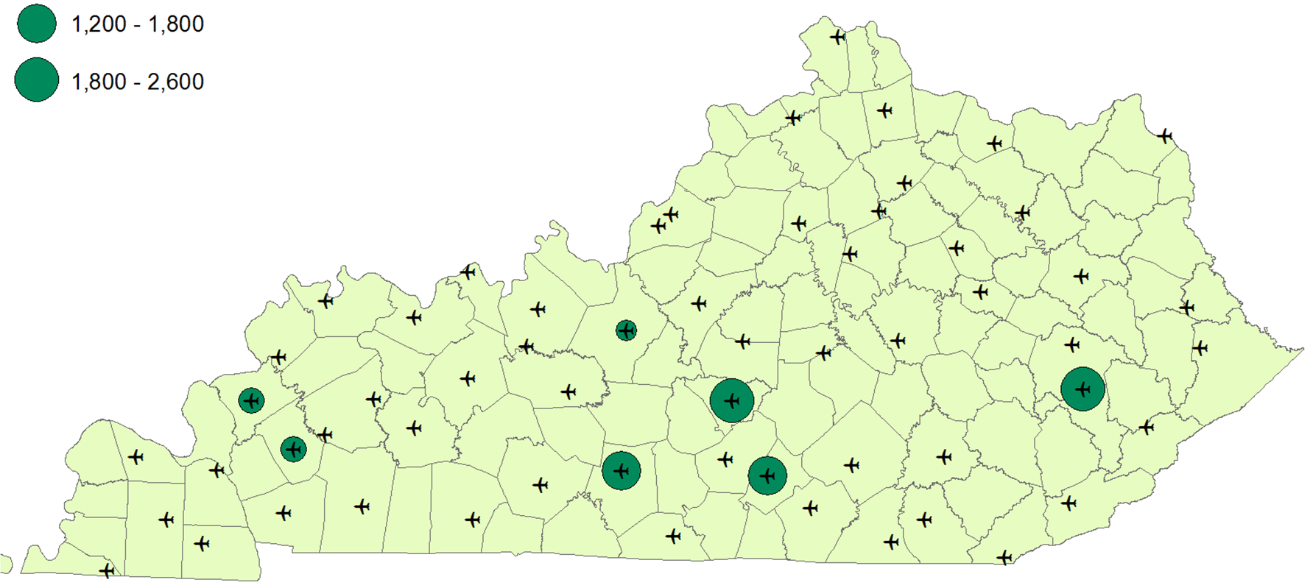
Airport maintenance fund projects FY 2019
Funding (thousands)
Airport maintenance
funds: $9,651,414
200 – 400
400 – 600
1,200 – 1,800
1,800 – 2,600
KYTC DEPARTMENT of AVIATION

Slide 7
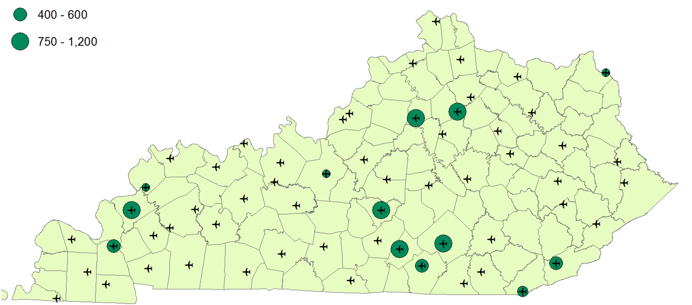
Airport economic development fund projects FY 2019
Funding (thousands)
Aviation fuel tax funds: $8,694,000
200 – 200
200 – 400
400 – 600
750 – 1,200
KYTC DEPARTMENT of AVIATION

Slide 8
Proposed airport maintenance fund projects FY 2020
Falmouth
Danville-Boyle Co.
Leitchfield
London-Corbin
Bowling Green
Harlan
Fulton
KYTC DEPARTMENT of AVIATION

Slide 9
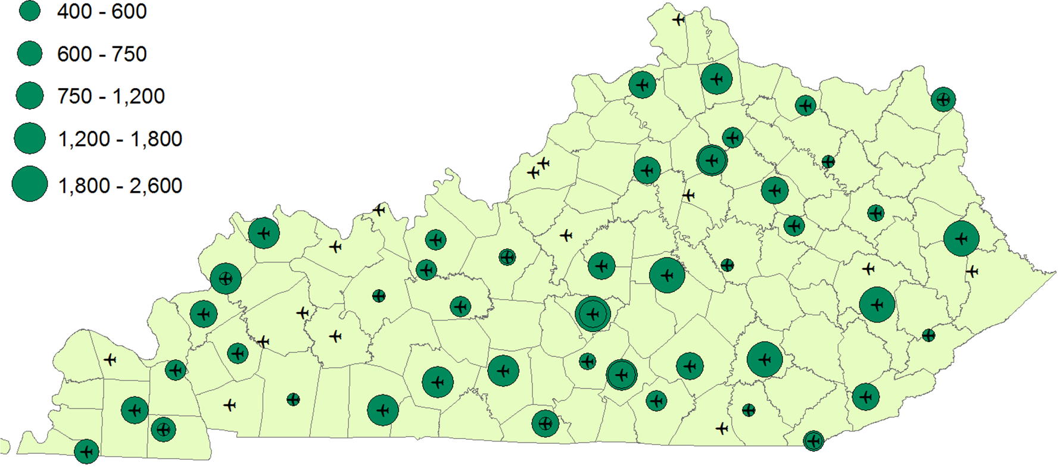
Airport economic development fund projects FY 2019
Funding (thousands)
47 combined past and projected projects: $57,086,253
20 – 200
200 – 400
400 – 600
600 – 750
750 – 1,200
1,200 – 1,800
1,800 – 2,600
KYTC DEPARTMENT of AVIATION

Slide 10
Additional FAA airport funding (AIP)
Every FAA Classified Airport in Kentucky receives at least $150,000/year in entitlement funds.
  There are 50 classified airports in Kentucky
  These funds require a 10% match. The state provides 7.5% of that match.
Kentucky airports can also request additional Federal Discretionary funding based on need and FAA funds available.
The FAA has committed to $36,582,339 in Airport Improvement Funds for Kentucky airport infrastructure over the next year with more possible through discretionary grants.
KYTC
DEPARTMENT of AVIATION

Slide 11
FAA AIP airport funding 2019-2020
Total of $36,582,339 in AIP funds over the next year
Taylor County – Land Acquisition; $197,000 | Blue Grass – Taxiway Construction; $11,095,200
Cynthiana – Obstruction Removal; $60,000 | London/Corbin – Runway Reconstruction; $1,850,000
Big Sandy – Environmental Study; $68,691 | Standiford Field – Airport Study and Master Plan; $1,215,000
Addington Field – Vertical Guidance System; $130,000 | Marion County – Hangar Construction; $270,253
Falmouth – Environmental Study; $150,000 | Morehead/Rowan Co – Runway Rehabilitation; $80,000
Muhlenberg County – Obstruction Removal/Drainage; $205,000 | Mt. Sterling/Montgomery Co – Taxiway Const.; $400,000
Harlan County – Update Airport Master Plan; $135,000 | Owensboro – Runway Rehabilitation; $737,760
Ohio County – Update Airport Master Plan; $168,435 | Gallatin Co – New Airport Construction; $9,000,000
Hazard County – Update Master Plan; $180,000 | Lebanon/Springfield – Environmental Study; $60,000
FAA supplemental funds: Big Sandy - $4.2 million runway safety area and Falmouth - $4.4 million runway reclamation
KYTC
DEPARTMENT of AVIATION

Slide 12
State airport funded projects summer 2019
Ashland – New Pavement Striping; $115,000 | Stanton – Pavement Striping & Terminal Reno; $142,523
Bowling Green – Taxiway Reconstruction; $151,496 | Sturgis – New Pavement Striping; $115,000
Frankfort Capital City – Micro-surface Overlay; $600,000 | Addington Field – T-Hgr Apron Repair; $400,000
Georgetown – New LED Lighting; $1,100,000 | Fleming/Mason – T-Hgr Apron Repair; $500,000
Glasgow – Apron Resurface; $13,467 | Marion/Crittenden – Runway & Taxiway Extension; $421,414
Murray – Taxiway Overlay/Striping; $146,454 | Russell County – Runway, Taxiway, & Apron Reconst.; $1,500,000
Muhlenberg – Pavement Striping; $60,000 | Hazard County – Runway and Taxiway Resurface; $45,111
Somerset – New LED Lighting; $1,200,000 | Taylor County – Runway, Taxiway, & Apron; $2,150,000
Mt. Sterling – Taxiway & Apron; $20,832 | Ohio County – Apron Maintenance; $175,000
Owensboro – Airport Improvements; $19,125 | London/Corbin – Runway Overlay; $95,000
KYTC
DEPARTMENT of AVIATION

Slide 13
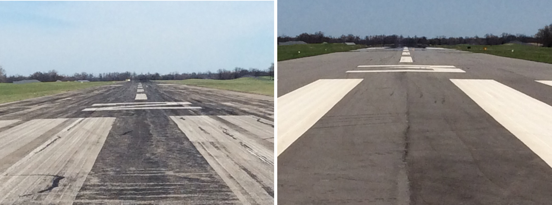
Recent pavement overlay project in Bardstown
KYTC DEPARTMENT of AVIATION

Slide 14
Continued legislative commitment is essential for:
Saving vital airport infrastructure
  A $70 million backlog of deferred pavement maintenance currently exists. Like highways, airport pavement degrades with time and requires continuing maintenance.
Catching up to neighboring states who compete for our aviation activity
Contributing to developing a workforce that is ready for the future
Supporting continued success in economic development
Positive and lasting statewide impact
KYTC
DEPARTMENT of AVIATION

Slide 15

Thank you for your past
– and continuing –
support of aviation
KYTC DEPARTMENT of AVIATION

