Slide 1
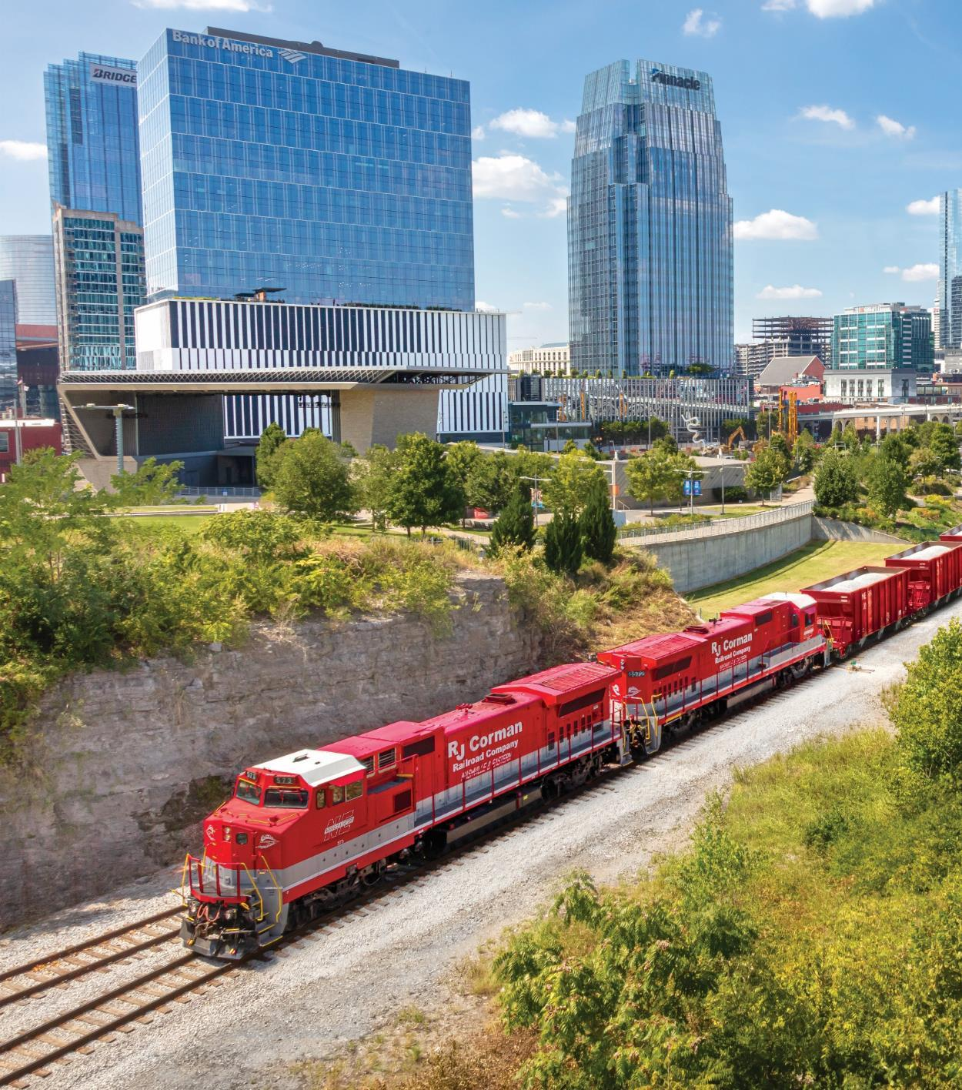

IJC on Transportation Committee
8/18/2020
Notes:
Good afternoon, I am William Downey with R. J. Corman Railroad group here today representing the Kentuckians For Better Transportation and the railroad industry in Kentucky. I would like to start off by thanking Chairman’s Higdon, Upchurch, and the members of the committee for allowing me to speak before you today.

Slide 2
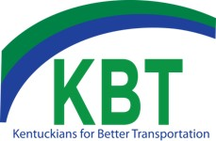
Railroad 101
Classifications
Class 1 Railroads
7 major class 1 railroads in the US
Long haul, high density traffic
Short Line and Regional Railroads
Over 600 in the US
Focus on “first and last mile” of rail car delivery and connectivity to the transportation network
Notes:
Quick comparison: Class 1’s = Interstate Highways whereas Short Lines = State and Local roadways

Slide 3
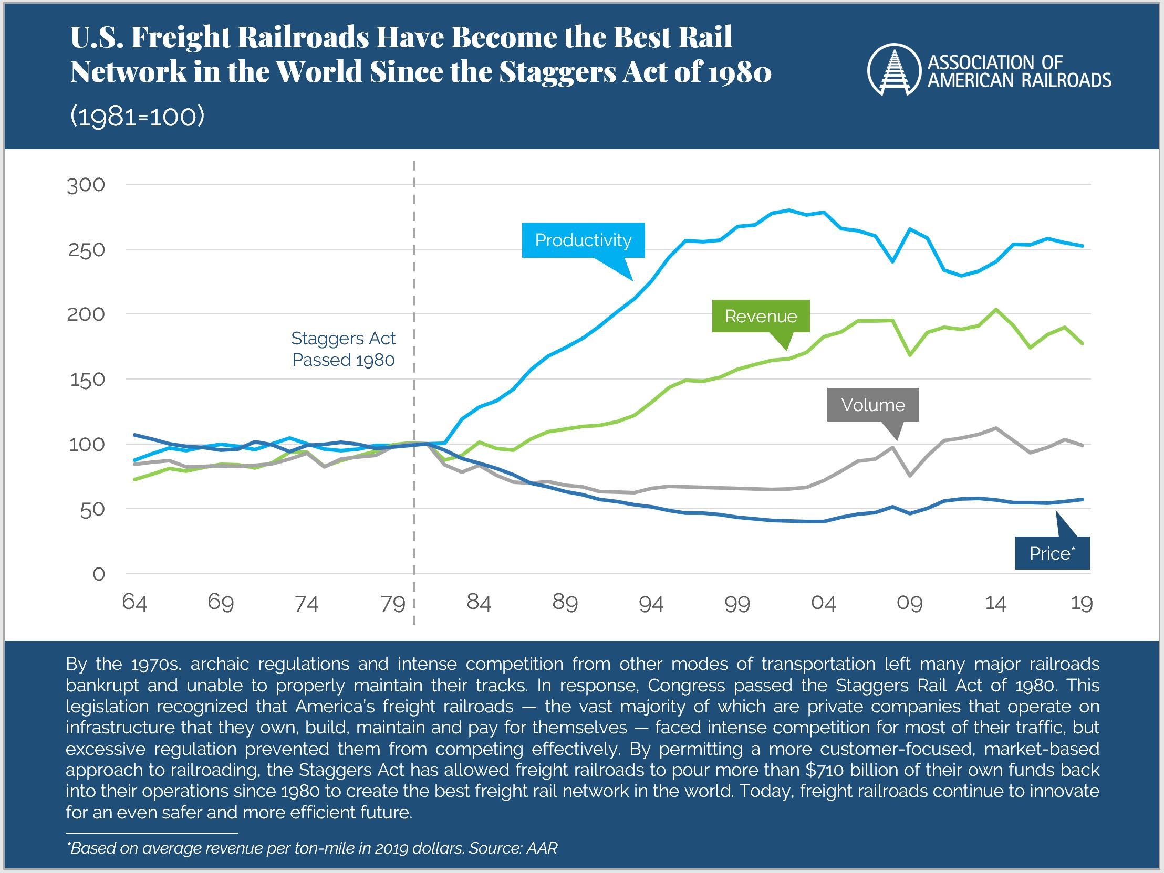
Staggers Act : Balanced Regulation
Notes:
1980 Staggers act allowed for balanced regulation. Class 1’s could divest in abandoned properties and lines that were no longer strategic for their overall operations. This allowed for entrepreneurs such as Rick Corman to invest in these smaller branch lines and develop business

Slide 4
Railroad Regulatory Agencies
FRA – Federal Railroad Administration
“The Federal Railroad Administration’s mission is to enable the safe, reliable, and efficient movement of people and goods for a strong America, now and in the future.”
Safety, Compliance, Enforcement
STB – Surface Transportation Board
“The Surface Transportation Board is an independent federal agency that is charged with the economic regulation of various modes of surface transportation, primarily freight rail.”
Economics: Service, Rates, Sales and Mergers
Source: https://railroads.dot.gov/ and https://prod.stb.gov/
Notes:
Railroads are Federally regulated. FRA established 1966 by the Department of Transportation Act, one of ten agencies within USDOT focused on intermodal transportation. STB was created in 1996 as a successor to the ICC (Interstate Commerce Commission) and was aligned with USDOT until 2015 when Congress reauthorized the STB and established it as an independent federal agency.

Slide 5
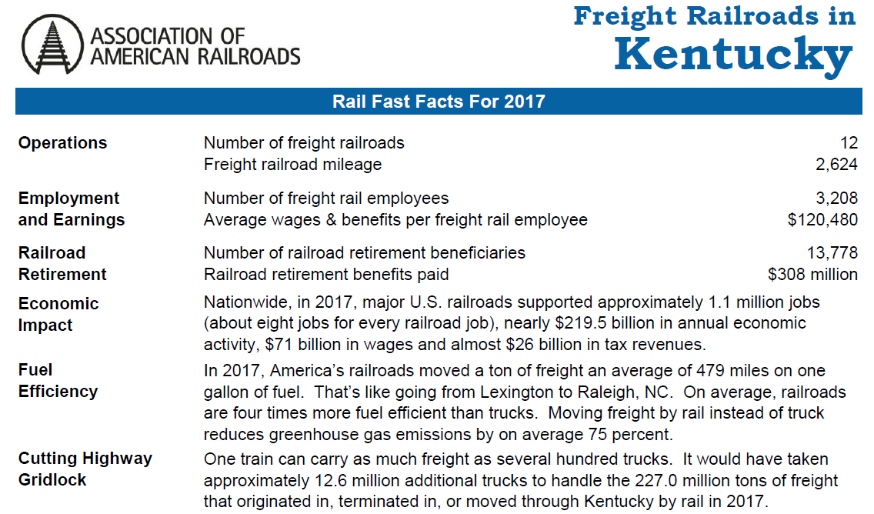
Kentucky Railroad Overview
Notes:
Quick overview of rail in KY. Will briefly highlight four of the main rail carriers in the state

Slide 10
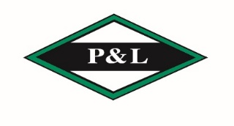
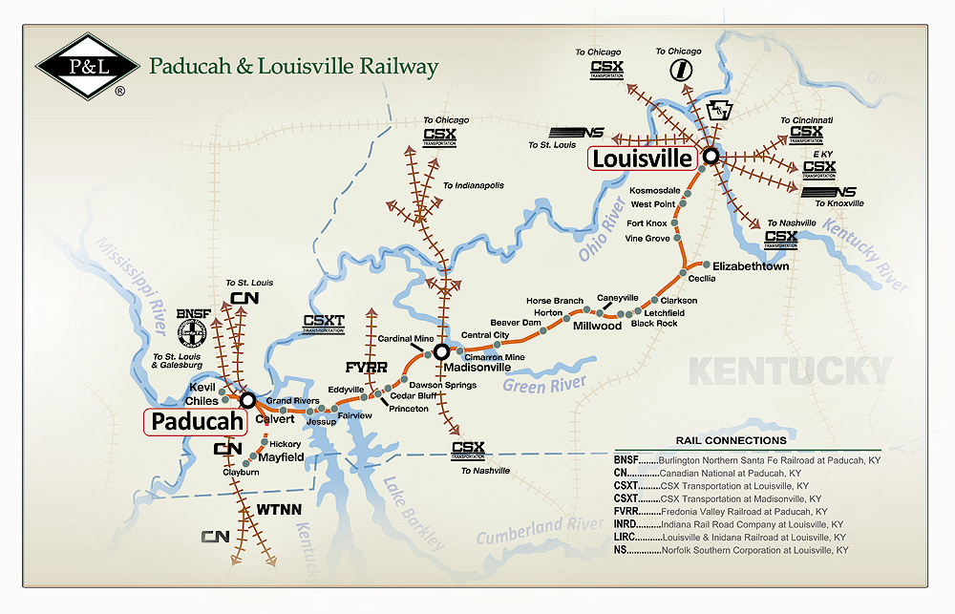
Paducah & Louisville Railway, Inc.
Full service railroad that operates over a 280 mile main line from Paducah to Louisville.
Connects directly to five (5) Class I carriers: BNSF, CSX, CN, NS and Union Pacific. These connections allow us to reach virtually any destination in the U.S. with one switch.
Service is enhanced by our geographic proximity to the interstate highway system and inland waterways.
Our reach extends beyond rail served customers by serving multiple rail-barge and rail-truck transloading facilities.
226 Employees.
Annual Payroll & Benefits: $35M.
Annual Capital Investment: $28M.
Shippers Served: over 100.

Slide 11
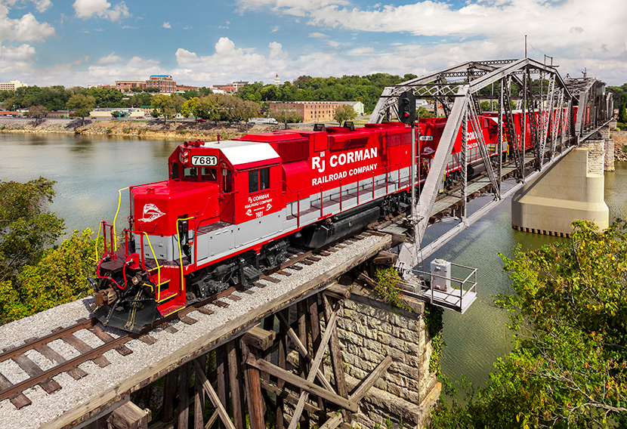
R. J. Corman Railroad Company
Notes:
R. J. Corman Railroad Company, LLC is a holding company for 14 short line railroad companies with a combined total of over 1,000 miles of track. We have operations in 10 states and move approximately 80,000 carloads per year.

Slide 12
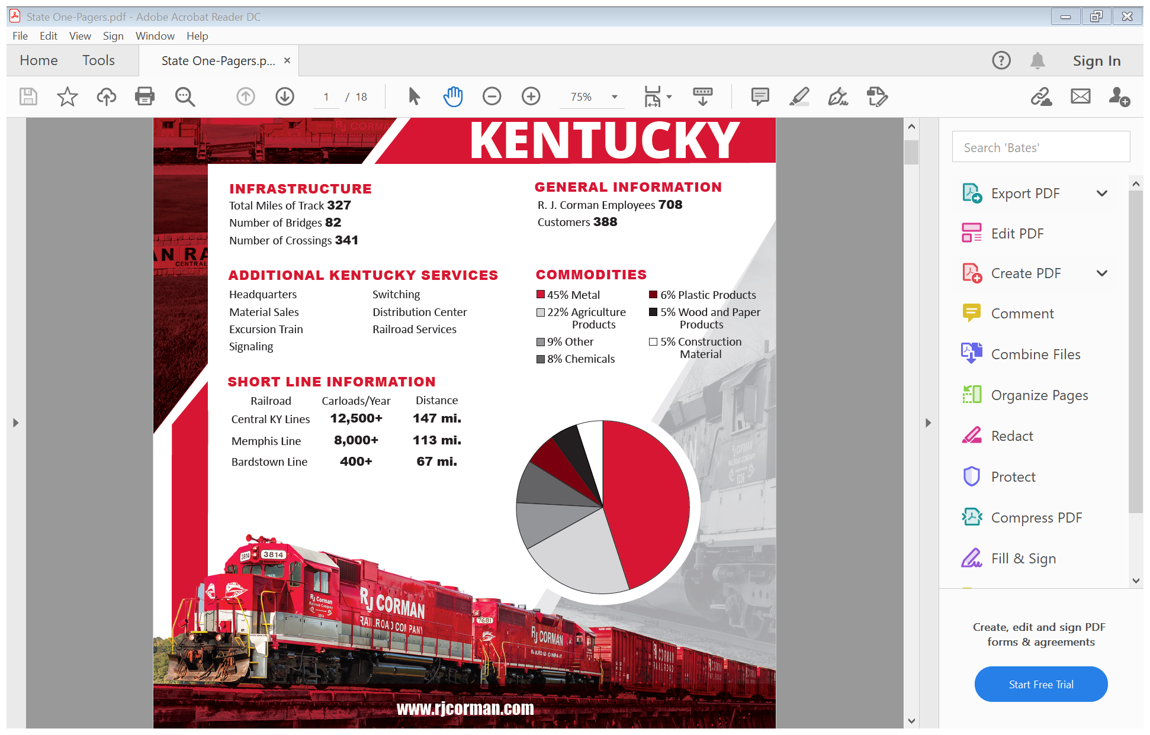

Slide 13
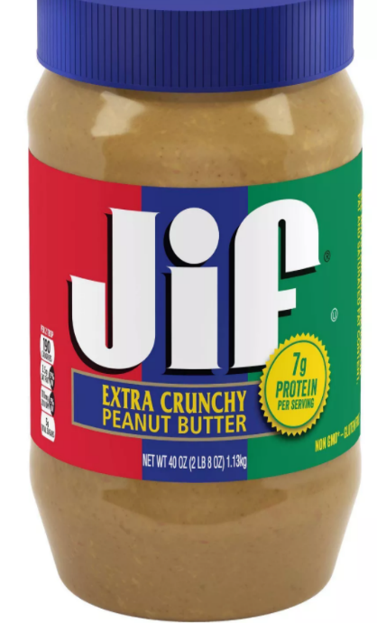
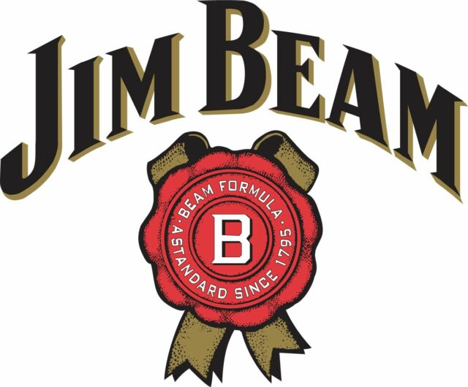
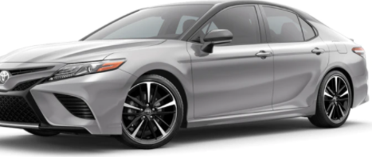
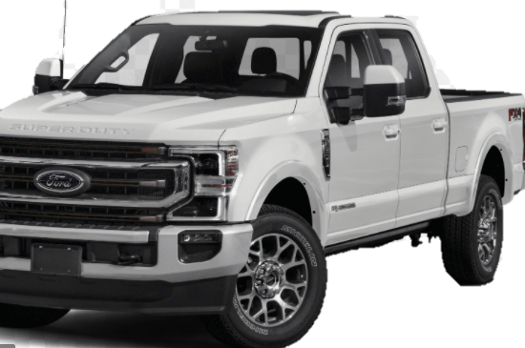
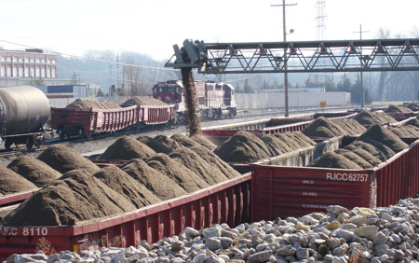
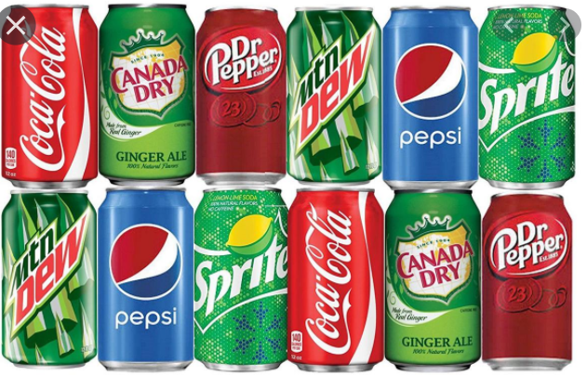
Products shipped via Rail
Notes:
2019 carloads for Nugent Sand (primarily concrete sand, also mortar sand) 6,000. Novelis 6,200 aluminum ingots. Shipped via RJC and CSX from Berea to Russellville. Smuckers plants in Lexington, 1,700 cars of peanuts and some oil. 100 carloads of spirits from Florida and Mexico to Jim Beam in Frankfort. 680 carloads of plastics to Washington Penn for multiple uses but primarily used in automotive.

Slide 14
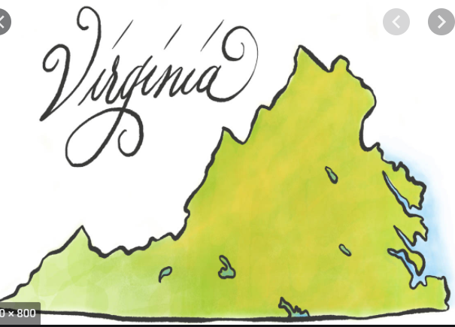
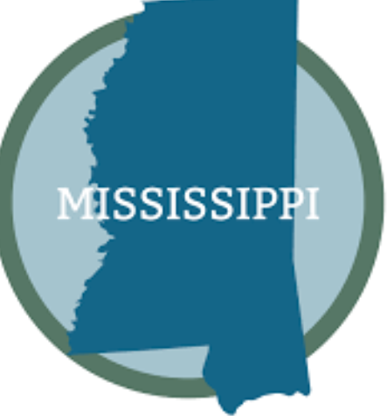
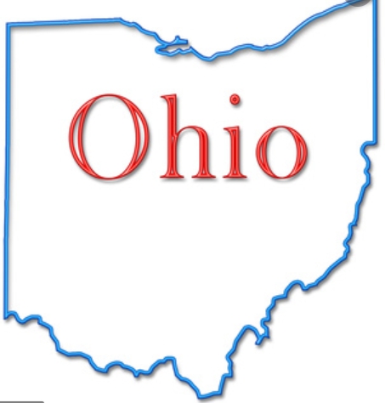
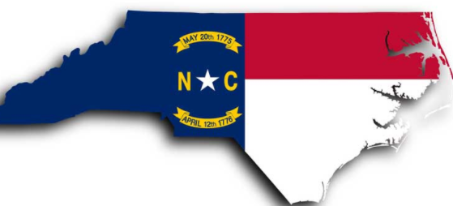
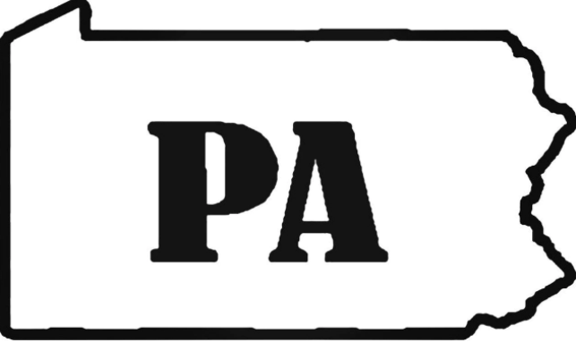
States with railroad funded programs
Notes:
Virginia – Rail Preservation Fund 70/30 and Rail Industrial Access 70/30 $450K max. Mississippi – MS Rail Grant Program 2018 $30 million dollars 75/25 match. OH – ORDC 2 million match can very based on funding 65/35. NC – SIAP and Industrial Access funds 50% march 2019 $7 million. PA – RTAP and RFAP 70/30 annually about 30 million dollars.

Slide 15
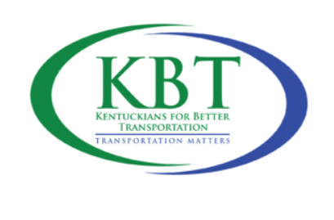
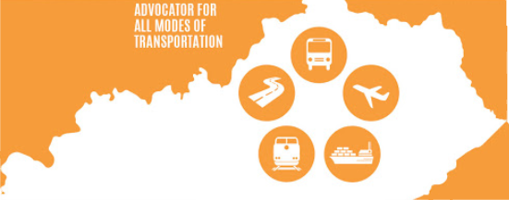
Multi-Modal Transportation Fund
Notes:
Infrastructure investment is needed to stay competitive with other states. Safe, reliable, efficient transportation is needed to make KY and logistical hub that allow business and industry to locate and expand and in the Commonwealth.

Slide 16
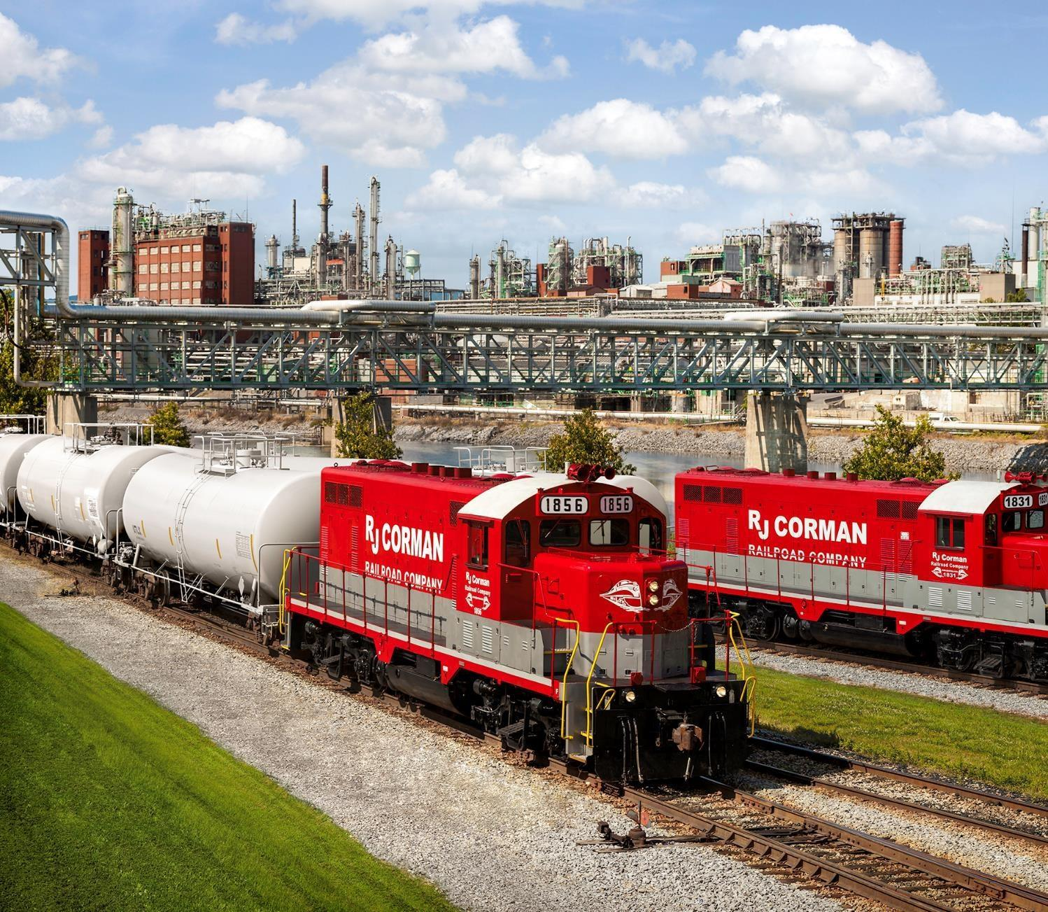

THANK YOU
.

