Slide 1

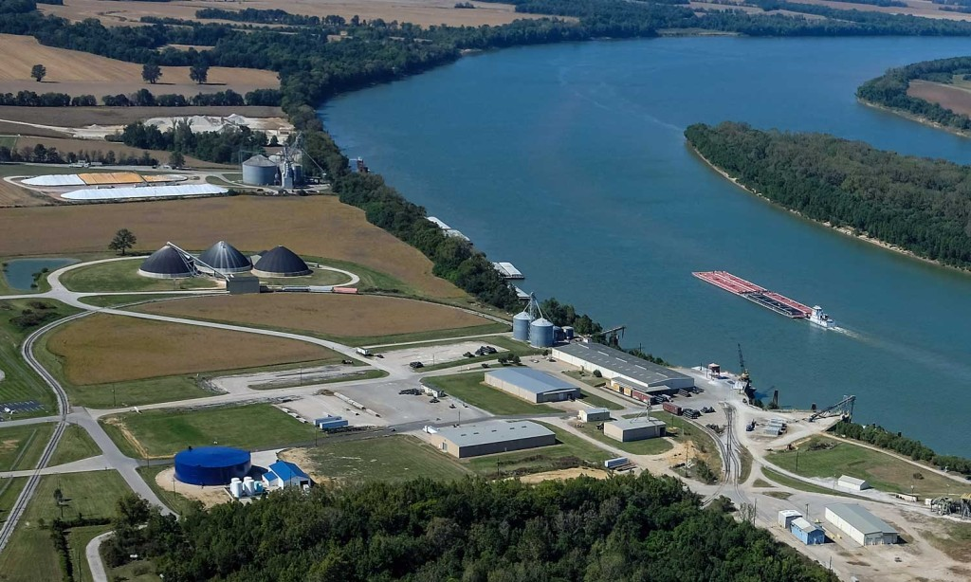
Kentucky Legislature Transportation Committee August 18, 2020
KBT Waterway committee remarks by Greg Pritchett
Notes:
Good afternoon. I am Greg Pritchett with the Henderson County Riverport Authority representing Kentucky Public riverports.
On behalf of public riverports across Kentucky we appreciate the opportunity to present today.
Kentucky Public Riverports are organized under Kentucky Revised Statues by cities and counties across the state as necessary or desirable to promote freight transportation via water and to attract industrial or commercial operations to the property held as riverport industrial parks in Kentucky.

Slide 2
Notes:
The Kentucky public riverport system starts on the Mississippi river then spans the state using the Ohio, Tennessee, Cumberland Rivers.
These city and county operated riverports offer efficient year-round freight transport of bulk materials, agricultural products, chemicals, minerals, metals, wood and manufactured goods to and from communities across the Commonwealth.
For example, the Henderson county Riverport client base includes national and international Aluminum, Steel and Zinc suppliers who sell into the local and regional communities of North Western Kentucky and Southern Indiana. Our port also offers space for two agri-business fertilizer suppliers and 3 grain shippers. We work with third-party European banks, Wall Street commodity traders as well as local and regional manufacturers.
Kentucky riverports also work to develop industrial parks and recruit companies which in turn enhances job opportunities.

Slide 3
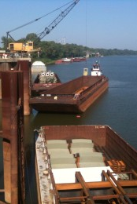
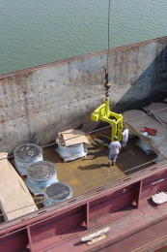
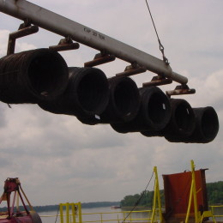
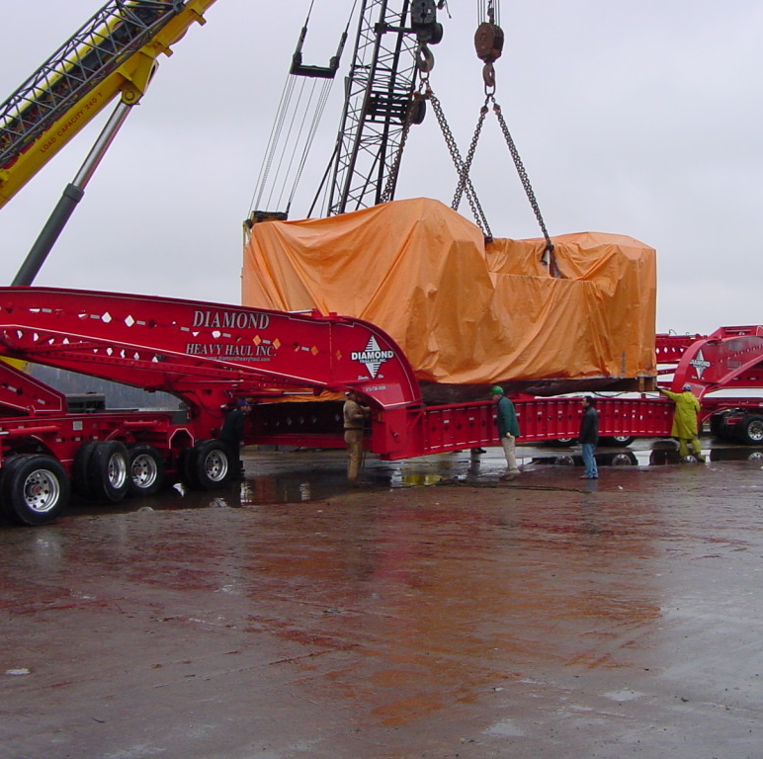
Steel tank components built in Webster County going to Mississippi.
Tinplate roll sheet from China going to a local food can maker
Steel Wire Rod from Texas going to a Henderson based company.
Steel Presses from Germany and South Korea going to Bardstown, Bowling Green and Owensboro
Notes:
As you can tell from these slides, many industries are dependent on Kentucky Public Riverports to handle inbound and outbound cargo. The saving created by water transportation make it possible for Kentucky industries to compete while improving safety and reducing the maintenance by minimizing truck traffic on our highways.

Slide 4
Notes:
During 2006, 2007 and 2008, the Kentucky Transportation Cabinet in concert with several participating public ports worked with a consultant and executed a research project titled Kentucky Riverport Improvement Project. This report studied each existing public riverport and additionally those communities wishing to develop public riverports . The report provided an analysis of each port's infrastructure, needs assessments and recommended legislative actions such as offering infrastructure and marketing funds to assist. The report called for the formation of an advisory board to the Transportation Cabinet for the purpose of administrating and reviewing grant applications from public riverports from funds allocated to the Transportation Cabinet.
Beginning in 2013, the Kentucky General Assembly has annually provided $500,00 each year to the present for riverport projects across the state.

Slide 5
Notes:
Just recently, the Kentucky Water Transportation Advisory Board met and reviewed this list of grant applicants from Riverports across the state. The board went onto recommend to the Transportation Cabinet Secretary funding the projects indicated by the blue stars.
Kentucky Public Riverports appreciate your willingness to provide funds for improvements such as these.

Slide 6
$11 Million
Proposed new port
$40 Million
Notes:
It is important to note that Kentucky is competing with surrounding states all desiring to enhance economic development activities During 2020 the Ohio and Illinois legislatives set a side $11 and $40 respectively to develop and expand public riverports in their states. Indiana has announced a plan to develop another Ohio River port in direct competition with Ohio and Kentucky for future business opportunities.
A few years ago while attending a freight conference in New York, I listened as a senior official with a major freight transportation company presented their vision and business expansion plan to Wall Street. A map was shown denoting the projected population growth in the Carolina’s, Georgia and Tennessee to the south then Ohio, Indiana and Illinois to the north. What I found disturbing about the map was no significant growth projections for Kentucky and our state was just a land bridge between the projected growth centers of the east, north and south of the Commonwealth.
Supporting and growing Kentucky’s economy builds stability, strong jobs and retains our next generation of Kentucky families and citizens. I hope we are all mindful of the work our riverport network is doing to facilitate commerce and grow with your past and future financial support to maintain and upgrade.
Thank you.

