Slide 1
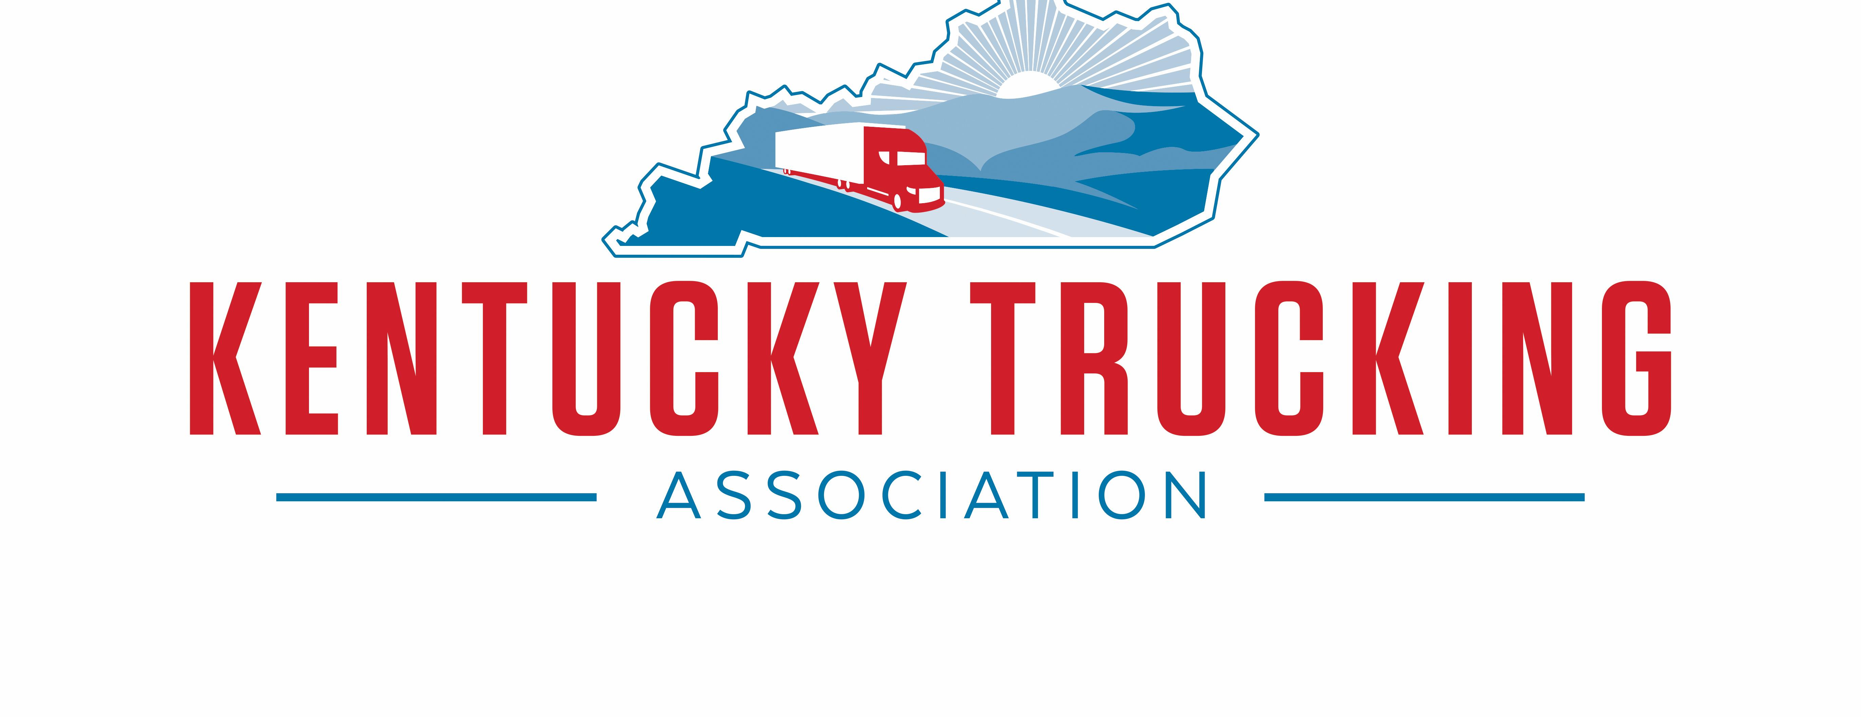
Interim Joint Committee Transportation
October 20, 2020

Slide 2
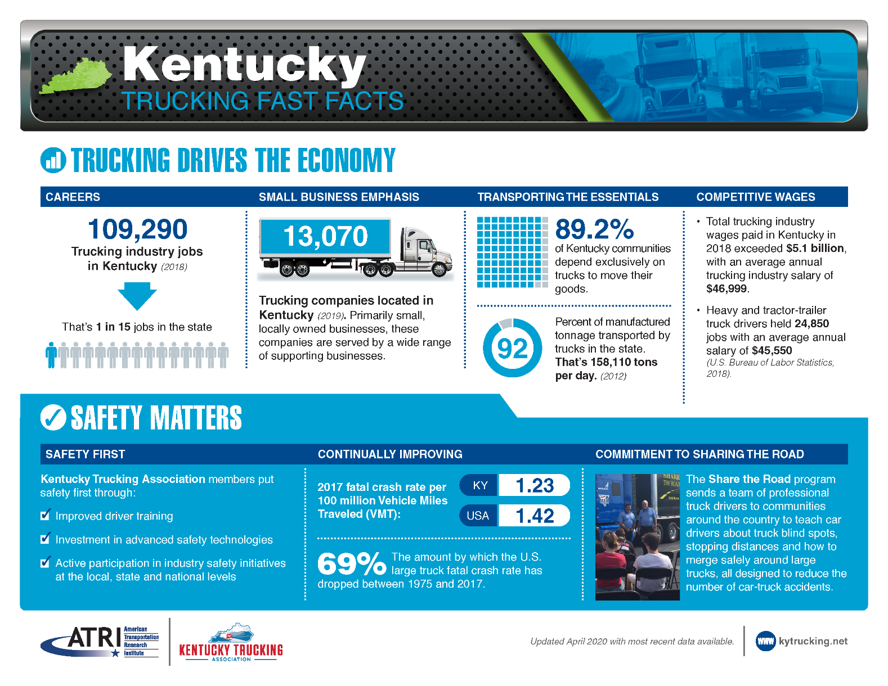
Kentucky Fast Facts

Slide 3
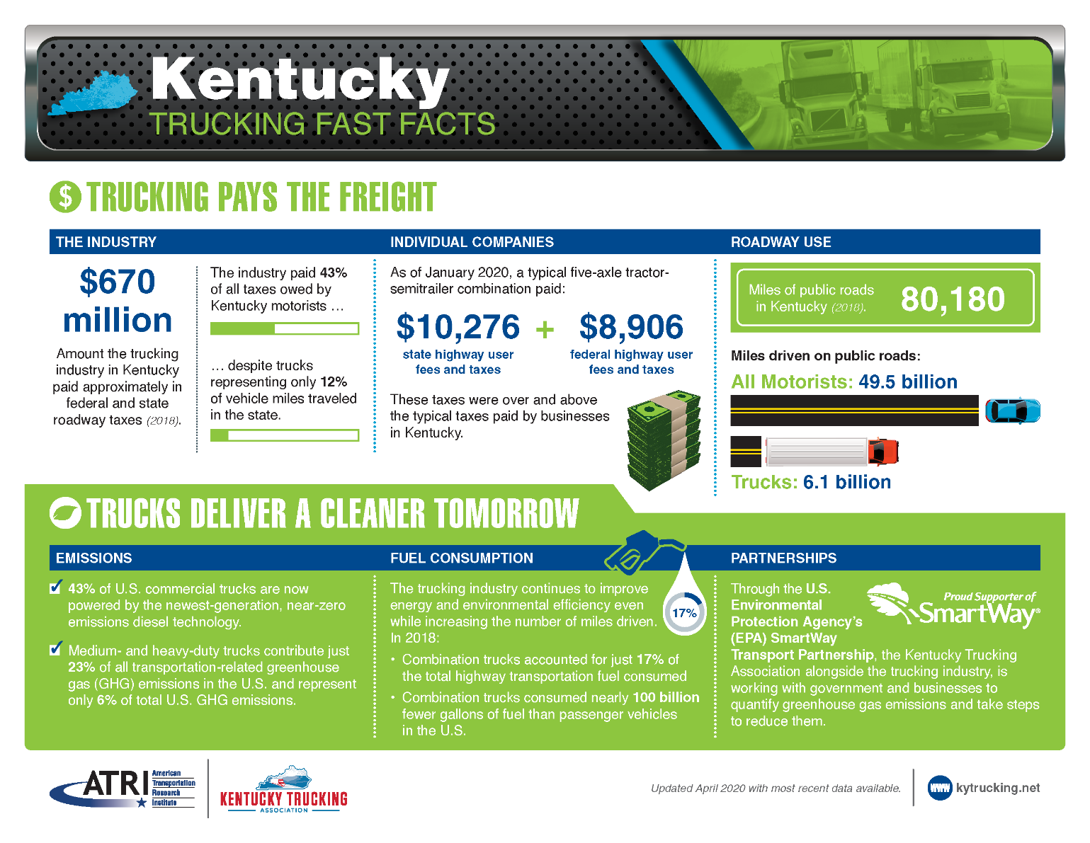
Kentucky Fast Facts

Slide 4

COVID Impact on Trucking
83% of normal commercial transportation activity at beginning of the pandemic. Parts of trucking are doing well as capacity is tight due to some carriers shutting down or running less trucks along with ecommerce expectations being at an all time high during the holidays, so retailers are restocking.
Truck Tonnage fell 8.9% in August compared to year ago levels. This is the 5th consecutive year over year levels that have fallen. Heavier industrial loads are factored into tonnage.
Not all freight is created equal. Fleets hauling for retailers are doing well while those hauling industrial products are seeing lower freight volumes.
Moving essential consumer goods and medical supplies on a local and regional level went up approximately 13%
Increase in final mile services
50% of companies experienced lower to much lower freight levels, 28% about the same, and 22% were higher
Companies supplying manufacturing facilities experienced a negative impact due to shutdowns.
Companies hauling petroleum saw a decrease in business due to stay at home orders – no commuters to work
Freight volumes are still expected to grow by 36% between 2020 and 2031 – ATA Bob Costello
Trucking volumes are expected to rebound in 2021, rising 4.9% next year and then growing 3.2% per year on average through 2026.
Spot market rates were down 25% in April from the pervious year. They are now up 17% . Spot market rates are determined by the ratio of the number of loads in the market compared to the number of trucks available to move this freight.

Slide 5
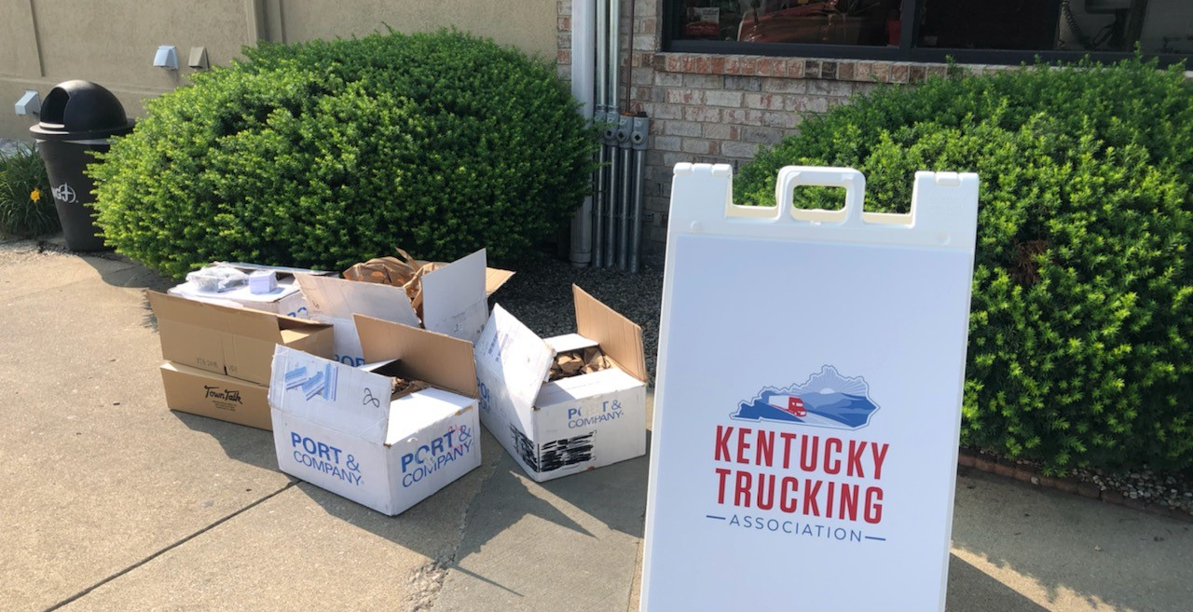

COVID Impact on Professional Drivers
Drivers needed PPE and sanitization products. Some states closed rest areas and/or truck stops. Limited capacity for facilities that were open. No drive thru – no walk-up customers
Contact and Paperless technologies are being used for bills of lading, payments, sales – more efficient because of no paper.
Congestion was way down – no commuter traffic, etc. 55mph through Atlanta
Positive Image – Highway Heroes – National Truck Driver Appreciation Week was September 13-19th. Billboard/Shirts
Odd but there is still a driver shortage – Difficulty for new drivers to get CDL because of covid challenges with driver training programs, backlog of paperwork at DMV’s, and the new drug an alcohol clearinghouse -30,000 drivers have tested positive- must complete a return to duty program -90% have not completed the program and drivers want to stay closer to family

Slide 6
Legislative Consideration for 2021
Registration Certificate Fee for vehicles 44,001 lbs. or greater must pay an extra $30 fee to the clerk along with the three $1 bucket fees and the $1 childcare assistance account for a total of $34.00. KRS 186.040 (3), (4), and (6).
Approximate number of vehicles, 19,000 apportioned vehicles and 9,000 intrastate.
Issue: Motor carriers are required to make an unnecessary trip to the clerk’s office just to pay this fee. Registration is completed on-line. Decal and/or plate is mailed, and/or temp is printed.
Preferred solution is to eliminate the $30 fee as proposed in the previous two infrastructure bills HB 517 (2019) and HB 580 (2020).
Alternative solution: keep fee but allow payment at the clerk’s office or pay the fee on-line through the IRP system. Intrastate commercial registration is not on-line.

Slide 7
Legislative Consideration for 2021
This legislation would prevent measures taken by motor carriers to improve safety from being considered in evaluating a worker’s status as an independent contractor or employee.
Problem: Requiring independent contractors (ICs) to use certain safety technologies or monitoring their driving behavior and coaching them based on it can be viewed as exercising employer like control.
This serves as an unnecessary impediment to carriers utilizing some safety measures with their ICs.
Passed in TN, AK, IN, and GA
Supported by UPS and FedEx
This is a safety issue
AAA found that video based onboard safety monitoring could prevent 63,000 crashes, 17,700 injuries, and 293 deaths each year.
This would encourage deployment of safety technologies and make our highways safer
This does not change the state’s test for classifying a worker or mandate that a motor carrier or IC use this technology

Slide 8
Legislative Consideration for 2021
Prevent Failure to Equip Claims
Possible language “An owner operator, lessor, or lessee of a commercial motor vehicle as defined in 49 CFR 390.5 shall not be liable in a bodily injury or wrongful death action for not equipping the commercial motor vehicle with safety technology not required by federal or state laws or regulation”
Example: collision avoidance technology such as side cameras or lane departure notification, auto braking, etc. are not required by law but plaintiff attorneys argue that they should have had it on the vehicle. They failed to equip the vehicle.

Slide 9
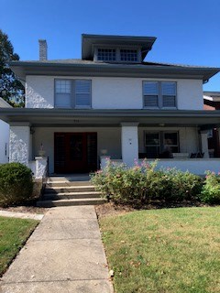
Thank You
Kentucky Trucking Association
Rick Taylor, President/CEO
512 Capital Ave.
Frankfort, KY 40601
Phone 502 227-0848
Email: rtaylor@kytrucking.net

