Slide 1
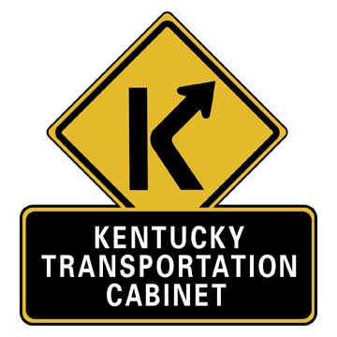
Outdoor advertising devices

Slide 2
History
Why are we required to regulate?
  Bonus Act
  Beautification Act
  Federal Agreement
Where are we required to regulate?
  Protected Areas Along Controlled Routes

Slide 3
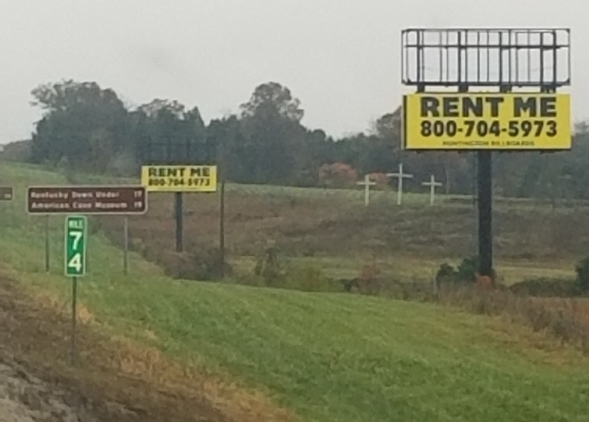

Slide 4
POTENTIAL Impacts
$70 Million
Up to 10% of annual federal funding if not exercising effective control

