Slide 1
Interim Joint Committee on Transportation
EKU Aviation Update
Fall 2021

Slide 2
Overview
Background / History
EKU Aviation Program - Currently
EKU Aviation ‘By the Numbers”
Demographics
Enrollment history
Flight hour trends
Assets
Path to the Future

Slide 3
Background/History
1983: First aviation related courses offered
1991: First BS in Aviation degree awarded
2009: Colgan Air accident - impact on entire industry
2010: Brought program under direct control of EKU
Lease first aircraft in April 2010
2011: Fixed Base Operator (FBO) management (August 2011)
2013: Earned FAA 1,000-hour R-ATP authorization
August 2013 – 3rd university in US
2018: Purchased first aircraft – C172

Slide 4
Our Program
Bachelor of Science (B.S.) in Aviation
Professional Flight concentration
Aerospace Management concentration
Aerospace Technology concentration
Unmanned Aircraft Systems (UAS) concentration
Starting Fall 2022

Slide 5
Dual Credit/Aviation Pathway
49 Kentucky High Schools
EKU Aviation offers dual credit courses for secondary aviation pathways:
Introduction to Aviation (3 hrs.)
Introduction to Unmanned Aircraft (FAA Part 107 certification) (3 hrs.)
Private Pilot Ground (4 hrs.)
Private Pilot Flight I (1 hr.)
Private Pilot Flight II (1 hr.)
Up to 12 hours of Aviation credits
Advanced standing in the EKU Aviation program

Slide 6
Aviation Program Fall 2021 By the Numbers
One of the fastest growing degree program at EKU
The only four-year Aviation BS degree program in Kentucky
Bachelor of Science in Aviation with 329 students:
Professional Flight: 270
Aerospace Management: 57
Aerospace Technology: 2
Demographics:
284 Male
45 Female
18% Minorities
17% Veterans

Slide 7
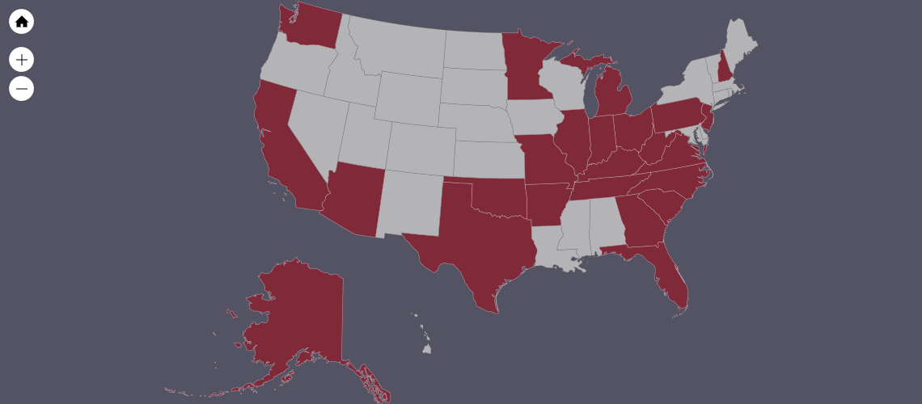
Enrollment 2021-2022

Slide 8
Enrollment History

Slide 9
Flight Hours by Year

Slide 10
Aircraft Assets
Current status of fleet: 27
Single Engine (24)
Cessna 172-N 1
Cessna 172-M 1
Cessna 172-P 8
Cessna 172-R 6
Cessna 172-S 6
Cessna 172-RG 2
Multi-engine (3)
Piper Seminole 3

Slide 11
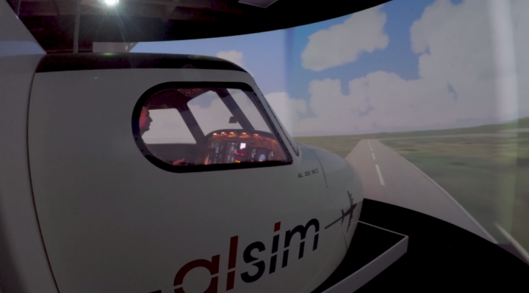

Flight Simulators
Current simulator assets:
AlSim AI200 MCC
Precision Flight Control PFC-DCX ProMotion
VR Flight Simulator Lab
12 VR Sleds available for use

Slide 12
Investing in Success
FY ‘21 Budget Investment from General Assembly
Transition from Leased Aircraft to EKU-Owned Aircraft
17 Aircraft Acquisitions since July 2020
Secured Secondary Temporary Facility to Accommodate Enrollment Growth
Funded Construction of Future Training Center at Central Kentucky Regional Airport

Slide 13
EKU and Central Kentucky Regional Airport Partnership
EKU board members
2 of 8 board members chosen by the President of EKU
EKU operates Fixed Base Operator (FBO)
FBO/Airport staff – all EKU employees
Airspace/Airfield
Less than 20 minutes from campus
Dedicated training areas
FAA approved precision/non-precision approaches
Proximity to LEX (control tower)
Third busiest GA airport in Kentucky (2019 LRASP survey)

Slide 14
Airport and Flight Training Center

Slide 15
Continued Growth Considerations
EKU forecasts enrollment at 400 students by Fall 2022
To support over 400 students, we must consider:
- 30+ aircraft
- New Flight Training Center
(with simulators, briefing space and classrooms)
- Additional Staffing
- Satellite Fields
- Planned UAS Concentration (Fall 2022)

Slide 16
www.aviation.eku.edu
Questions?

