Slide 1

Kentucky Department of Aviation
Interim Joint Committee on Transportation
Commissioner Mark Carter
Deputy Commissioner Brad Schwandt
KYTC DEPARTMENT of AVIATION – October 5, 2021

Slide 2

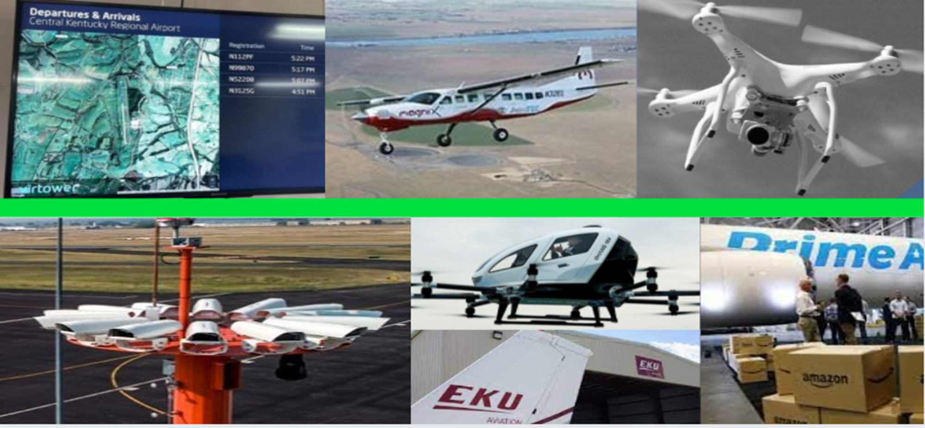
Department of Aviation
Promoting economic development through the support of aviation
The Commonwealth’s resource
for all aviation issues:
Airport Planning
Airport Project Oversight
Federal and State Airport Inspections
Fleet Services
Economic Development
STEM/Aviation education advocacy
Unmanned Aircraft Systems Development
Airport Zoning

Slide 3


Department of Aviation Staff
Office of the Commissioner
Mark Carter, Commissioner
Brad Schwandt, Deputy Commissioner
Shelby Peel, Staff Assistant
Cherri Bemis, Administrative Support
Aviation Operations Branch
Terry Hancock, Inspection Branch Manager
John Henry, Hangar Utility
Engineering Branch
Jacob Dahl
Engineering Branch Manager
Joe Carter
Transportation Engineering Technologist III
Pilots
Michael Riensche
Fixed-wing Aircraft Pilot
Danny Rogers
Helicopter Pilot
Capital City Airport Division
Scott Shannon, Airport Asst. Director
Serai Davis, Program Coordinator
Flight Line Operations
Anthony Adams
Airport Manager
Mitch Coldiron
Flight Line Attendant II
John Armstrong
Flight Line Attendant II
Ricky Doss
Flight Line Attendant I
Aircraft Maintenance Branch
Steve Seger
Aircraft Maintenance Branch Manager
Amanda Sanders
Administrative Support
Morris Bryant
Aviation Mechanic Inspector I
Jason Doss
Aviation Mechanic Inspector I
Shane Wilson
Aviation Mechanic Inspector I

Slide 4

State Airport System
57 public use airports
  1 under construction: Gallatin County
  4 state owned airports
94 private airports
114 private heliports
2 military air facilities
1 Unmanned Aerial Systems Drone Port
23,392 on-airport jobs*
$1.4 billion payroll for on-airport jobs*
*Based on the 2017 Statewide Aviation System Plan: Economic Evaluation (has not been trended to 2021 wage rate growth)
KYTC
DEPARTMENT of AVIATION

Slide 5

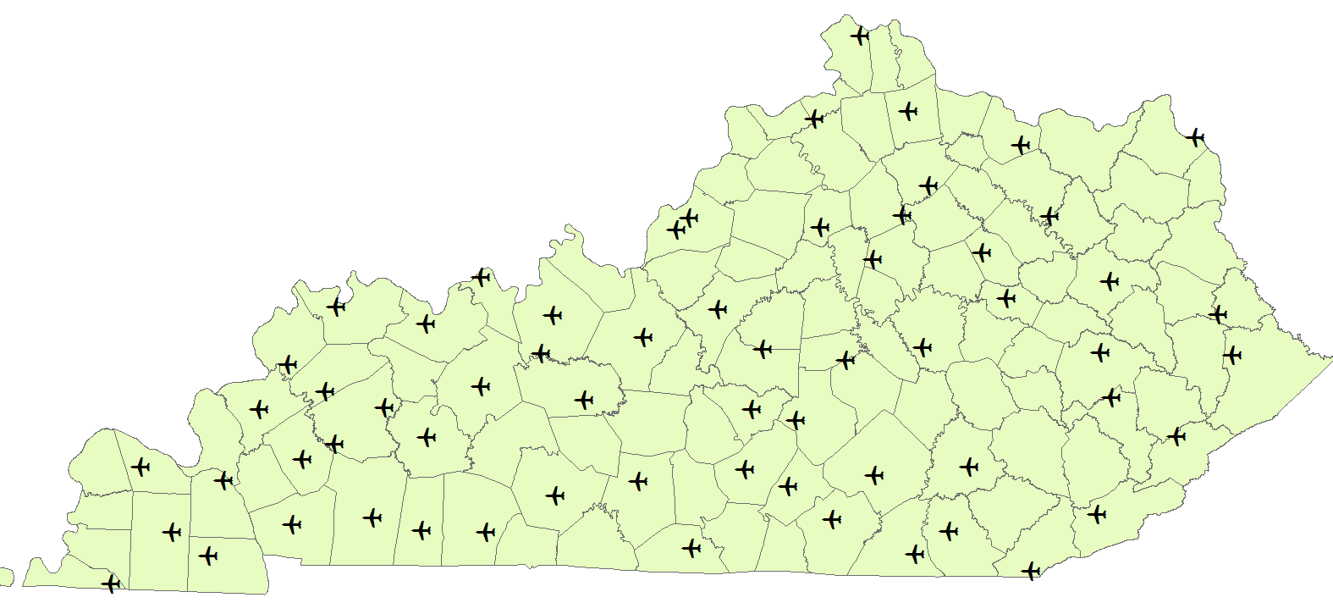
Kentucky’s Public Airports
KYTC DEPARTMENT of AVIATION

Slide 6
Airport Funding Sources – State Funding
Kentucky Aviation Economic Development Fund “Jet Fuel Tax”
KRS 183.525 – established by the State Treasury
All receipts collected from the sale or use of jet fuel are deposited into this fund and are to be expended
Fund can receive state or federal appropriations, grants, and shall include earnings from investments of money from the fund
Funds to be used for the development, rehabilitation and maintenance of publicly owned or operated aviation facilities and for other aviation programs within the commonwealth that will benefit publicly owned or operated facilities
Airport Pavement Maintenance Allocation
Funding granted and approved by the Legislative body
Intended primarily for pavement maintenance
  Runway, taxiway, apron repairs, overlays, rehabilitation, sealing, etc.
Previously received ~$10 million/ per year for four years. Has not been funded the last two years
Based on most recent budget projections

Slide 7
Airport Funding Sources – Federal Funding
Local Matching Program:
  Federal/State Airport Improvement Program (API)
    The Federal Aviation Administration grants Classified airports in Kentucky at least $150,000/year in entitlement funds
      Airports can save these funds for 3 years and invest on the 4th year (for $600,000 total)
    There are 51 airports deemed classified in Kentucky
    There are 6 airports in Kentucky that do not typically receive entitlement funds (due to eligibility)
  These funds require a 10% match. The state provides 7.5% of that match and local government provides 2.5%
    There is no match required on state-only grants
  KDA provided $4 million in matching funds in FY20
  KDA provided $2.5 for matching funds in FY21
Federal Aviation Administration Discretionary Fund:
Kentucky airports may also request additional funding through the federal discretionary fund, based on need and FAA funds available.
  Kentucky general aviation (GA) airports received $18.5 million in FY21 (Not including COVID disbursements)

Slide 8
Airport Project Selection – Standard Criteria
Federal and state standards dictate the prioritization of airport projects
  Top considerations are: safety, maintenance, design, and function
  Tolerance for variances and discrepancies are extremely low
Changes in policy and functionality of airport infrastructure occur often and in many cases unpredictably
KDA continually monitors multiple metrics, evaluates airport conditions, and adjusts priorities as required
  FAA policy and regulation
  Airport Layout Plans
  Capital Improvement Plans
  State Airport Pavement Maintenance Plan
  Federal and State Inspections
  Constant communication with airport stakeholders
KYTC
DEPARTMENT of AVIATION

Slide 9
Jet Fuel Tax Fund Projects FY 2021
KYTC DEPARTMENT of AVIATION
Funding (thousands)
2 projects (1-400)
1 – 400
2 projects (1-400)
2 projects (1-400)
401 – 600
601 – 1,000
2 projects (1-400)
>1,000
2 projects (1-400)
2 projects (1-400)
3 projects (1-400)
2 projects (1-400)
2 projects (1-400)
2 projects (1-400)
2 projects (1-400)
2 projects (1-400)
2 projects (1-400)
3 projects (1-400)
2 projects (1-400)
3 projects (1-400)
3 projects (1-400)
2 projects (1-400)
Total funds obligated:
$17,605,352.67

Slide 10
Airport Maintenance Fund Projects FY 2021
KYTC DEPARTMENT of AVIATION
Funding (thousands)
1 – 400
401 – 600
601 – 1,000
>1,000
Total funds obligated:
$3,043,109.17

Slide 11
Jet Fuel Tax Fund Projects FY 2022
KYTC DEPARTMENT of AVIATION
Funding (thousands)
1 – 400
401 – 600
601 – 1,000
>1,000
Total funds obligated and unspent:
$14,865,630.63

Slide 12
Funding Breakdown By Fiscal Year
Funding Available by FY
(Revenue minus three year average of debt service and overhead)
FY 2021 FY 2022 FY2023* FY2024*
Pavement Maintenance :
Jet Fuel Tax:
Total:
$ 0 M
$9.28 M
$9.28 M
$ 0 M*
$14.5 M
$14.5 M
$ 0 M*
$14.5 M
$14.5 M
$ 0 M*
$14.5 M
$14.5 M
*projected
Forecasted projects by FY:
FY 2022 FY 2023 FY 2024 FY 2025 FY2026 FY2027
Pavement Maintenance:
Other Airport Projects:
Total:
$ 10 M
$18.39 M
$28.39 M
$ 10 M
$15.7 M
$25.7 M
$ 10 M
$19.1 M
$29.1 M
$ 10 M
$12.7 M
$22.7 M
$ 10 M
$13 M
$23 M
$ 10 M
$10.6 M
$20.6 M
Other Projects include: Lighting projects, hangar development, fencing projects, obstruction projects, land acquisition reimbursements, fuel system projects, and unanticipated matches.
KYTC
DEPARTMENT of AVIATION

Slide 13
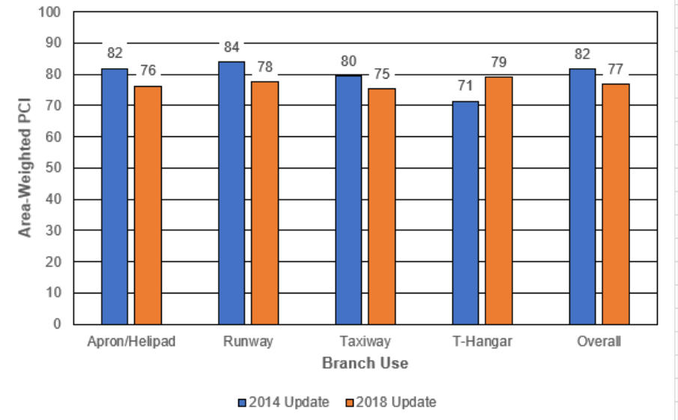
Critical Needs
Airport Pavement Maintenance was bad then, it’s worse now
  Imperative to start the conversation of funding to assist with the backlog of pavement needs

Slide 14
Advancing Aviation in Kentucky - Priorities
Maintaining and Improving our Airports
Eliminate backlog of runways requiring remediation
Implement a consistent runway maintenance program
Invest broadly in airports
Increase the number of Kentuckians pursuing careers in Aviation
Coordinate efforts across Cabinets (Economic Development, Education/Workforce, etc.)
Establish goals for training new pilots, technicians and other aviation positions
Promoting Aviation as a priority, and a tool, for economic development
Increase our focus on future state of aviation
Raise the profile and use of state aircraft by administrative and legislative branch leaders
State aircraft fleet modernization

Slide 15
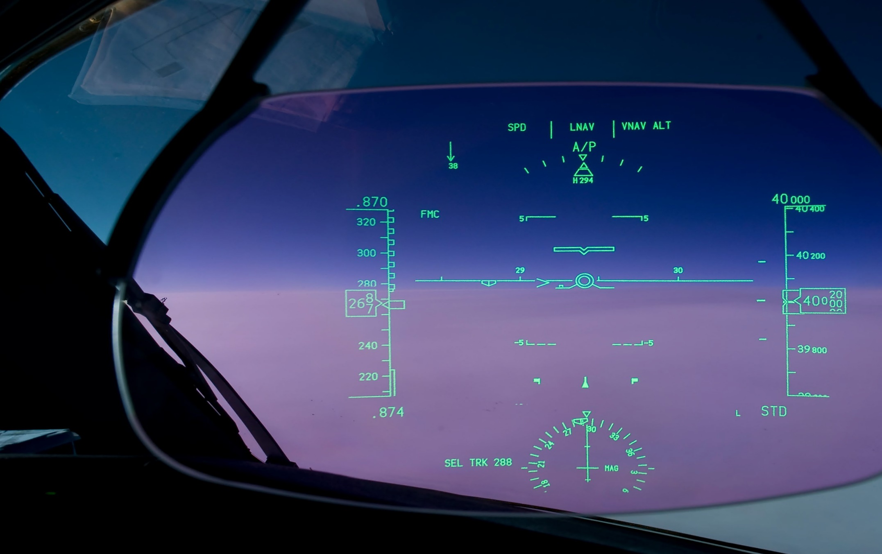
Moving Forward
Assessment of the current environment
Updating Runway Condition Survey
Collaboration with Legislative Branch
Developing recommendations for investment in aviation/aerospace
Assembling a set of options for funding

Slide 16

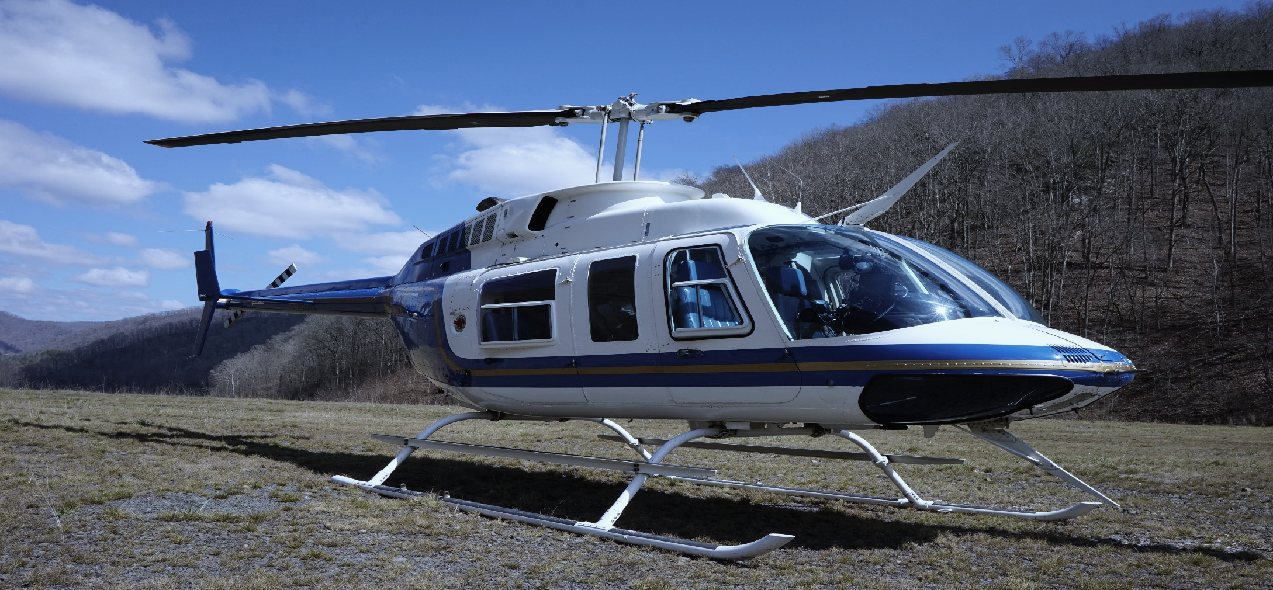
Thank you for supporting Aviation in Kentucky!
www.transportation.ky.gov/Aviation
KYTC DEPARTMENT of AVIATION

