Slide 2
School Bus Safety, Training and Technology
Elisa Hanley
Pupil Transportation Branch

Slide 3
What’s involved in Safety
Federal Motor Vehicle Safety Standards - FMVSS
School Bus Driver Selection
Driver Training Program
Technology

Slide 4
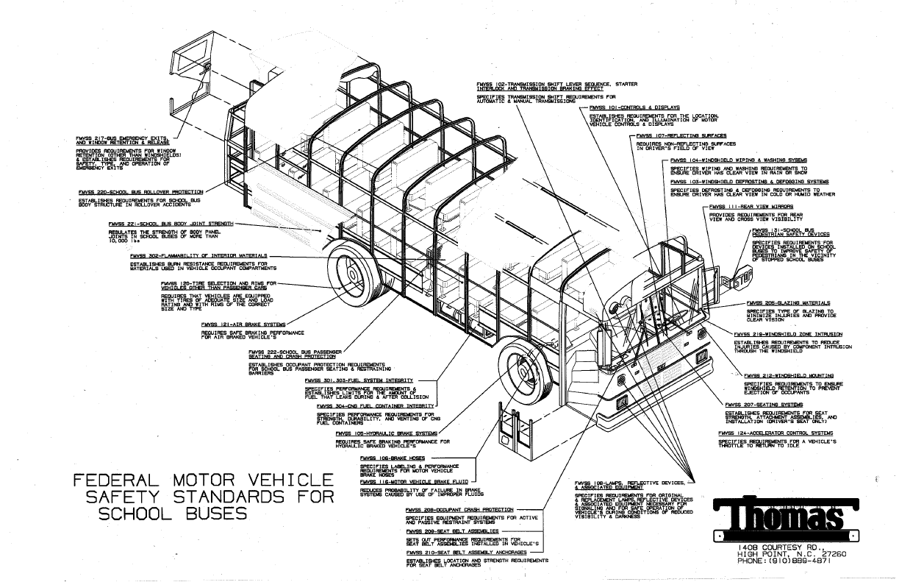
28 Safety Standards
Notes:
Here you will see that there are 28 Safety Standards listed for the school bus. These are the minimum requirements by the federal government that must be followed. Kentucky goes above and beyond in several of these areas.
Each year, a member of my team goes to the bus manufacturer to do a pilot, which is to ensure our buses are built to Kentucky Minimum specifications. In addition, each year there is a committee of school bus drivers, trainers, technicians, inspectors, directors, and at least one superintendent that determine what the minimum specifications should include. We have an engineer from each manufacturer to discuss our concerns, anything that might work better for our buses, and new safety features that may be added.
FMVSS 217 - establishes minimum requirements for bus window retention and release to reduce the likelihood of passenger ejection in crashes; and for emergency exits to facilitate passenger exit in emergencies.
FMVSS 222 are the occupant protection requirements for school bus passenger seating and restraining barriers. To reduce the number of deaths and the severity of injuries that result from the impact of school bus occupants against structures (such as the seat in front of them) within the vehicle during crashes and sudden driving maneuvers.
FMVSS 302 lays out the minimum standards for flammability of interior materials. We are the only state that uses Aramid (Kevlar) Fabric with Kevlar jersey knit- and Kevlar thread to sew the seats).
This material prevents penetration of fire into the foam cushioning and will self-extinguish when the source of fire is removed. The coating has been formulated to give this product high abrasion resistance, fire retardant and low smoke generation properties. In addition to the safety factors, Kevlar is the most vandal resistant fabric ever used in school buses. The puncture resistance is three times that of standard seating fabric and the unique construction makes it difficult to cut and almost impossible to tear. If there is a hole in any of the seats, the bus driver will know that a very sharp object was brought on the bus.
We utilized compartmentalization. This is where the student will hit the seat in front of them, where the padding and structure of the seat absorbs the impact. NHTSA has recommended lap/shoulder belts for all school buses because unfortunately being hit from the front or back is not the only type of accident a school bus has. They can be hit from the side and roll over, which is where most injuries come from.

Slide 5
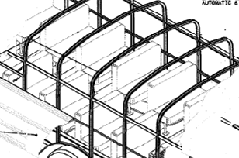
Tested at 36,000 LBS
Notes:
FMVSS 220 School Bus Rollover Protection
To reduce the number of deaths and the severity of injuries that result from failure of the school bus body structure to withstand forces encountered in rollover crashes.
FMVSS 221 School Bus Body Joint Strength
The strength of the body panel joints in school bus bodies to reduce deaths and injuries from the structural collapse of school bus bodies during crashes.
Kentucky buses are tested to the heaviest school bus we have times 1.5. There are several types of buses. The heaviest bus is 24,000 lbs so it is tested at 36000 lbs.
You may see on the news buses that have rolled over, but it is not often you will see a school bus with a crushed roof. Damaged, yes, but not crushed. These barriers are structured to withhold a lot of pressure.

Slide 6
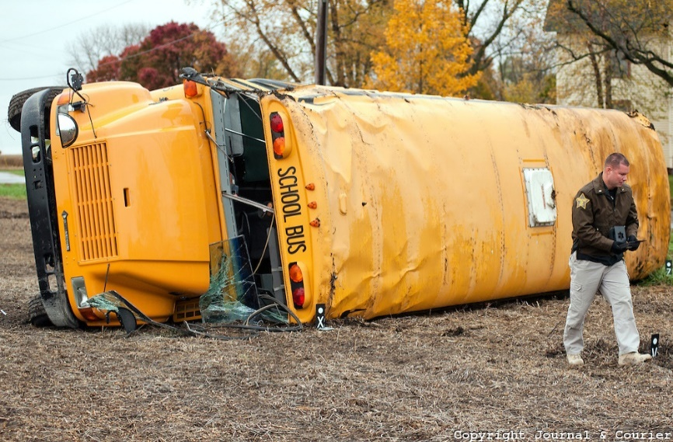
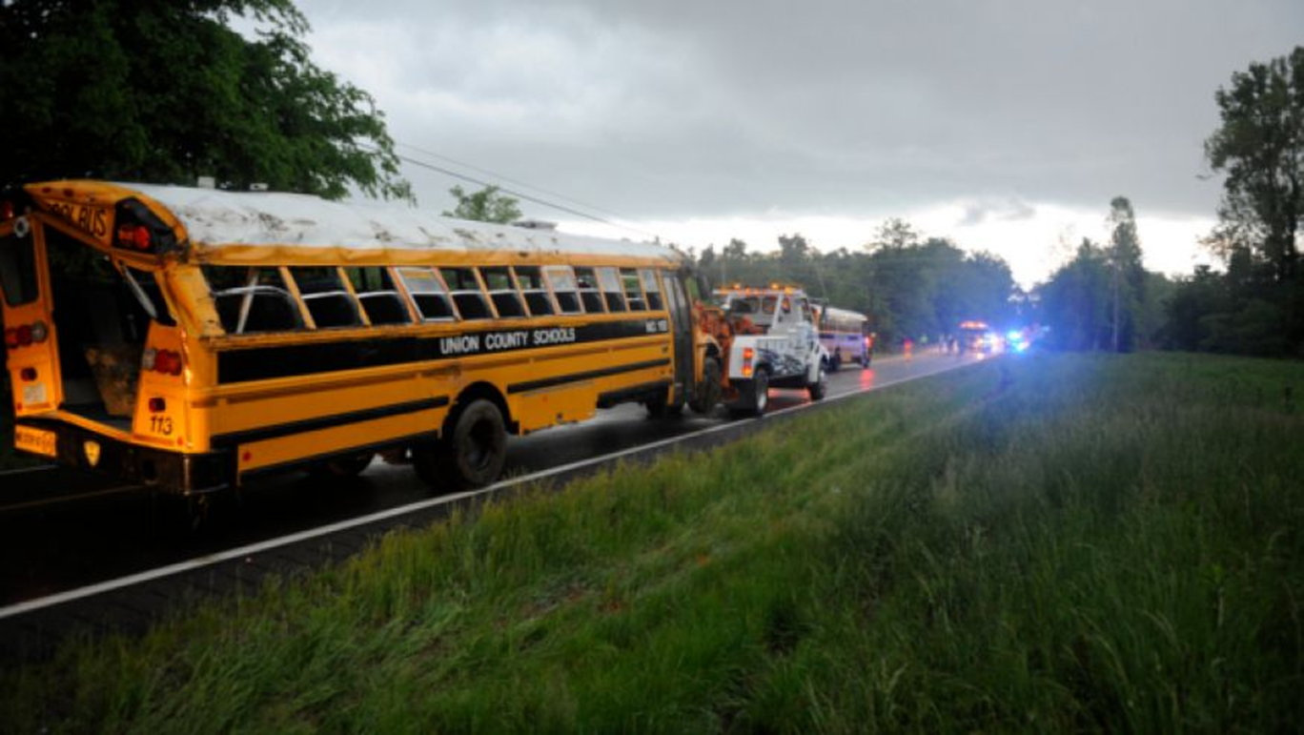
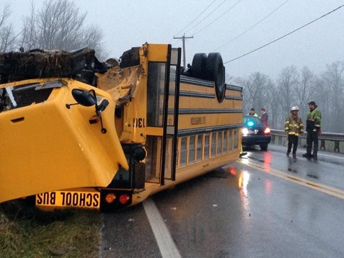
http://cdn.c.photoshelter.com/img-get2/I0000xJ8zAdfTJg0/fit=1000x750/Bus-Rollover.jpg
Notes:
As you can see, the picture on the top left is a rollover. Had your car rolled over, the roof would be crushed. FMVSS 220 and 221 have strict requirements to ensure the roof’s integrity.
The top right is a bus that where the roof moved but was not crushed to the point children could not escape through the many exits.
At the bottom, this school bus is upside down and the roof is kept intact. Students transported in other vehicles such as cars, vans, or even coach buses are not afforded these safety features. Therefore, we insist our students ride in a bus whenever possible. We know that if something happens, they have the weight and safety of the bus.

Slide 7
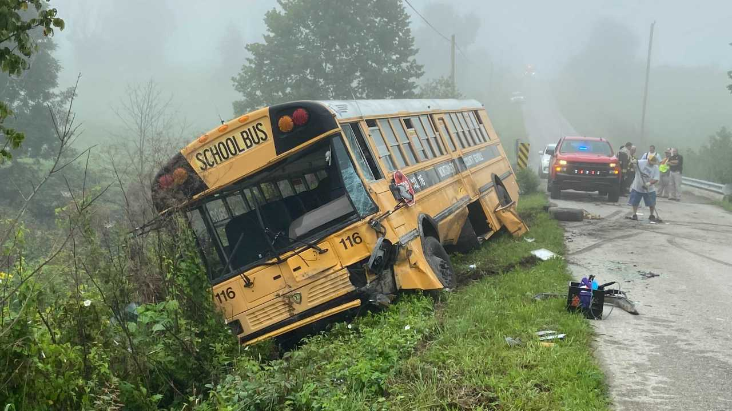
Lex 18 Photo
Notes:
Here is a picture of a bus that had an accident on August 20^{th,} 2021. It was damaged on the side and front of the bus. What you don’t see is the creek down below at the bottom of the hill. The drivers' skills helped keep that bus out of it.
https://ewscripps.brightspotcdn.com/dims4/default/f4c0460/2147483647/strip/true/crop/4032x3024+0+0/resize/1280x960!/quality/90/?url=http%3A%2F%2Fewscripps-brightspot.s3.amazonaws.com%2F6a%2F51%2Fee621830430f8bd6a7c53dd2e743%2Fimage-from-ios-62.jpg

Slide 8
Driver Selection and Safety
Criminal Background Check
Motor Vehicle Records Check-No DUI/DWI within the last 5 years-some districts don’t allow this in the records at all
Physical-Initial and Annually
Drug Test-Initial, Random and after an accident
Notes:
The process of hiring a school bus driver can take weeks if not months. We don’t take the safety of our children lightly. Some districts have even stricter requirements than state regulation. We provide the minimum requirements, and the local boards of educations can expand on them if they wish.
It has been hard to recruit, one reason is due to all that is involved and the amount of time it takes.

Slide 9
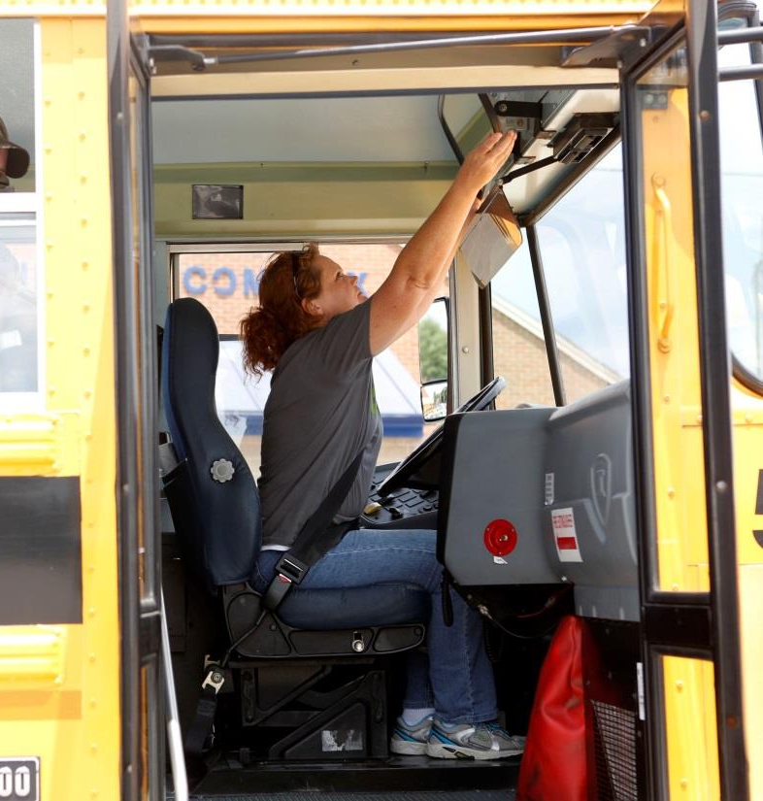
Training
Minimum of 25 Hours of Classroom and Driving Instruction
Yearly Recertification
  8 hours of update training
CPR/First Aid
Positive Behavior Intervention and Supports (PBIS)
Pupil Behavior Management
Evacuations
Special Needs
Notes:
Once the driver is chosen and has gone through all the proper checks, they are be trained.
Our drivers have an extensive minimum 25-hour training program that includes both classroom and on the road training.
The State of Kentucky requires an annual 8-hour update training for anyone who wishes to maintain their status as a school bus driver.
During the 25 hours of classroom and driving training, they are taught many different things. There are 11 chapters in our current manual. Training is only one step of a good, safe driver. Many people don’t recognize the training put into a school bus driver, but these are professional drivers with a professional driver's license that we entrust with our children. We expect them to follow the laws and regulations, bring safety concerns to directors and to the state. We teach them to properly load and unload our most precious cargo and expect them to follow the procedures. When they don’t, consequences occur.
Just as important to driving is the ability to control the 60 plus children sitting behind them. They are taught pupil behavior management and positive behavior management. Some school districts put monitors on the buses to help with student behavior, but just like there is a shortage of drivers, there is a shortage of monitors. In addition, not all school districts can afford to put monitors on every school bus. Funding is a big factor of why many buses do not have them.

Slide 10
Entry Level Driver Training
February 2022
Additional Training
Federal Reporting
  Training Provider Registry (TPR)
  Drug and Alcohol Clearing House
Notes:
Starting February 2022, Entry Level Driver Training is required. This is for anyone getting a Class B license, P endorsement or S endorsement. The school district will be required to provide specific training to ensure drivers understand their responsibilities as CDL drivers, not just school bus drivers. Therefore, additional strains are being added to the district, which may cause a larger shortage of drivers. Not all school districts pay people while they are in training and our parents/communities cannot afford to go through 4-6 weeks of training with no pay. Many school districts provide training for people to get their permits, which is 5-10 days of training just to get a permit, then through the Kentucky Curriculum/ELDT requirements. At the state education level, we have created our manual to include what is required for ELDT to help eliminate the need to add additional weeks of training. However, we had to include certain items, such as log books, cargo handling, hours of service, and other areas that don’t apply to us. We are also working towards creating tests for those needing their license and endorsements to be able to prove to the federal motor carrier safety administration that the candidates have received 80% on their knowledge. In addition, there is on the road training and testing.
In total there are at least 40 hours' worth of training for any district that provides the permit training and the curriculum. If they do not provide the permit training, it’s between 25-30 hours or more for book and on the road/range.
Additional responsibilities, other than KDE requirements include the Training Provider Registry where the district affirms they are complying and then uploads documentation certifying a driver has completed the training. They also need to run drivers through the Federal alcohol and drug clearing house to verify their background doesn’t include CDL violations in this area. This is an added cost per driver initially and annually.

Slide 11
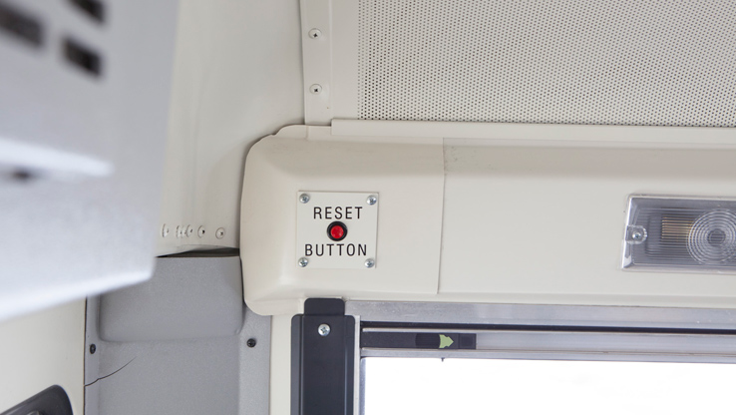
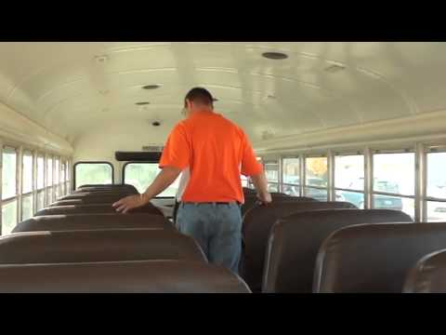
Additional Safety Features
GPS
No Child Left Behind Alarm System
http://www.proaims.com/products/School-Bus-and-School-Gate-attendance-system.php
Notes:
GPS is an additional feature that can be used for routing, school bus location, and maintenance issues. Unfortunately, there is a cost for this and most districts do not purchase it.
No Child Left Behind alarm system is on all buses. The drivers, when turning off their buses are to walk to the back of the bus and turn this off. In the time doing so, they should be checking the seating areas for sleeping children. This system is designed to force the bus driver to walk to the back of the bus and de-activate the system before leaving the bus. If the driver fails tries to exit the bus through the front door without deactivating the system, the horn will immediately sound.

Slide 12
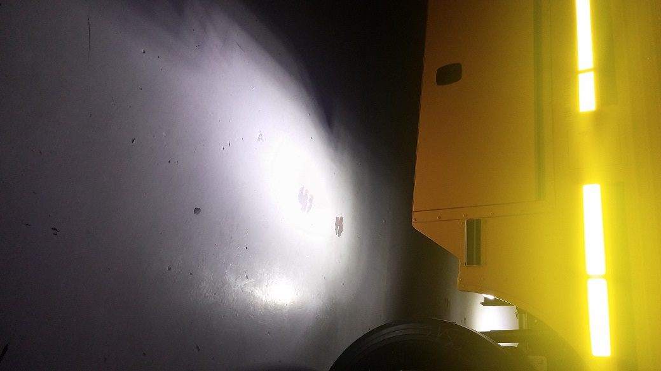
Back-up Lights
Added to Kentucky buses in 2015
Clearer view of area around the bus

Slide 13
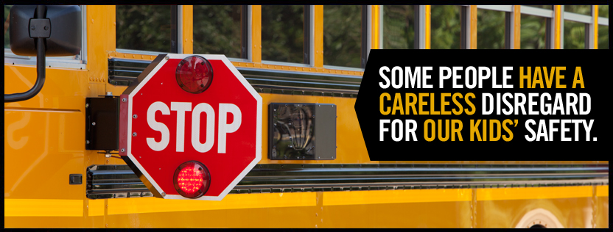
Stop Arm Cameras
Safety of the driver and students
1/3 of stopped school buses are illegally passed each day
http://www.stoparmcamera.com/about-the-program/
Notes:
Everyday thousands of drivers pass school buses while the buses are stopped and are loading and unloading children. By catching and going after those that pass stopped buses, we are hopefully preventing that person from doing it again AND people become more vigilant because they understand there are consequences for their actions. Unfortunately, districts have fought with their counties to prosecute illegal passing. This should not be a fight, it should be common sense. Although the law states the owner of the vehicle should be the person prosecuted, often they are fought in court and dismissed. Some camera companies now make it easier for the districts by linking directly into their system and the camera company will file the complaint with the law enforcement agencies.
If a person passes a bus illegally, they should be fined. The school district should also retain some of that funding for the upkeep of their systems. These systems cost money, but the district doesn’t receive funding for their upkeep.
It costs $350-$850 per stop arm camera, depending on the type of system the district has, if it is front and back, and if it is just adding a camera or if it is the whole system. Taking the midpoint of $600 for 7600 buses, that’s over $4.5 million to put it on all daily buses.

Slide 14
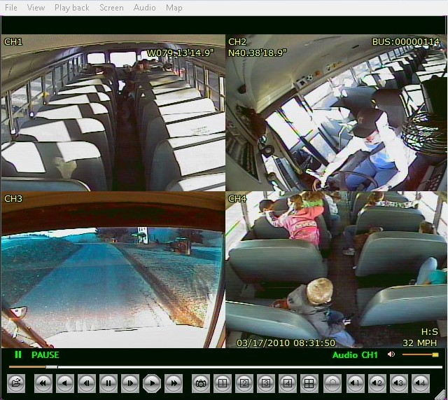
School Bus Cameras
Notes:
Cameras can be a districts best friend when it comes to critical situations. The videos are used during an accident to see what occurred and with student seating. Districts can learn a lot about what is going on inside of a bus, good and bad.
Every school bus should be equipped with cameras and the cameras maintained; however, funding is a barrier. The camera system alone can range from $1200 - $2600. These just the system and most only include 1 camera. Some of the systems only need one camera and others need 4 or more cameras. At $2600 that’s over $19.7 million. Many districts are already putting them on. However, we still have many districts that don’t have them or are refusing to put them on. This is something we have discussed as having to be added as a minimum specification item and then allowing the districts to upgrade or opt out if they have aftermarket cameras or moving from one bus to another from a retiring bus.

Slide 15
Current Options
Fire Suppression Systems
Lap/Shoulder Belts
Traction Control
Back-up Cameras with view in mirrors
Notes:
We have discussed several safety options that are already allowed on our buses. Additional options include fire suppression systems, lap/shoulder belts, traction control, and back up cameras.

Slide 16
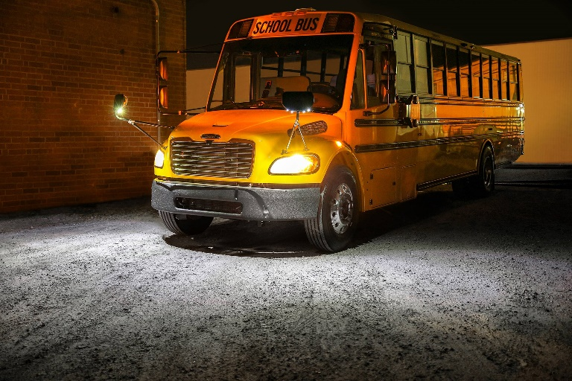
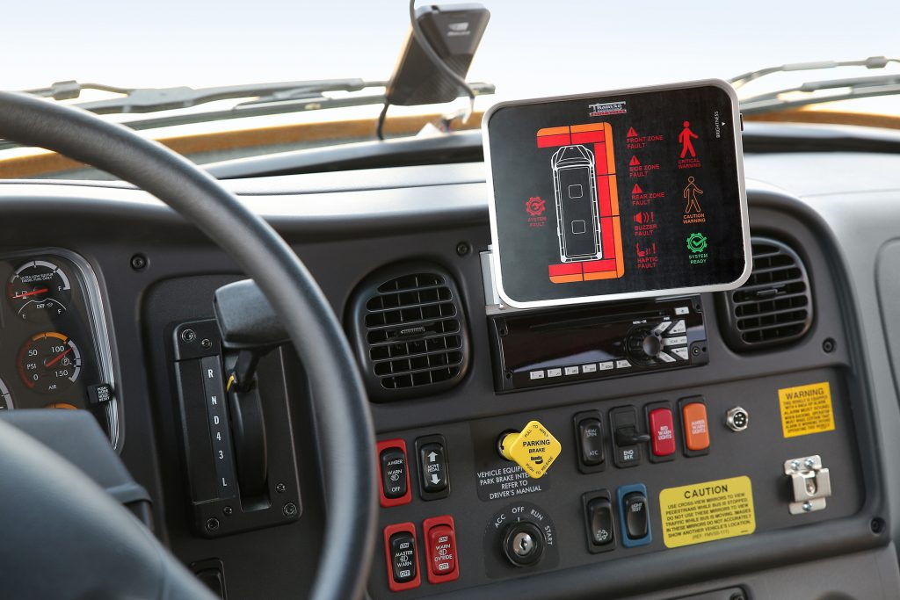
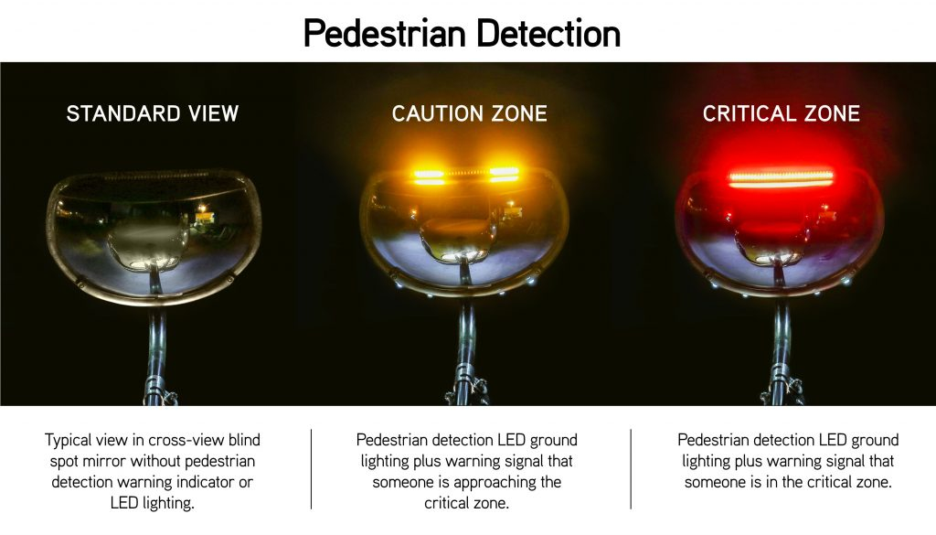
The Future
Sensor/reverse door – Knox & Jefferson – August/September
Pedestrian Detection with lighting on the ground to see in the mirrors – in progress
Predictive Stop Arm w/ Sound/Voice – Fayette, Franklin, Madison Counties and Community Action Buses
Notes:
We are always looking at ways to improve the school bus, while not making it so difficult for the driver that they are over stimulated and unable to watch the road. As with us on the road, drivers must be careful that when they look somewhere they see what they are looking at. Over stimulation can cause them to miss the important things, such as a child caught in the door. They looked because they were trained to turn their heads, but did they SEE the child?
There are many new items on the market, and we want to test them. However, we require any product that is being tested to be at no cost to the district. Many times, we watch what other states are doing and ask questions. As the bus manufacturers add items to their buses, we are able to pilot the items much easier. They add the items to the bus when it is built, or the dealer adds it, and we pilot it.
We will be testing a reverse door that automatically opens if something is in the door. There a concern of unwanted persons being able to also stick their hand or body in the door and keep it open. The bus manufacturer has agreed to add an override switch. This will be tested in Jefferson or Knox this month. They will come back to the specifications committee and give us their feedback.
Pedestrian Detection or often called sensors is improving every year. Here you will see that this product is being used by a bus manufacturer. Previously sensors were sold by companies after market. As previously stated, we prefer the bus manufacturer to have them tested and available for install because we know it has gone through their rigorous testing and they believe the product to be the best fit for their buses. This system shown has LED lights that will be turned on for the driver to better see what is going on. This is in addition to the warning lights for the driver.
The last item, which I have a video of is predictive stop arm. This is an audio alert system that tells students to stop if a car is about to pass on the left side. Something like this is a game changer! It costs $2600 per bus. That’s over $19 million if it was added to all daily buses.
Allowing the pupil transportation community in Kentucky to test products and choose what goes on the bus or has been beneficial because we are not wasting taxpayer dollars on products that don’t work or are not able to be maintained. Districts give us their honest opinions and explain why. As it is, school districts are adding upwards of $10-15k on top of the base cost of the bus for things like radio’s, camera’s, air conditioning (which in heat like this, we need more of!). Typically, once districts have tested the products and the manufacturer has the bugs worked out, then we add them to the options. If many of the buses have been purchasing the options, then we look at adding them to all buses.
If funding were to be provided to retrofit and add to new buses safety technology specifically, this would decrease the amount of time it would take for all buses to have the same safety features. However, mandating something to be added to new buses only benefits some students on those new buses. At approximately 500 buses per year, it would take 16 years for all new buses to have a particular feature.
https://www.safefleet.net/products/passenger-pedestrian-safety/predictive-stop-arm/
https://thomasbuiltbuses.com/bus-advisor/articles/thomas-built-buses-enhancing-safety-of-school-buses-with-pedestrian-detection-systems/

