Slide 1


Airport Presentation for CKRA Board of Directors

Slide 2
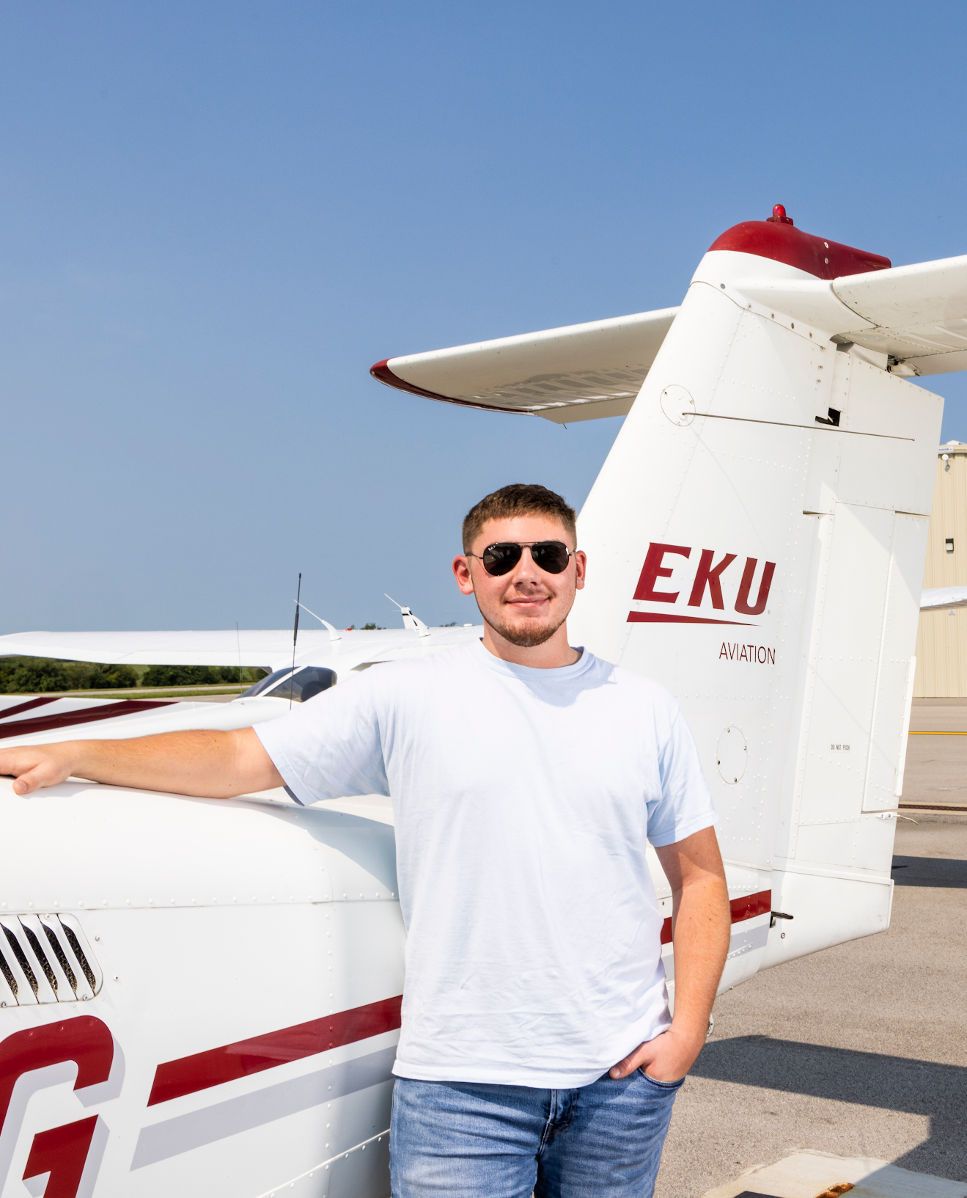

HISTORY OF
1991
THE EKU
FLIGHT
PROGRAM
EKU was approved to offer Kentucky’s first baccalaureate degree program in aviation
2021
Purchased 25 fixed-wing aircraft for the EKU fleet with assistance from state appropriations.
1982
EKU’s Aviation Program was born from a feasibility study that determined the Commonwealth needed a university-level aviation program to keep top candidates from leaving the state to pursue degrees in a rapidly growing field.
2022
$4.9M from the General Assembly for planning & site preparation for classroom building and other airport improvements.
1983
2023
EKU offered first aviation courses to 10 students.
KY’s only four-year, university-based flight program - enrollment more than doubled between 2018-2023. Record enrollment of 425 students drives the need for facility improvements.
EASTERN KENTUCKY UNIVERSITY: HISTORY OF THE EKU FLIGHT PROGRAM
EASTERN KENTUCKY UNIVERSITY: HISTORY OF THE PROGRAM

Slide 3
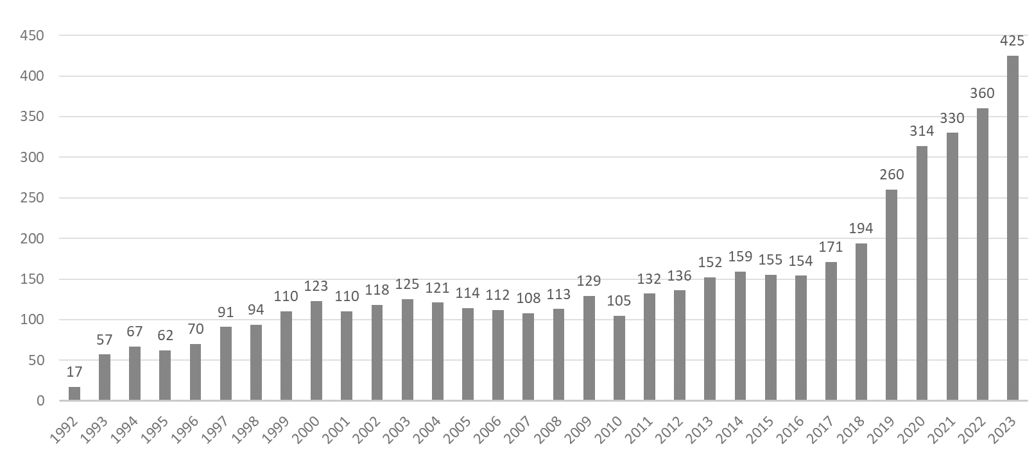
ENROLLMENT
Aviation Students (1992-2023)
EASTERN KENTUCKY UNIVERSITY: ENROLLMENT

Slide 4
EKU’S DIFFERENTIATORS
Kentucky’s only four-year, university-based flight program
Most affordable among competitors: EKU $56K vs. OSU $95K, MTSU $75K, Auburn $95K
99% hire rate for EKU Professional Flight and Aerospace Management grads
31 planes (25 EKU owned, 6 leased)
Central KY Regional Airport (Madison County) is third busiest in KY - behind Louisville & CVG
Student Flight Hours per year increased from 3,500 in 2013 to 14,300 in 2022
Students from 25 different states – could recruit more students with adequate classroom space
Highly qualified aviation instructors, with 100% student success focus
EASTERN KENTUCKY UNIVERSITY: EKU’S DIFFERENTIATORS

Slide 5
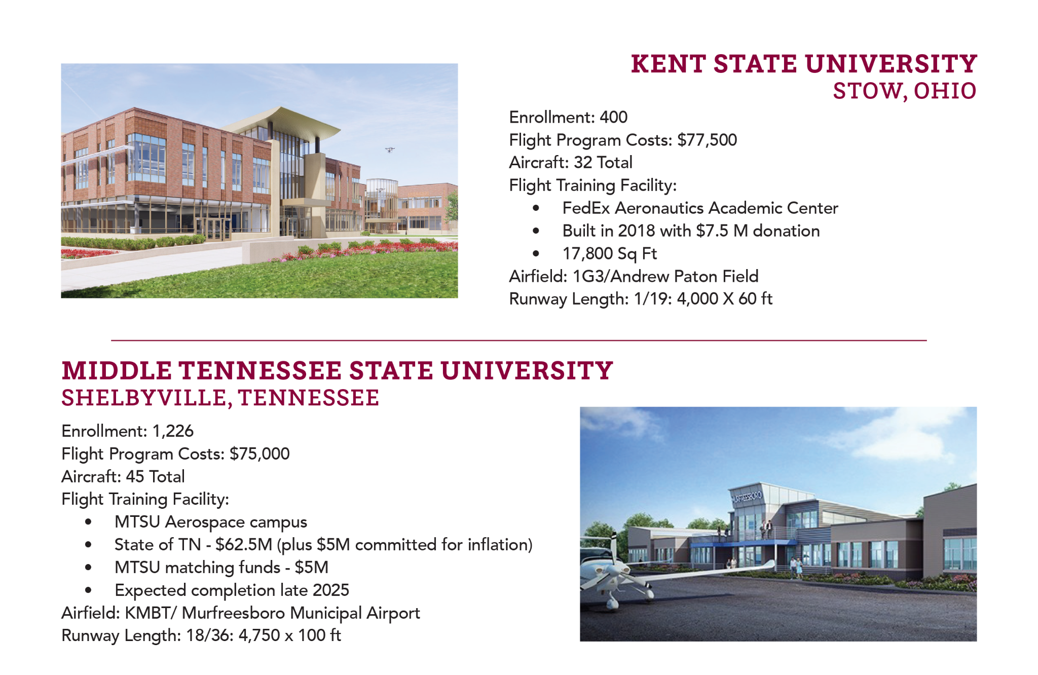
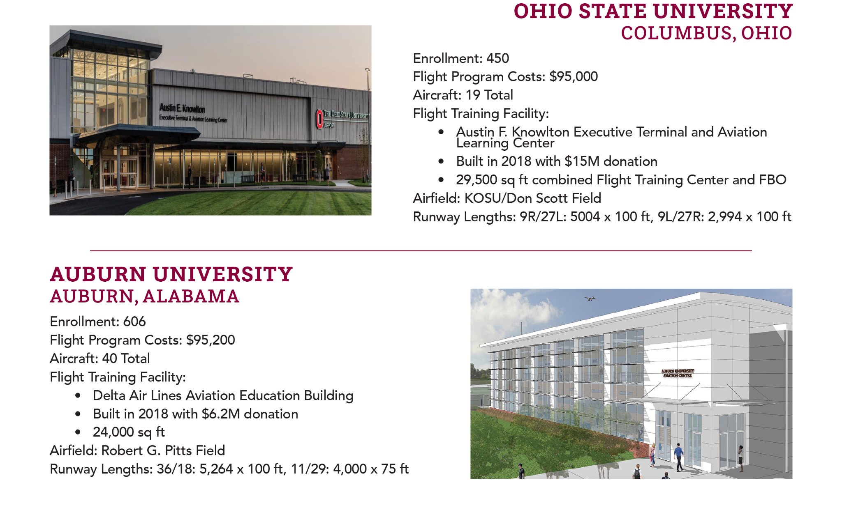
The Competition
EASTERN KENTUCKY UNIVERSITY: HOW DO WE STACK UP AGAINST OUR COMPETITOR UNIVERSITIES?

Slide 6
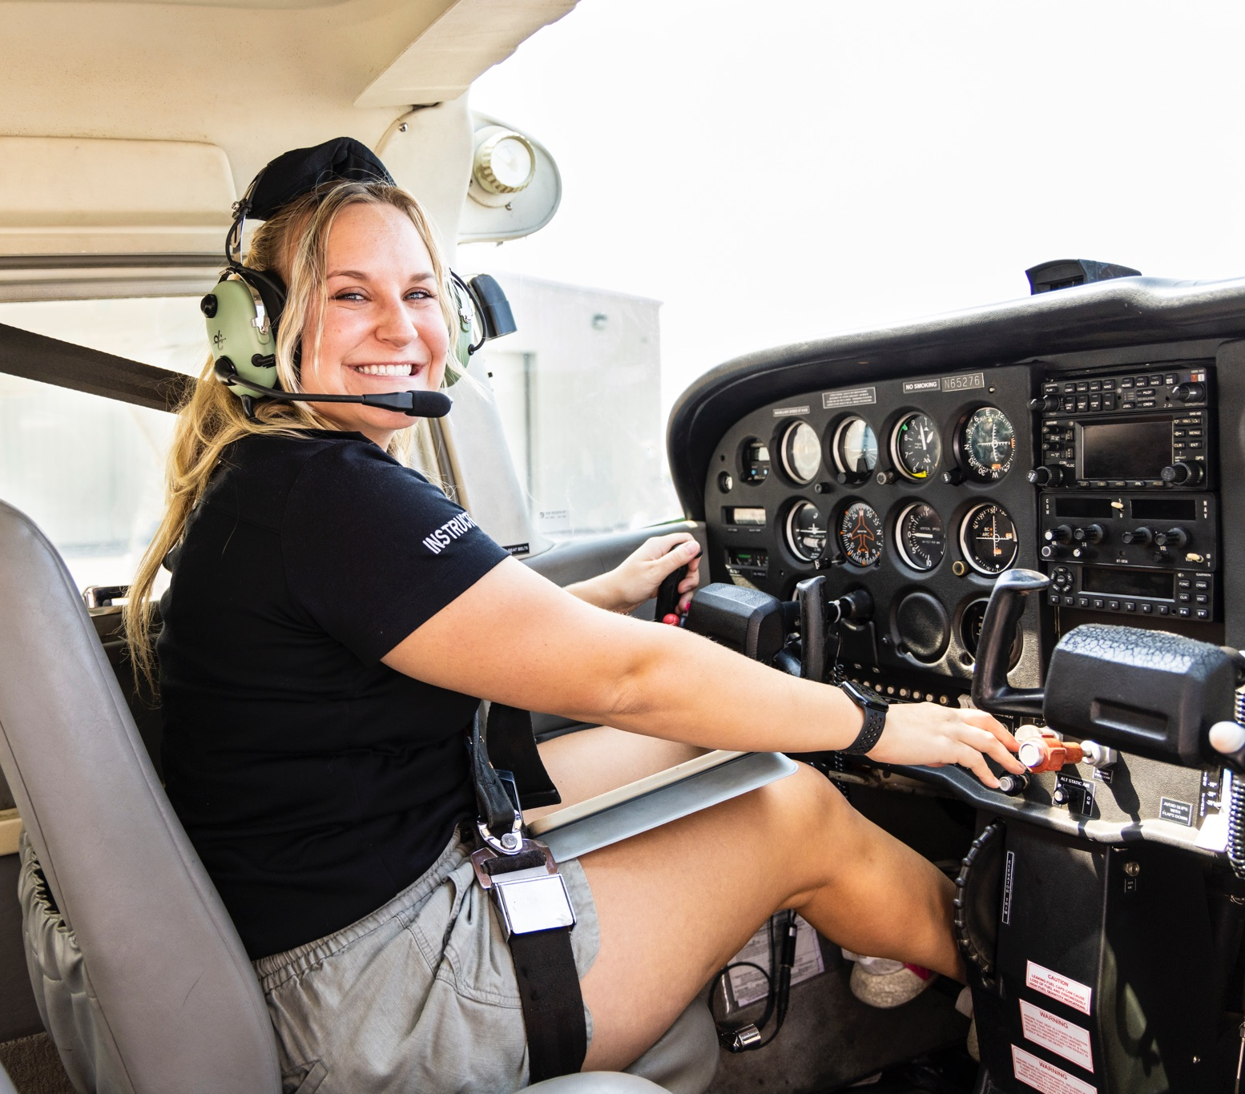
WHY DO WE NEED Facility upgrades?
Current training space doesn’t reflect the quality and professionalism of our program
Current facilities give a negative first impression when recruiting students and their parents
Our students need a flight experience that reflects what they will see in the workforce
Compliance with FAA regulations - need private briefing spaces
EASTERN KENTUCKY UNIVERSITY: WHY DO WE NEED FACILITY UPGRADES?

Slide 7
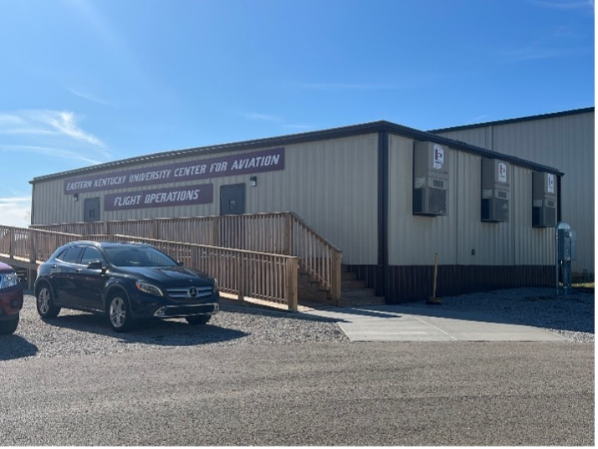
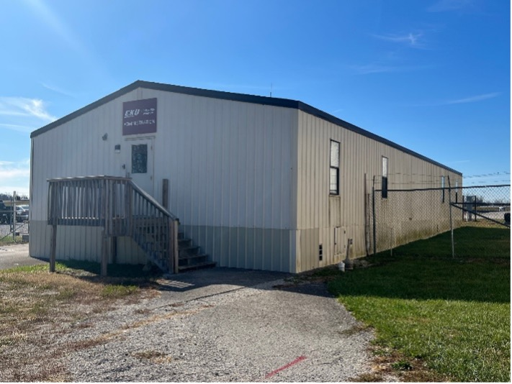
FACILITY IMPROVEMENT PLANS
Current flight training space utilizes a decommissioned FEMA double wide trailer (cost $35,000) and a KY Air National Guard triple wide trailer (cost $130,000)
THANK YOU – Step 1
  HB 192 provided a big leap forward for the EKU Flight Program in 2021
    $3.2 Million-Pilot Equipment (Aircraft)
    $4.9 Million-Architectural Planning and Site Preparation (Budget)
EASTERN KENTUCKY UNIVERSITY: FACILITY IMPROVEMENT PLANS

Slide 8
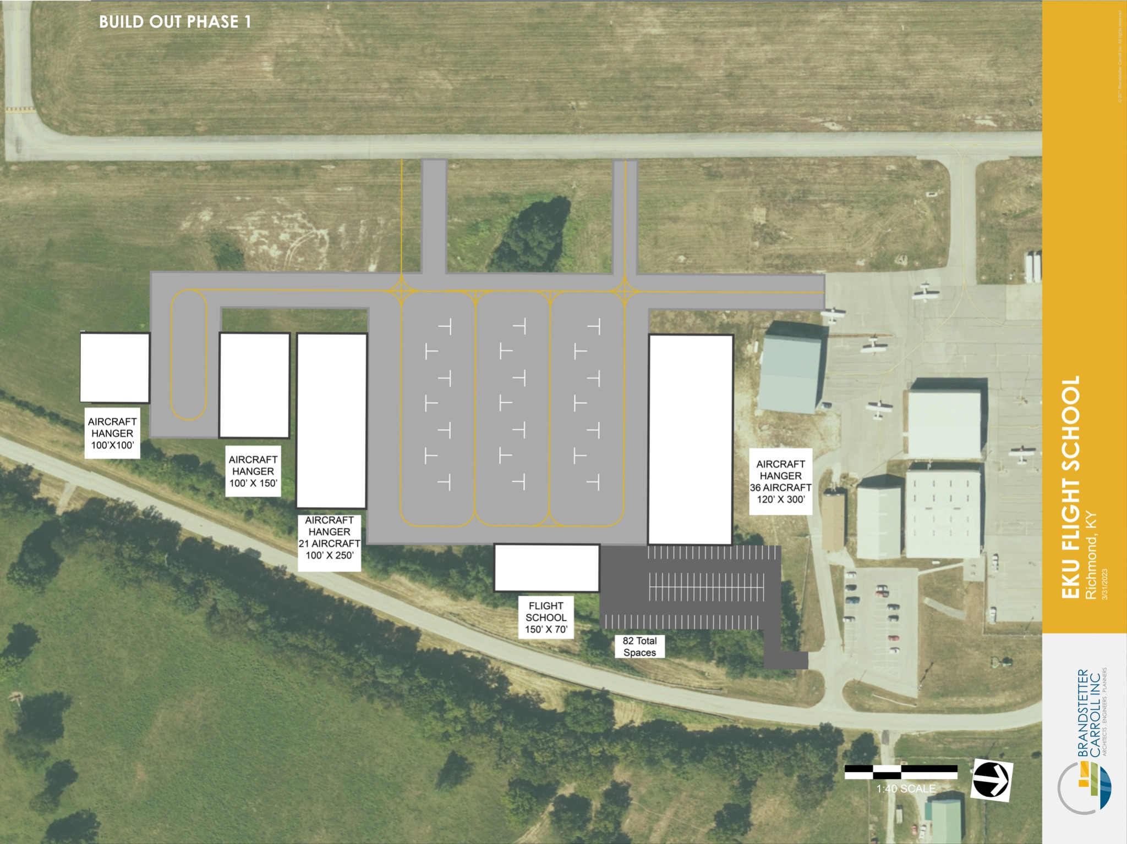
FACILITY IMPROVEMENT PLANS
Step 2 - 2024 EKU Request $25M- New Classroom/Training Building and Support Facilities
  Flight Education Building
  Maintenance and Aircraft Storage Hangars
  Flight simulators, classroom desks, chairs, etc.
EASTERN KENTUCKY UNIVERSITY: FACILITY IMPROVEMENT PLANS

Slide 9
Questions?

