Slide 1
KAVIS Program Update
Interim Joint Transportation Committee
Presentation by Heather Stout and John Eiler
Frankfort, Kentucky | October 17, 2023

Slide 2
History
Kentucky Automated Vehicle Information System (KAVIS) - vehicle registration and titling systems modernization
Replaces legacy mainframe system (AVIS) implemented in 1978.
The 4th attempt at modernizing AVIS.
KAVIS is a custom Microsoft .NET solution developed in-house at KYTC.
AVIS was an extremely complex system.
KAVIS is being developed to produce a consistent experience for the customers and users.
The final implementation of KAVIS will replace all AVIS functionality.

Slide 3
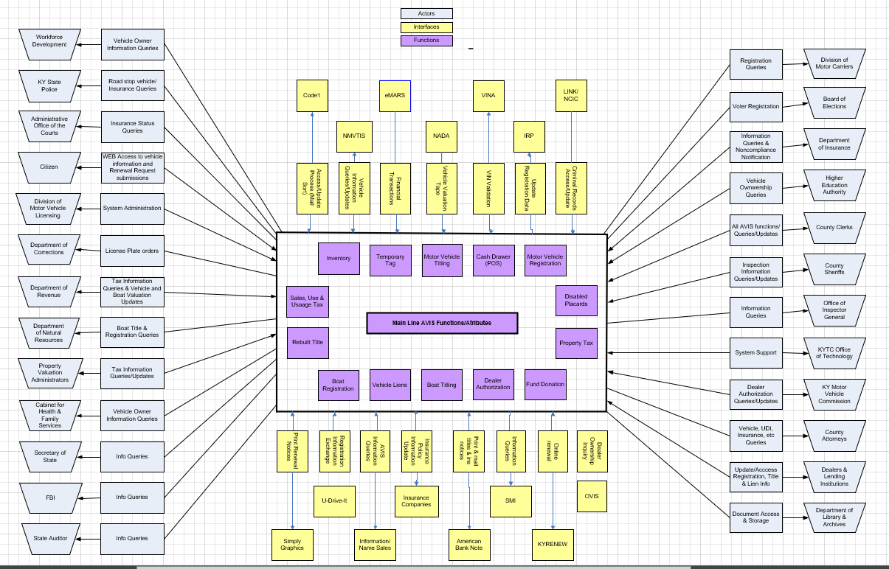

Slide 4
Stakeholders
County Clerks (146+ Offices/1200+ Deputy Clerks)
  Public Facing
  Initial process of all title and registration related transactions
  Tax Collection and Disbursement
  Fee Collection and Disbursement
Central Agency – Motor Vehicle Licensing
  Title Approval
  Inventory Management
  Service Center
  User Administration
Department of Revenue
Property Valuation Administrators
Department for Natural Resources
County Sheriffs
Kentucky Motor Vehicle Commission
Justice & Public Safety Cabinet/KSP
Cabinet for Health and Family Services
Higher Education Assistance Authority
Internal Revenue Service
Department for Library and Archives
Attorney General

Slide 5
Project Roadmap
Already Implemented
Print on Demand Decal & Real Time Scanning - May 2015
Web Renewal Enhancement Phases (2015 and 2016)
Disabled Placard-Complete January 2016
State-Wide Point of Sale Solution-Complete March 2018
Vehicle Foundation – Boats July 2019
Decommission and Implement Inventory Solution-July 2021
Implement Flat Plate Solution-July 2021
Implementing Soon
Module – All Vehicles-January 2024

Slide 6
Implementation Date
January 2024 (consensus decision)
Clean 2024 Reporting
Valuation performed in AVIS
Clerk Workload in December
Key Cutover Tasks
  Data Migration
  Data Cleansing
  AVIS Decommission
  KAVIS Cutover

Slide 7
Training
Continuous Education/Training
Clerk/User Training
Public Awareness
User Acceptance Testing
Solution testing
Production Readiness
November 2023
Development Effort
Cutover
Analysis, Design, Develop, Deliver
Performance Testing
Stabilization
Incremental delivery for user acceptance and testing
Load/Performance
Turn off AVIS
Stabilization and Acclimation
January 2024
October
November
December
January
February
2023
2024

Slide 8
Expectations during and after cutover
Clerk offices closed to public
  Dates still being finalized
  System Training and acceptance of dealer and customer work will continue
  Opening incrementally across the state
Long lines
  Backlog of work from closure
Learning curve
  Process and procedure changes
  Engagement from all offices is not the same
System issues

