Slide 1
Work Zone Safety
Phil Tolliver
Manager Distribution Systems

Slide 2
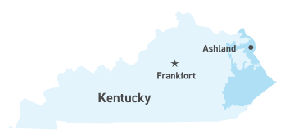
SERVICE Area
Kentucky Power, headquartered in Ashland, provides service to approximately 163,000 customers in all or part of 20 eastern Kentucky counties. Kentucky Power’s distribution operations work from service centers in Ashland, Hazard and Pikeville and from area offices in Paintsville and Whitesburg.
MILES OF POWER LINES
Miles of Distribution Lines 10,108
Miles of Transmission Lines 1,263

Slide 3

Work Zone Safety
Kentucky Power has experienced near misses in traffic control zones.
Because we cannot control the actions of drivers, we cannot fully eliminate the risk to utility workers in work zones.
Risks include:
    Distracted Driving (cell phone use, adjusting controls of radio, talking to passengers etc.)
    Speeding in work zones
    Fatigued Drivers
    Impaired Drivers

Slide 4
Proper Training / Professional Flagging Business Partners
The Manual on Uniform Traffic Control Devices for Streets and Highways, or MUTCD defines the standards used by road managers nationwide to install and maintain traffic control devices on all public streets, highways, bikeways, and private roads open to public travel. The MUTCD is published by the Federal Highway Administration; part 6 temporary traffic control (relates to traffic control work zones).
Training: Kentucky Power employees complete annual flagging certification through the University of Ky, Basic Work Zone and Flagger Train-the-Trainer program.
Utilize Qualified Business Partners
Area Wide Traffic Control
Road Safe Traffic Control
Asplundh Tree Service
Safety Observations conducted by Kentucky Power Safety and Health and Management to verify proper work zone set up.

Slide 5
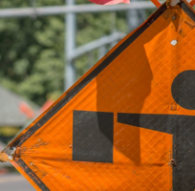
Safety in Work Zone Setup
  Every work zone is different! Several items must be considered in determining traffic control.
  1. Plan for Safety: Workers should always consider the safety of motorists, pedestrians and workers moving through their zone.
  2. Limit Delays: Traffic controls should keep vehicles moving safely and quickly.
  3. Positive Guidance: Motorists and pedestrians should be warned, informed and guided in a clear and positive manner while they approach and travel through the work zone.
  4. Monitor: Workers should periodically assess the effectiveness of the traffic control.
  5. Plan for the Worst Case: Workers should plan for the possibility of errant vehicles leaving the roadway and affecting the work zone.
  6. Rely on Your Training. Refer to the Utility Work Zone Traffic Control Field Manual (MUTCD)
Proper Signs

