Slide 1
Road Right of Way Work Zone Protection
Dave Roy, Vice President of Operations – Columbia Gas of Kentucky
Sept. 18, 2023

Slide 2
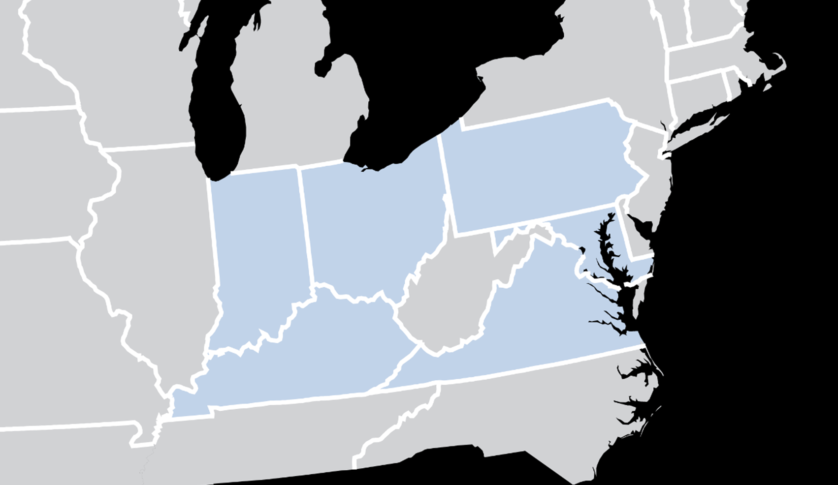
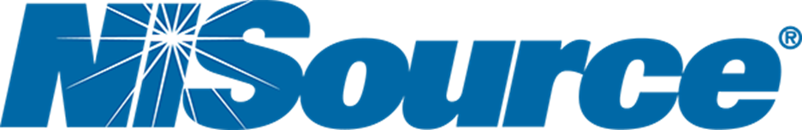
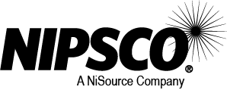

AN INNOVATIVE AND TRUSTED ENERGY PARTNER
~3.3M
GAS CUSTOMERS
~500K
ELECTRIC CUSTOMERS
~7,300
EMPLOYEES
NEWSWEEK’S AMERICA’S MOST RESPONSIBLE COMPANIES
DOW JONES SUSTAINABILITY INDEX
MSCI AA ESG RATING
FORBES' AMERICA'S BEST LARGE EMPLOYERS
FORBES' AMERICA'S BEST EMPLOYERS FOR DIVERSITY
FORBES' AMERICA'S BEST EMPLOYERS FOR WOMEN
Notes:
NiSource Inc. (NYSE: NI) is one of the largest fully-regulated utility companies in the United States, serving approximately 3.2 million natural gas customers and 500,000 electric customers across six states through its local Columbia Gas and NIPSCO brands. Based in Merrillville, Indiana, NiSource’s approximately 7,500 employees are focused on safely delivering reliable and affordable energy to our customers and communities we serve. NiSource is a member of the Dow Jones Sustainability - North America Index. Additional information about NiSource, its investments in modern infrastructure and systems, its commitments and its local brands can be found at www.nisource.com. Follow us at www.facebook.com/nisource, www.linkedin.com/company/nisource or www.twitter.com/nisourceinc.

Slide 3
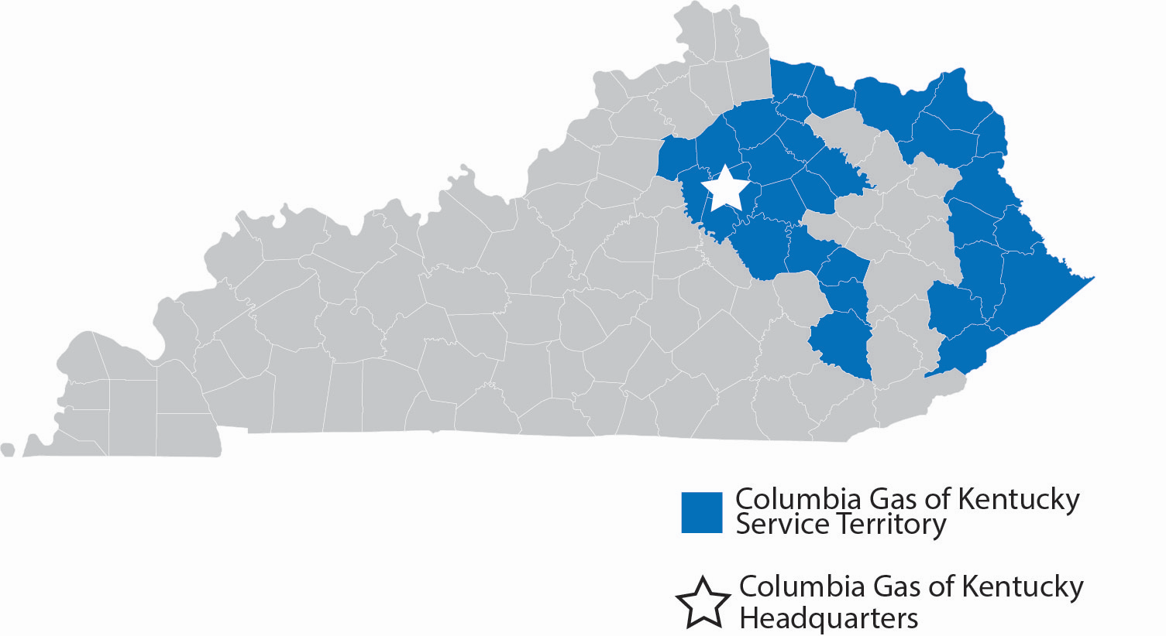
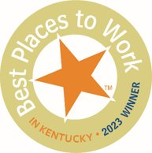
~135k
GAS CUSTOMERS
~30 of 120
COUNTIES SERVED
~260 (~310)
EMPLOYEES (CONTRACTORS)
NAMED TO “BEST PLACES TO WORK IN KENTUCKY” 4 OF PAST 5 YEARS

Slide 4
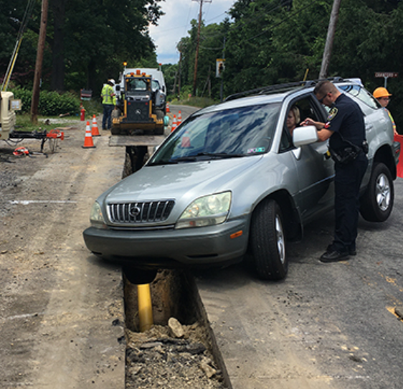
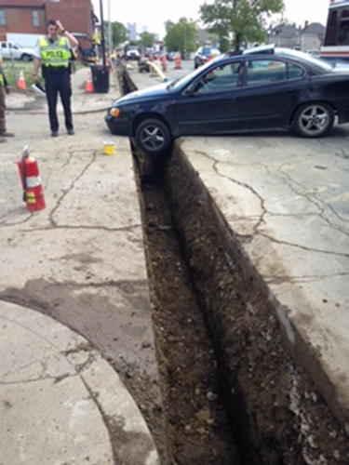
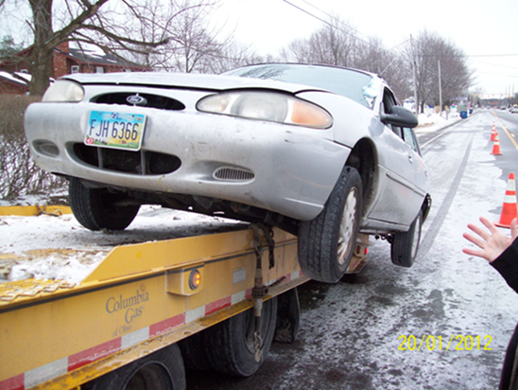
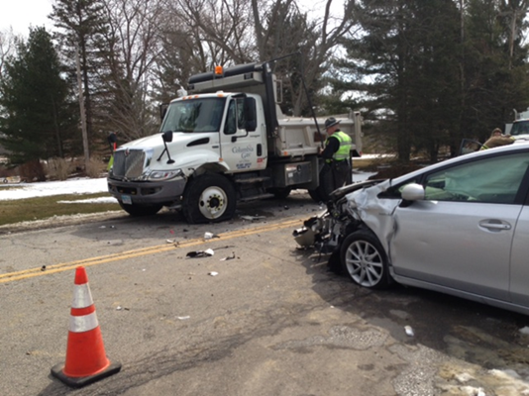
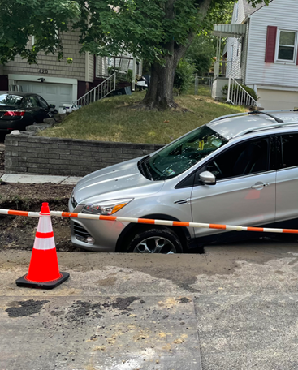
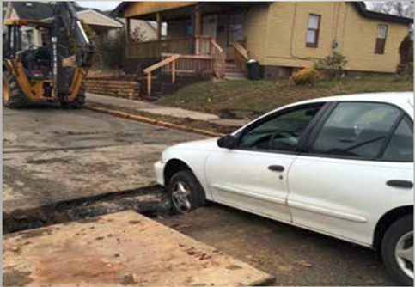
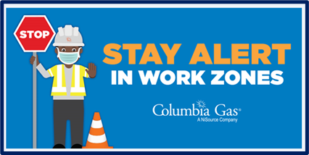
Work Zone Protection – Mitigating Vehicle Intrusions
Work zone risks consistently represent one of the most significant hazards our employees and contractors face each day. At NiSource, we are always seeking to reduce risks in our work zones and to keep everyone safe.
Notes:
In 2022, we experienced 55 work zone intrusions across NiSource. We experienced 10 in PA in 2022. This year in 2023, we have experienced 24 total across NiSource and 6 work zone intrusions YTD in Pennsylvania.

Slide 5
Work Zone Protection – Mitigating Vehicle Intrusions
What are the most common causes of work zone Intrusions?
Impatient - Disgruntled Drivers - Intentional
Inattention - Distracted Drivers
Driver Intoxication
Medical Events
Confused Motorists
Why focus on mitigating vehicle intrusions?
Prevent Injuries
Prevent Vehicular Crashes
Ensure Public Safety
Minimize Risk of Escalated Natural Gas Incident
260%
Represents the % INCREASE in work zone intrusions over the past 5 years on our projects

Slide 6
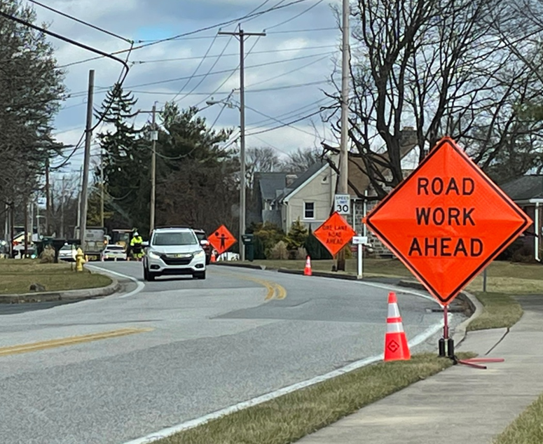
Work Zone Risk Mitigation Options (used by Columbia Gas)
Cones & Signage (most common)
Lane/Road Closures
Flaggers
Portable Speed Bumps/Rumble Strips
Law Enforcement (Off Duty Officers)
Jersey, Concrete or Water-Filled Traffic Control Barriers
Crash Truck w/ Attenuator
Automated Flagger Assist Devices
Work Zone Intrusion Alarm System
Radar Speed Indicator
**Aggressive Drivers Have Been Known to Challenge All of These Options**

Slide 7
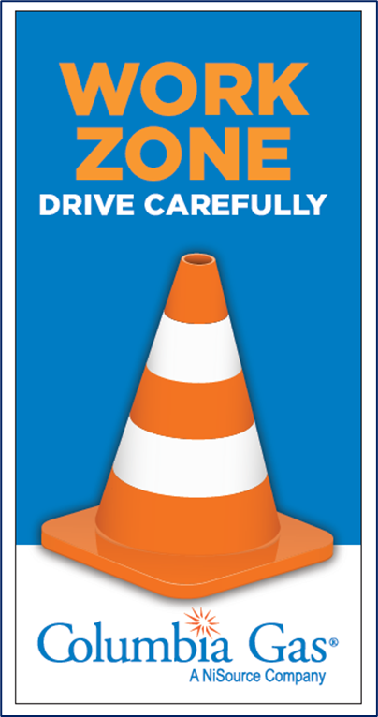
Our Workers Need Your Help!
Utility Workers Seek:
  Materially harsher penalties to incent drivers not to disregard work zone safety setups
  Establish a way for work zone violators to be penalized, if they can be identified, even if an officer did not witness the event

Slide 8

Thank You!
Questions?

