Slide 1
KAVIS Program Update
Transportation Committee
Presentation by Heather Stout & Eddie Pagan
June 4, 2024

Slide 2
KAVIS Overview
Largest modernization in Kentucky’s history
Generational change to process and technology
250+ million records migrated
45 years of code modernized
Impact to every vehicle owner in the state
All related vehicle and tax legislation reviewed and incorporated
A vast user base of MVL, Clerks, PVAs, law enforcement, dealer commission, dealers, etc

Slide 3
Comparisons 2023 vs 2024
2023 (AVIS)
State Total collected YTD
  $646,840,813
Checkouts
  1,719,524
Past Due Date – Ad Val
  $84,466,101
2024 (KAVIS)
State Total collected YTD
  $656,291,026
Checkouts
  1,832,798
Past Due Date – Ad Val
  $98,776,592
YTD numbers are January 8th through May 31st for 2023 and 2024

Slide 4
Overview of Current Operations
We have migrated from a daily release to a two-week release schedule for issue correction and enhancements
We are seeing a change in the type of support requests, emails and phone calls
Some counties have adapted to KAVIS well and are helping others to learn the new processes
Converting from a vehicle centric to customer centric model continues to be a challenge
New resources are finding the system much easier to operate
There is still frustration from Clerks and there is still room for system improvement
Notes:
One time title fixes-Data issue/legacy data/clerk error
30%
Finding/logging new bugs-edge cases or rare events
10%
Enhancement requests
10%
Guidance/training
60%

Slide 5
County and Office Visits
Jefferson (5/23/24)
Anderson (5/15/24)
Grant (5/16/24)
Fayette (TBD)
Jefferson follow up (6/6/24)
Grant follow up (2nd week of June)
MVL Rebuilt Branch

Slide 6
Prioritized System Improvements
Bulk Transactions
  5,000 + transactions in one action
Legislative Updates
  KY ELT
  Fleet Management
  2024 Legislation
    10K plate to birth month
    Electric Vehicles
    Autonomous vehicle flag
    Reinstatement Fee
Reporting
  Continue to improve and increase report options
Data Cleanup
  Continue running cleanup scripts as issues are identified
Enhancements-Speed, Efficiency
  Business process flow enhancements for larger counties
  Transaction Reversal updates
  Edit Actions; Edit "in flight" transactions
    Allows editing of data while processing
    Increased flexibility
    Reduced guardrails and validations

Slide 7
Ad Valorem and Data Issues
Ad Valorem – PVA Issue Cleanup:
513,000 updated via one-time scripts for DOR/PVA
No activity
Dealer and Insurance Companies
Canceled - Junked or Sold out of State
Surrendered
Data Scripts run to date:
554 scripts since January
Legacy data issues
Clean up PVA issues
Remove impediments to clerk processing work
Notes:
67,145 were marked Non-taxable Junked or Sold out of State based upon the Registration status of Cancelled – Junked or Sold out of State
63,905 were marked non-taxable for any County, any Customer type, with PVA issues, in a Surrendered status from tax years 2021 or earlier
340,396 tax segments were marked “Inactive” if they had no activity in 2021, 2022, 2023 and in most cases 2024. These did not all clear “PVA issues”. I believe roughly 85,000 were ‘88’ or $0 value.
87,484 Dealer Organization PVA issues were fixed
34,061 Insurance Company PVA issues were fixed

Slide 8
KY Electronic Lien & Titling (KYELT)
Prior to 1/2024 | January 2024 | February to July 2024 | August to December 2024
Establish contract with third party vendor Consult with the vendor to understand all title, registration and lien requirements needed for ETRS and ELS Communicate with KADA, clerks, franchise dealerships and others on rollout plans Define and develop the application to become an approved entity (dealer, lending institution, UDI, fleet) Design new fleet plate Determine how to handle permanent registration fleet plates | Paper form and dedicated email for applying to become an approved entity Introducing the vendor and program to county clerks | Start piloting Electronic title and reg system (ETRS) Start piloting a request for Electronic Title Lien filing and release (ETLS) Statewide training engagement Piloting with Pulaski, Grant, Mason, Madison, Pike, Franklin (6/10) and Anderson (6/10) Expanding the program to more types of transactions | Integrate with KAVIS – this integration enables quick submission of title and registration applications and automated lien filing and releases Fleet plates with permanent registration
Pilot Successes: Ensured reports are accurate, workflow is processing seamlessly, documents are delivered to the image repository, separated fees more appropriately, and identified other issues needing resolution prior to growing the pilot

Slide 9
Rebuilt Titles
Cause: KAVIS was unable to process rebuilt titles for a few weeks and due to staffing shortages
Currently – working 2nd week of March (6 weeks behind)
Biggest issue:
  Staff spends significant time in rebuilt inquiries
  All transfers on vehicles with rebuilt brand are dropping into the rebuilt queue, but not visible to rebuilt staff unless they search for a specific title number
Corrective Action:
  A daily post/e-mail to share with clerks what days are currently being processed
  Change process to only process in the order received
  Process improvements to enhance the speed with which a dealer can sell their rebuilt vehicle
  Four additional staff hired (rebuilt employees require a more in-depth level of training)

Slide 10
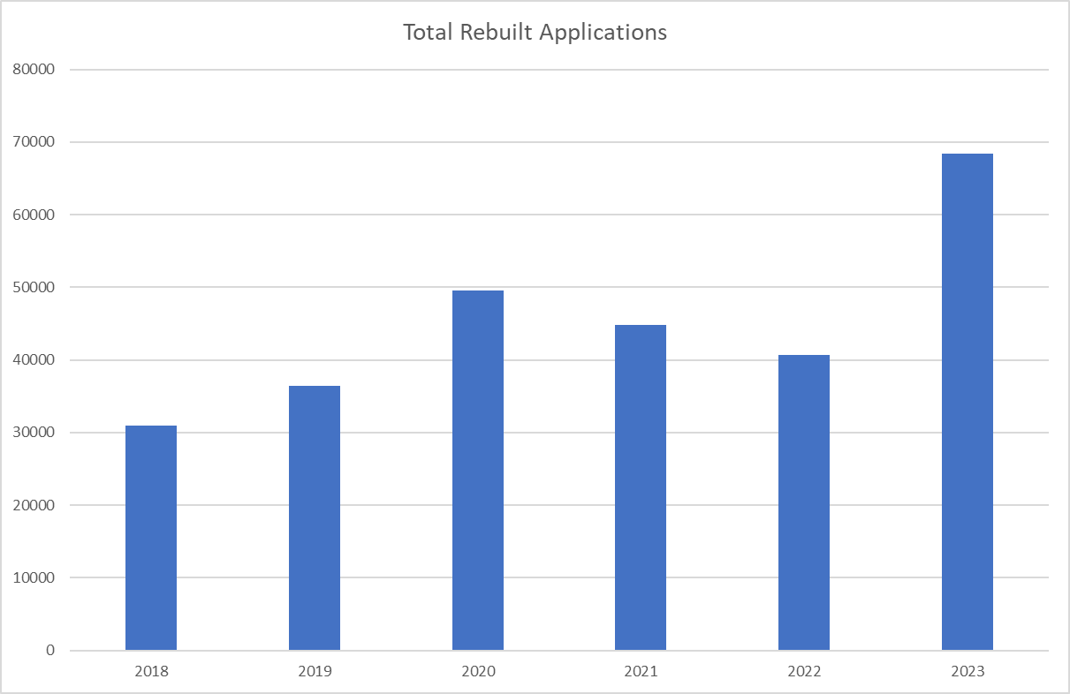
Five Year Totals
Rebuilt Titles​
>120% increase in five years
>65% increase in just one year

