Slide 1
KAVIS Program Update
Transportation Committee
Presentation by Heather Stout
July 16, 2024

Slide 2
Agenda
2023 vs 2024 Comparison Numbers
Title Update
Rebuilt Update

Slide 3
Comparisons 2023 vs 2024
2023 (AVIS)
State Total collected YTD
$774,382,857
Checkouts
2,137,668
Ad-valorem Collection
$342,282,041
2024 (KAVIS)
State Total collected YTD
$794,568,537
Checkouts
2,169,776
Ad-valorem Collection
$354,058,940
YTD numbers are January 1st through June 30th for 2023 and 2024

Slide 4
Collections in Top 8 Counties
Name | AmtCollected2023 | AmtCollected2024 | Difference
Jefferson | $129,212,054.61 | $126,978,811.33 | -$2,233,243.28
Fayette | $57,976,937.46 | $58,340,382.84 | $363,445.38
Boone | $26,962,996.03 | $27,350,057.86 | $387,061.83
Kenton | $25,192,555.42 | $26,743,908.76 | $1,551,353.34
Warren | $25,784,597.13 | $25,994,713.07 | $210,115.94
Hardin | $20,215,021.05 | $19,849,314.51 | -$365,706.54
Madison | $17,464,440.05 | $19,157,787.52 | $1,693,347.47
Daviess | $16,631,925.86 | $17,452,750.66 | $820,824.80

Slide 5
Prioritized System Improvements
Bulk Transactions
5,000 + transactions in one action
Legislative Updates
KY Electronic Lien and Titling
Fleet Management
2024 Legislation
10K plate to birth month
Electric Vehicles
Reinstatement Fee
Reporting
Continue to improve and increase report options
Data Cleanup
Continue running cleanup scripts as issues are identified
Enhancements-Speed, Efficiency
Business process flow enhancements for larger counties
Transaction Reversal updates
Edit Actions; Edit "in flight" transactions
Allows editing of data while processing
Increased flexibility
Reduced guardrails and validations

Slide 6
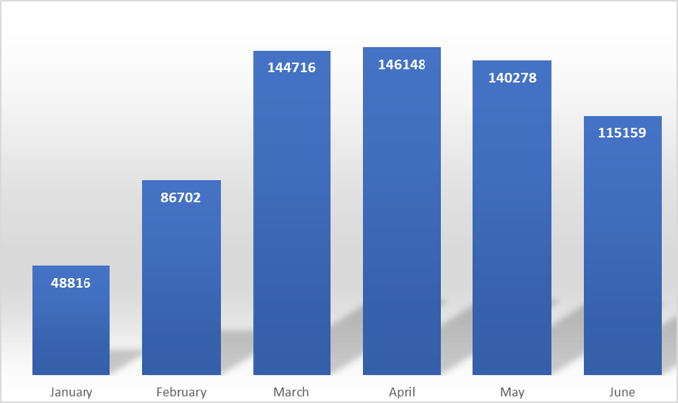
Titles Processed for 2024
Statutory Requirement: Review titles within 5 days
Current timeline: 4 days
Titles printed in 2024: 681,819

Slide 7
Rebuilt Titles
Volume Increases, staffing shortages, early KAVIS challenges = Backlog of rebuilt title applications awaiting approval
Currently – working May 17th
Improvements since June 4th meeting:
Modified support processes
Cleaned up rebuilt queue to remove applications that should have been worked by title staff
Additional cleanup still possible
Post/e-mail to share with clerks what days are currently being processed
Implemented process change to increase speed of approval
Hired 10 additional temporary staff (training for rebuilt staff is more extensive)
Pending Improvements
Only process applications in the order received, and process resubmissions based on initial submission date
Considering a mechanism to share transparency of status in a self-service online format

Slide 8
Rebuilt Backlog Progress
7/3/2024
3180 | KAVIS Queue Pending Review
3210 | Mail/Drop Pending Review
6390 | Total Pending Review
200 | Average Daily Received
350 | Average Daily Reviewed
35.93 | Total Business Days to 1000 Pending
8/21/2024 | Predicted Backlog meets statutory compliance
7/15/2024
3034 | KAVIS Queue Pending Review
1288 | Mail/Drop Pending Review
4322 | Total Pending Review
200 | Average Daily Received
360 | Average Daily Reviewed
20.76 | Total Business Days to 1000 Pending
8/12/2024 | Predicted Backlog meets statutory compliance

