Slide 1


Kentucky
EV Charging
Program Update
July 16, 2024
Notes:
Welcome and thanks for attending

Slide 2
KY EV Charging Program
*All numbers in millions
EV Infrastructure Plan Elements
Build-Out AFC Network
(Phase 1 - Ongoing)
Other Priority Corridors (Phase 2)
Community Charging (Phase 3)
Fiscal Year | To-Date (FY2022-2024) | FY 2025 | FY 2026 | Total
Federal Funds Available | $39.9 | $14.8 | $14.8 | $69.5
Federal Funds Awarded | $27.2 | - | - | $27.2
Federal Funds Remaining | $12.7 | $14.8 | $14.8 | $42.3
Per FHWA guidance, the Alternative Fuel Corridor (AFC) network must be operational before KYTC may allocate funding to Phases 2 and 3.
Notes:
National Electric Vehicle Infrastructure Program (NEVI) is funded by the 2021 Infrastructure Investment and Jobs Act (IIJA) also known as the Bipartisan Infrastructure Law (BIL).
This law provided $5 Billion in NEVI formula funds over 5 years for EV charging infrastructure across the nation.
Kentucky’s Share is $69.5 million over those five years.
The funds have to be spent first on Alternative Fuel Corridors (AFCS), which in Kentucky includes all interstates and parkways. The federal program goals is the creation of a national EV charging network supporting long-distance travel.

Slide 3
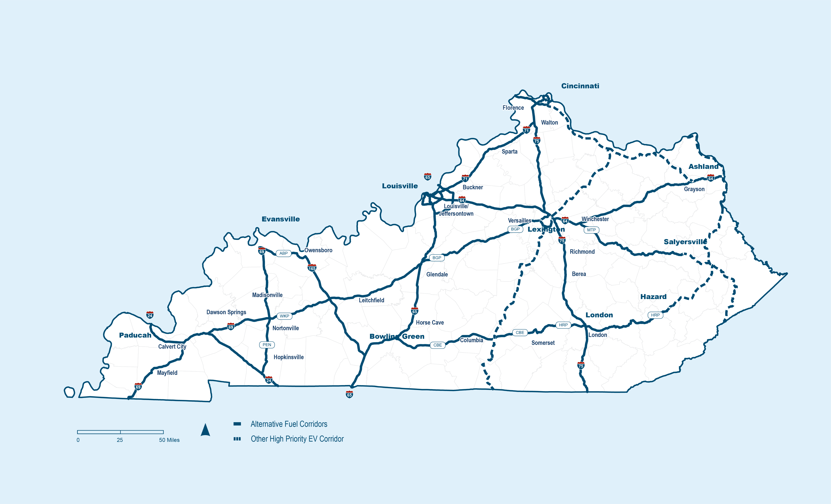
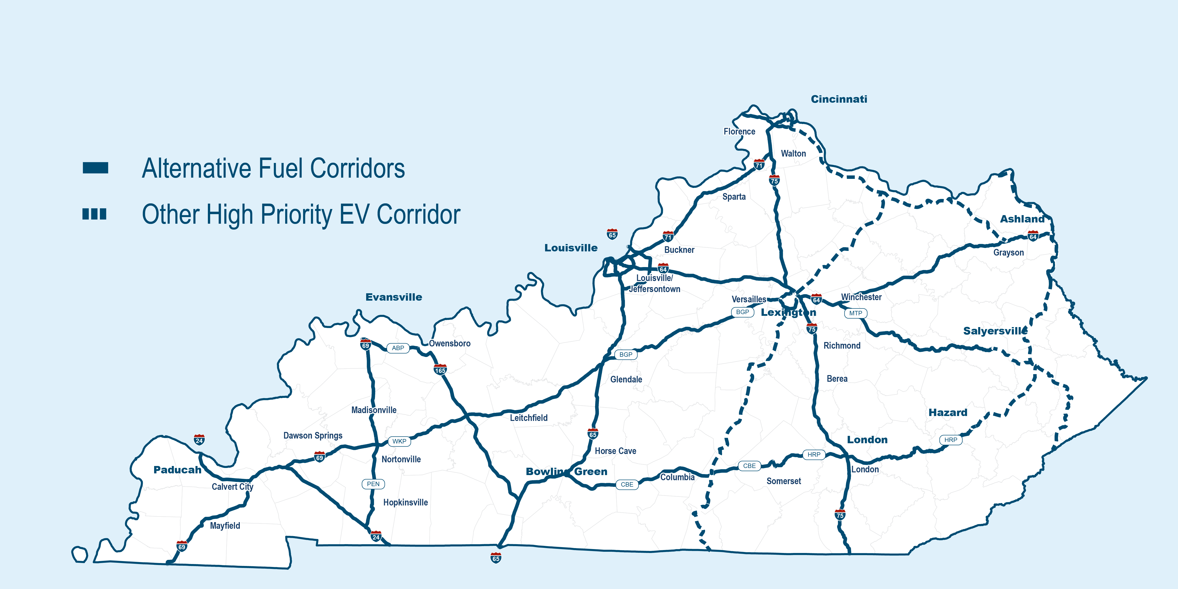

Kentucky’s EV Charging Network

Slide 4
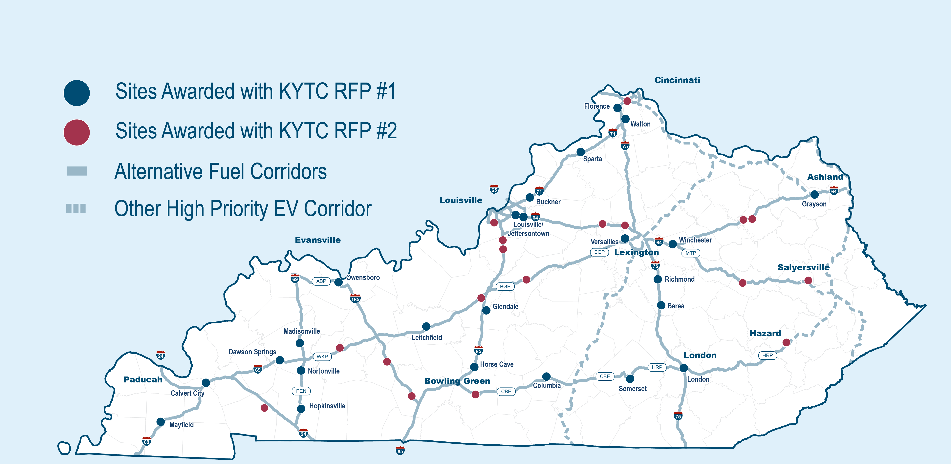
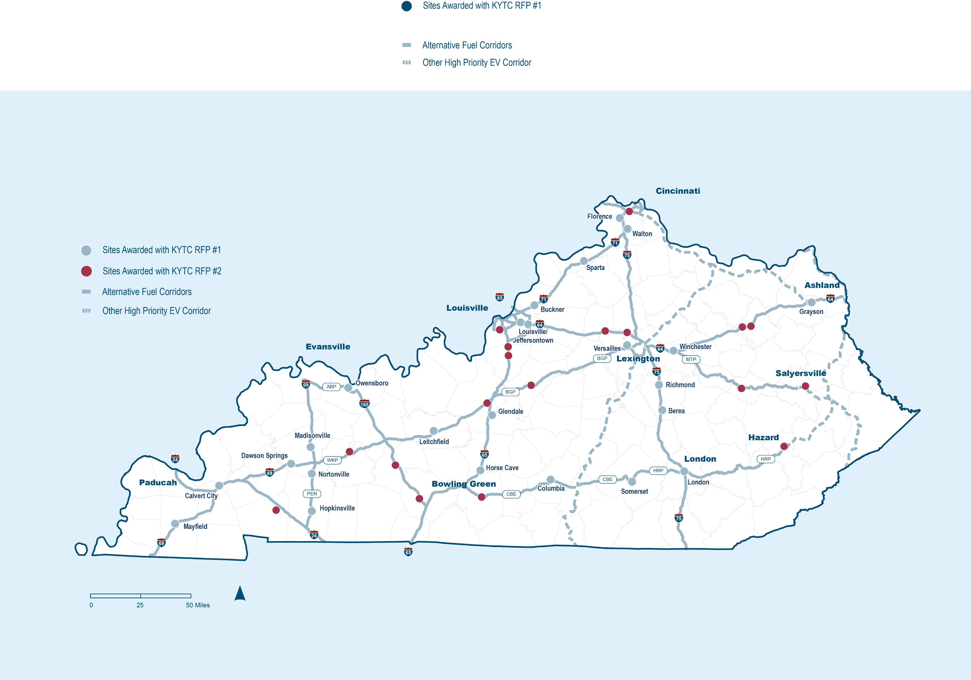
RFP 1 and 2 Sites Awarded
 | Submissions Received | Charging Stations | Developers | Federal Funding Allocated (millions)
RFP 1 | 150 | 24 | 7 | $15.4
RFP 2 | 55 | 18 | 8 | $11.8
Notes:
Overview of RFP 1 and 2 stats- describe RFPs, rounds, stats between the two

Slide 5
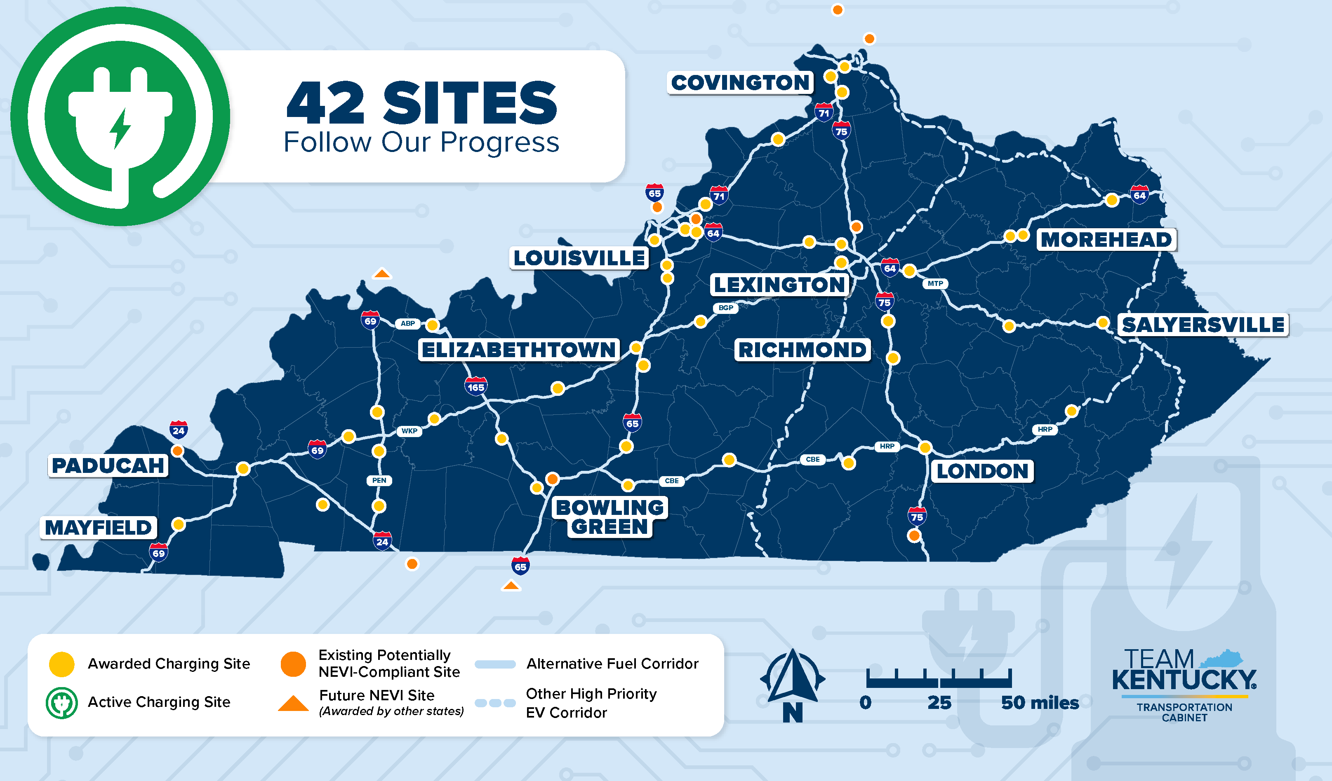




Network Progress
Submissions
Received
205
Federal Funding Allocated
$27.2
Charging Stations
42
Developers
11
Notes:
RFP 2 yielded 18 sites. Two additional sites were awarded based on the efficiency of the previous proposals. (check press release language)
KYTC determining strategy to finalize buildout with consideration of an additional round of procurement (RFP 3)
This RFP 3 will address the issue of potentially NEVI compliant sites that we have learned that we will not be able to count toward build-out
FHWA must certify before NEVI funds can be spent toward Phase 2 or 3

Slide 6
Federal e
Example Developer Timeline
Task 5 Reporting Requirements
Task 0
Project Agreement Coordination
Task 1
Pre-Construction
Task 2
Final Design & Permitting
Task 3
Construction
Task 4
Operations & Maintenance
2 to 3 months
3 to 7 months
4 to 7 months
5 Years
Notice of Award
Agreement Signed
Groundbreaking
Station Open
Close Out
Notes:
Developers initially set their schedules while KYTC keeps them on track with targeted delivery dates and regular updates between developers and the cabinet

Slide 7
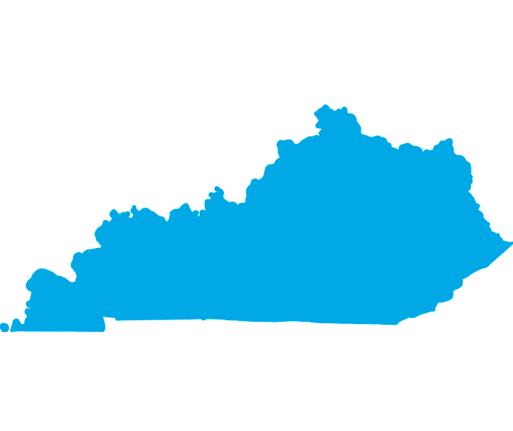
Path to Build Out
Key Issues Include:
  Federal requirements for each station and the system as a whole
      Build America/Buy America requirements
  Transformer lead times (can be 1yr+)
Currently anticipate…
  Up to 11 to become operational in 2024
  ~21 to become operational in 2025
  FHWA Certified build-out expected in 2026 (along with the remaining stations)
Notes:
Fully Built Out Criteria
In a State that is fully built out, every designated AFC for EV charging must meet the following criteria:
1. Stations are spaced along all designated EV AFCs at a maximum distance of 50 miles apart and within 1 mile of the designated roadway, except where exceptions have been granted. (See Section III-B for information about discretionary exceptions). All creditable stations must: o be publicly accessible,36
o include at least four 150kW Direct Current Fast Chargers with CCS ports,
o be capable of simultaneously charging four EVs at 150kW or above at each port, with a minimum station power capability at or above 600kW, and
o meet the minimum standards and requirements as described in 23 CFR 680.104, 23 CFR 106(b), 23 CFR 680.106(c), 23 CFR 680.106(d), 23 CFR 680.106(e), 23 CFR 680.106(f), 23 CFR 680.106(g), 23 CFR 680.106(h), 23 CFR 680.106(i), 23 CFR 680.106(k), 23 CFR 680.106(l), 23 CFR 680.108, 23 CFR 680.110, 23 CFR 680.114, and 23 CFR 680.116
2. Any point along the corridor must be connected via an AFC to a station in each logical direction so that the gap is no more than 50 miles.
3. All creditable stations are operational. While working to fully build out AFCs, States are encouraged to engage communities to begin planning activities beyond their AFCs.
4. All corridor termini must have a station located within 25 miles. o If the continuation of the corridor is not designated as an AFC by the adjacent state, then this corridor should be considered a terminus at the state border (e.g., there must be a station located within 25 miles of the state border.)
o If a designated corridor extends beyond a state’s border into an adjacent state, the 50-mile spacing must be maintained along the designated corridor (e.g., one state may have a station greater than 25 miles from their border if the adjacent state has a station along that same corridor less than 25 miles from their border in a manner that maintains the overall 50-mile spacing). If a designated corridor changes names or highway designation along the corridor, this is not considered a corridor terminus.

Slide 8

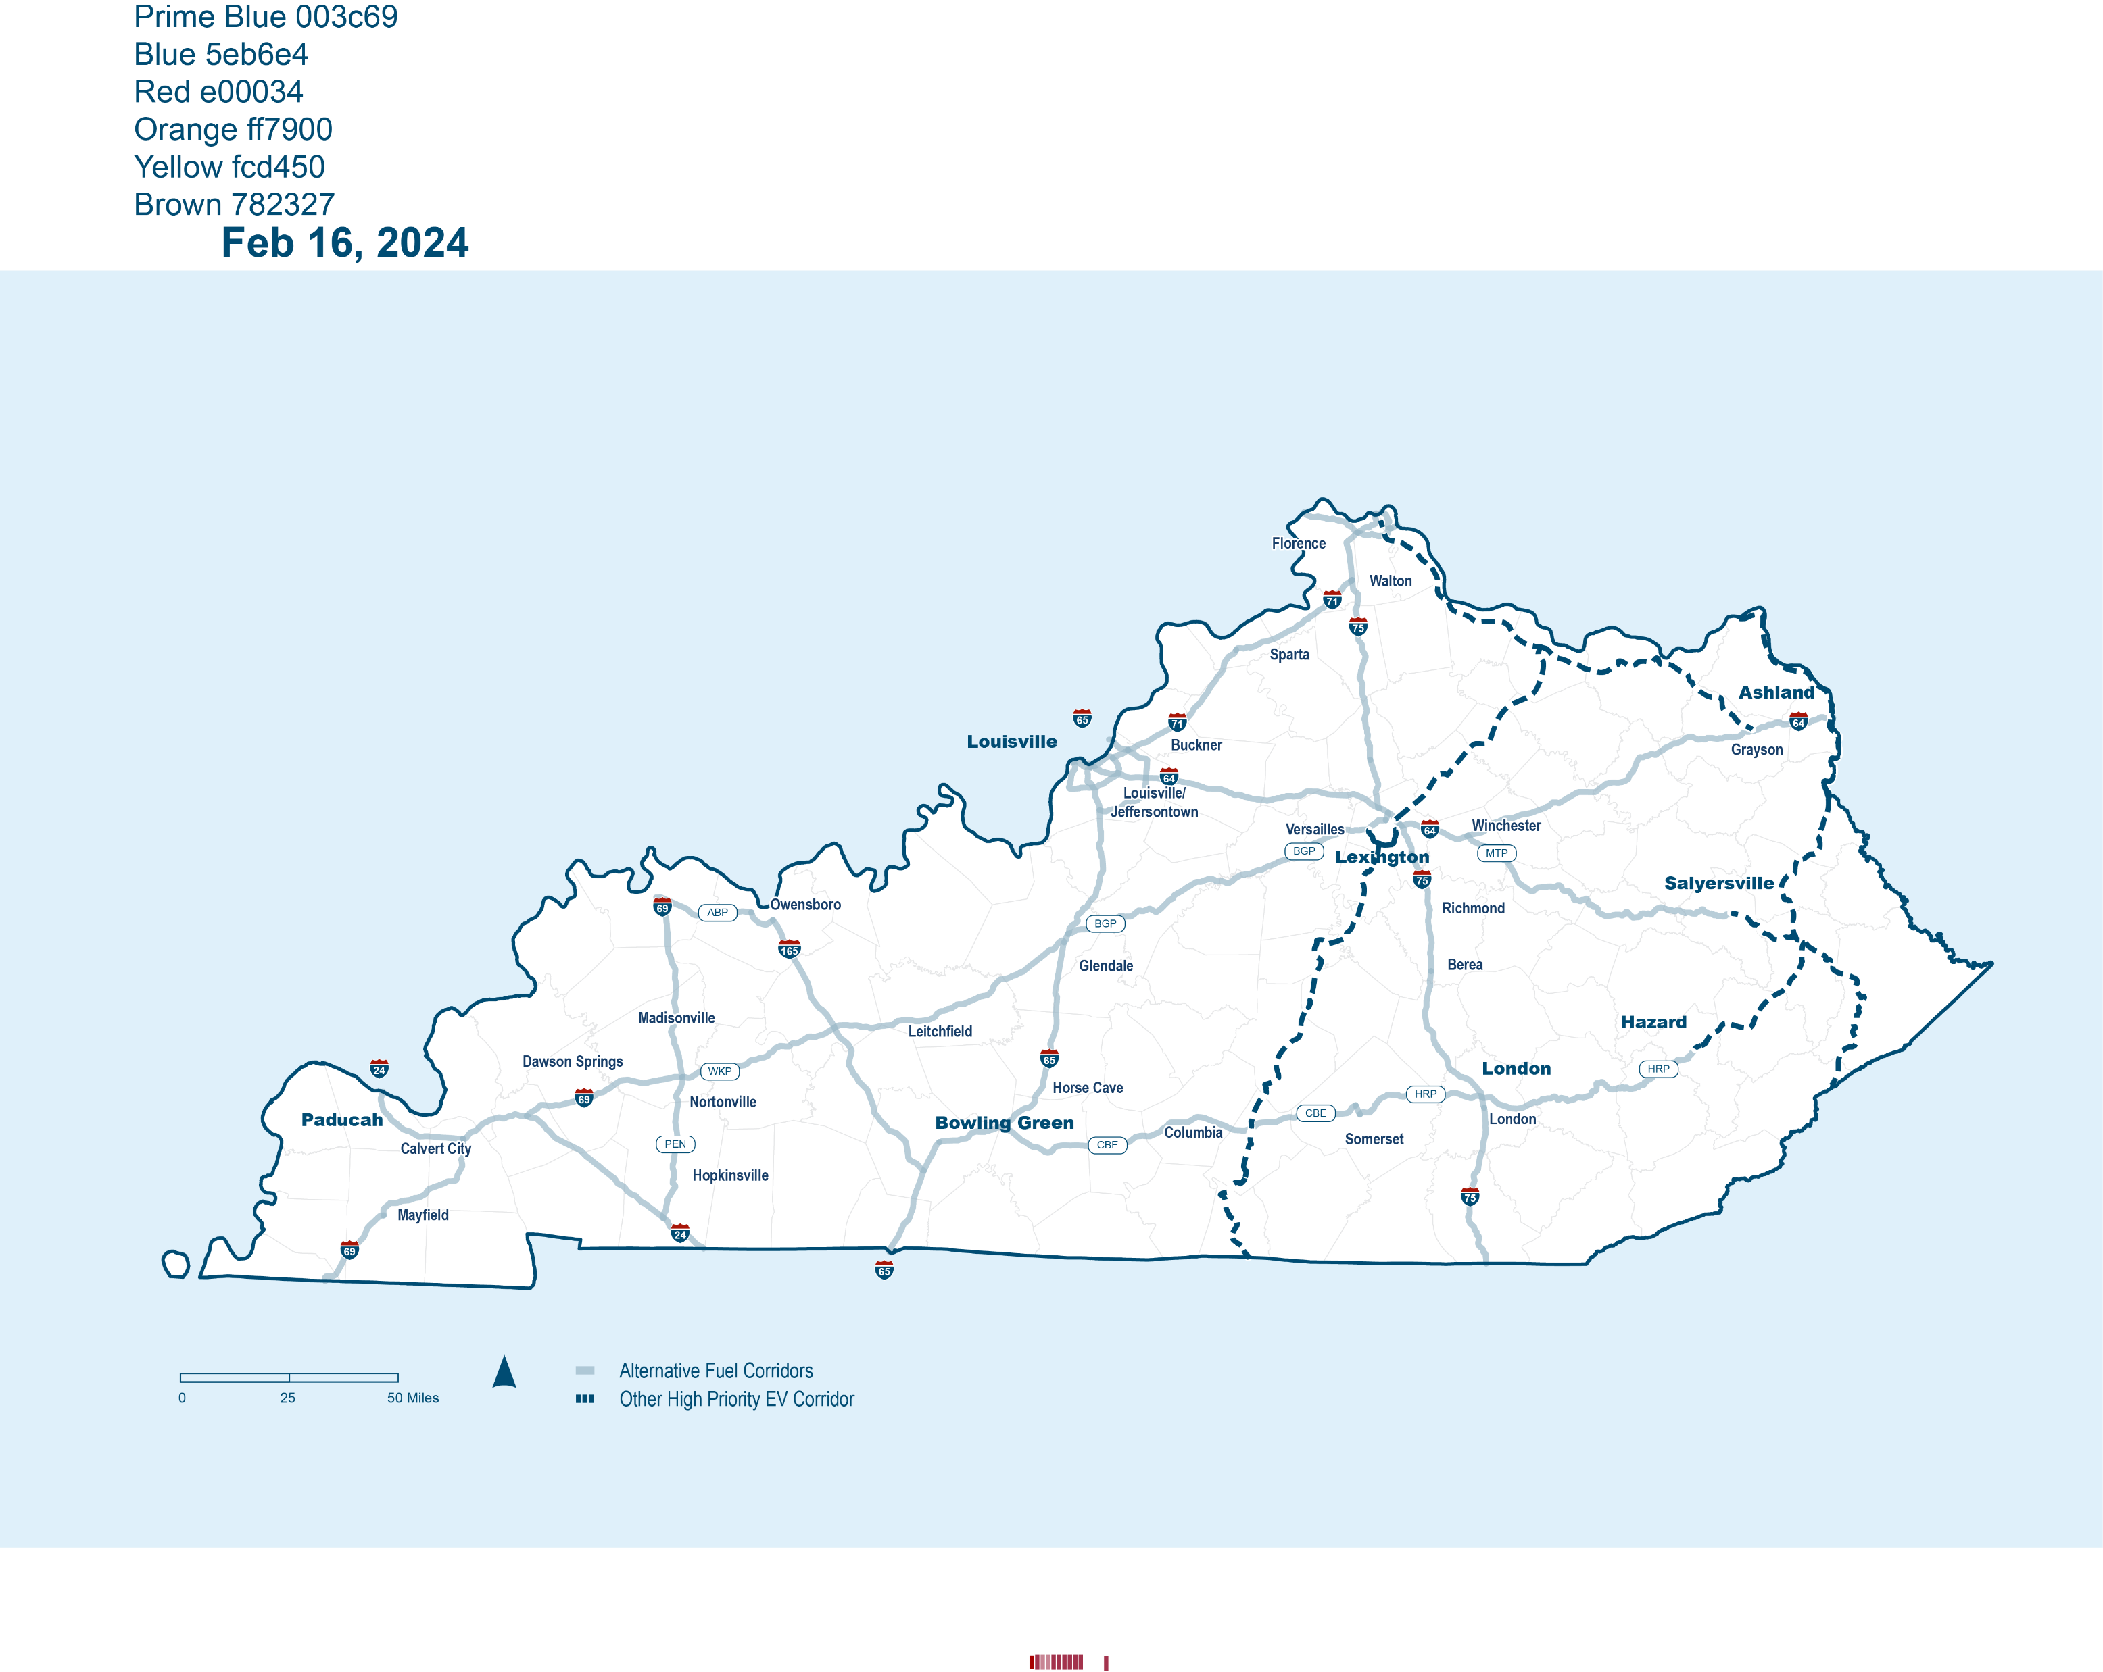
Post-Approval: Other Priority Corridors
Other highly trafficked and significant corridors off the AFC network
KYTC identified corridors in 2022
Additional analysis to identify other corridors that will enhance the network

Slide 9









Post-Approval: Community Charging
Workplace | Retail and Commercial Centers | Multifamily Housing
Rural and Disadvantaged Communities | Fueling Stations | Hotels and Lodging
Public Facilities (libraries, parks, gov. buildings) | Tourism Destinations | Downtown Centers
Notes:
Need FHWA buildout certification approval to move to this phase
Will provide coverage and access across the entirety of the state at publicly accessible locations
Equity
Providing equitable access to charging will continue to be a key focus of Kentucky’s EV Charging Program that will be expanded upon in future phases, including the community charging phase. The Federal Justice40 Initiative goal is that at least 40 percent of the benefits of the NEVI Program be distributed to disadvantaged communities. Kentucky is exceeding this goal. Of the 42 stations awarded to date, 48% of sites are within a disadvantaged community while 90% are within 3 miles of a disadvantaged community.

